Slide 1
Earthquakes
Made by: Michel.s, Ayoub.kakish , Kareem. Dabit

Slide 2
What is an earthquake?
Notes:
An earthquake is when two blocks of the earth suddenly split one another.
An earthquake is also intense shaking of the earth’s surface of the outer
An earthquake is a sudden release of the strain energy in the crust of the earth resulting in a wave of shaking

Slide 3
Causes and effects of earthquake
Notes:
Earthquakes happen when tectonic plates move against each other suddenly
Earthquakes cause ground shaking surface faulting ground failure landslide

Slide 4
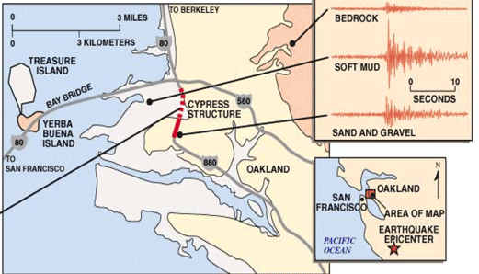
The factors that effect the intensity of an earth quakes
Notes:
Whereas the magnitude of an earthquake is one value that describes the size, there are many intensity values for each earthquake that are

Slide 5
Methods used to detect , measure and predict
Notes:
A seismogram is a record of the ground motions caused by seismic waves from an earthquake. Seismometers allow us to detect and measure earthquakes by converting vibrations due to seismic waves into electrical signals, which we can then display as seismograms.

Slide 6
The impacts of earthquakes on the natural and ecosystem
Notes:
Earthquakes are among the most impressive processes with destructive effects on humans, nature and infrastructures induced by the ground shaking and are classified into ground cracks, slope movements, dust clouds, liquefactions, hydrological anomalies, tsunamis, trees shaking and jumping stones.

Slide 7
Conclusion
Notes:
Earthquakes shake the ground surface, can cause buildings to collapse, disrupt transport and services, and can cause fires.

Slide 8
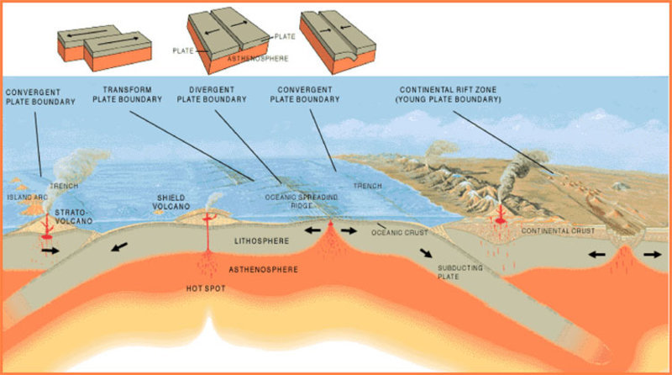
the different types of tectonic plate boundaries that cause earthquakes
Notes:
The Mid-Atlantic Ridge is an example of divergent plate boundaries.
The Pacific Ring of Fire is an example of a convergent plate boundary.

