Slide 1
Water Crisis
Khalid Majd and Mohammed

Slide 2
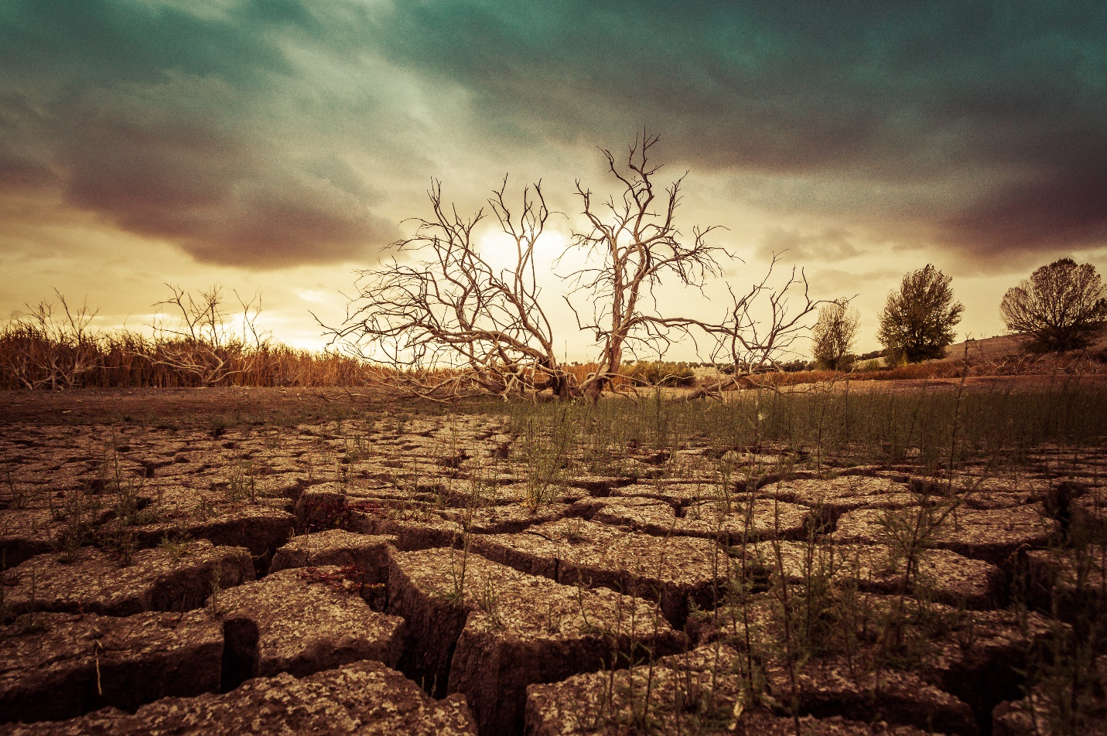
What is water crisis
The scarcity of supplies of fresh water It can be anywhere in the world it can be economic or physical. One prime example for a country experiencing this problem is Jordan.

Slide 3
The effects of water crisis
Water crisis effects millions of people, if you drink unclean water you can get sick and some sicknesses are very bad and could lead to death, that is one very good reason to help prevent this global issue. Don’t you think?

Slide 4
Two main causes
Droughts and climate change
Poor water management
One of the biggest drives of water scarcity is drought. A long period of time when there is little to no rain. Climate change helps lead to drought which is why we need to conserve energy.
Overuse of water or wrongfully playing with it carelessly. Farming requires a lot of water and resources, people tend to overuse it which is a massive problem.

Slide 5
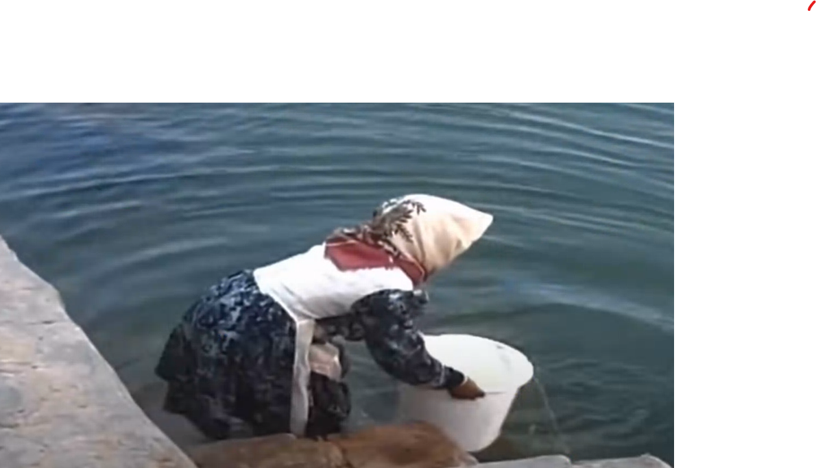
A surprising fact
Jordan is the second most water scarce country in the world.

Slide 6
How to solve water crisis
There are two clear methods to solving this problem which are desalination, the separation of salt from water in seawater, and recycling waste water which doesn’t mean that it should be drinking water, it can be used for agriculture and farming

Slide 7
Citations and credits
Walton, B., Blue, C., Schneider, K., &amp; Circle of BlueCircle of Blue provides relevant. (2018, October 5). Experts name the top 19 solutions to the global freshwater crisis. Circle of Blue. Retrieved May 5, 2023, from https://www.circleofblue.org/2010/world/
|, N. A. A. (2023, February 6). Ways to counter water scarcity in Jordan. EcoMENA. Retrieved May 5, 2023, from https://www.ecomena.org/water-scarcity-jordan/
Lai, O. (2022, October 19). Water shortage: Causes and effects. Earth.Org. Retrieved May 5, 2023, from https://earth.org/causes-and-effects-of-water-shortage/#:~:text=No%20continent%20on%20Earth%20has,face%20water%20shortages%20by%202025
Water, sanitation and hygiene. UNICEF Jordan. (2020, November 4). Retrieved May 5, 2023, from https://www.unicef.org/jordan/water-sanitation-and-hygiene

