Slide 1
Water Crisis in Jordan
By Raed And Fuad

Slide 2
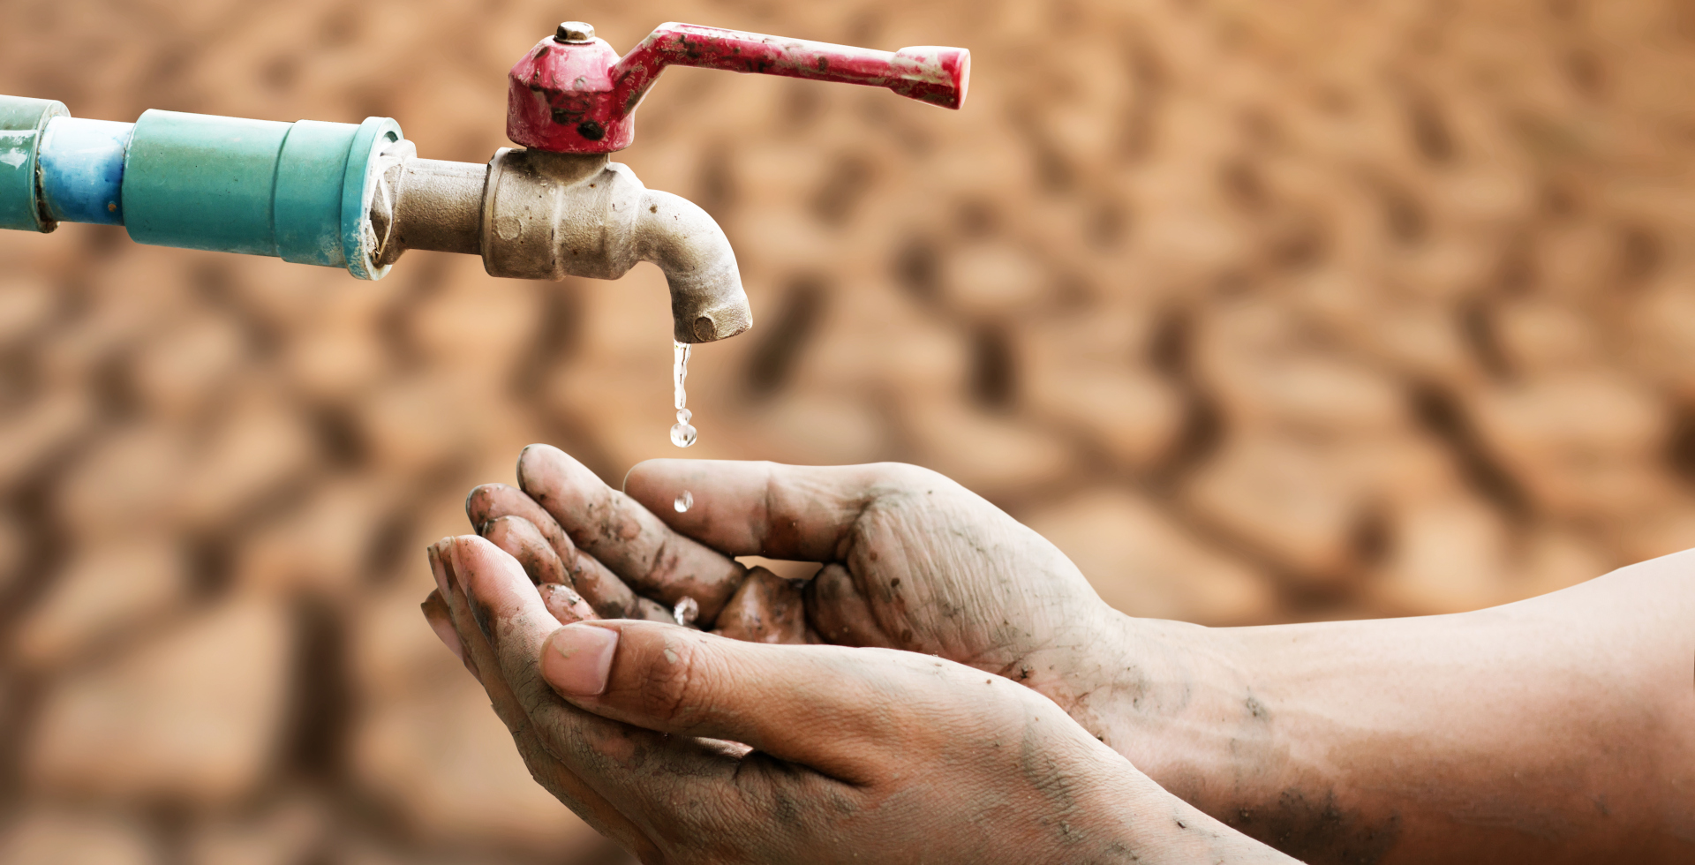
What Is Water Crisis?
Water scarcity is a major problem in the 21st century, many households on every continent, with poorer communities and countries are the most affected by the lack of water, Jordan is a major victim in said water scarcity. about two billion people worldwide do not have access to safe drinking water today and roughly half of the world’s population is experiencing severe water scarcity, these numbers are expected to increase by a large amount.

Slide 3
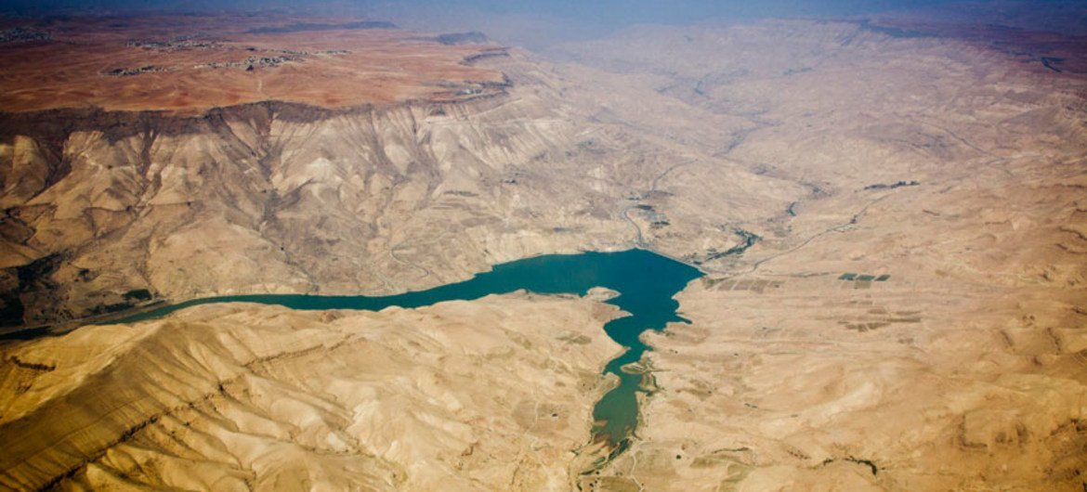
Issues
Jordan is a very water-scarce country with most of its water being used up as quickly as it can be refilled. Poorer households are forced to spend a lot of their incomes on poor quality services and water. The situation in Jordan is also of great concern because of the high rates of open defecation and the limited access to safer water.

Slide 4
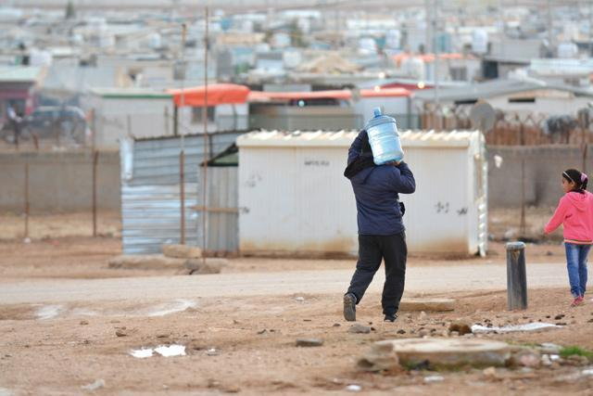
Causes
The overflow of wastewater pumping stations, leaks from sewage systems and exposure to industrial and commercial waste are majorly polluting Jordan's surface river sources which causes water pollution.
The population growth and the waves of refugees from regional disputes such as Syria, Iraq and Palestine put additional strain on an already stressed water supply.

Slide 5
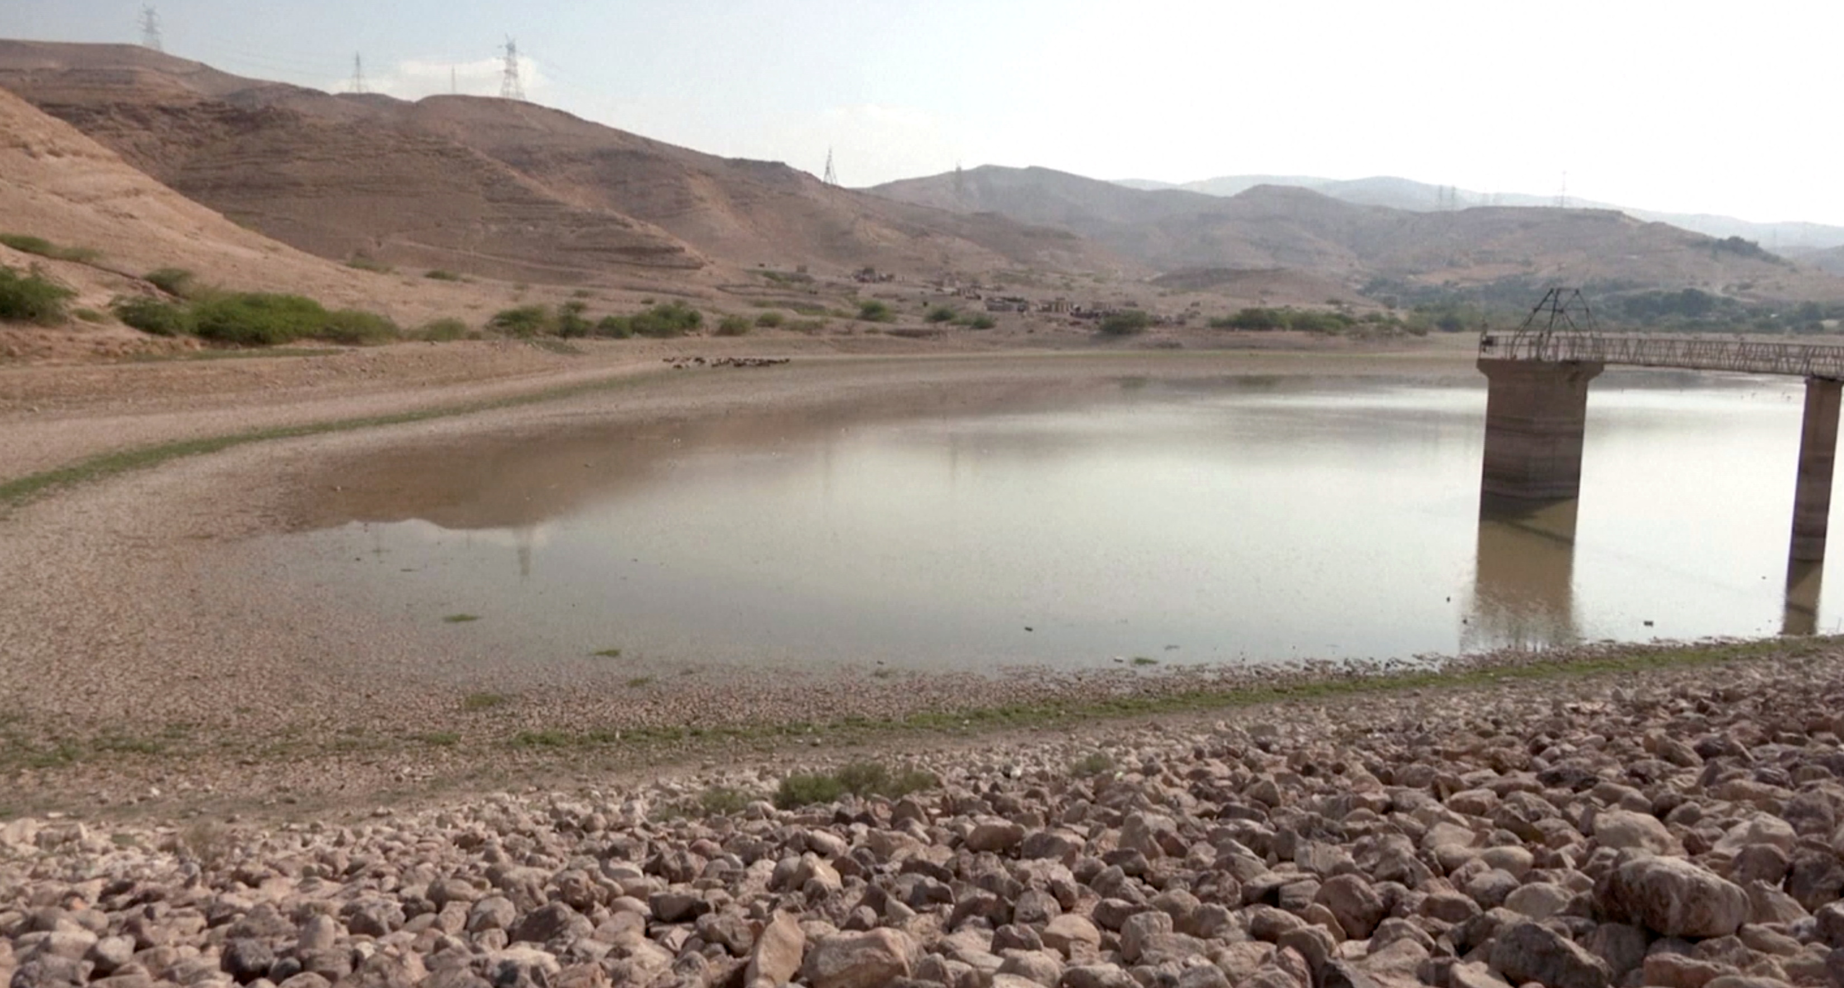
Consequences
Scarcity of water in schools results in children and young adults being unable to practice important hygiene behaviour like washing their hand. Limited access to water can also decrease school attendance and performance for younger people. The water crisis in Jordan can affect health, environment, economy, social stability and can lead to dehydration.

Slide 6
Solutions
Jordanians should replace their taps when it is leaking to save themselves money and water. Jordanians that live on the ground floor with their own garden should collect rainwater in buckets and give it to cats, use it to clean their car. Jordanians should attempt to save and recycle water when they are able to. The government should also attempt to seek help from major global powers such as the United States.

Slide 7
Sources
1: Water Resources & Environment: Basic page: Jordan (2022b) U.S. Agency for International Development. Available at: https://www.usaid.gov/jordan/water-resources-environment#:~:text=Jordan%20is%20one%20of%20the,as%20it%20can%20be%20replenished. (Accessed: 10 May 2023). 2: United Nations. (n.d.). Water – at the center of the Climate Crisis. United Nations. https://www.un.org/en/climatechange/science/climate-issues/water?gclid=CjwKCAjwge2iBhBBEiwAfXDBR3SqgGtMt_ehx1yVSKmKsiniYuMUa302xtTXc21yo1VMlPFRoDywJRoCzMEQAvD_BwE 3: “Water, Sanitation and Hygiene.” UNICEF Jordan, www.unicef.org/jordan/water-sanitation-and-hygiene. Accessed 10 May 2023.
4: United Nations. “Water Scarcity.” UN-Water, 2021, www.unwater.org/water-facts/water-scarcity. 5: Saiesha. (2022, April 14). 7 facts about water scarcity in Jordan. The Borgen Project. https://borgenproject.org/water-scarcity-in-jordan/

Slide 8
The End
Raed And Fuad

