Slide 1
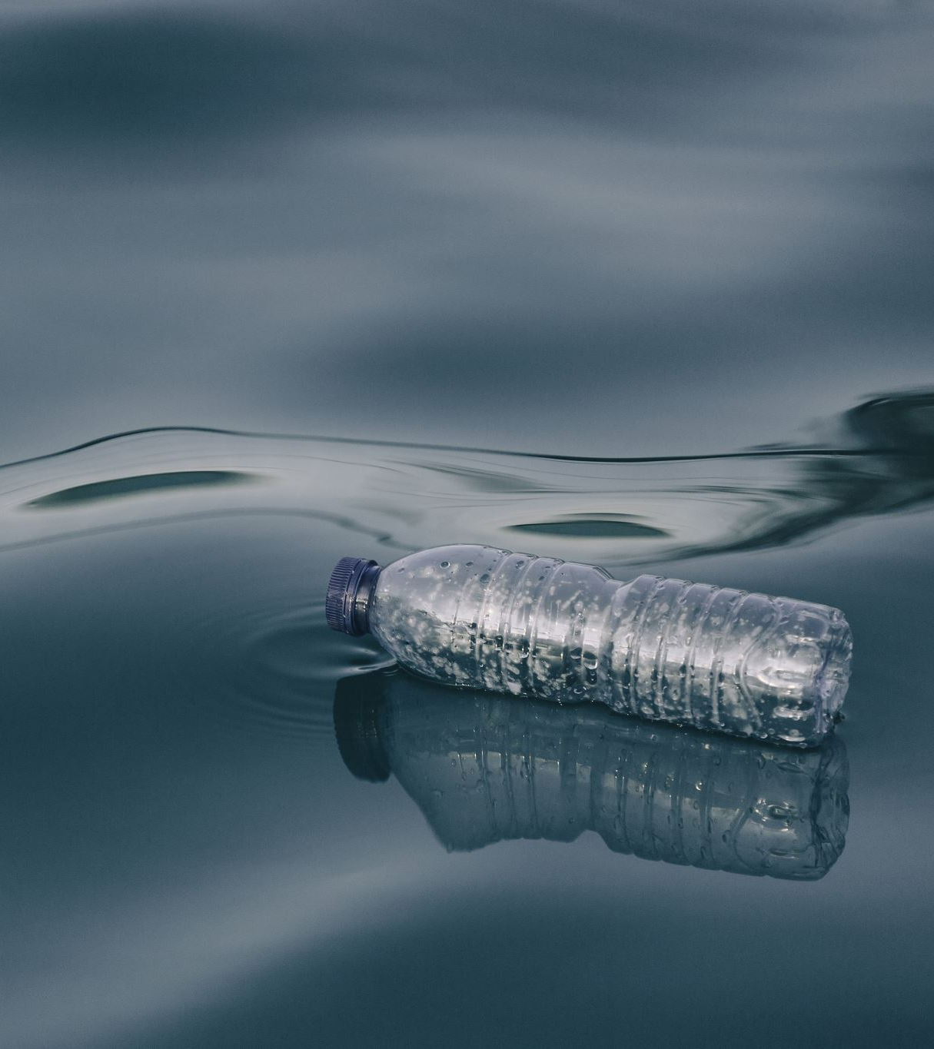
Water Crisis
Introduction:
The water crisis is a global problem that affects many countries, including Jordan. It is caused by various factors such as climate change, population growth, pollution, and mismanagement of water resources.
Issues in Jordan:
-Water scarcity and shortage
-High demand for water
-Limited access to clean water in some areas

Slide 2
Causes
Climate change, with changes in weather patterns, is a major factor in the water crisis. Rising temperatures lead to unpredictable rainfall, resulting in less overall rain and more frequent and longer droughts. This leads to water scarcity, making it harder to meet the increasing water needs of communities, farms, and industries.
Population growth worsens the water scarcity problem. As the global population rapidly grows, the demand for water increases. More people need water for drinking, sanitation, and food production. This puts a lot of pressure on already limited water resources, leading to more widespread water scarcity.

Slide 3
Consequences
Droughts and water shortages become more frequent and severe due to limited water availability, affecting various regions and making it harder to find enough water for daily needs, farming, and industries. This, in turn, leads to environmental damage as water scarcity harms natural habitats and wildlife. Aquatic ecosystems are disrupted, biodiversity suffers, and the quality of water worsens, impacting aquatic life and overall ecosystem health.
Food insecurity becomes a pressing concern as water becomes scarce. With limited water availability, crop yields decrease, leading to potential food shortages. Insufficient water for irrigation and agricultural needs hampers the growth and productivity of crops, impacting food production and availability. The reduced water supply poses a significant challenge to sustaining agricultural systems and meeting the growing demand for food

Slide 4
Course of Actions
Solutions:
-Increase water conservation efforts
-Promote the use of renewable energy
-Implement sustainable agriculture practices
-Improve water management and infrastructure
Reasoning:
These solutions can help reduce water demand, decrease pollution, and increase the availability of clean water. They can also help mitigate the effects of climate change and promote sustainable development.

Slide 5
Conclusion
In conclusion, the water crisis is a serious problem that requires immediate action. Jordan, like many other countries, is facing significant challenges related to water scarcity and mismanagement. However, by implementing sustainable solutions, we can mitigate the consequences of the crisis and ensure a better future for all.

Slide 6
Citations
MLA citations:
Website: "The Water Crisis in Jordan: Causes and Solutions." Water Crisis Info. Web.
Blog Post: "Tackling Jordan's Water Crisis: Why It's a Big Problem." Aqua Insights Blog, 7 Sept. 2022. Web.
News Article: Johnson, Lisa. "Jordan's Water Woes: Scarcity and High Demand Impacting Communities." Water World News, 15 Nov. 2022. Web.
Report: Sustainable Solutions Research Group. "Mitigating the Water Crisis in Jordan: Promoting Conservation, Renewable Energy, and Sustainable Agriculture." SSRG Reports, vol. 5, no. 3, 2023. Print.
Magazine: Waters, Sam. "Managing Water in Jordan: Challenges and Opportunities." AquaLife Magazine, vol. 9, no. 2, 2023. Print.

Slide 7
Seventh Grade “D”
Done by:
-Marius Sahawneh
-Kenan Awwad
-Kareem Fakhoury

