Slide 1
Earthquakes
By: Amir, Ramez, Zaid

Slide 2
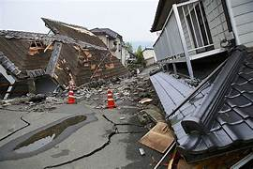
What is an earthquake
Notes:
a sudden and violent shaking of the ground, sometimes causing great destruction, as a result of movements within the earth's crust or volcanic action.

Slide 3
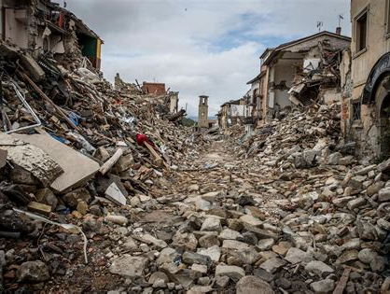
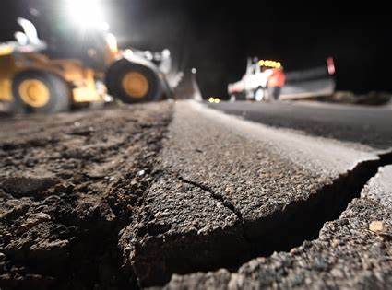
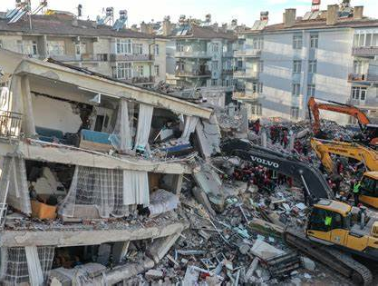
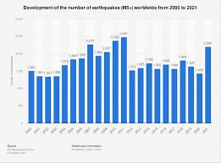
What are the issues of earthquakes
Made by: Zaid Barghouth
Notes:
Earthquakes have different kinds of strength according to how strong the magnitude of the earthquakes is, plus, the poorly built houses are in severe danger.

Slide 4
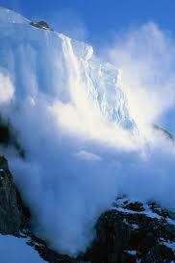
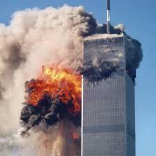
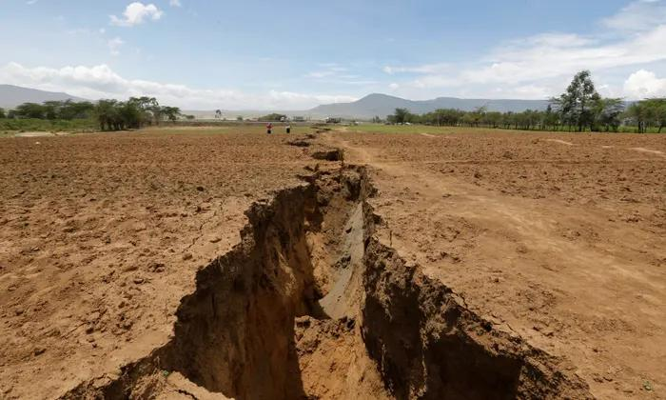
What are the issues of earthquakes
Made By: Zaid Barghout

Slide 5
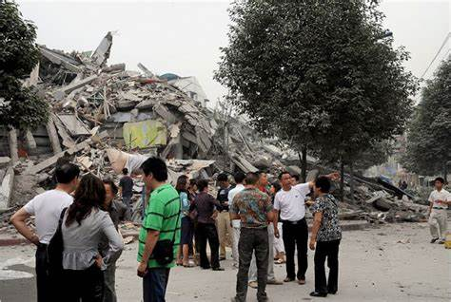
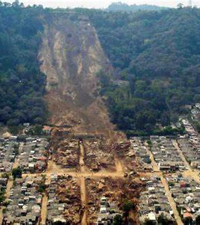
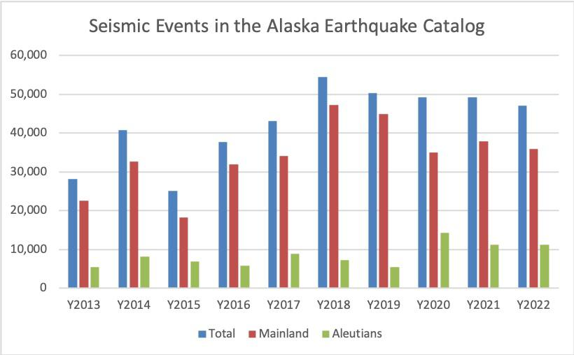
What are the consequences of earthquakes?
Made By: Amir Haddadin
Notes:
Earthquakes can result in ground shaking, landslides,
fissures, avalanches in snowy areas and fires.
Earth shaking as we explained can have an impact on buildings in general, this can be deadly.
Landslides is basically when the earth opens, and it could swallow things during the process.
Fissures are just little cracks on the earths surface.
Avalanches happen when a chunk of snow falls off a mountain and appears as a smokey substance rushing down a mountain.
Fires take place by the earthquakes shaking, now this shaking releases a flammable liquid or gas.

Slide 6
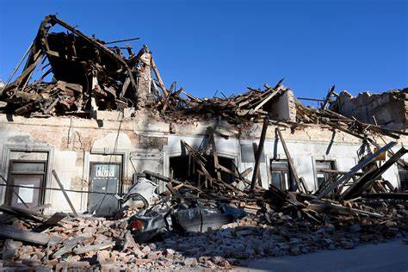
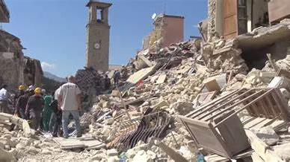
What are solutions for earthquakes
Made By: Ramez Zraikat
Notes:
There are 2 ways to protect yourself from earthquakes. First one is by financially taking your insurance representative. Second is by increasing your earthquake insurance.

Slide 7
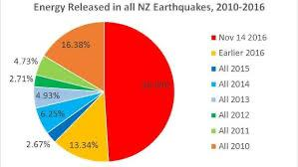
What are the causes earthquakes?
Made By: Ramez Zraikat
Notes:
Now we have a lot of causes of earthquakes, so we decided to talk about one main cause. This cause basically talks about when a rock underground breaks along with a fault, there is a sudden release of energy, this sudden release of energy causes seismic waves that make the ground shake.

Slide 8
References
Made By: The entire group
Fema.gov
Usgs.gov
Who.int
Mtu.edu

