Slide 1
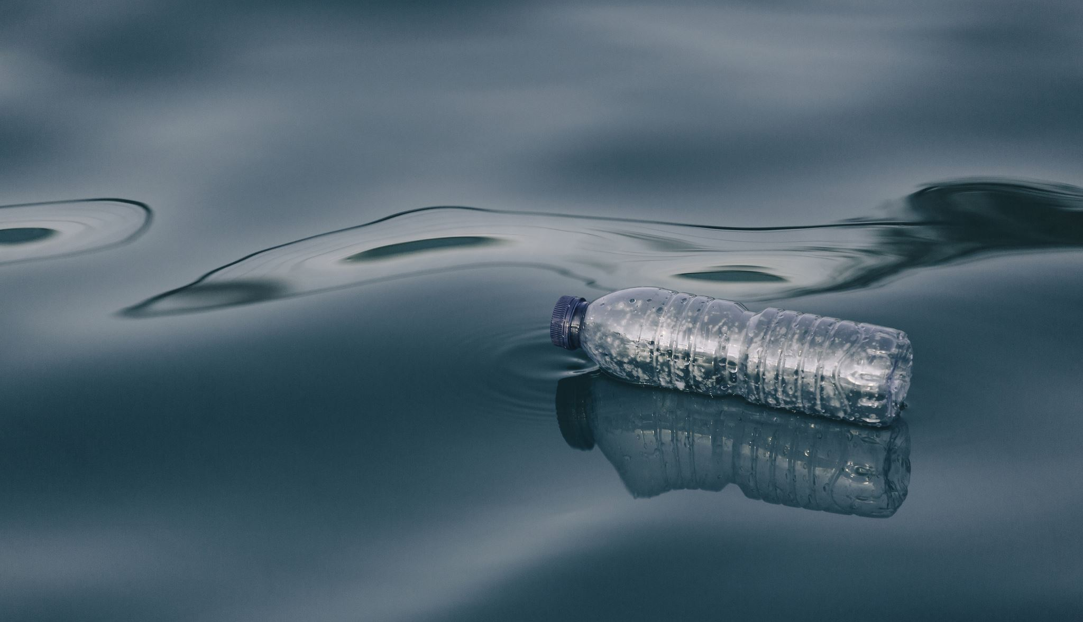

Water crisis in Jordan
Yasir, Kareem. A , and Satie

Slide 2
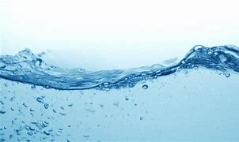
Jordan’s water crisis is demonstration of challenges circling all over the planet as a result of climate change and quick growth in the population.
What is water crisis in Jordan?
Less steady water supplies and an expanding civilization will half water use in Jordan by the end of this century. Without interruption, few homes in the dry nation will have access to 40 liters of piped water per person per day.
poor neighborhoods will have it the hardest , with 91 % of homes getting less than 40 liters daily for 11 months straight per year by the year 2100.

Slide 3
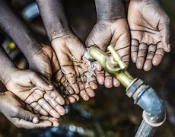
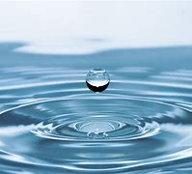

Reasons for water crisis
NATURAL DISASTERS
Drought
CLIMATE CHANGE
LACK OF WATER DATA
WAR AND CONFLICT
LACK OF INFRASTRUCTURE
INEQUALITY AND AN IMBALANCE OF POWER

Slide 4
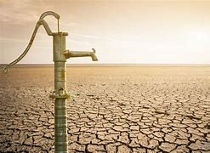
Consequences of water crisis
Food Insecurity
Increased Human Conflict
Water is Now Traded as a Commodity
Less people have accsess to water
Kids will not be able to develop as much as water is critical to develop a healthy child

Slide 5

What can we do to stop this?
1. When showering instead of wasting water while waiting for it to heat use a bucket to collect the water.
For things such as cleaning your car, and watering your plant life.
2. Minimize water usage if unnecessary.
3.Stop polluting the water.

Slide 6

Conclusion
In conclusion I believe it is best if we start to take water crisis more seriously, as it can ruin are country (Jordan).
Not only that it can effect the future generations, as children need water to develop, and if we don’t start now in just a couple years we will run out of clean water.
We need to start now or the future of our country will vanish.

Slide 7
citations
10 causes of the Global Water Crisis. Concern Worldwide. (2022, April 14). Retrieved May 7, 2023, from https://www.concernusa.org/story/global-water-crisis-causes/
Effects of the water crisis on health. Water.org. (n.d.). Retrieved May 7, 2023, from https://water.org/our-impact/water-crisis/health-crisis/
Lai, O. (2022, October 19). Water shortage: Causes and effects. Earth.Org. Retrieved May 7, 2023, from https://earth.org/causes-and-effects-of-water-shortage/
Lai, O. (2022, October 19). Water shortage: Causes and effects. Earth.Org. Retrieved May 7, 2023, from https://earth.org/causes-and-effects-of-water-shortage/
Team, W. W. F. (2023, May 6). Understanding the water crisis: Causes, effects, and solutions. WWF7 Water Resources. Retrieved May 7, 2023, from https://worldwaterforum7.org/understanding-the-water-crisis-causes-effects-and-solutions/
University, S. (2021, March 29). Jordan's worsening water crisis a warning for the world. Stanford News. Retrieved May 7, 2023, from https://news.stanford.edu/2021/03/29/jordans-worsening-water-crisis-warning-world/#:~:text=Jordan%E2%80%99s%20water%20crisis%20is%20emblematic%20of%20challenges%20looming,for%2011%20consecutive%20months%20per%20year%20by%202100.
University, S. (2021, March 29). Jordan's worsening water crisis a warning for the world. Stanford News. Retrieved May 7, 2023, from https://news.stanford.edu/2021/03/29/jordans-worsening-water-crisis-warning-world/#:~:text=Jordan%E2%80%99s%20water%20crisis%20is%20emblematic%20of%20challenges%20looming,for%2011%20consecutive%20months%20per%20year%20by%202100.
10 causes of the Global Water Crisis. Concern Worldwide. (2022, April 14). Retrieved May 7, 2023, from https://www.concernusa.org/story/global-water-crisis-causes/
University, S. (2021, March 29). Jordan's worsening water crisis a warning for the world. Stanford News. Retrieved May 7, 2023, from https://news.stanford.edu/2021/03/29/jordans-worsening-water-crisis-warning-world/#:~:text=Jordan%E2%80%99s%20water%20crisis%20is%20emblematic%20of%20challenges%20looming,for%2011%20consecutive%20months%20per%20year%20by%202100.
10 causes of the Global Water Crisis. Concern Worldwide. (2022, April 14). Retrieved May 7, 2023, from https://www.concernusa.org/story/global-water-crisis-causes/
Lai, O. (2022, October 19). Water shortage: Causes and effects. Earth.Org. Retrieved May 7, 2023, from https://earth.org/causes-and-effects-of-water-shortage/
Lai, O. (2022, October 19). Water shortage: Causes and effects. Earth.Org. Retrieved May 7, 2023, from https://earth.org/causes-and-effects-of-water-shortage/
University, S. (2021, March 29). Jordan's worsening water crisis a warning for the world. Stanford News. Retrieved May 7, 2023, from https://news.stanford.edu/2021/03/29/jordans-worsening-water-crisis-warning-world/#:~:text=Jordan%E2%80%99s%20water%20crisis%20is%20emblematic%20of%20challenges%20looming,for%2011%20consecutive%20months%20per%20year%20by%202100.

Slide 8
The end

