Slide 1
Water Crisis
Done by: Eleanor Haddad, Helana Jouaneeh, Sama Al.Soury, Nayefa Al-Batarseh
7A

Slide 2
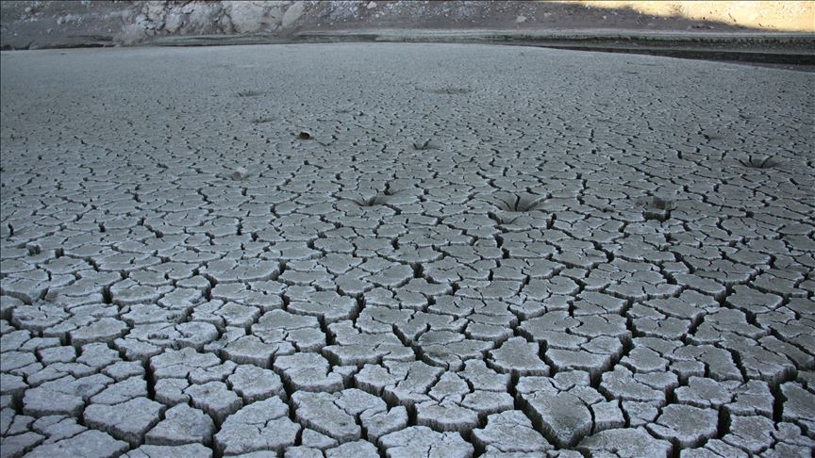
How do you imagine life to be without water if around 60 percent of our body is made up of water, and we can only live three to five days without fluids

Slide 3
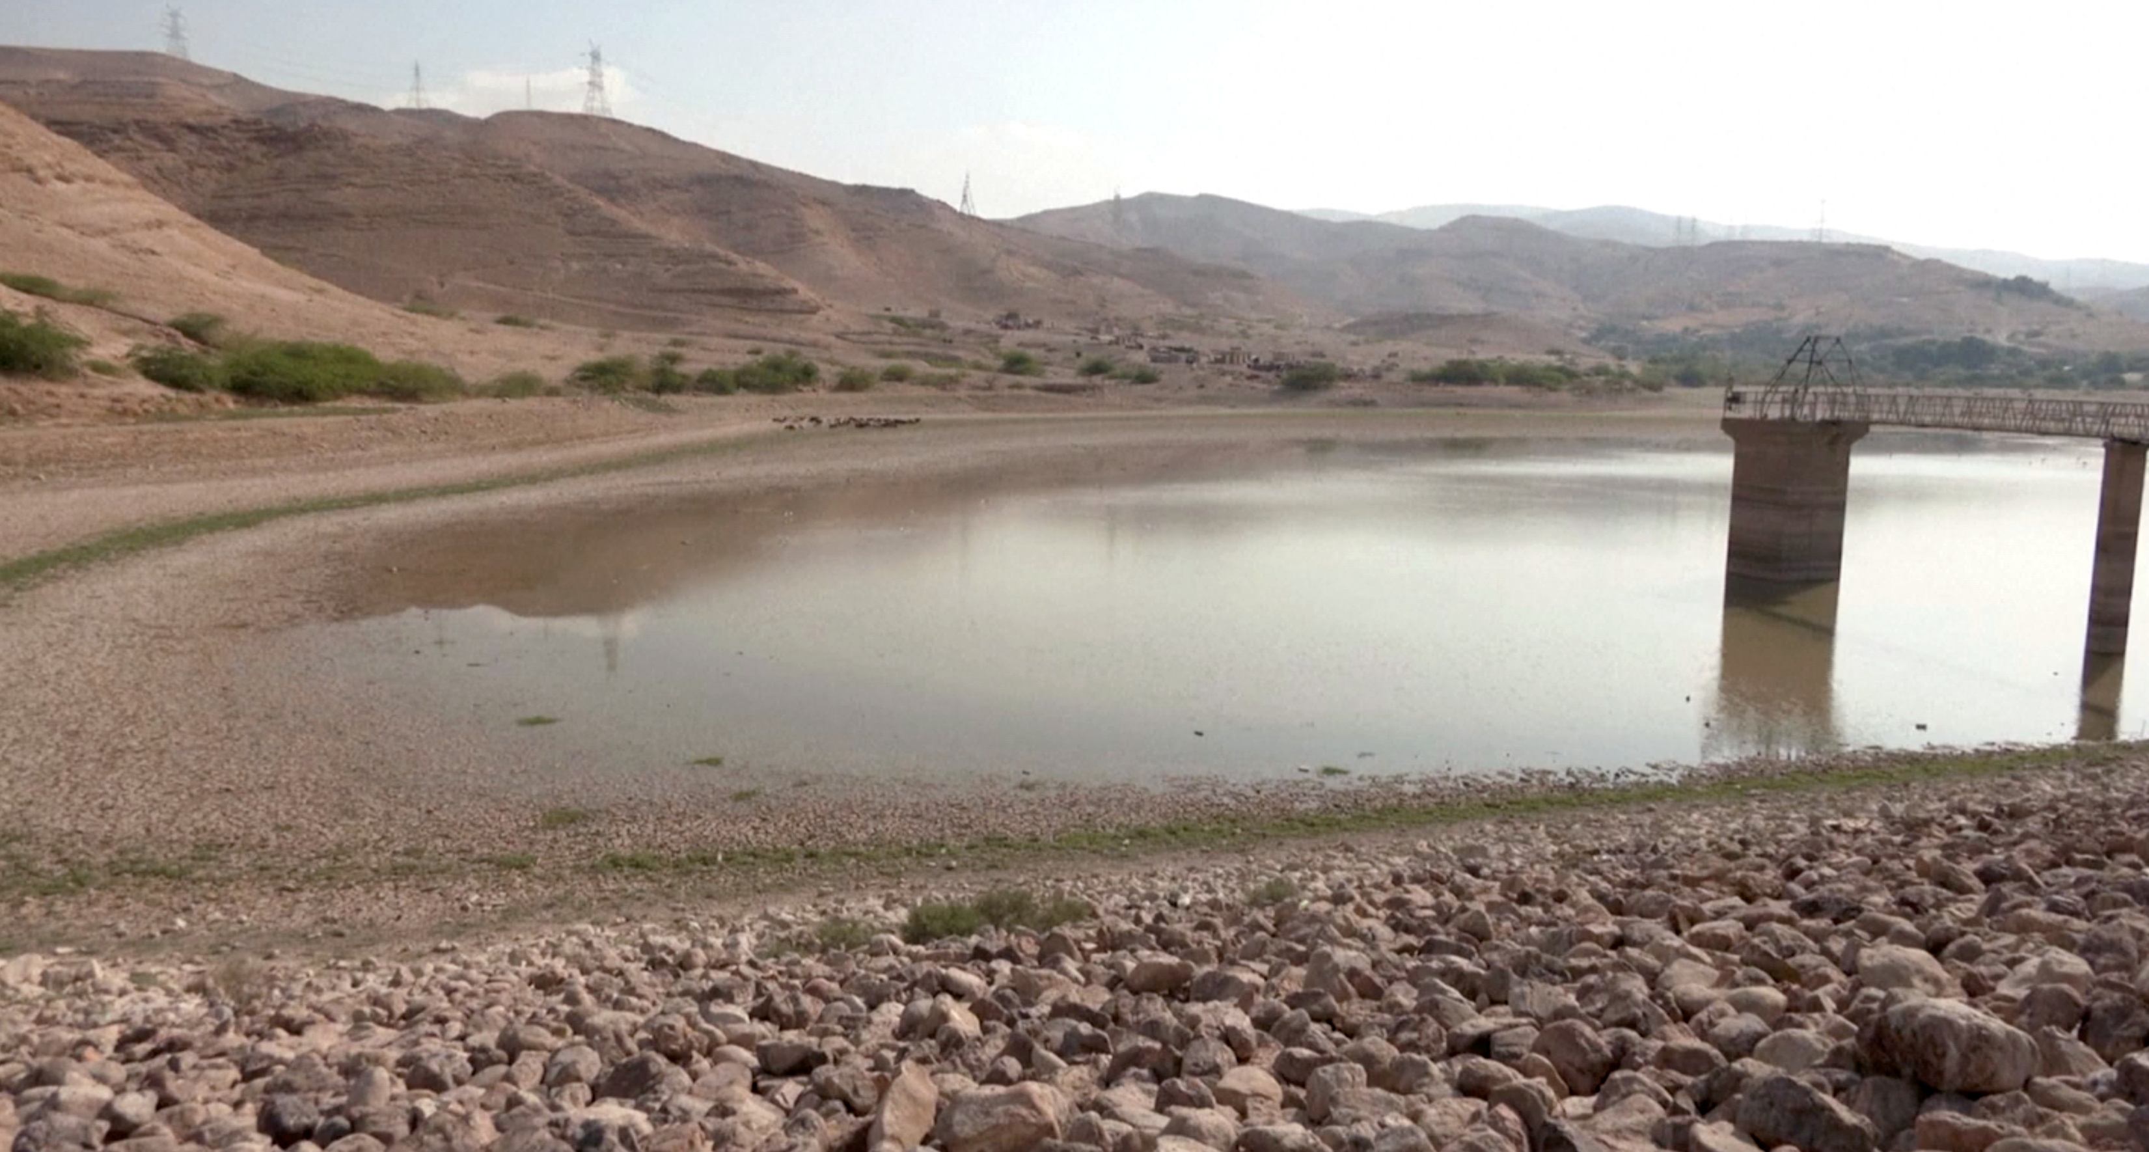
Water Crisis Issues
Two issues of water crisis are:
Water pollution
Water shortage

Slide 4
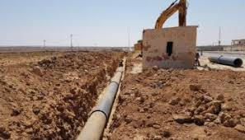
Causes Of Water Crisis
Some Causes Of Water Crisis are:-
Climate Change
Natural Disasters
Water Waste
Lack Of Water Data

Slide 5
Consequences of water pollution
Destruction of biodiversity. Water pollution depletes aquatic ecosystems and triggers unbridled proliferation of phytoplankton in lakes
Disease
Contamination of the food chain
BackWater Crisis Issues

Slide 6
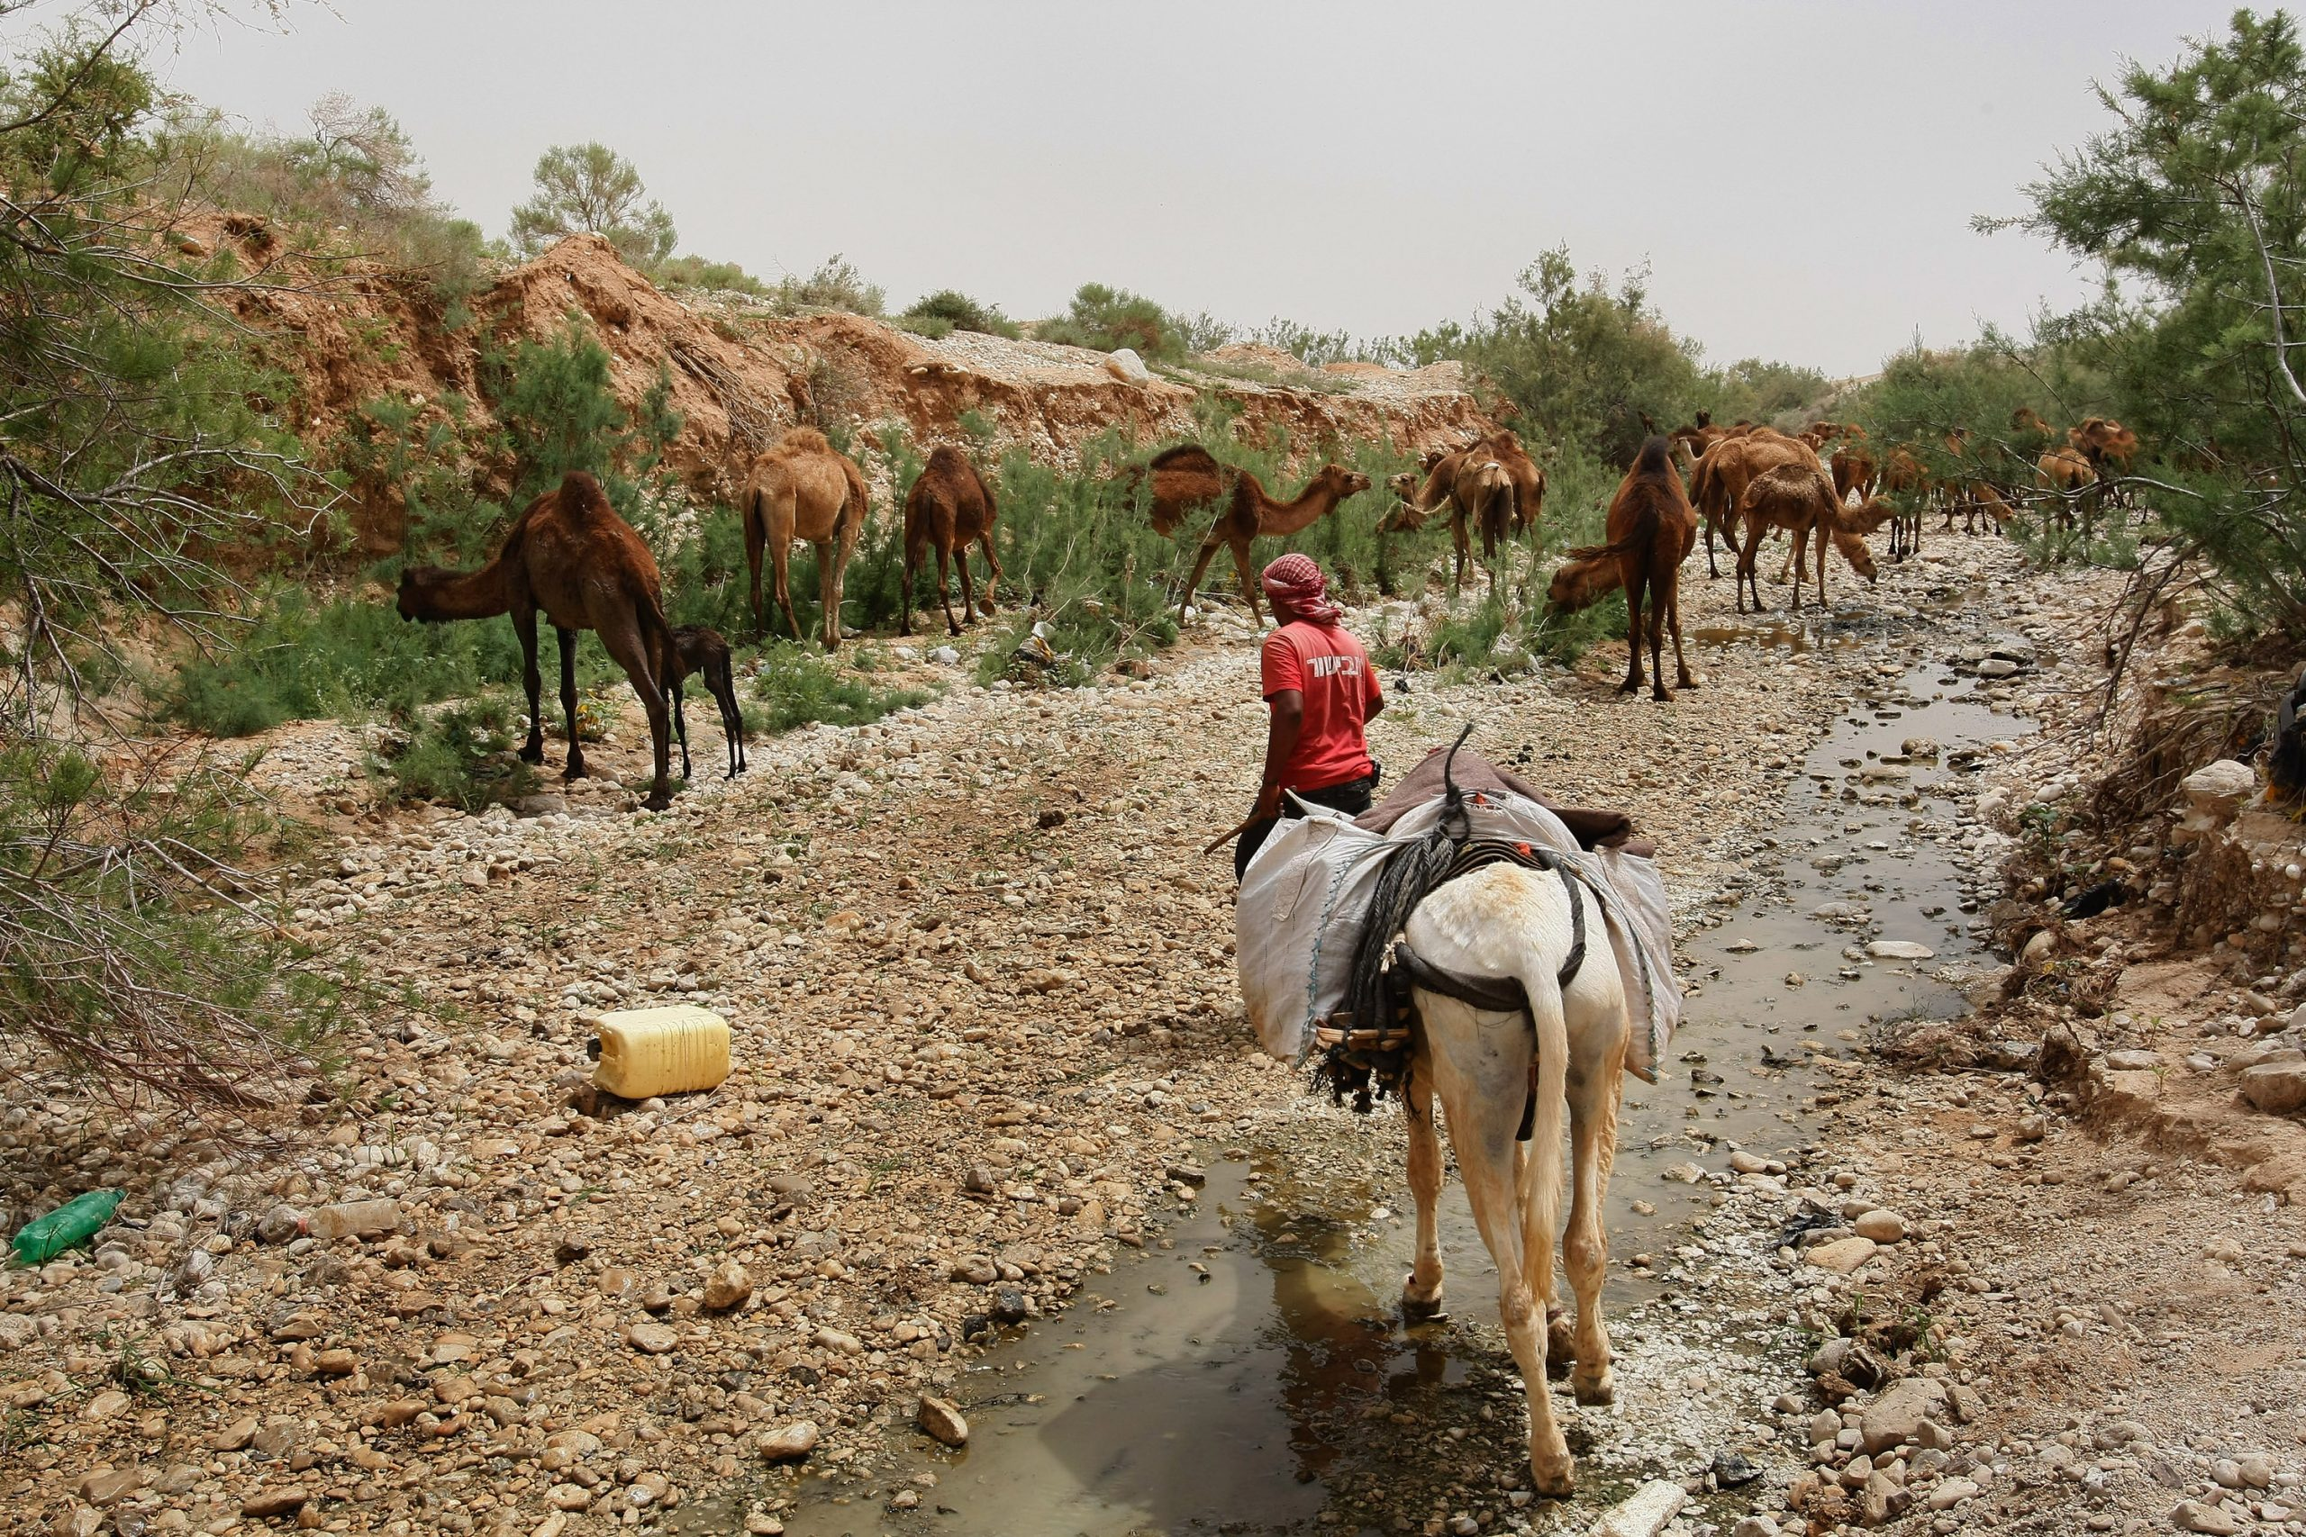
Consequences of Water Shortage
Increased operational costs and increased complexity in supply chains
BackWater Crisis Issues

Slide 7
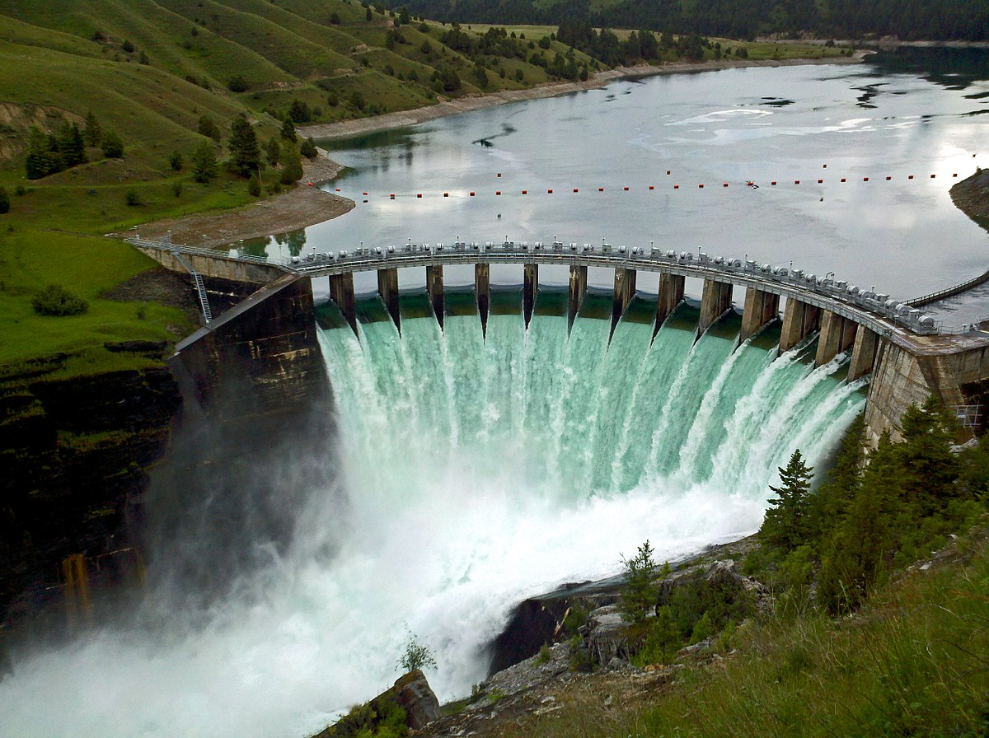
Solutions To Water Crisis
Dams
Storing/Saving Water

Slide 8
Math part
العام | النسبة المئوية | كسر فعلي | عدد عشري
2013 | 53% | 53 100 | 0.53
2017 | 45% | 45 100 | 0.45
2018 | %3.7 | 3.7 100 | 0.037
2020 | %47 | 47 100 | 0.47
2023 | 27.9% | 27.9 100 | 0.279

Slide 9
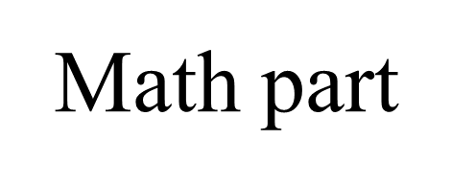
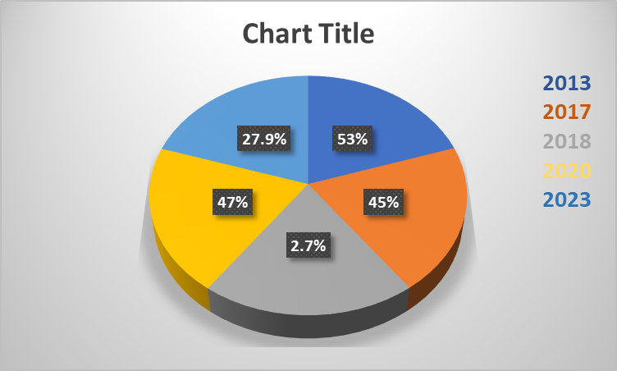

Slide 10
Recourses (Citation)
Water crisis. Unicef. (N.D.). Https://www.Unicef.Org/wash/water-scarcity
Council on Foreign Relations. (n.d.). Water crisis is getting worse. Council on Foreign Relations. https://www.cfr.org/backgrounder/water-stress-global-problem-thats-getting-worse Kolb, M. (2023, February 1). water crisis . Water Scarcity in Jordan: An Examination of the Causes behind the Crisis. https://www.norwich.edu/news/voices-from-the-hill/4043-water-scarcity-in-jordan-an-examination-of-the-causes-behind-the-crisis Water Crisis. UNICEF. (n.d.). https://www.unicef.org/wash/water-scarcity
Council on foreign relations. (N.D.). Water crisis is getting worse. Council on foreign relations. Https://www.Cfr.Org/backgrounder/water-stress-global-problem-thats-getting-worse Kolb, M. (2023, february 1). Water crisis . water scarcity in jordan: an examination of the causes behind the crisis. Https://www.Norwich.Edu/news/voices-from-the-hill/4043-water-scarcity-in-jordan-an-examination-of-the-causes-behind-the-crisis Water crisis. Unicef. (N.D.). Https://www.Unicef.Org/wash/water-scarcity Water resources & environment: basic page: jordan. U.S. Agency for international development. (2022, august 16). Https://www.Usaid.Gov/jordan/water-resources-environment
Saiesha. (2022, April 14). 7 facts about water scarcity in Jordan. The Borgen Project. https://borgenproject.org/water-scarcity-in-jordan/
| N. A. A. (2023, February 6). Ways to counter water scarcity in Jordan. EcoMENA. https://www.ecomena.org/water-scarcity-jordan/#:~:text=Desalination%20can%20provide%20a%20safe,a%20new%20independent%20water%20source

