Slide 1
Water Crisis
In Jordan
Done by: Natalia abuhadba, sama khair, nuor alazawi

Slide 2
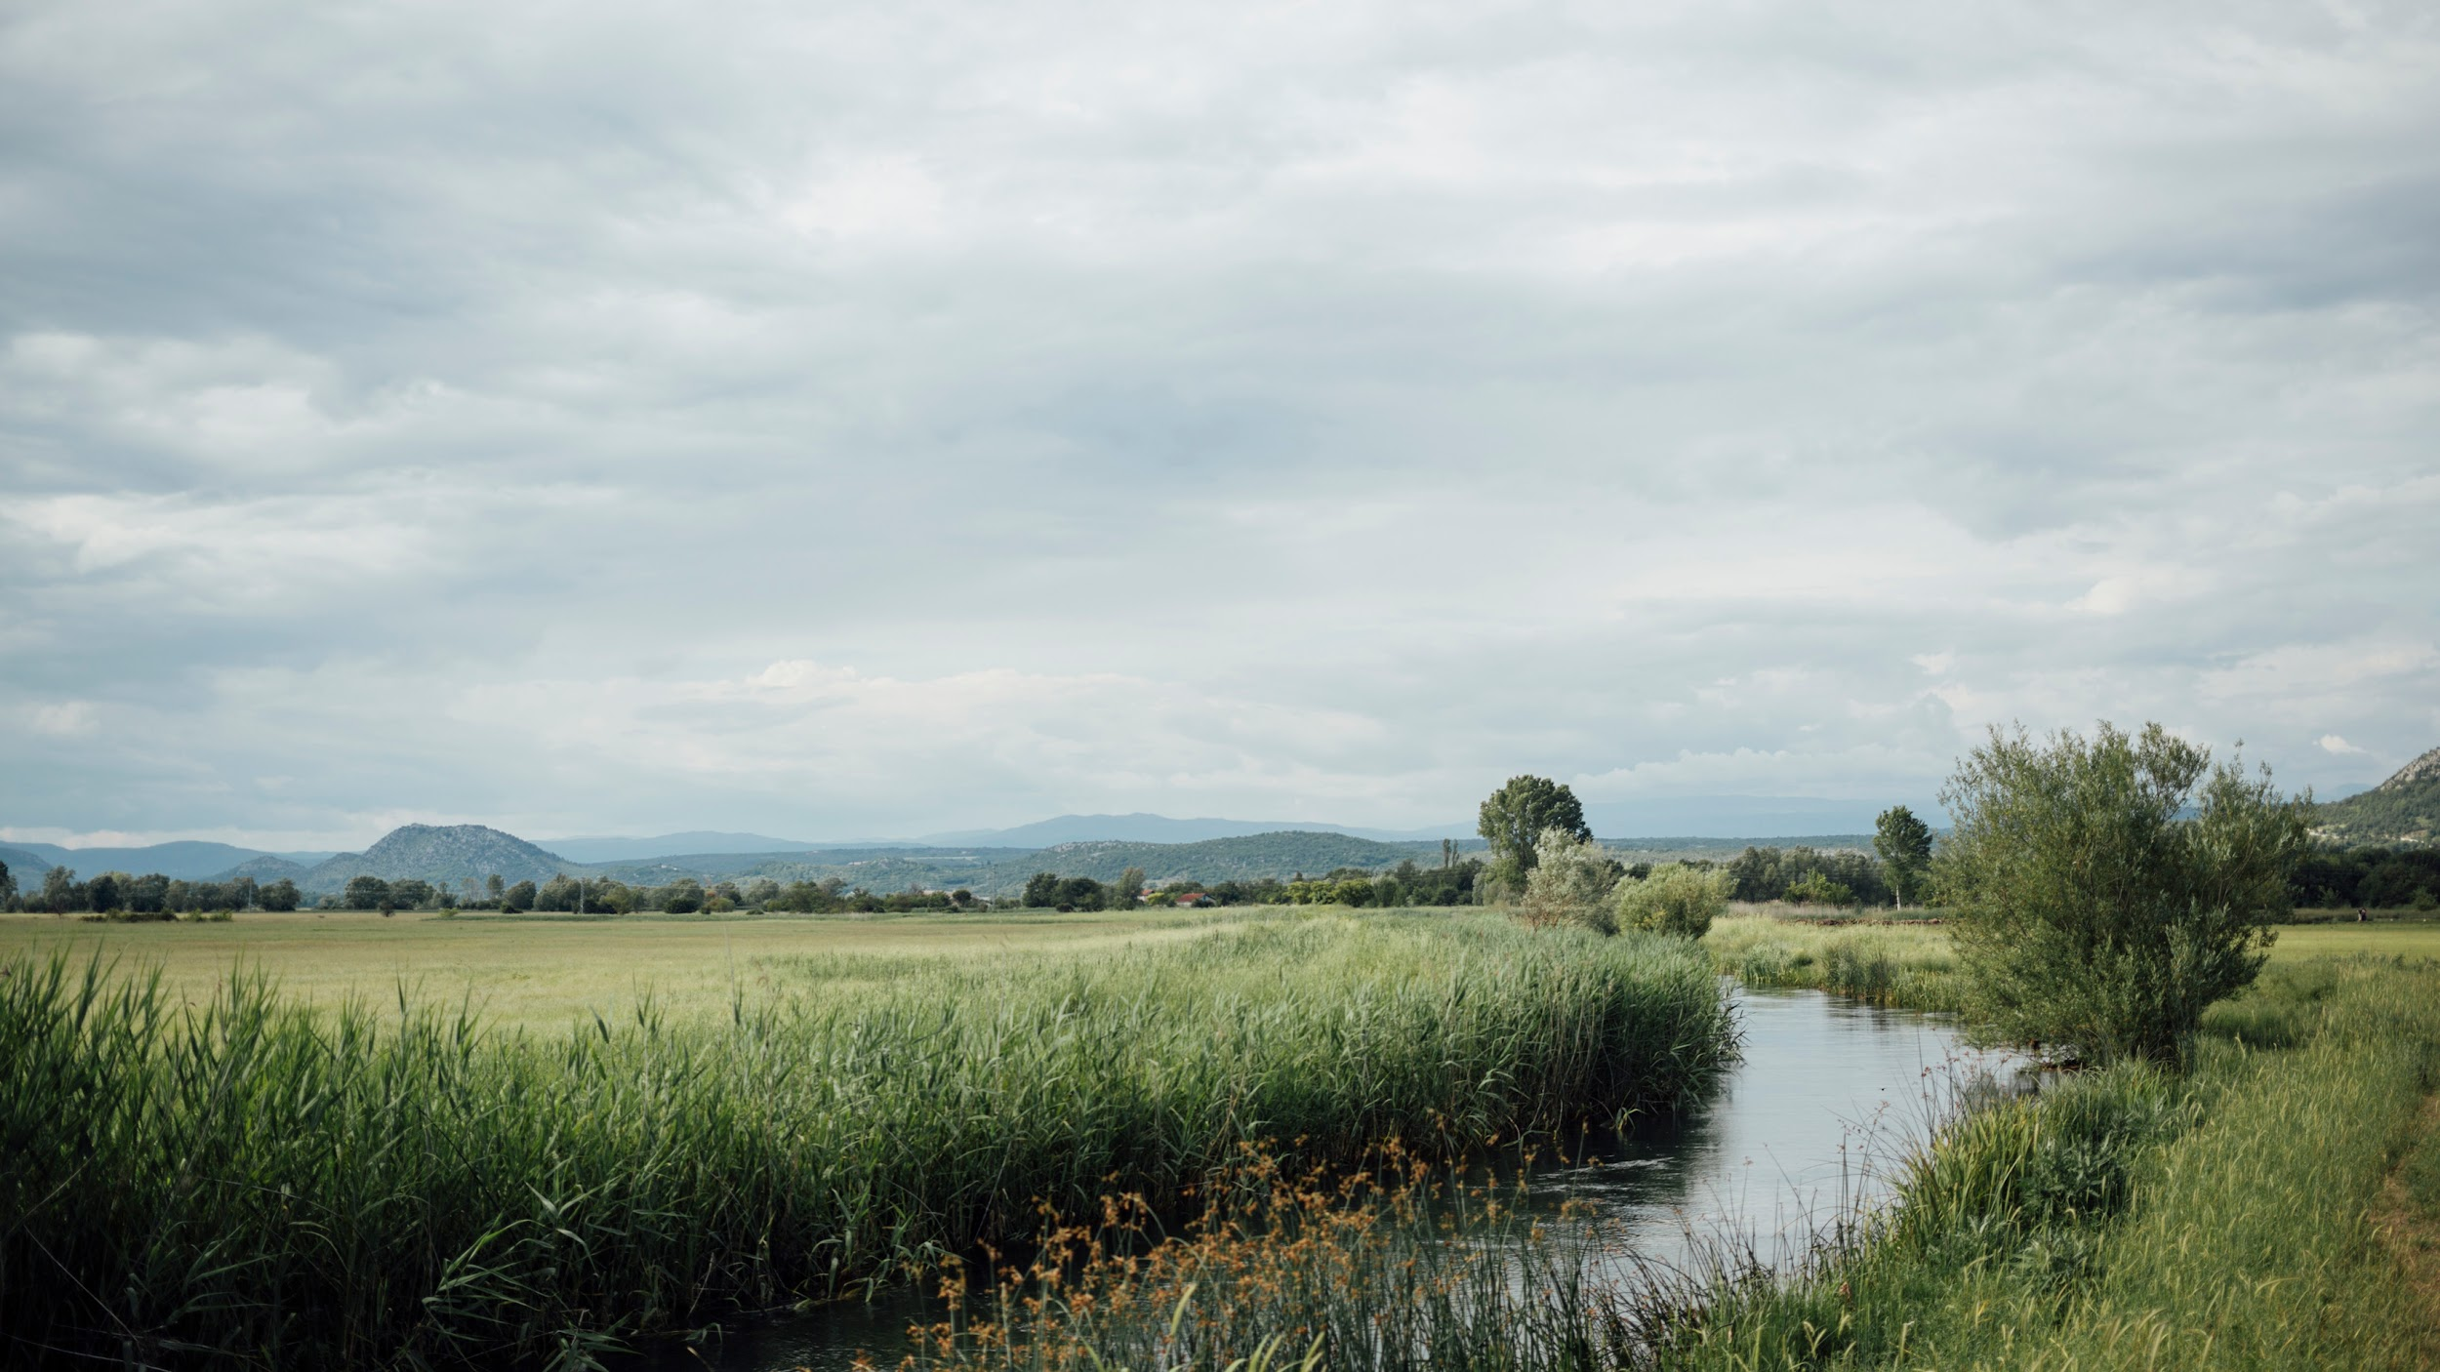
Introduction
To begin with, Jordan is one of the most water-scarce countries in the world. The country’s renewable water supply currently meets around two-thirds of the population’s water demands, with groundwater being used twice as quickly as it can be replenished, which will cause multiple problems to the people in the country lets get into that.

Slide 3
Problems and issues
Pollution:The overflow of wastewater pumping stations, leaks from sewage systems and exposure to industrial and commercial waste are polluting Jordan’s surface river sources. This has resulted in nitrate and phosphorus contamination of water supplies.
Water scarcity: Water scarcity is another problem in the country of Jordan. what is it you may ask? Well water scarcity limits access to safe water for drinking and for practising basic hygiene at home, in schools and in health-care facilities. When water is scarce, sewage systems can fail and the threat of contracting diseases like cholera surges. Scarce water also becomes more expensive.

Slide 4
Consequences
There are many Consequences of water crisis for example: water shortage of clean drinking water is the most immediate threat to human life, water scarcity can have far-reaching consequences. Diminished flows in the rivers of Jordan and streams can increase concentration of harmful pollutants. Researchers believe when waterways run dry, animals may seek out drinking water from places where people live, increasing the likelihood of contact between humans with wildlife and any disease-carrying insects they host. Drought can also increase the risk of wildfires and dust storms that may lead to irritation of lungs and airways and may kill many people.

Slide 5
Causes
Agriculture: One of the many causes of water crisis is, Agriculture consumes more water than any other source and wastes much of that through inefficiencies. Climate change is altering patterns of weather and water around the world, causing shortages and droughts in some areas and floods in others.
Drought: drought is some of the many reasons for water crisis it is a prolonged dry period in the natural climate cycle that can occur anywhere in the world. It is a slow-onset disaster characterized by the lack of precipitation, resulting in a water shortage. Drought can have a serious impact on health, agriculture, economies, energy and the environment.

Slide 6
Solutions
Build awareness: make people conscious the problem of water crisis You want to make this certain topic of water crisis more visible within the community, which would help out many people in Jordan and even save lives Solving drought: One of the easiest steps we can take to help mitigate the impacts of drought is conserving water. If we use water wisely at all times, more water will be available to us and to plants and wildlife when a drought happens. Water-saving Devices: Just shutting off the faucet or fixing a leak can save a lot of water. Another way to save water is to install devices that use less water to perform everyday tasks

Slide 7
CITATION
World Wildlife Fund. (n.d.). Water scarcity. WWF. https://www.worldwildlife.org/threats/water-scarcity#:~:text=Agriculture%20consumes%20more%20water%20than,areas%20and%20floods%20in%20others
Saiesha. (2022, April 14). 7 facts about water scarcity in Jordan. The Borgen Project. https://borgenproject.org/water-scarcity-in-jordan/#:~:text=The%20overflow%20of%20wastewater%20pumping,phosphorus%20contamination%20of%20water%20supplies
Water Resources & Environment: Basic page: Jordan. U.S. Agency for International Development. (2022, August 16). https://www.usaid.gov/jordan/water-resources-environment#:~:text=Jordan%20is%20one%20of%20the,as%20it%20can%20be%20replenished.
The effects of climate change on water shortages. Stanford Earth. (n.d.). https://earth.stanford.edu/news/effects-climate-change-water-shortages
Get involved. The Borgen Project. (2022, September 23). https://borgenproject.org/get-involved-in-the-cause/

