Slide 1
Interdisciplinary Project
By: Samir, Rashed, Mohammed, Hashem

Slide 2
Table of Contents
Objectives (Slide 3)
Lithium Chloride + Water (Slide 4)
Sodium Chloride + Water (Slide 5)
Magnesium Nitrate + Water (Slide 6)
Zinc Sulfate + Water (Slide 7)

Slide 3
Objectives:
Investigate and describe exothermic and endothermic changes of some salts when dissolved in water.
Search for the chemical properties of these substances and their uses in our lives.

Slide 4
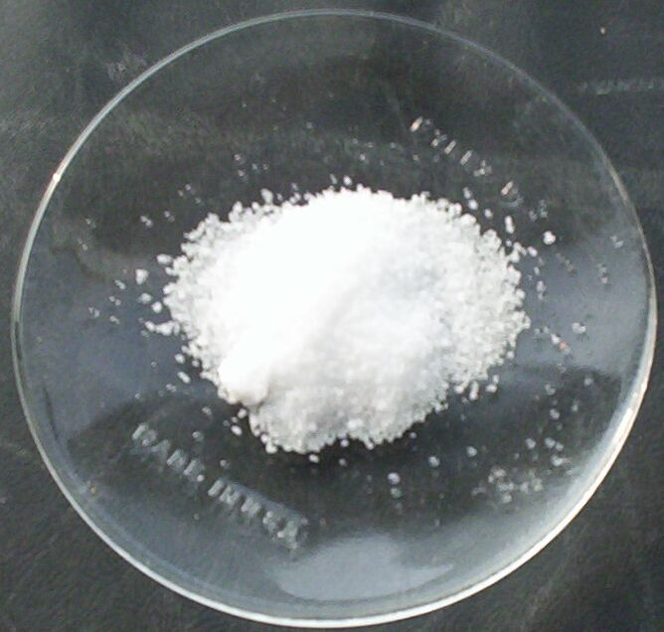
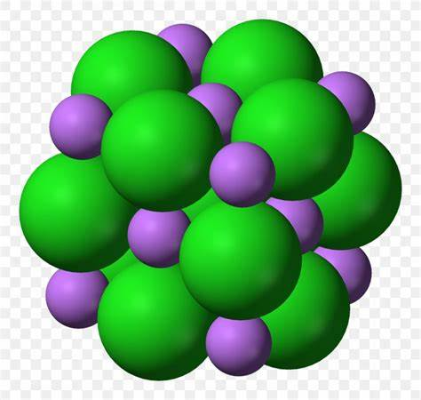
Lithium Chloride
Lithium Chloride is a salt. It is made when Lithium reacts with HCl. Lithium Chloride is
barely even soluble in water, it is the least soluble salt when added to water. Its solubility in water is 11.3g in 100g of water. In our lives we use it to precipitate RNA from our cellular extracts, its chemical formula is LiCl. Its melting point is 605-614°C, its boiling point is 1,382 °C. This reaction is exothermic. It appears white at room temperature. Its atomic structure looks like this following picture:

Slide 5
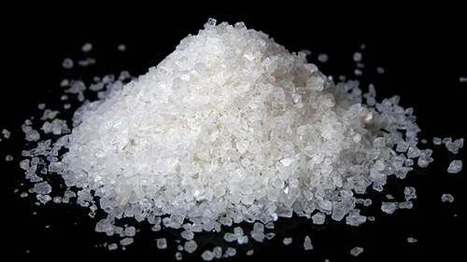
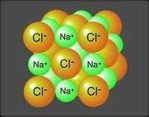
Sodium Chloride
Sodium Chloride is also salt. It is made when Sodium reacts with HCl. Another name for
Sodium Chloride is table salt. Sodium Chloride is very soluble in water, it dissolves when added to water. In our lives we use it when we eat, its solubility in water is 36g per 100g of water. Its chemical formula is NaCl. Its melting point is 801°C, its boiling point is 1,465°C. This reaction is endothermic. It appears a greyish white at room temperature. Its atomic structure looks like this following picture:

Slide 6
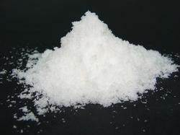
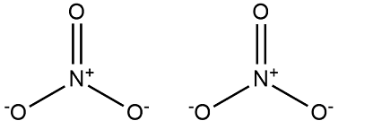
Magnesium Nitrate
Magnesium Nitrate is also another salt. It is made when Magnesium reacts with HNO3.
Magnesium Nitrate is very soluble in water, it dissolves when added to water. Its solubility in water is 71g per 100g of water. In our lives, it acts as a fertilizer, its chemical formula is Mg(NO3)2 and Hydrogen. Its melting point is 129°C, its boiling point is 330°C. This reaction is exothermic. It also appears white at room temperature. Its atomic structure looks like this following picture:

Slide 7
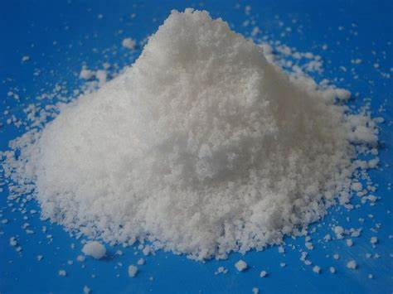
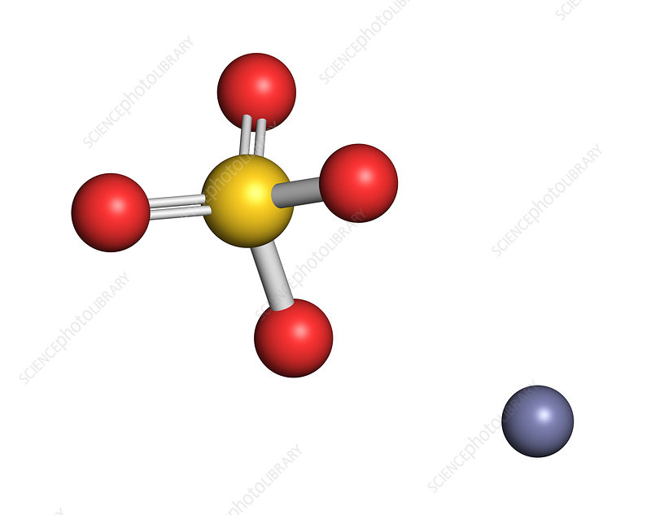
Zinc Sulfate
Zinc Sulfate is also another salt. It is made when Zinc reacts with H2SO4. Zinc Sulfate is very soluble
in water, it dissolves when added to water. Its solubility in water is 57.7g per 100g of water. In our lives, it also acts as a fertilizer, its chemical formula is ZnSO4(H2O) and Hydrogen. Its melting point is 680°C, its boiling point is 740°C. This reaction is endothermic. It also appears white at room temperature. Its atomic structure looks like this following picture:

Slide 8
Thank you for listening!

