Slide 1
Earthquakes
By Salma nabulsi, nour karsou, noor nassar

Slide 2
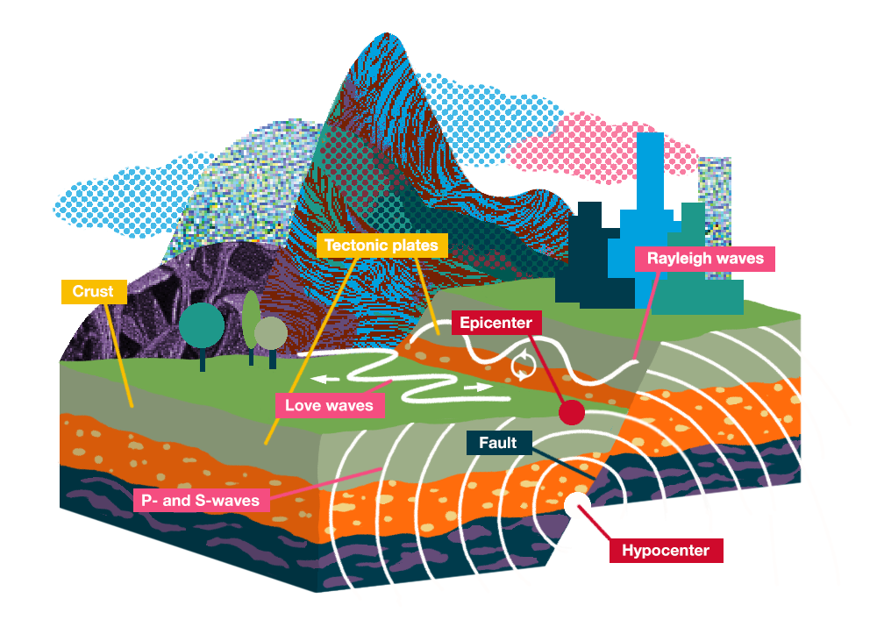
What Is an Earthquake?
Noor Nassar
An earthquake is an intense shaking of Earth’s surface. The shaking is caused by movements in Earth’s outermost layer.

Slide 3
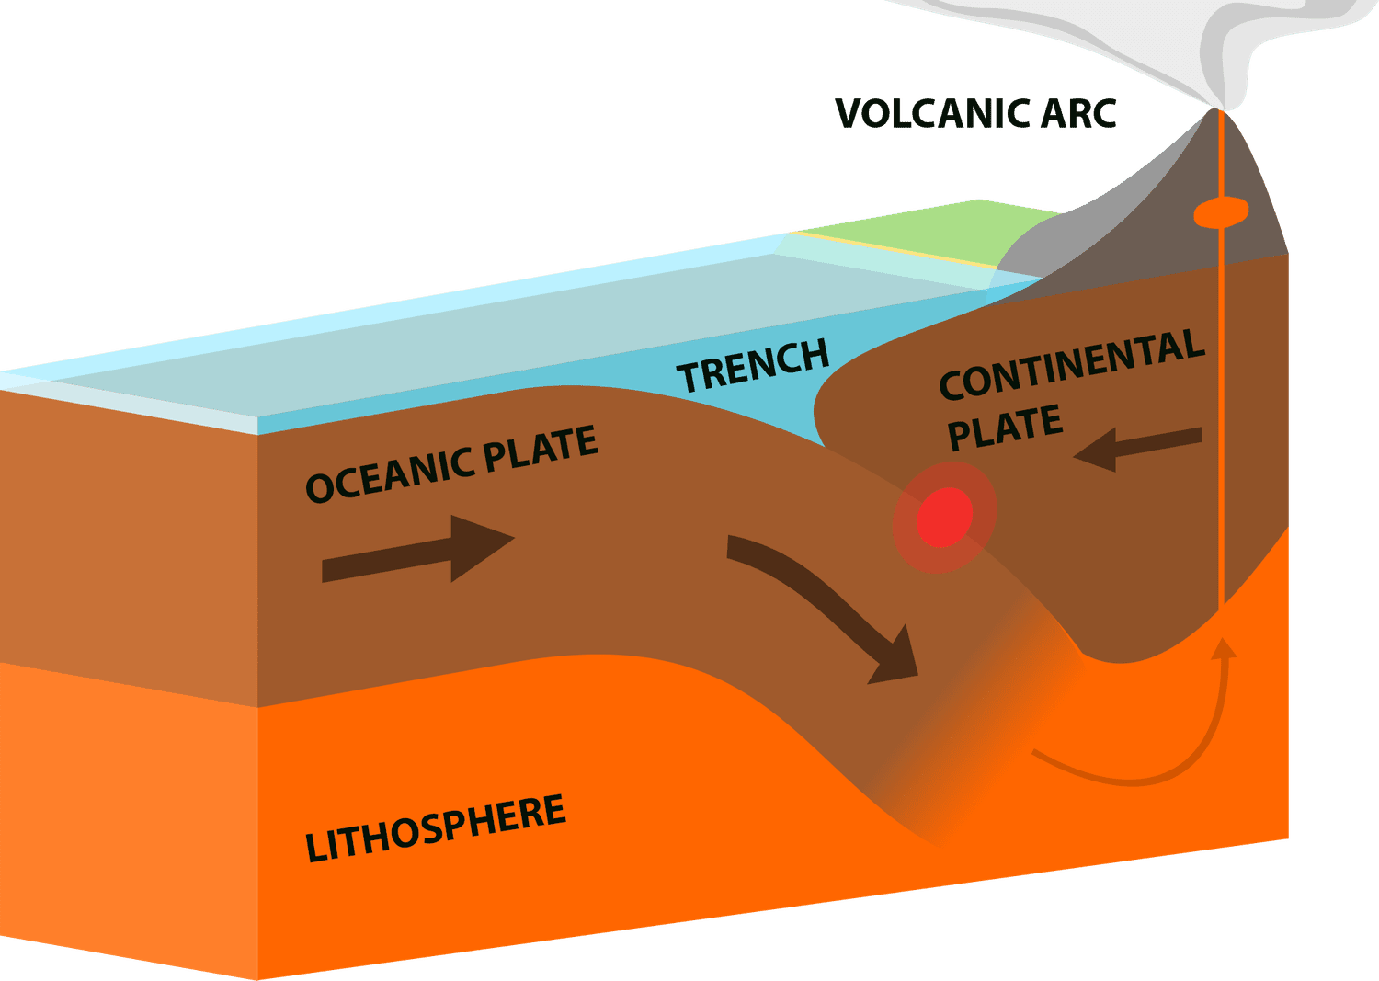
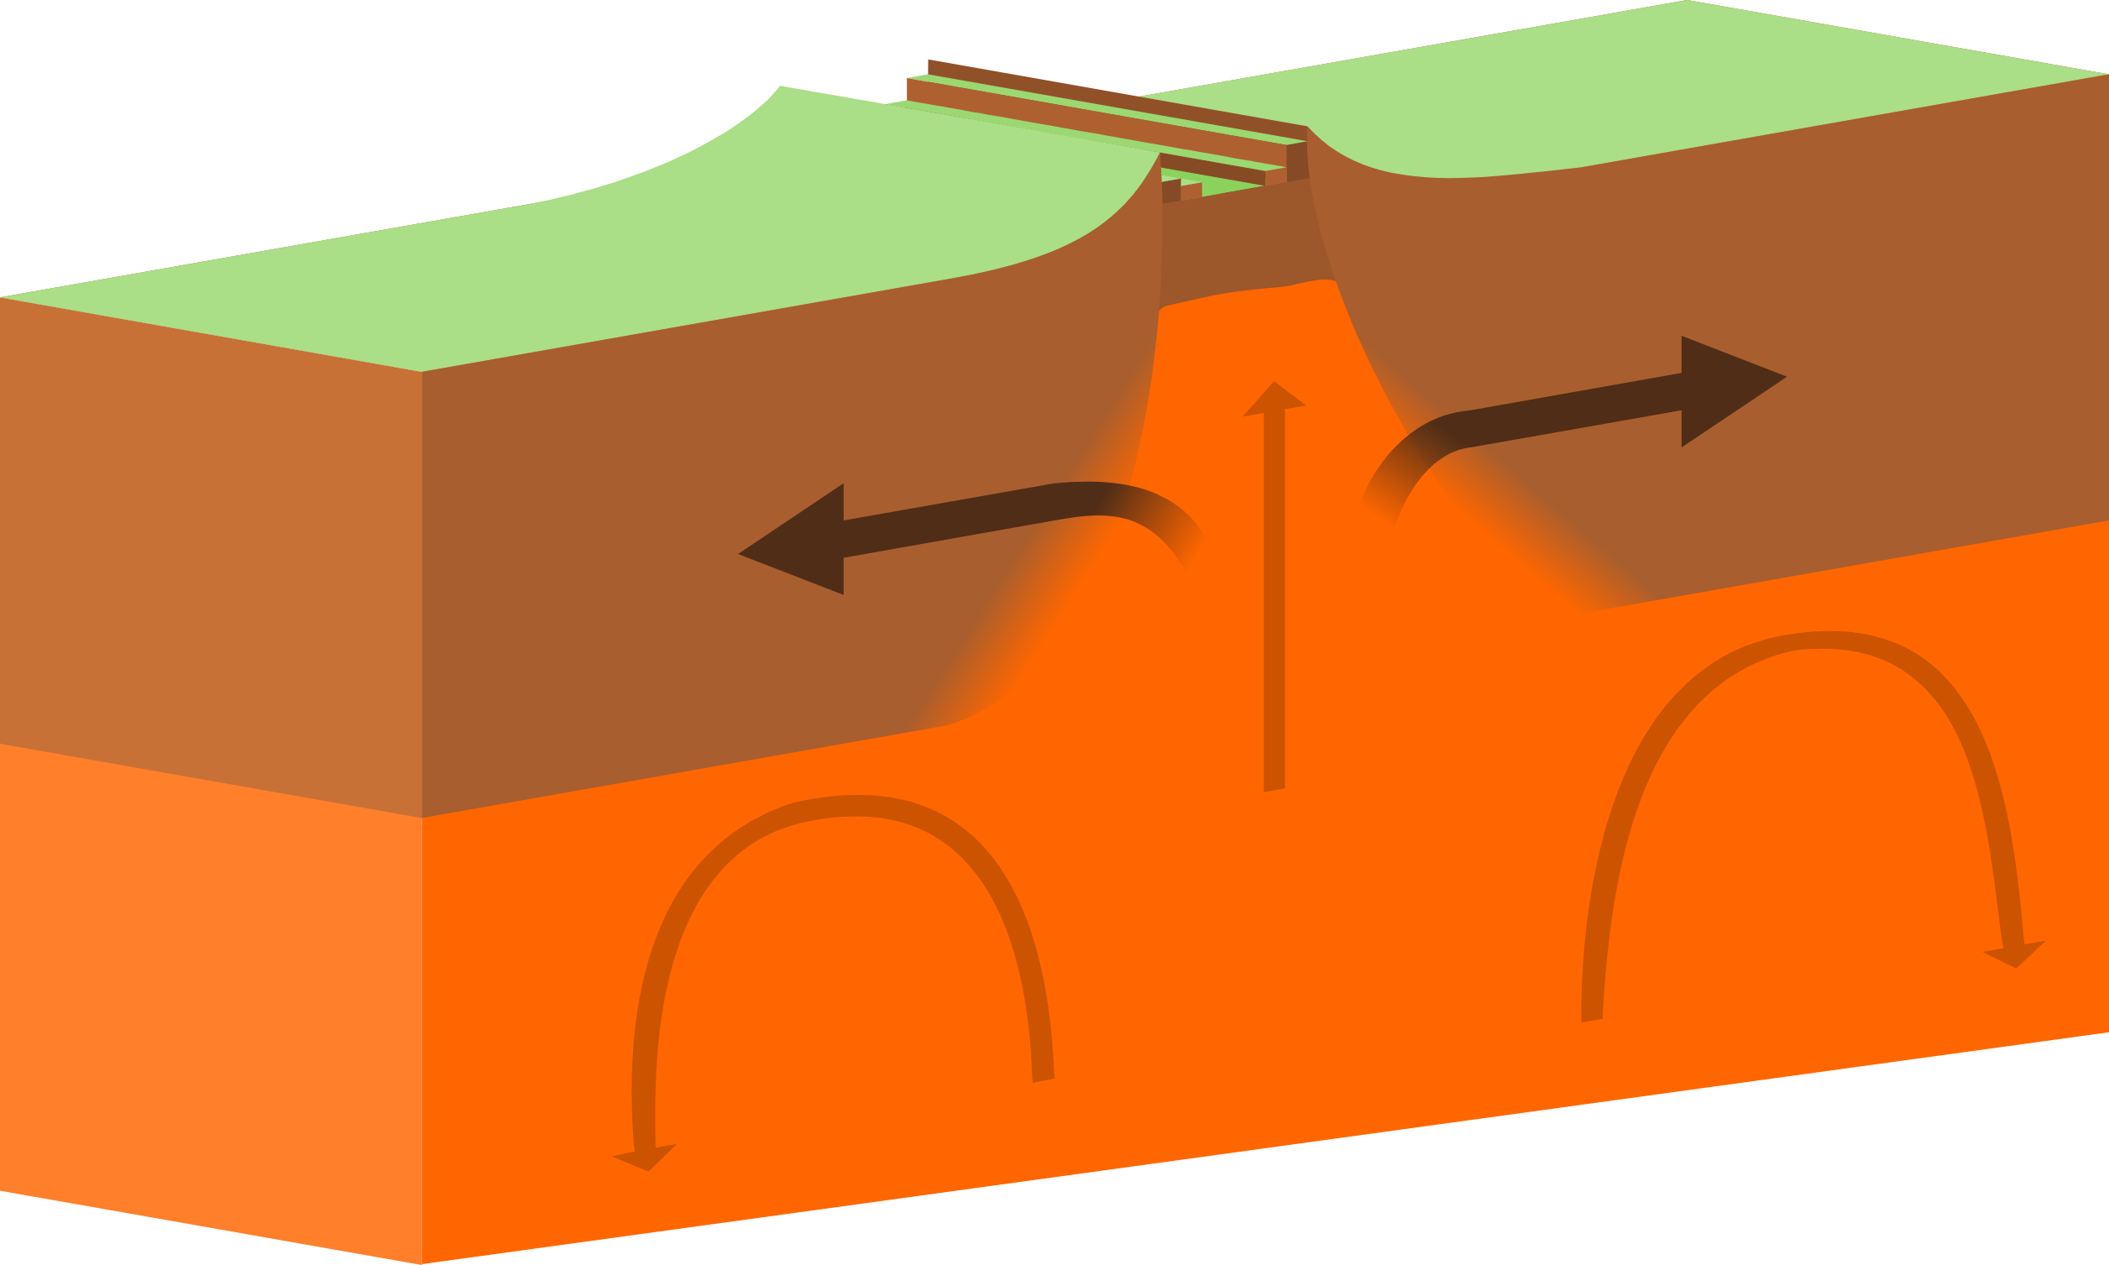
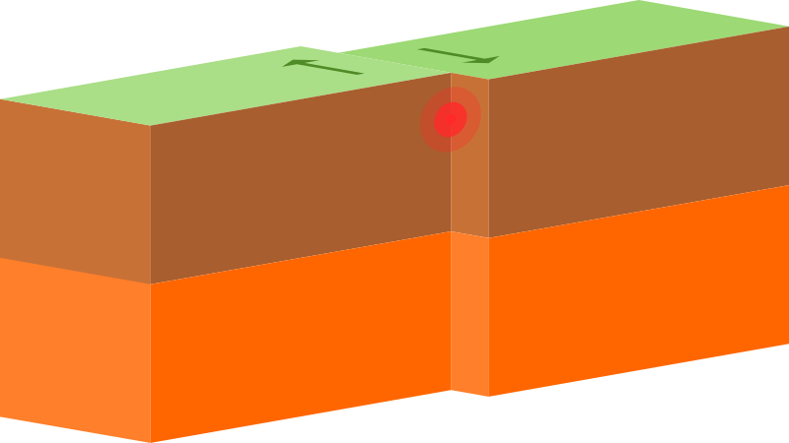
The different types of tectonic plate boundaries that cause earthquakes
Nour Karsou
Types of Earthquakes
Convergent Boundaries
Divergent boundaries
Transform boundaries
Notes:
Convergent boundaries: When two plates come together, it is known as a convergent boundary. The impact of the colliding plates can cause the edges of one or both plates to buckle up into a mountain ranges or one of the plates may bend down into a deep seafloor trench.
Divergent boundaries: A divergent boundary occurs when two tectonic plates move away from each other.
Transform Boundaries: Where two plates slide past each other, earthquakes originate at shallow depths.

Slide 4
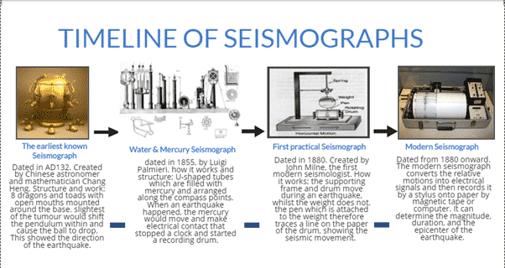
Methods used to detect, measure and predict earthquakes.
Nour Karsou
Seismometers allow us to detect and measure earthquakes

Slide 5
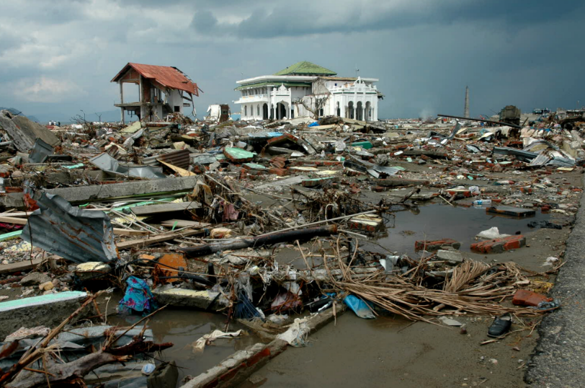
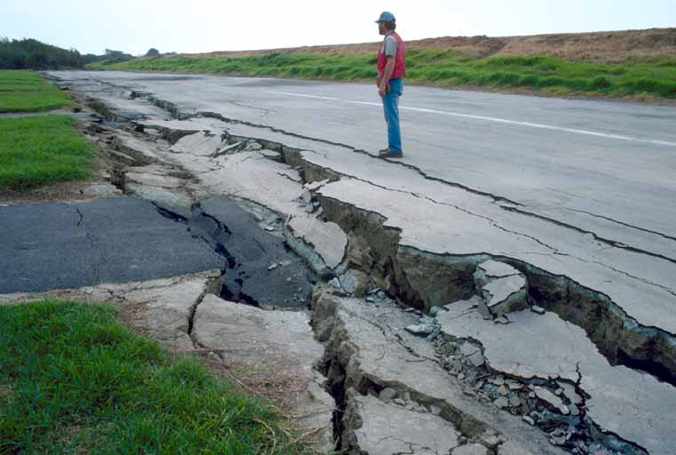
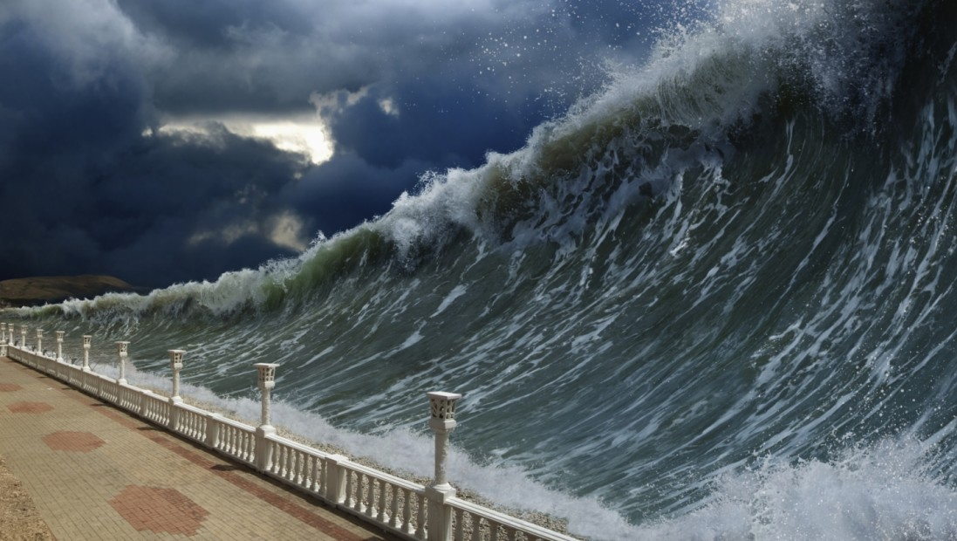
The effects/consequences of earthquakes on the environment.
Noor Nassar
Effects of earthquakes
tsunami
Destruction
Ground flattening
Notes:
Causes of earthquakes: When the stress on the edge overcomes the friction, there is an earthquake that releases energy in waves that travel through the earth's crust and cause the shaking that we feel. effects of earthquakes: The effects from earthquakes include ground shaking, surface faulting, ground failure, and less commonly, tsunamis.

Slide 6
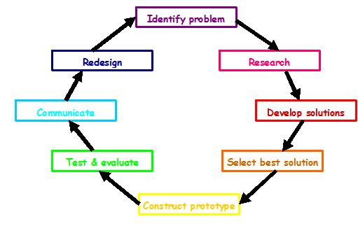
Solutions for earthquakes
Salma Nabulsi
identifying hazards, building safer structures, and providing education on earthquake safety, and don’t use bricks and cement for building houses use wood instead

Slide 7
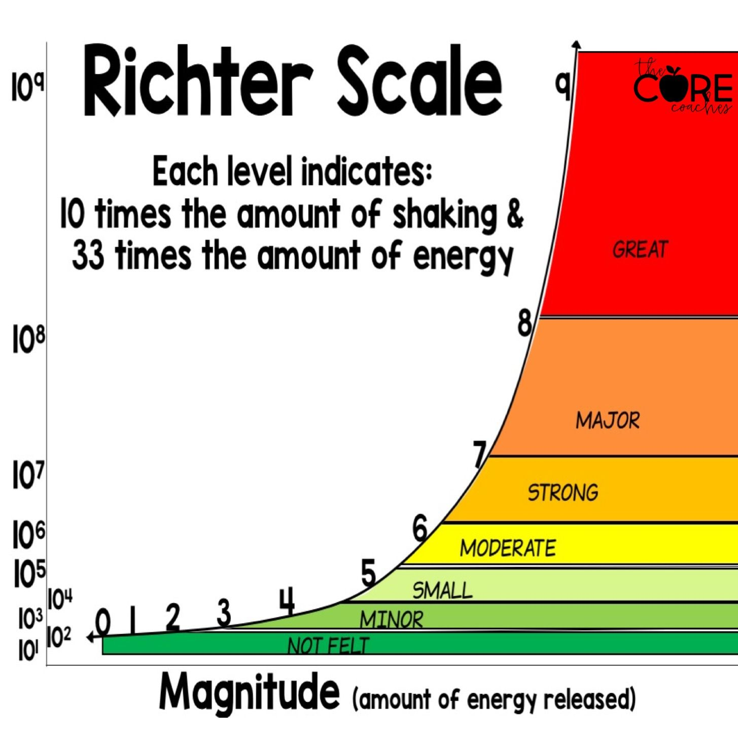
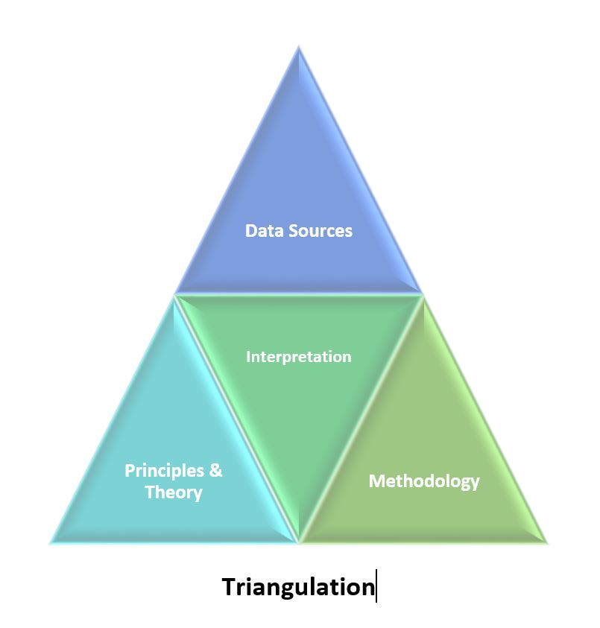
Methods used to detect, measure and predict earthquakes
Salma Nabulsi
the Richter scale:
triangulation
Notes:
Seismometers allow us to detect and measure earthquakes by converting vibrations due to seismic waves into electrical signals, which we can then display as seismograms on a computer screen.
The Richter scale which means that each one-point increase on the scale represents a tenfold increase in the magnitude of the earthquake.
Triangulation is a method used to increase the credibility and validity of research findings

Slide 8
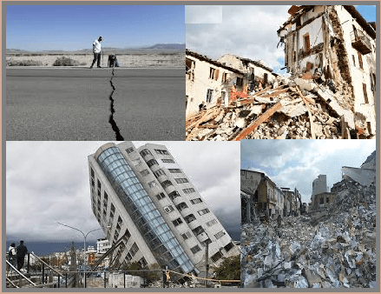
The impacts of earthquakes on the natural environment and ecosystem and what are the natural causes of earthquakes
Noor Nassar
Notes:
surface faulting, tsunamis, soil liquefactions, ground resonance, landslides and ground failure.
When the stress on the edge overcomes the friction

Slide 9
Websites we used to find information:
https://www.usgs.gov/programs/earthquake-hazards/what-are-effects-earthquakes#:~:text=The%20effects%20from%20earthquakes%20include,%2C%20and%20less%20commonly%2C%20tsunamis.
https://www.bgs.ac.uk/discovering-geology/earth-hazards/earthquakes/how-are-earthquakes-detected/
https://www.betterevaluation.org/methods-approaches/methods/triangulation
Https://ui.adsabs.harvard.edu/abs/2017EGUGA..19.3884M/abstract
https://topex.ucsd.edu/es10/es10.1997/lectures/lecture20/secs.with.pics/node10.html

Slide 10

Thank you
Created By: Salma Nabulsi, Nour Karsou,
Noor Nassar

