Slide 1
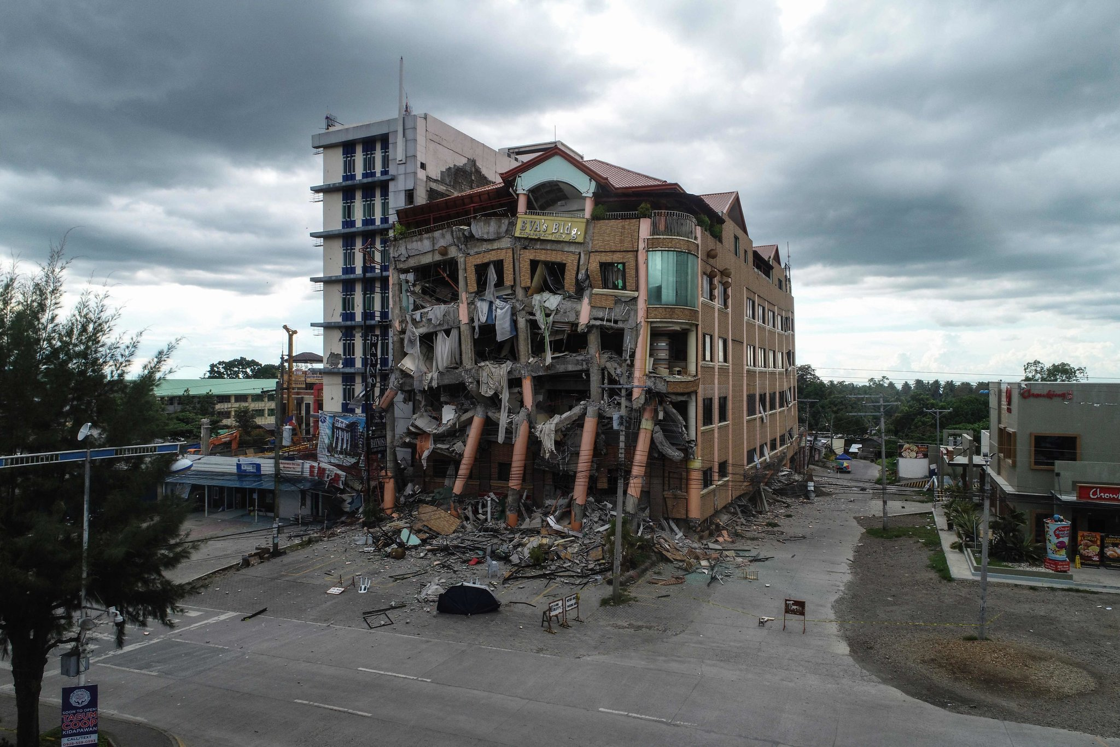
Earth quakes
Nabeel joseph Faisal Ramzi
Notes:
faisal

Slide 2
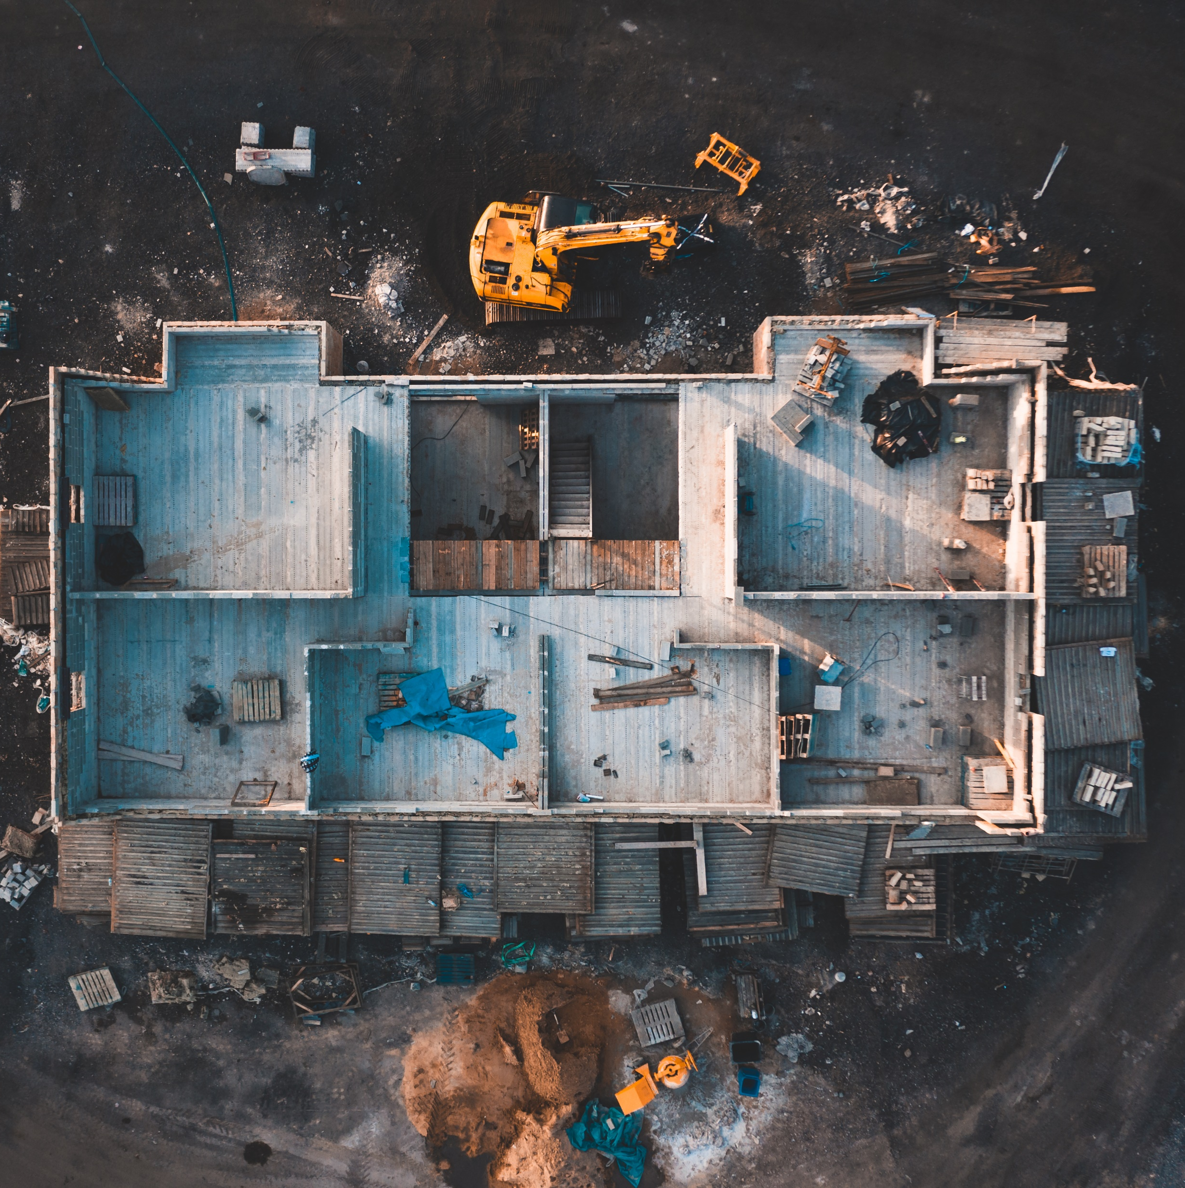
WHAT ARE EARTHQUAKES?
Notes:
faisal
An earthquake is a series of vibrations induced in the earth’s crust by the abrupt
rupture and rebound of rocks in which elastic strain has been slowly accumulating.

Slide 3
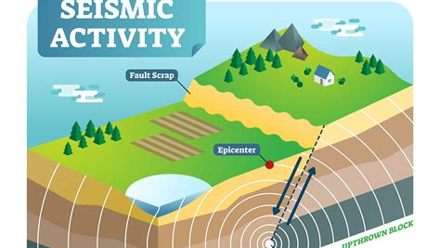
CAUSES OF EARTHQUAKES
Notes:
ramzi
The movement of tectonic plates causes long periods of pressure buildup in fault zones.
When the force of movement overcomes the friction, seismic waves are released, known as tectonic earthquakes.

Slide 4
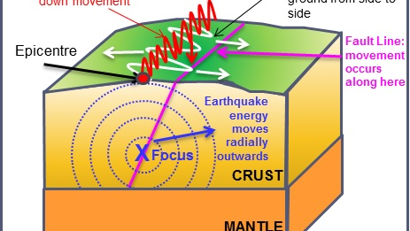
EFFECTS OF EARTHQUAKES
Notes:
ramzi
Earthquakes can often induce natural disasters such as land slides, tsunamis, fires or floods.

Slide 5
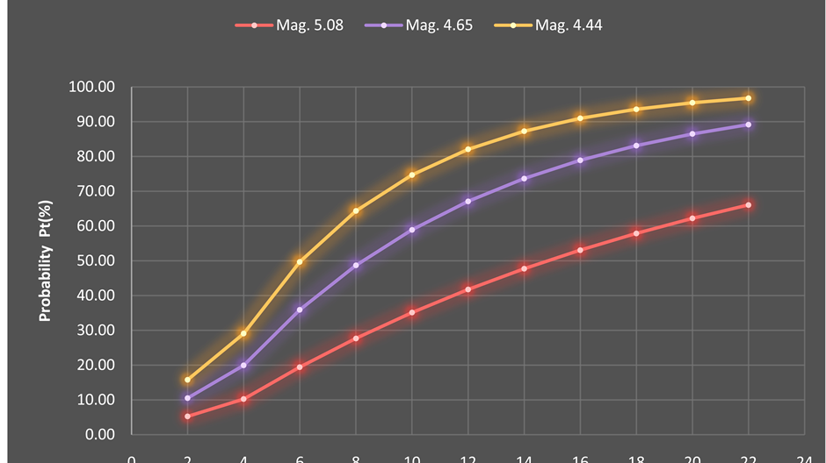
Factors that effects the intensity OF EARTHQUAKES
Notes:
joseph
Earthquake intensity can be determined by earthquake depth, proximity to the fault, soil and building height.

Slide 6
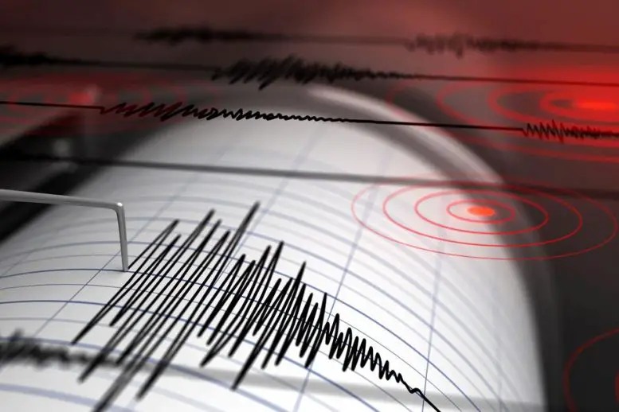
Can we predict earthquakes?
Notes:
nabeel
Short answer is we can’t. While we can identify areas of the world where earthquakes are more likely to occur,
it’s not currently possible to predict exactly when or where an earthquake is going to happen.

Slide 7

Sources and websites
Main Source:
www.dictionary.com
scienceexchange.caltech.edu
Notes:
No one

Slide 8



Thank You For Listening!!
Notes:
nabeel

