Slide 1
Obesity
By: yann Haddadin/qais haddad/yasmine abuaita/hind habash

Slide 2
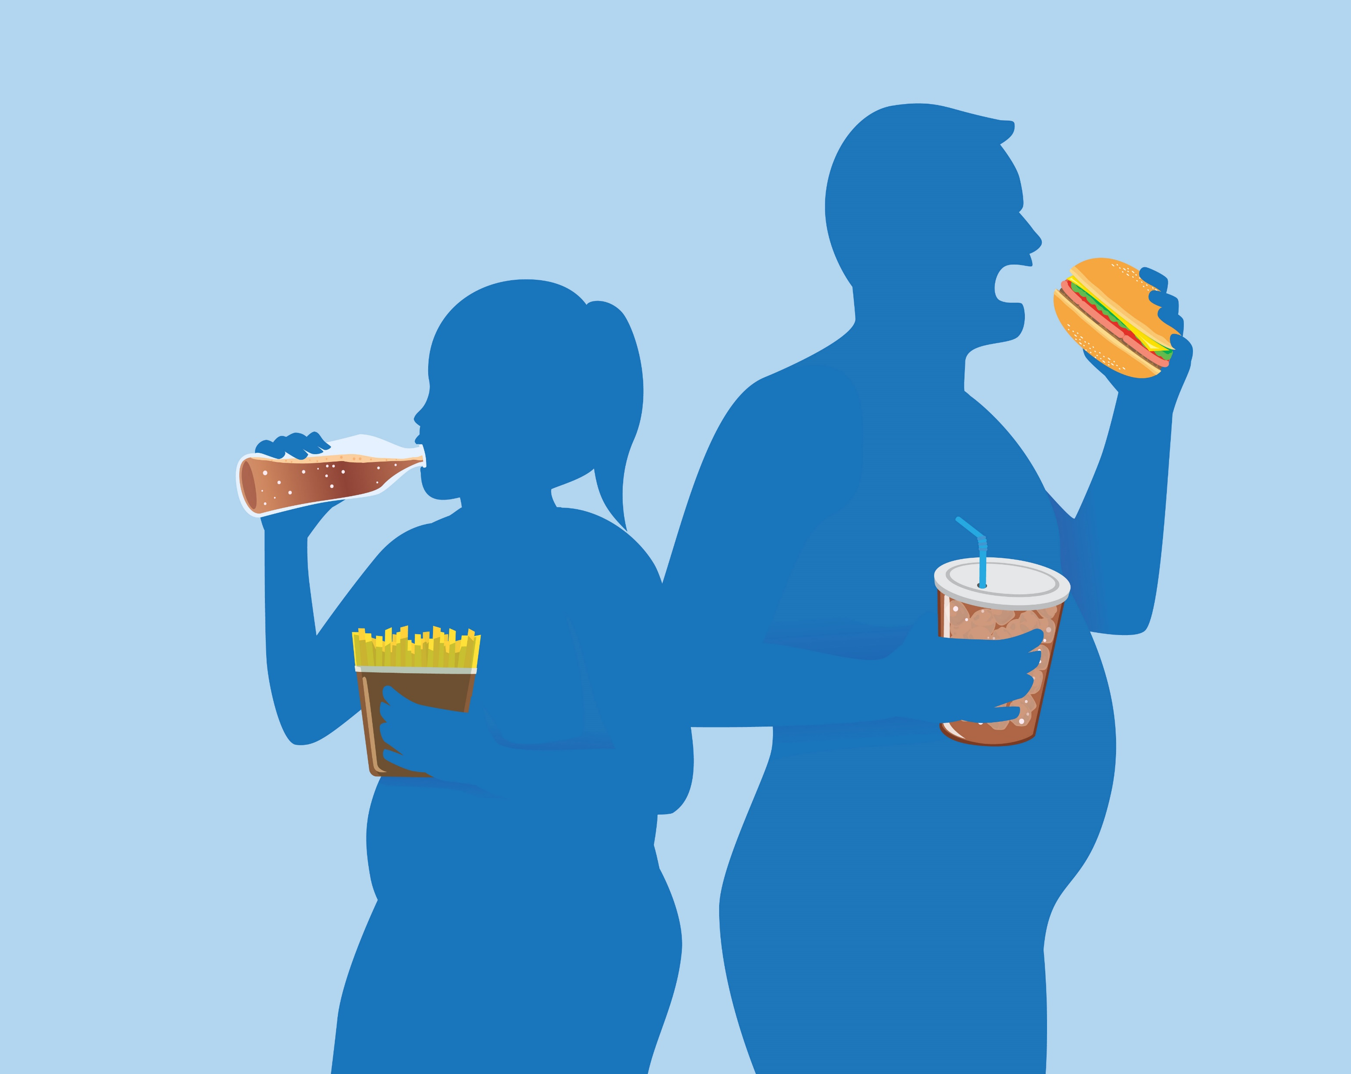
What is obesity?
Excessive fat buildup that poses a risk to health is what is meant by the terms "overweight" and "obesity." 4 million people dying annually as a result of being overweight or obese .In both adults and children, the prevalence of overweight and obesity is rising.
This Photo by Unknown Author is licensed under CC BY-SA-NC

Slide 3
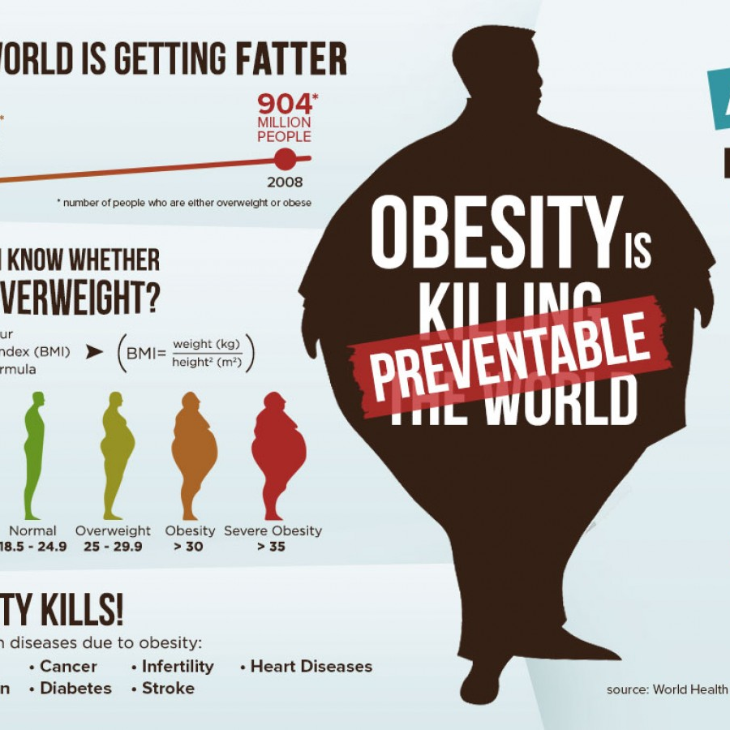
Causes of obesity
There are multiple causes of obesity:
The absence of exercise
Environmental influences
Genetics
Medical illnesses and therapies
Stress and uneasy sleep
This Photo by Unknown Author is licensed under CC BY

Slide 4
Health-related consequences of obesity.
It may lead to death
High blood pressure
LDL cholesterol
diabetes type 2
Stroke
Gallbladder illness

Slide 5
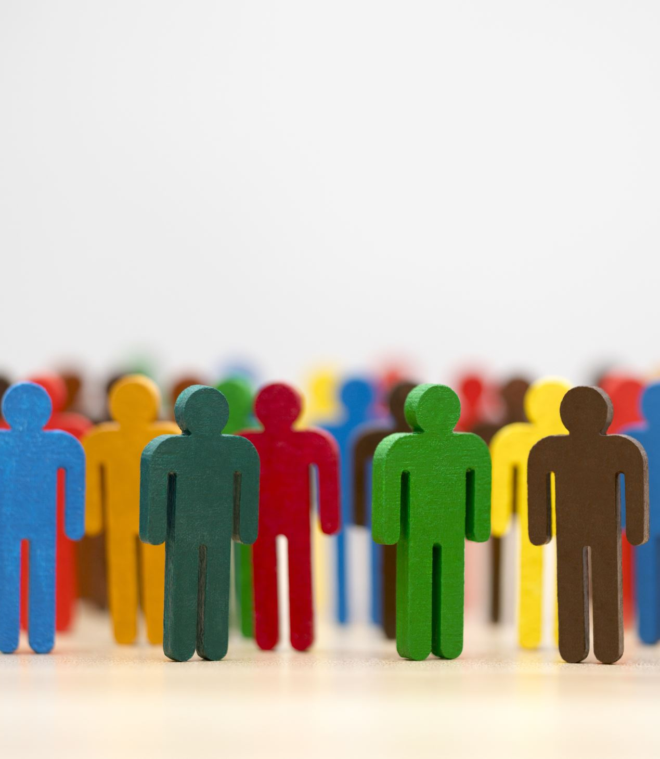
The social consequences of obesity
More likely to facing bias and discrimination more
less friends
A lower level of schooling
Decreased employment
Psychological issues including anxiety and depression
Low levels of self-esteem
Bullying

Slide 6
Ways to cure obesity
Updating your habits
Weight reduction medications
Bariatric surgery
Exercising more frequently
Maintaining a more nutritious diet

Slide 7
Resources
https://www.who.int/health-topics/obesity#tab=tab_1
https://www.nichd.nih.gov/health/topics/obesity/conditioninfo/cause
https://www.cdc.gov/healthyweight/effects/index.html
https://www.more-life.co.uk/information-centre/obesity-fact-file/consequences-of-obesity/#:~:text=Research%20tells%20us%20that%20people,Lower%20educational%20attainment
https://www.cdc.gov/obesity/basics/consequences.html#:~:text=Psychological%20problems%20such%20as%20anxiety,such%20as%20bullying%20and%20stigma

