Slide 1
Earthquakes
by: alia,saif,Nicola
6E

Slide 2
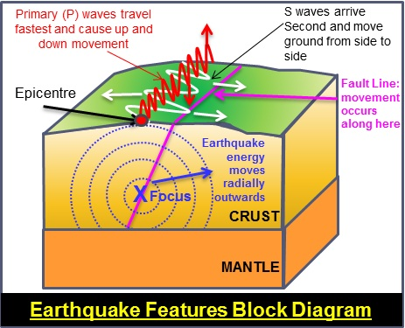
Introduction to Earthquake - Volcano .
Notes:
An earthquake is caused when two tectonic plates rub against each other, due to the tectonic plates not being smooth, The amount of energy and friction will make the plates suddenly slip then a earthquake forms

Slide 3
The factors that affect the intensity and frequency of earthquakes.
Notes:
When an earthquake strikes, the intensity of earthquake shaking determines the severity of damage. In turn, the main factors affecting earthquake shaking intensity are earthquake depth, proximity to the fault, the underlying soil, and building characteristic particularly height

Slide 4
Methods used to detect, measure and predict earthquakes.
Notes:
Seismometers allow us to detect and measure earthquakes by converting vibrations due to seismic waves into electrical signals, which we can then display as seismograms on a computer screen.

Slide 5
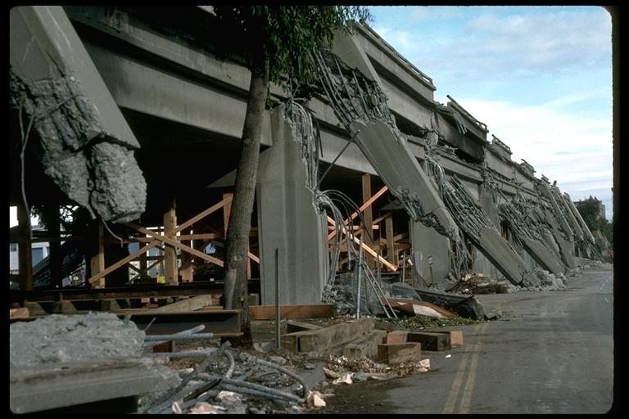
The impacts of earthquakes on the natural environment and ecosystem
Notes:
surface faulting, tsunamis, soil liquefactions, ground resonance, landslides and ground failure ground shaking, ground rupture, landslides, tsunamis, and liquefaction

Slide 6
How to protect us from earthquakes
Construction workers now are specializing in earthquake protection. Such as:
Making homes and skyscrapers out of materials that absorb less energy.
Adding more support to the building’s structure and base.
Making counter forces with damping(Examples: vibration damper/pendulum power
Notes:
Construction workers now are specializing in earthquake protection. Such as:
Making homes and skyscrapers out of materials that absorb less energy.
Adding more support to the building’s structure and base.
Making counter forces with damping(Examples: vibration damper/pendulum power

Slide 7
recources
1st slide :Introduction to Earthquake – Volcano
2nd slide: Introduction to Earthquake - Volcano – DOST
3rd slide :What Affects Earthquake Shaking or Intensity? - Jumpstart Blog
4th slide: How are earthquakes detected? - British Geological Survey
5th slide: What are the Effects of Earthquakes? | U.S. Geological ...

Slide 8
Conclusion
We have finally learnt how earthquakes get formed and the effect it has on the environment, and how we measure and predict the earthquakes appearance and magnitude of the earthquake.
Before we end this presentation we all thank you for watching this presentation.
THANK you.

