Slide 1
obesity
By: Shadi, Jad , Raad ,Nassar

Slide 2
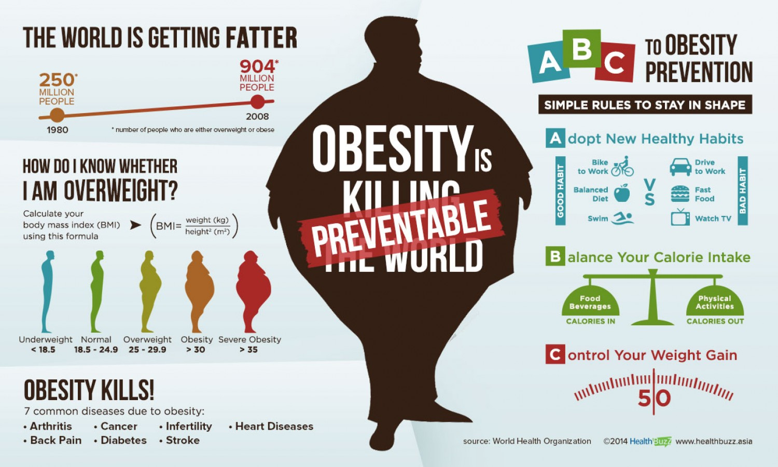
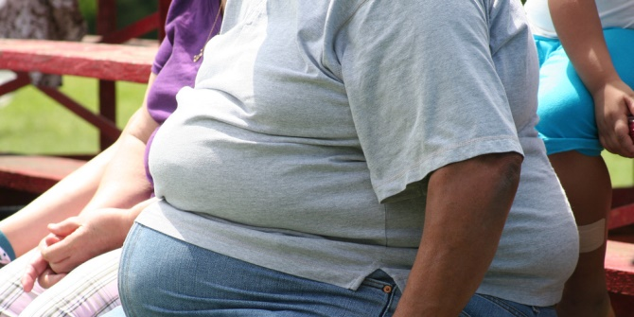
What does obesity mean? Obesity is a complex disease involving an excessive amount of body fat It's a medical problem that increases the risk of other diseases and health problems.
This Photo by Unknown Author is licensed under CC BY

Slide 3
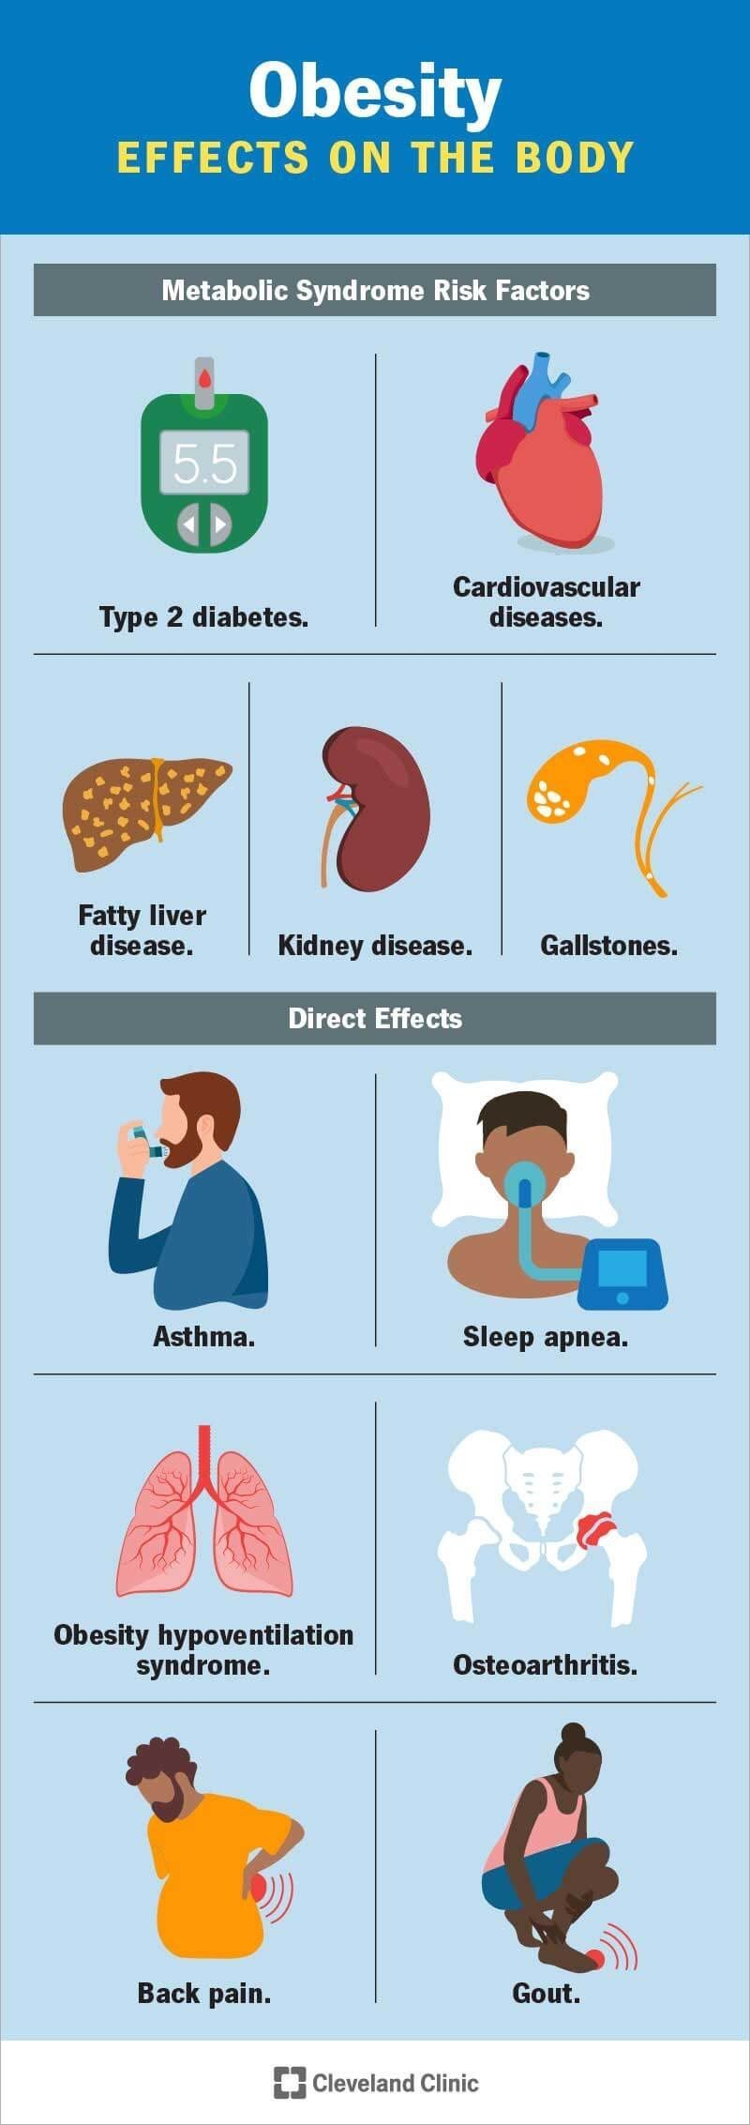
How can obesity affects your body?
Carrying extra fat leads to serious health consequences such as mainly heart disease and stroke, type 2 diabetes, and some cancers such breast and colon. These conditions can cause death and disability.

Slide 4
Causes of obesity.
People gain weight when they eat more calories than they burn through activity.
The world around us influences our ability to maintain a healthy weight.
Genetics.
Health Conditions and Medications.
Stress, Emotional Factors, and Poor Sleep.

Slide 5
Solutions for obesity
eat a balanced controlled diet as recommended by your weight loss management health professional (such as a dietitian)
join a local weight loss group
take up activities such as fast walking, jogging, swimming or padling for 3 hour to a 6 hours a week
eat slowly and avoid situations where you know you could be tempted to overeat

Slide 6
Questions.
1. What is obesity.
2. Describe how obesity can effect your body.
3. What are the causes of obesity.
4. How can you prevent obesity.

Slide 7
THANK YOU!

Slide 8
Resources.
Obesity - World Health Organization (WHO)
World Health Organizationhttps://www.who.int › Health topics
What causes obesity & overweight? | NICHD
National Institutes of Health (.gov)https://www.nichd.nih.gov › topics › conditioninfo › cause
Treatment for Overweight & Obesity - NIDDK
National Institutes of Health (.gov)https://www.niddk.nih.gov › weight-management › treat...

Slide 9
citation
haddad, raad. (2023, May 22). Obesity and overweight. World Health Organization. https://www.who.int/news-room/fact-sheets/detail/obesity-and-overweight
nino, shadi. (2023). Obesity and overweight. World Health Organization. https://www.who.int/news-room/fact-sheets/detail/obesity-and-overweight

