Slide 1
Obesity
Odeh Dababneh, Adeeb Alamat, Jad Tarazi, Ameer Al Oudat

Slide 2
What is obesity?
A condition known as obesity involves having too much body fat. Obesity is more than simply a visual issue. It's a medical condition that raises the risk of contracting a wide range of diseases.

Slide 3
How common is obesity?
Worldwide, 13% of all adults are obese and 39% of them are overweight. Which equals to one in five children and adolescents are overweight.
The ratio of energy intake to energy use determines obesity.

Slide 4
What causes obesity?
Eating large amounts of processed and fast foods
Lack of movement and exercise
Environmental factors
(TV and screen-related immobility, smart-phone, video games)
Genetics

Slide 5
Obesity increases the chances of getting the following diseases:
High blood pressure
High/low cholesterol
Type 2 diabetes(insulin your pancreas makes can't work properly)
strokes
Gallbladder diseases

Slide 6
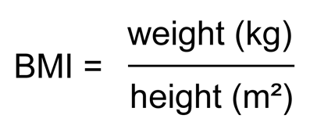
You want to know if your obese or not?
Its that easy, all you need is to measure your weight in kilograms (kg), and your height in meters (m).
Then use this formula.

Slide 7
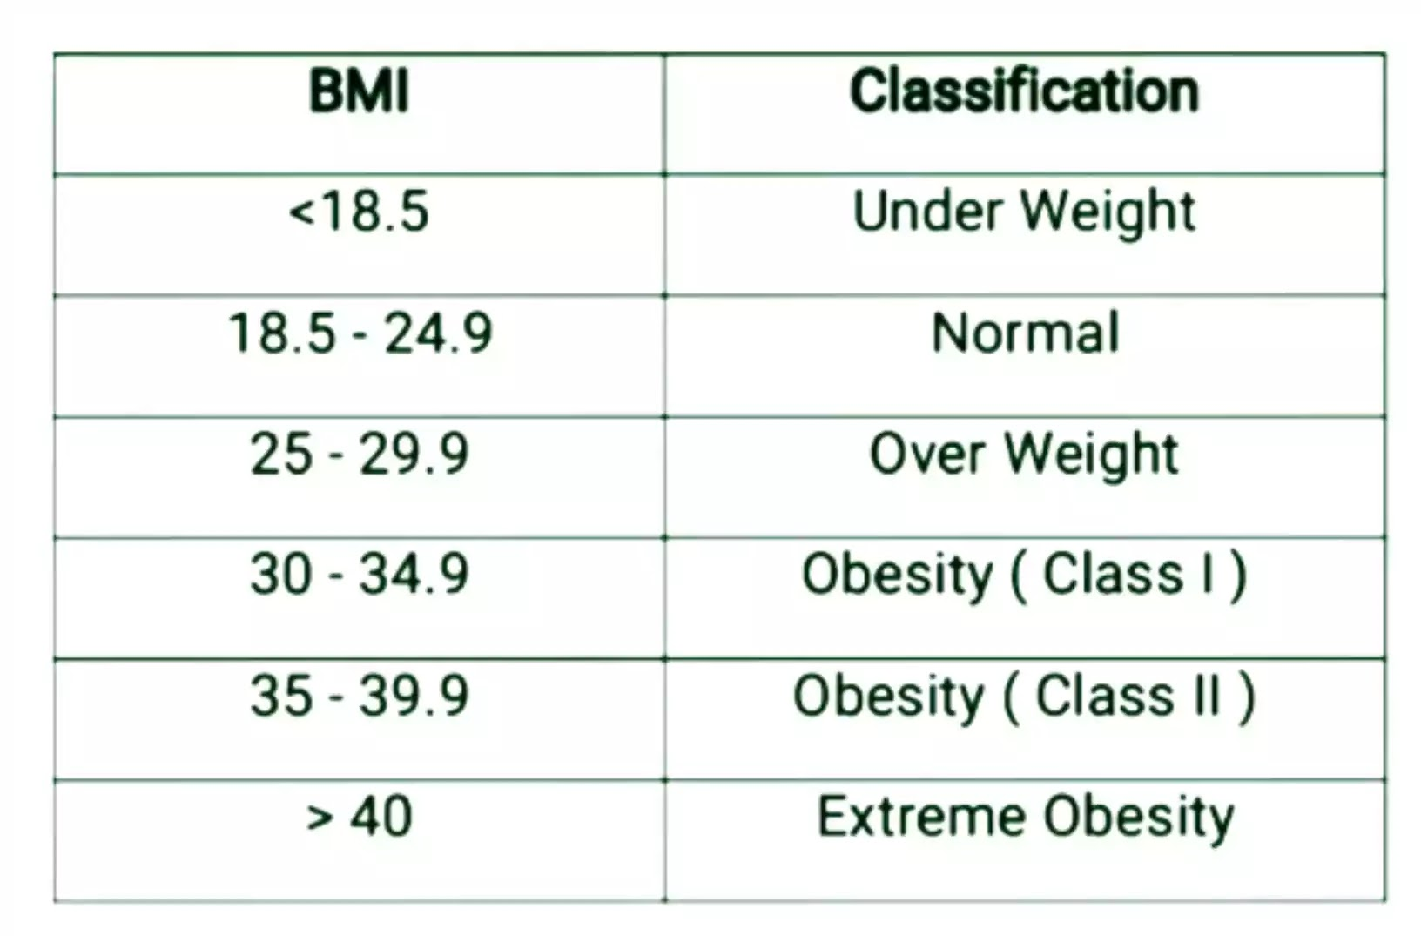
This formula will give you your “Body Mass Index” (BMI).
Obesity is diagnosed when the (BMI) is 30 or more.
Now look at this table to know more about the (BMI).

Slide 8
Beating obesity
Exercise frequently and follow a healthy, low-calorie diet as the best treatments for obesity. Eat a balanced, calorie-controlled diet as advised by your doctor or a weight loss management health professional (such as a nutritionist) to do this, and sign up for a local weight loss group.

Slide 9
Data used(Resources)
What is obesity
https://www.who.int/health-topics/obesity#tab=tab_1
https://www.mayoclinic.org/diseases-conditions/obesity/symptoms-causes/syc-20375742
how common is obesity
https://ourworldindata.org/obesity
https://www.cdc.gov/obesity/data/adult.html
what causes obesity
https://www.nichd.nih.gov/health/topics/obesity/conditioninfo/cause
https://www.nhs.uk/conditions/obesity/causes/

Slide 10
Data used(Resources)
consequences of obesity
https://www.who.int/news-room/questions-and-answers/item/obesity-health-consequences-of-being-overweight
https://www.cdc.gov/healthyweight/effects/index.html
beating obesity
https://www.nhsinform.scot/illnesses-and-conditions/nutritional/obesity
https://www.hsph.harvard.edu/obesity-prevention-source/obesity-prevention/

