Slide 1
BMI
Leen habash,Natalie awwad,Maria haddadin

Slide 2
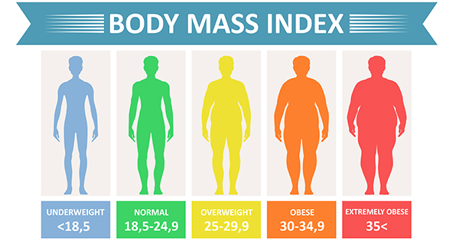

Slide 3
Name | Weight | Height | BMI | Shape
IBrahim | 79 | 179 | 24,6 | Normal
Rina | 67 | 173 | 23,1 | Normal
Shafiq | 92 | 187 | 27,0 | Normal
Marian | 58 | 158 | 24,1 | Normal
Safwan | 120 | 187 | 35,2 | Extremely obese
Mais | 44 | 157 | 18,3 | Underweight
Samer | 76 | 160 | 30,4 | Overweight

