Slide 1
Bullying
Done by hanna al farah. aoun azar. issa dihmes

Slide 2
What is bullying (introduction)
Bullying is unwanted, aggressive behavior among school
https://www.stopbullying.gov/bullying/what-is-bullying

Slide 3
Issue or problems in bullying
There will always be conflicts between kids, but bullying is intentional cruelty,harassment, and emotional, physical and sometimes sexual abuse.
https://www.stompoutbullying.org/issue-bullying

Slide 4
Reason of bullying
1-Power
2-Popularity
3-Payback
4-Problems at Home
5-Peer Pressure
https://www.verywellfamily.com/reasons-why-teens-bully-others-460532

Slide 5
Consequences of bullying
The psychological effects of bullying include depression, anxiety, low self-esteem, self-harming behavior.
https://www.stopbullying.gov/resources/research-resources/consequences-of-bullying

Slide 6
Solutions to bullying
If you are being bullied: tell them to stop, get away from the situation, and tell a trusted adult.
If you see someone being bullied, be an upstander: Tell the person to stop, get a trusted adult, reach out and be friends.
https://www.niot.org/blog/six-simple-solutions-bullying

Slide 7
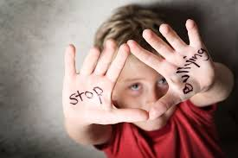
Type of bullying
There are several types of bullying, including
1-Verbal bullying
2-Physical bullying
3-Social bullying

Slide 8
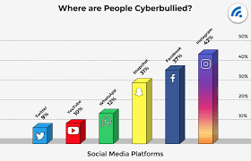
1- SOCIAL BULLYING
Social bullying, It can take various forms, such as spreading rumors, gossiping, social exclusion, embarrassing or mocking someone publicly, or manipulating social connections to harm someone's reputation or social standing. Social bullying can occur in person or online, and it often aims to undermine a person's self-esteem and social acceptance.

Slide 9
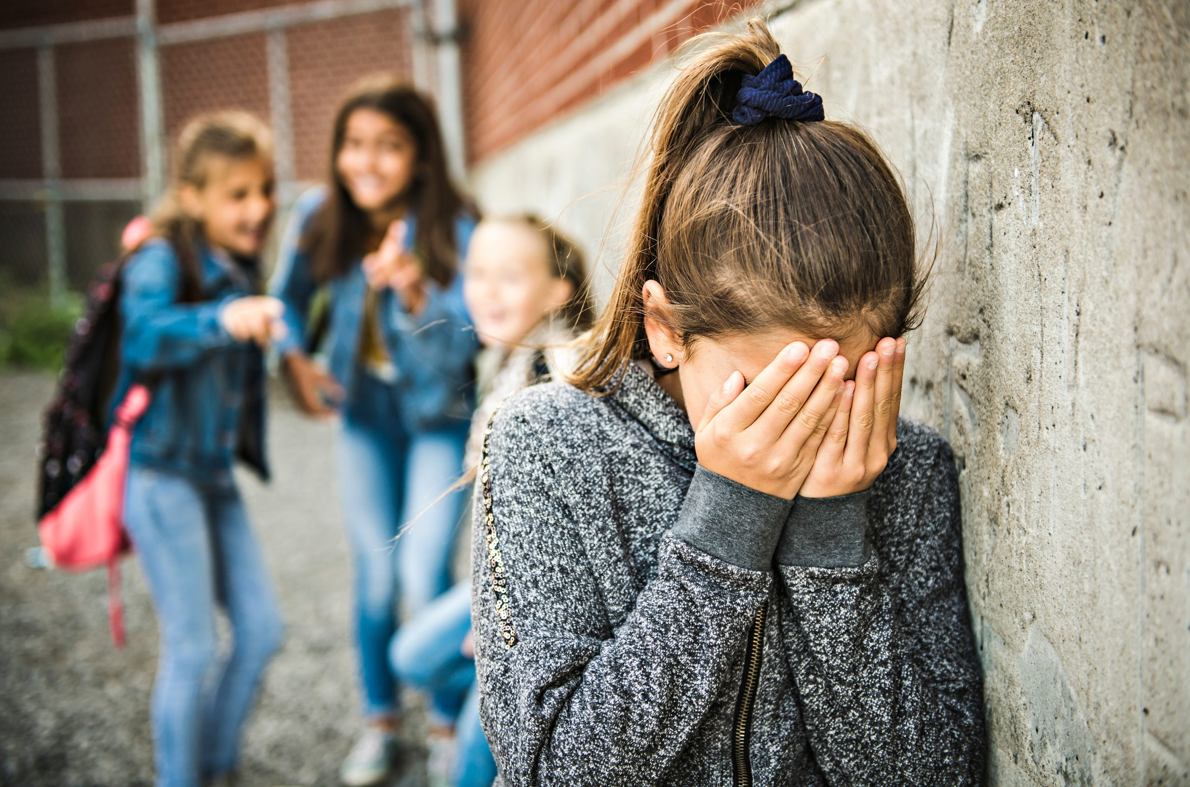
2-Physical bullying
Physical bullying refers to a form of aggressive behavior where a person intentionally uses physical force or harm to intimidate, hurt, or dominate someone else. It can include actions like hitting, kicking, pushing, punching, or any other physical act that causes harm or distress to the victim. Physical bullying can occur in various settings, such as schools, workplaces, or communities. It is important to report instances of physical bullying to authorities or trusted individuals who can provide support and help address the situation appropriately.

Slide 10
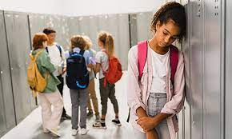
3-Verbal bullying
Verbal bullying is a form of bullying that involves the use of hurtful words, insults, or derogatory comments to intentionally harm or intimidate someone. It can occur in various settings such as schools, workplaces, or online platforms. Verbal bullying can have serious emotional and psychological effects on the victim, leading to low self-esteem, anxiety, and depression. It is important to address and report verbal bullying to ensure the safety and well-being of individuals involved.

Slide 11
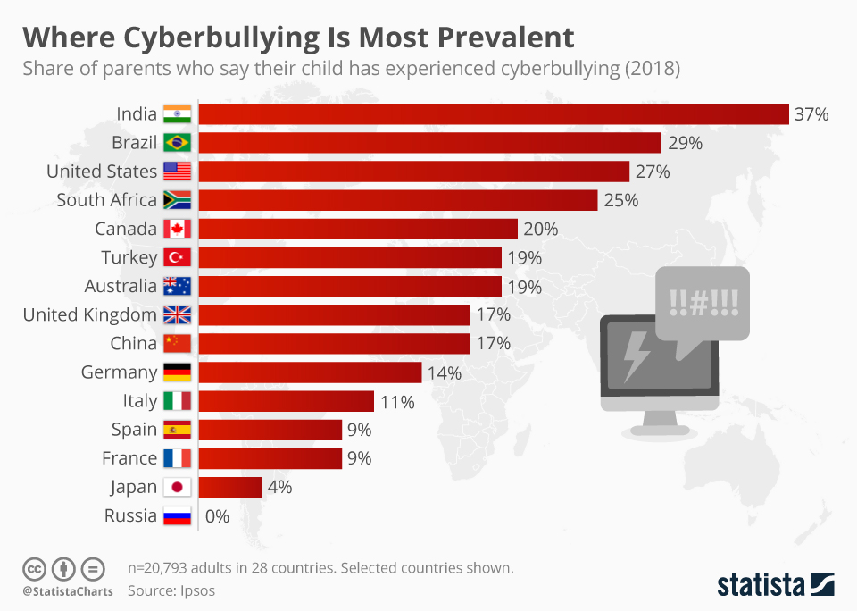
Persentage of bulling in contries
greece | 27% | 0.27 | 27 100
france | 20% | 0.20 | 20 100
russia | 37% | 0.37 | 37 100
sweden | 19% | 0.19 | 19 100

