Slide 1
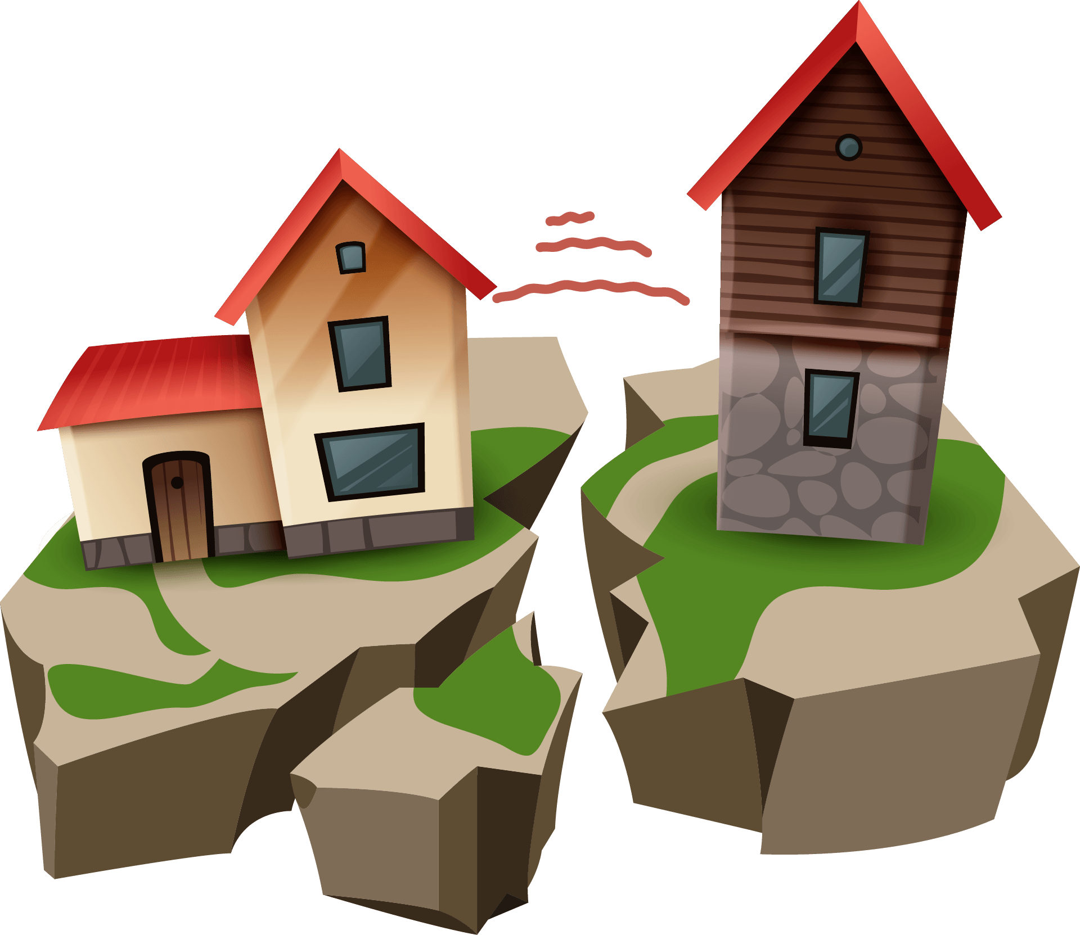
Causes & Effects of Earthquakes
Fuad Qubain
Sanad Samawi

Slide 2
TABLE OF CONTENTS
01
04
02
05
03
06
Introduction
Detect Earthquakes
Causes of Earthquakes
Earthquakes Impacts
Effects of Earthquakes
Conclusion

Slide 3
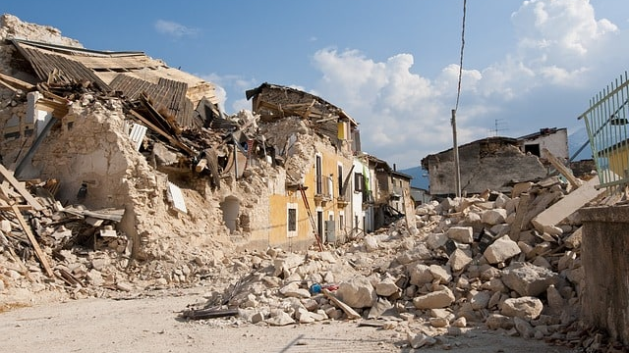
Introduction of earthquakes
An earthquake is a sudden and violent shaking of the Earth's surface, caused by the release of energy in the Earth's crust. It is a natural occurrence that results from the movement and interaction of tectonic plates, which make up the Earth's outermost layer. When the stress and pressure along fault lines become too great, rocks on either side of the fault slip, releasing stored energy in the form of seismic waves. These waves radiate outward from the point of origin, known as the focus, and the point on the Earth's surface directly above it is called the epicenter. Earthquakes can vary in magnitude, which measures the energy released, and can have various effects such as ground shaking, surface rupture, landslides, tsunamis, and structural damage. Understanding earthquakes is important for assessing seismic hazards, improving building codes, and developing mitigation strategies to minimize their impact.

Slide 4
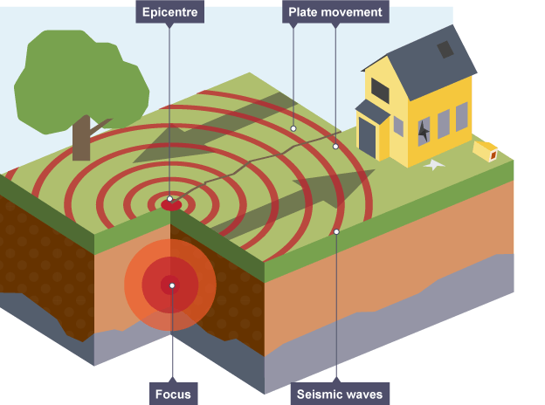
Causes of Earthquakes
Earthquakes are caused by the sudden release of energy in the Earth's crust, resulting in seismic waves. The primary causes of earthquakes can be categorized into three main types: volcanic, human-induced, and tectonic.
Volcanic Causes: Earthquakes can also be triggered by volcanic activity. As magma rises to the surface, it can cause significant pressure and stress, leading to earthquakes.
Human-Induced Causes: Human activities can induce earthquakes
Tectonic Causes: The majority of earthquakes are tectonic in nature, resulting from the movement of tectonic plates.

Slide 5
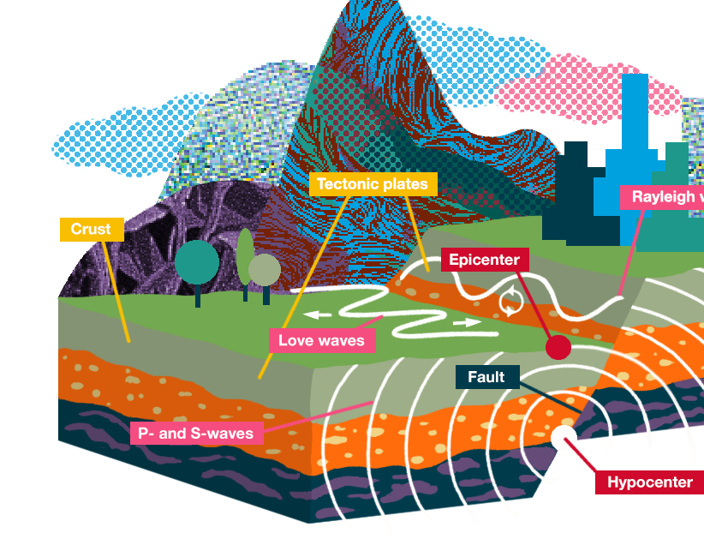
Effects of Earthquakes
Earthquakes can have devastating effects on the environment and human populations. The severity of the effects depends on various factors, including the magnitude of the earthquake, depth of the focus, distance from the epicenter, population density, building structures, and preparedness levels.
Ground Shaking
Surface Rupture
Tsunamis
Landslides and Avalanches
Fires
Human Casualties and Displacement

Slide 6
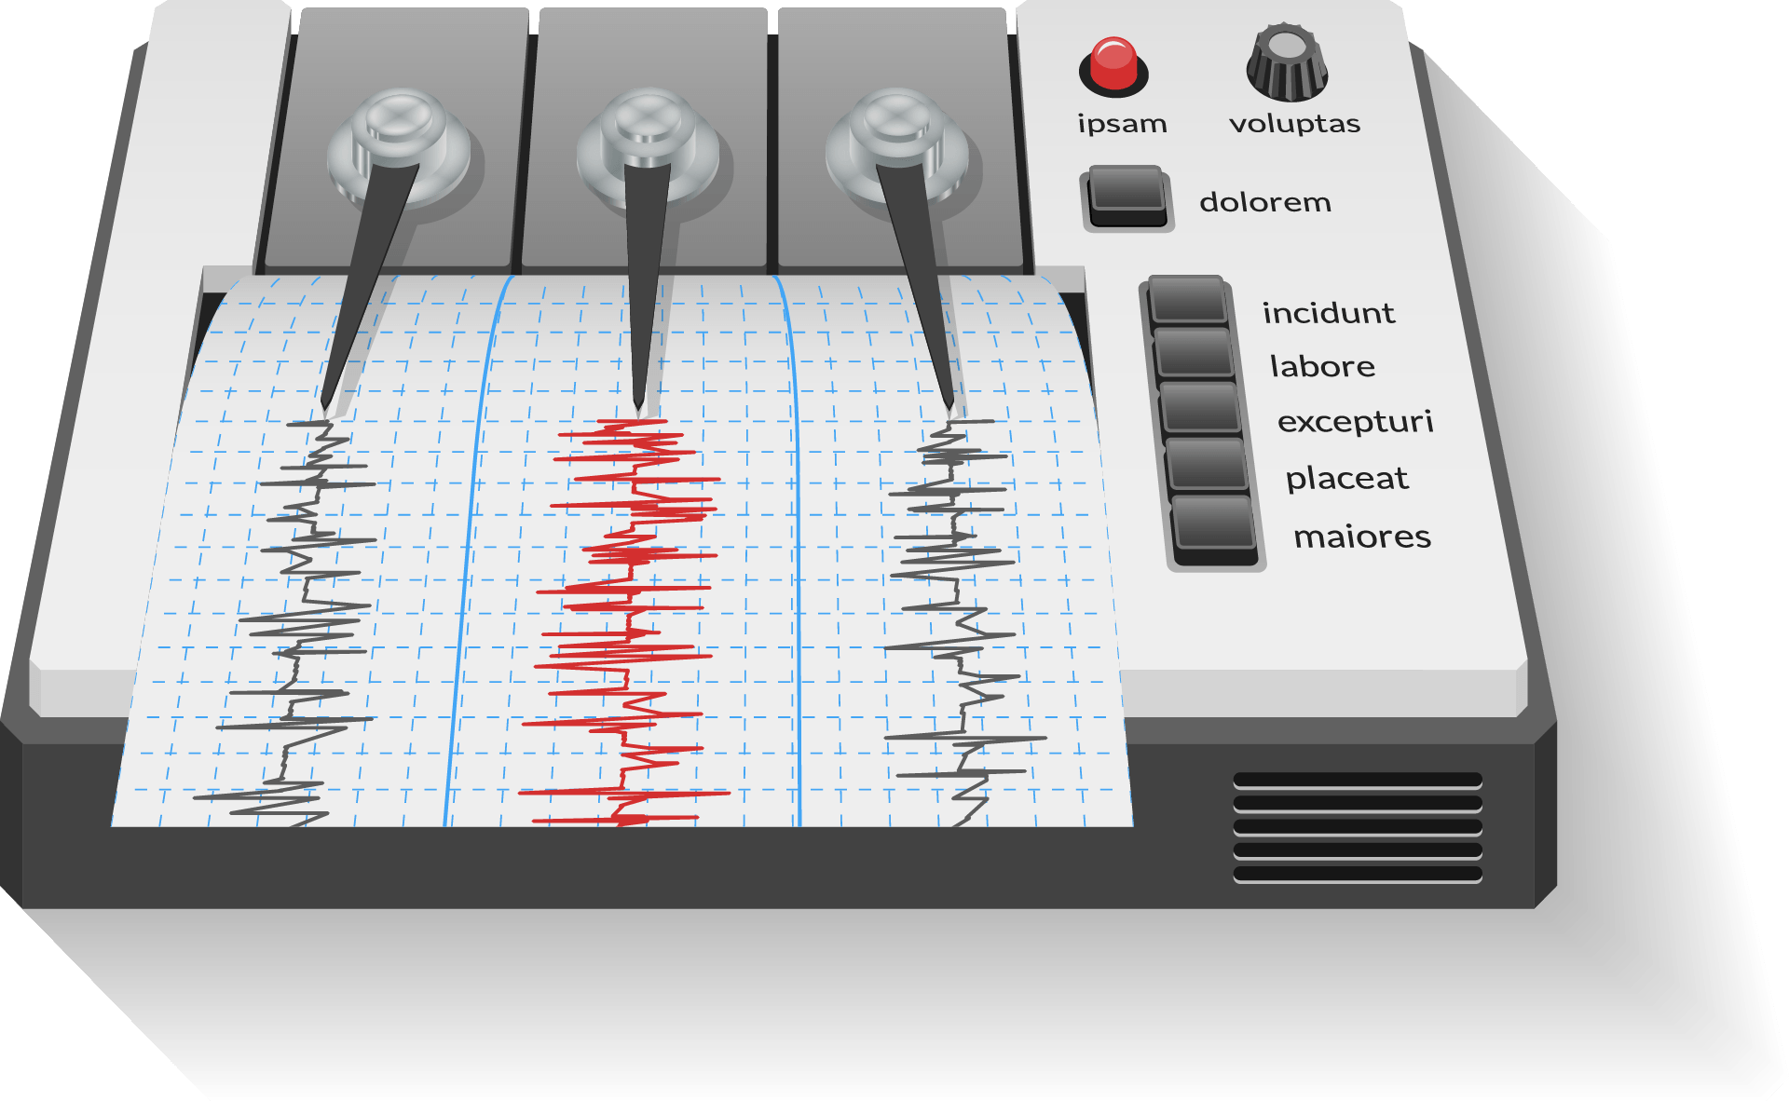
Detect Earthquakes
Seismometers allow us to detect and measure earthquakes by converting vibrations due to seismic waves into electrical signals, which we can then display as seismograms on a computer screen

Slide 7
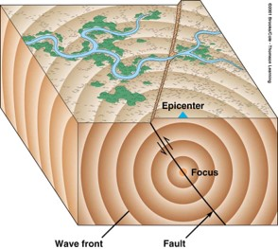
Earthquakes Impacts
The impacts of earthquakes can vary depending on various factors, including the magnitude of the earthquake, the depth of the earthquake's focus, the distance from the epicenter, local geological conditions, and population density. Here are some common impacts associated with earthquakes:
Ground Shaking
Surface Rupture
Tsunamis
Landslides
Secondary Hazards
Human Casualties and Injuries
Economic Disruption
Psychological and Societal Impact

Slide 8
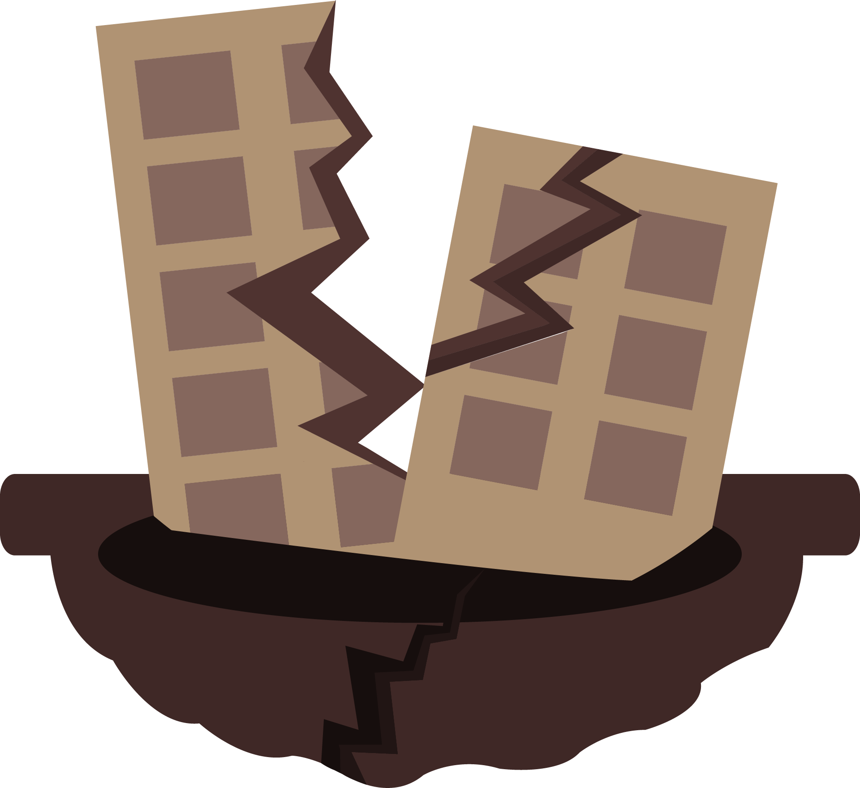
Conclusion
In conclusion, earthquakes are natural phenomena that occur due to the movement and release of energy within the Earth's crust. They cannot be prevented or avoided, but their impacts can be mitigated through preparedness and resilience measures. Earthquakes can cause significant damage to buildings, infrastructure, and communities, leading to casualties, economic disruption, and psychological effects.

Slide 9
References
Incorporated Research Institutions for Seismology (IRIS): https://www.iris.edu/
Geological Society: https://www.geolsoc.org.uk/

Slide 10
The End

