Slide 1
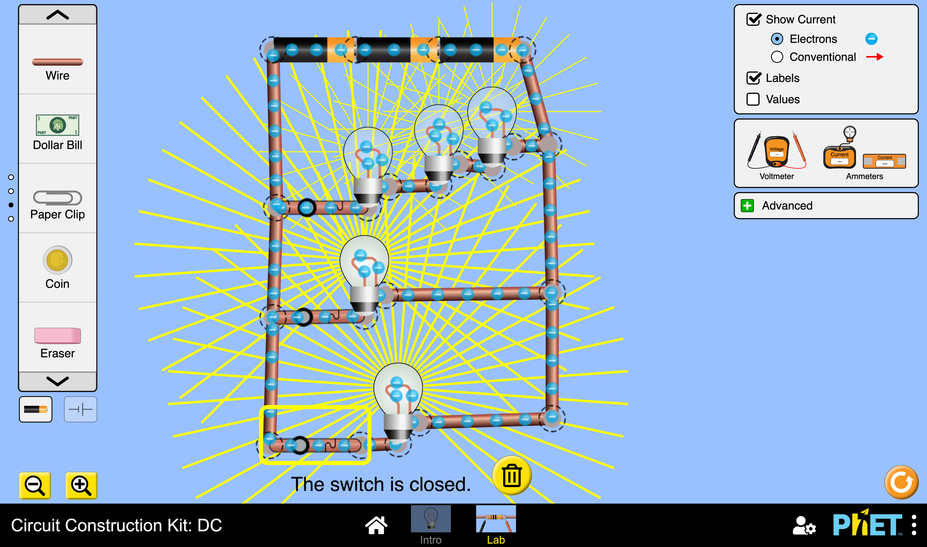
Living room:
We used 3 batteries, 5 LED light bulbs and connected 8 wires together to allow the flow of electrons through the circuit, the first 3 light bulbs are all connected together by one switch while the other 2 are each controlled with a separate switch, 10m² of wires were used so the price of the wires we used for this living room was 10 jds,the area turned out to be 12m² and this all together cost 19 jds

Slide 2
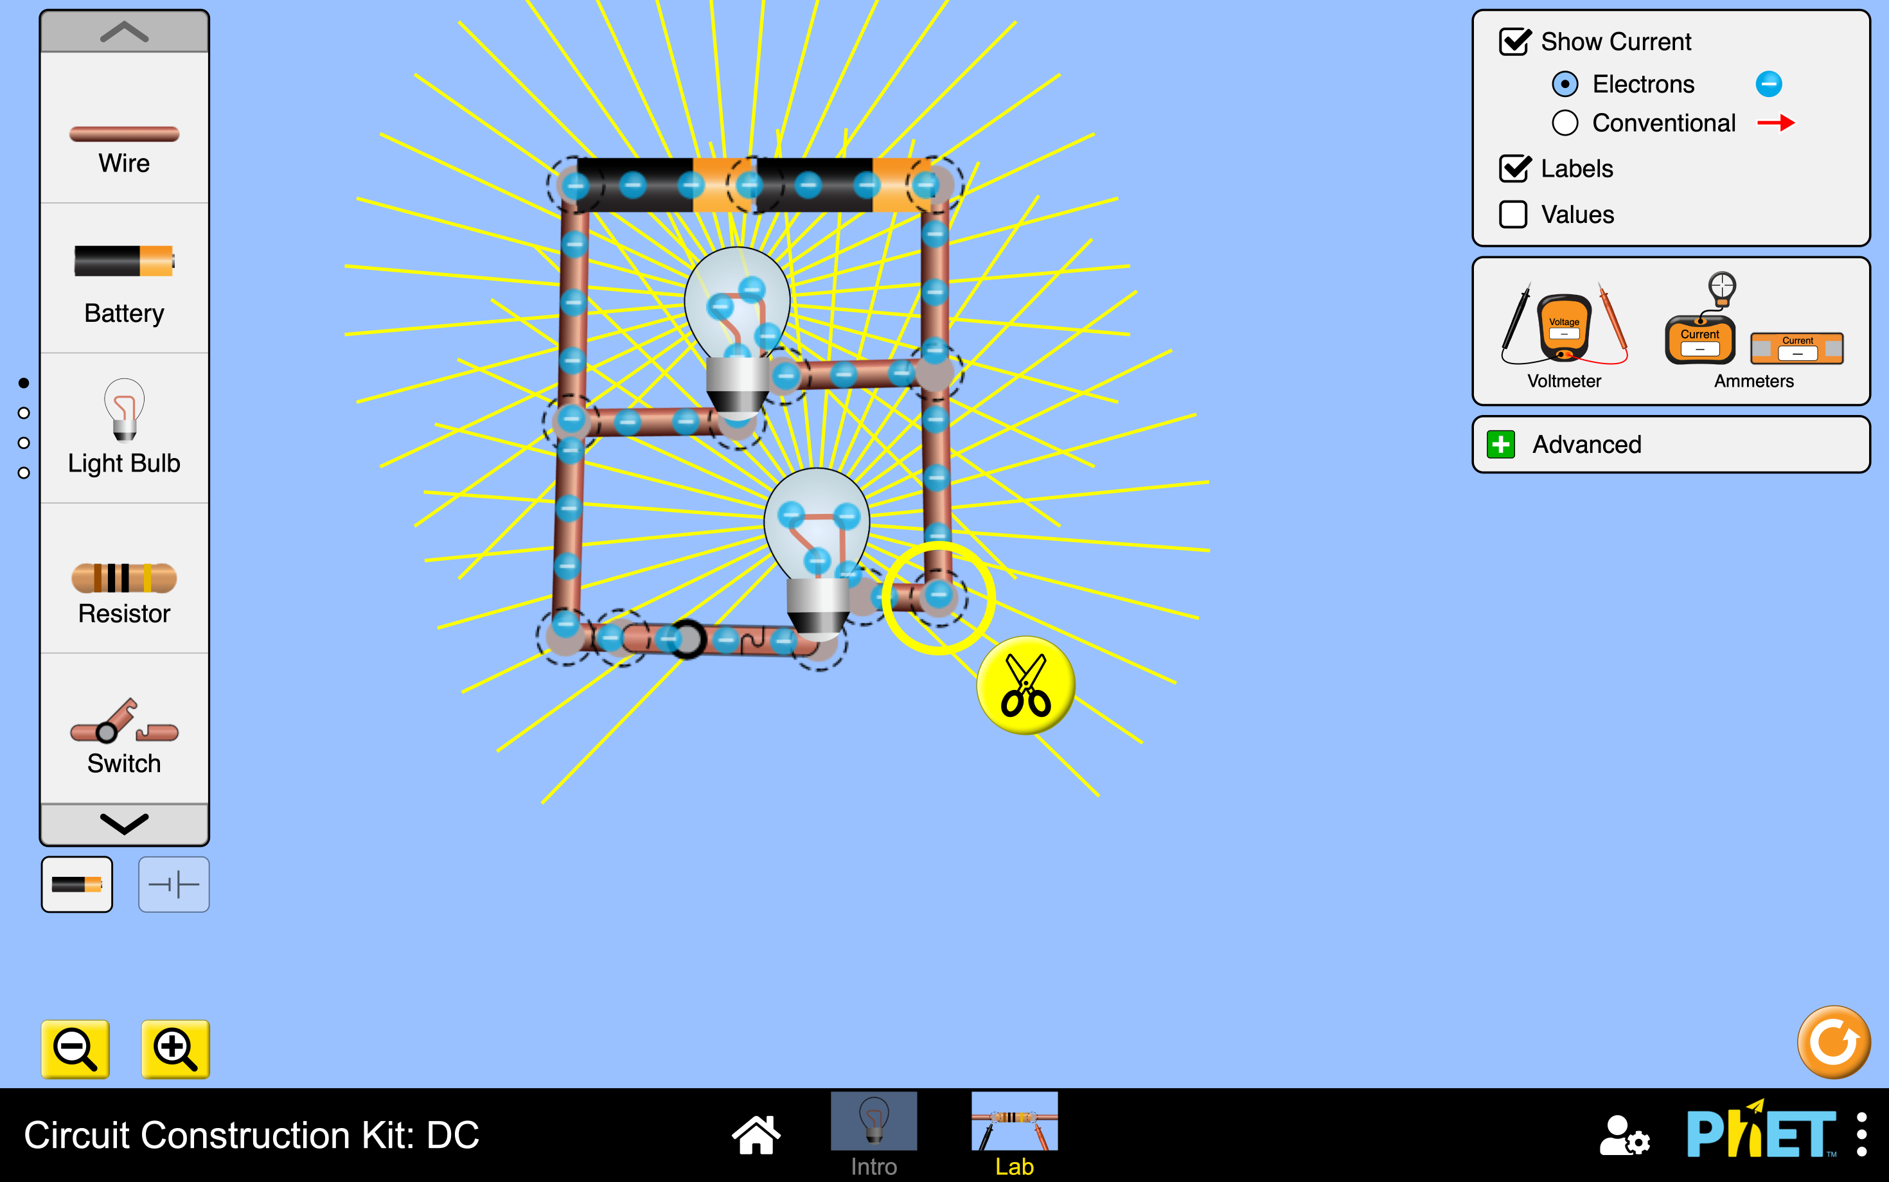
Bedroom:
We used 2 LED light bulbs, 1 switch,2 batteries and connected 6 wires together to allow the flow of electrons through the circuit, both of the light bulbs are connected together using one switch, the price of the wires we used for this bedroom was 8 jds,the area of the bedroom is 10m² and this all together cost 11.5 jds

Slide 3
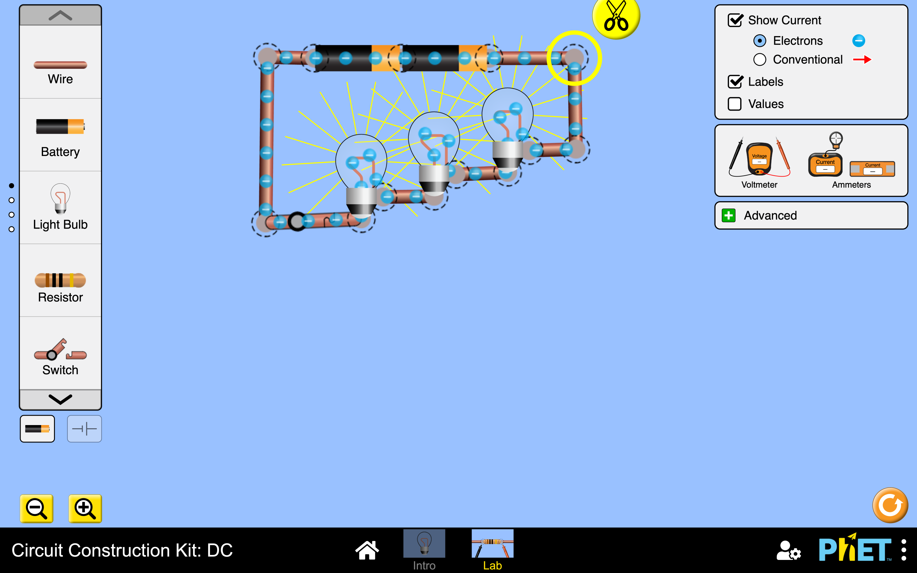
Kitchen:
We used 2 batteries,1 switch,3 LED lights and connected 7 wires together to allow the flow of electrons through the circuit,all 3 lights are connected to one switch,the price of the wires for this kitchen was 8 jds and the area of the kitchen is 10m² and all this together cost 13 jds.

Slide 4
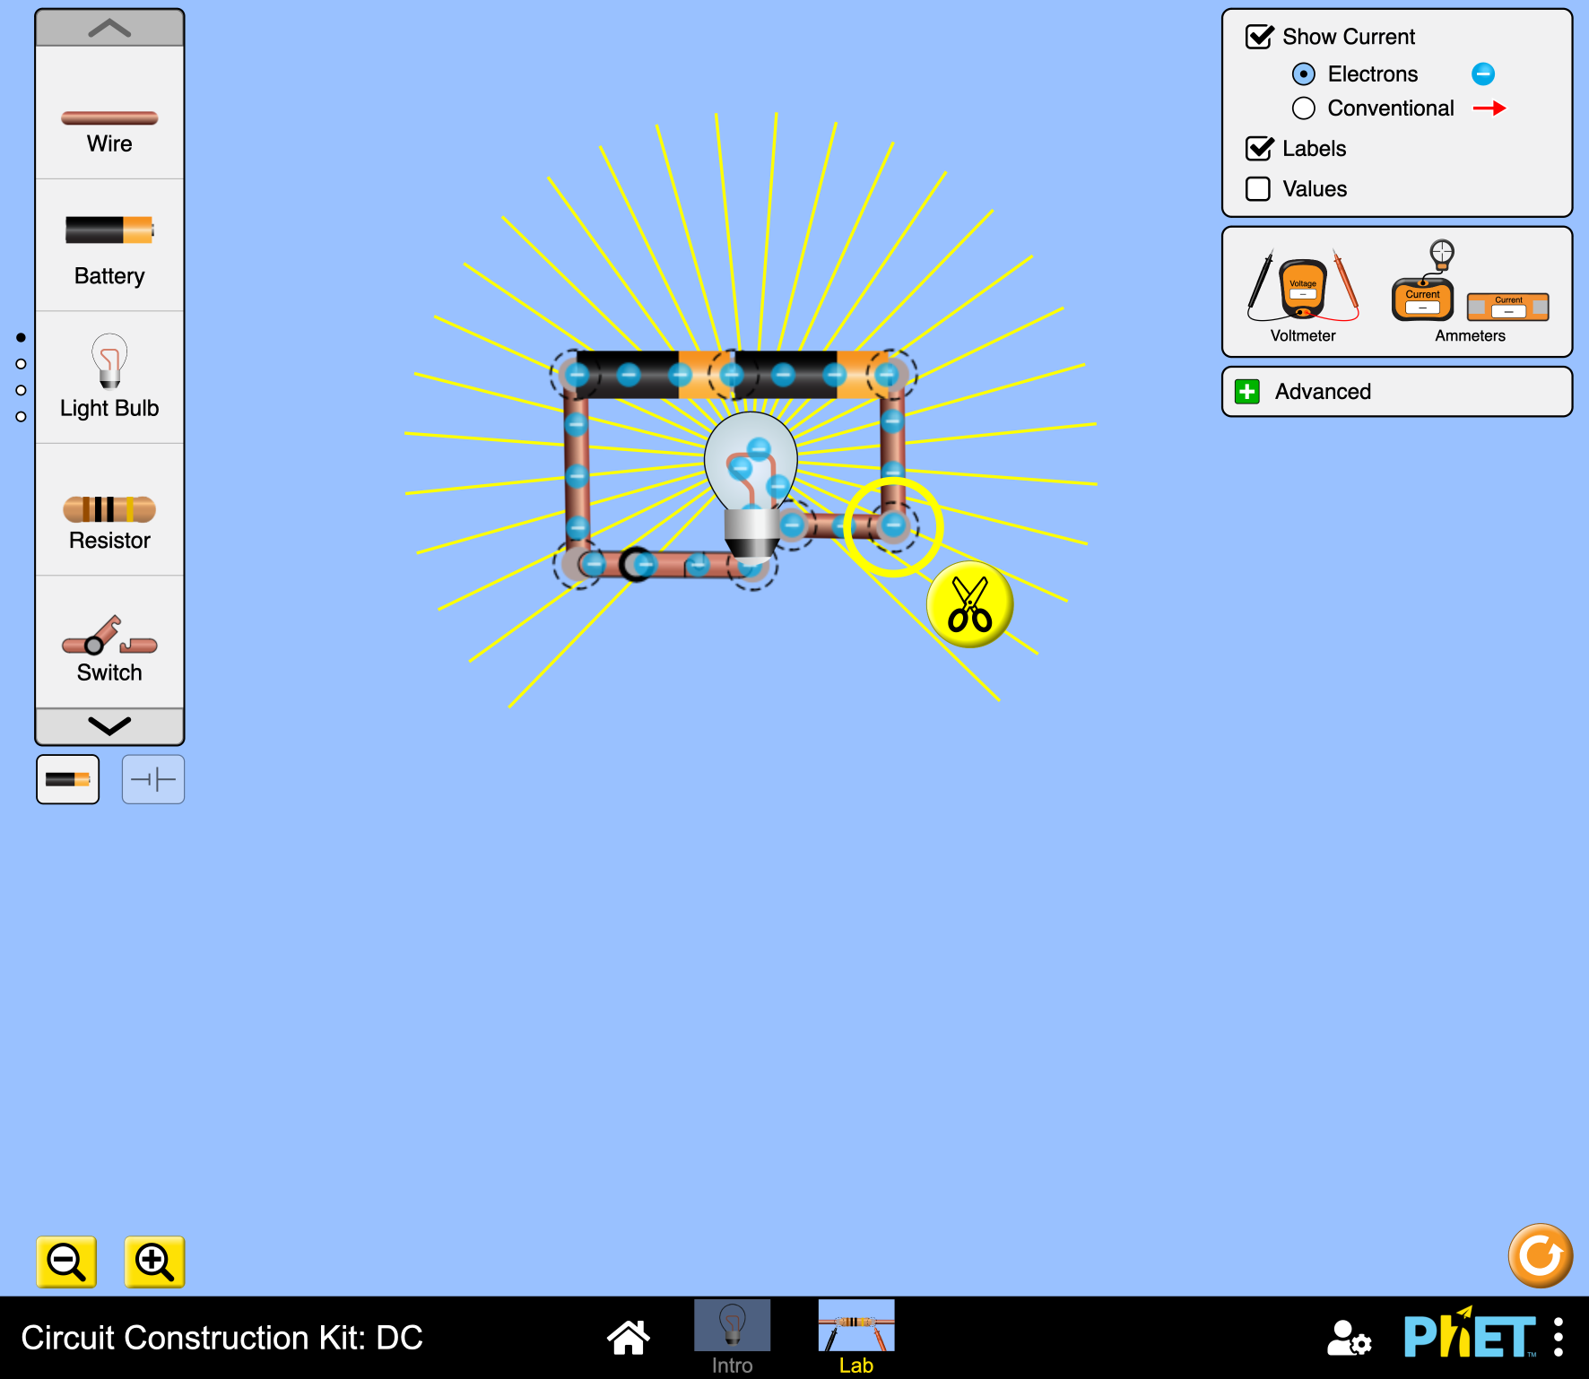
Bathroom:
We used 2 batteries, 1 LED light bulb,1 switch and connected 3 wires together to allow the flow of electrons through the circuit,the light bulb is connected to one switch,the price of the wires we used for this bathroom was 4 jds and the area of the bathroom is 6m² and this all together costs 6 jds

