Slide 1
Volume and surface area of a sphere
math

Slide 2
Objective:
Being able to find:
-(S.A.) surface area & (V) volume of a sphere
solve simple questions
https://youtu.be/8nGj0Q_Odus

Slide 3
1/ Volume
V= 4/3 * π * r³
π- pi (3.14)
r- radius
*The radius is half the
Diameter; if (D) is 4 so
(R) Is 2
radius

Slide 4
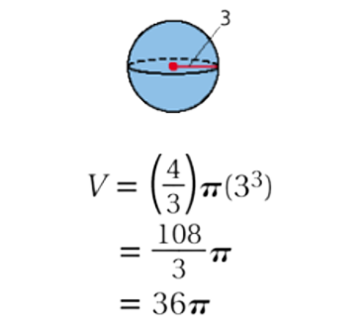
Example: -

Slide 5
Find the volume of the following sphere
5 in

Slide 6
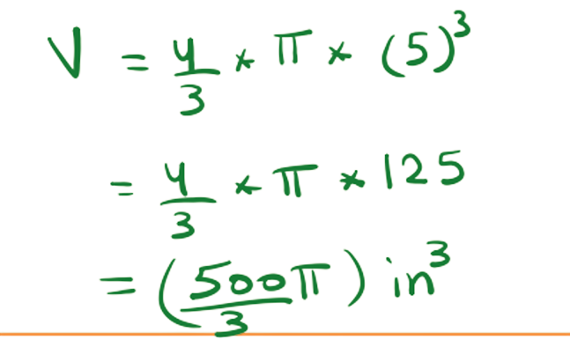

Slide 7
2/Surface Area
S.A= 4 * π * r²
^{Example:}
Diameter: 3ft
Radius: 1.5ft

Slide 8
