Slide 1
Earthquakes
by: alia,saif,Nicola
6E

Slide 2
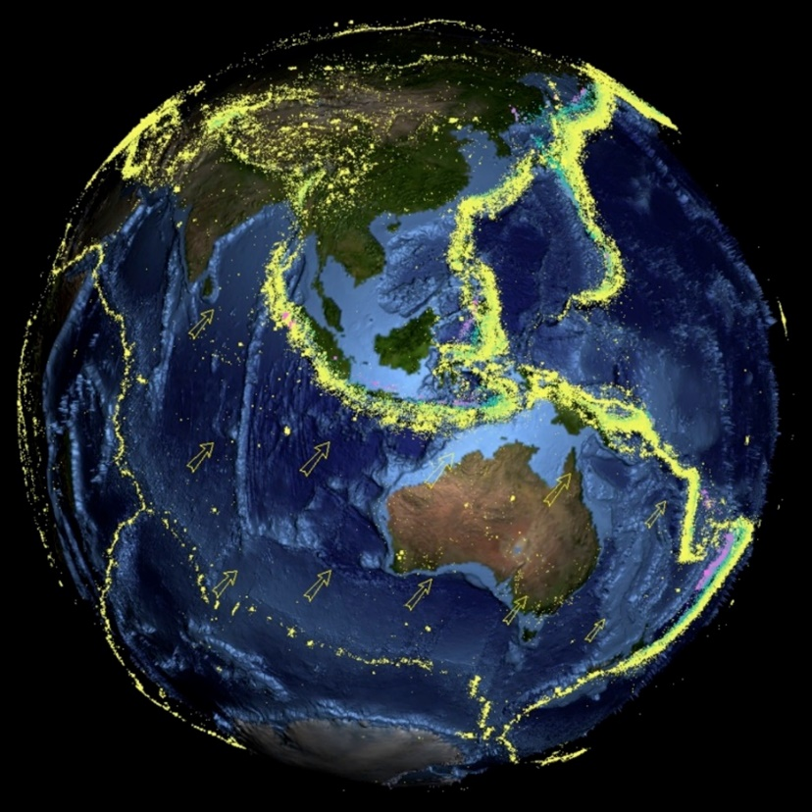
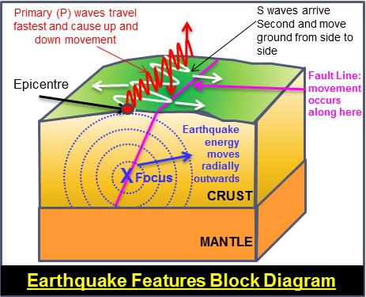
Introduction to Earthquake - Volcano
.
Notes:
Earthquakes are made when two techtonic plates rub against each other also there causes of orogeny witch makes vibrations in all directions

Slide 3
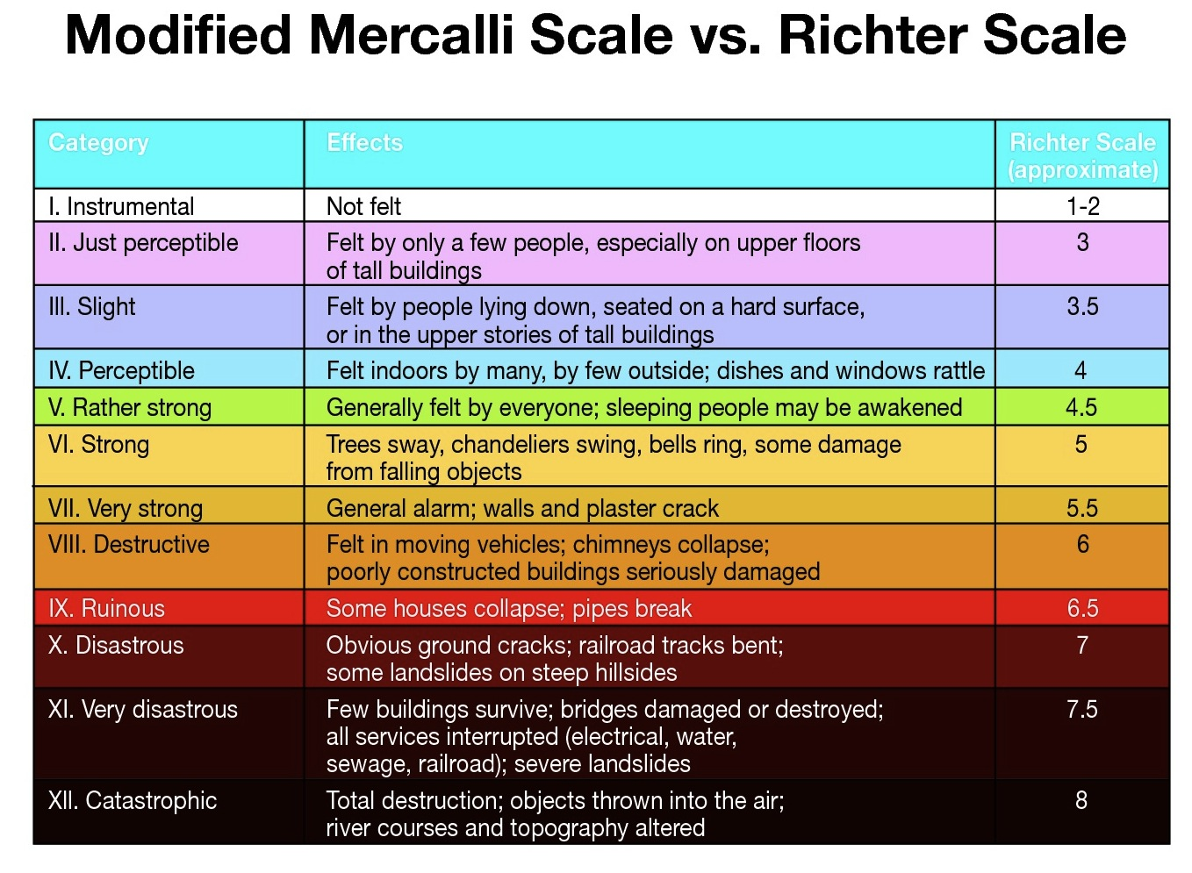
The factors that affect the intensity and frequency of earthquakes.
Notes:
When an earthquake strikes, the intensity of earthquake shaking determines the severity of damage. In turn, the main factors affecting earthquake shaking intensity are earthquake depth, proximity to the fault, the underlying soil, and building characteristic particularly height

Slide 4
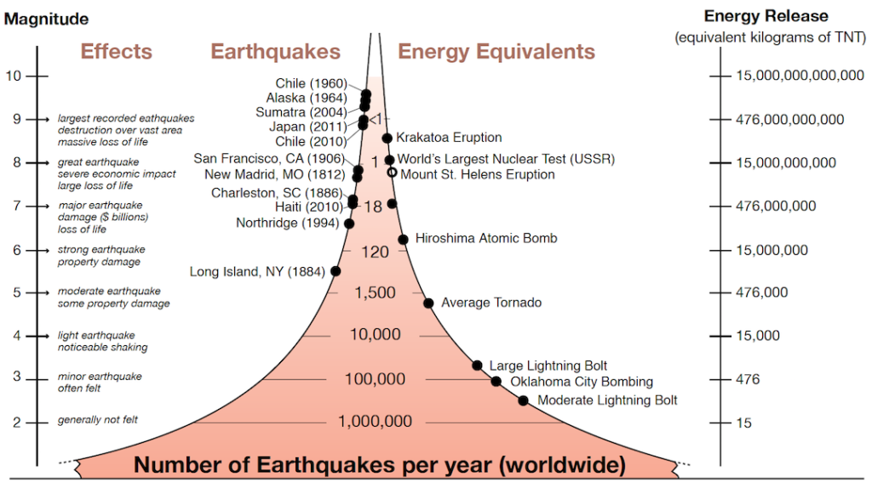
Methods used to detect, measure and predict earthquakes.
Notes:
Seismometers allow us to detect and measure earthquakes by converting vibrations due to seismic waves into electrical signals, which we can then display as seismograms on a computer screen.

Slide 5
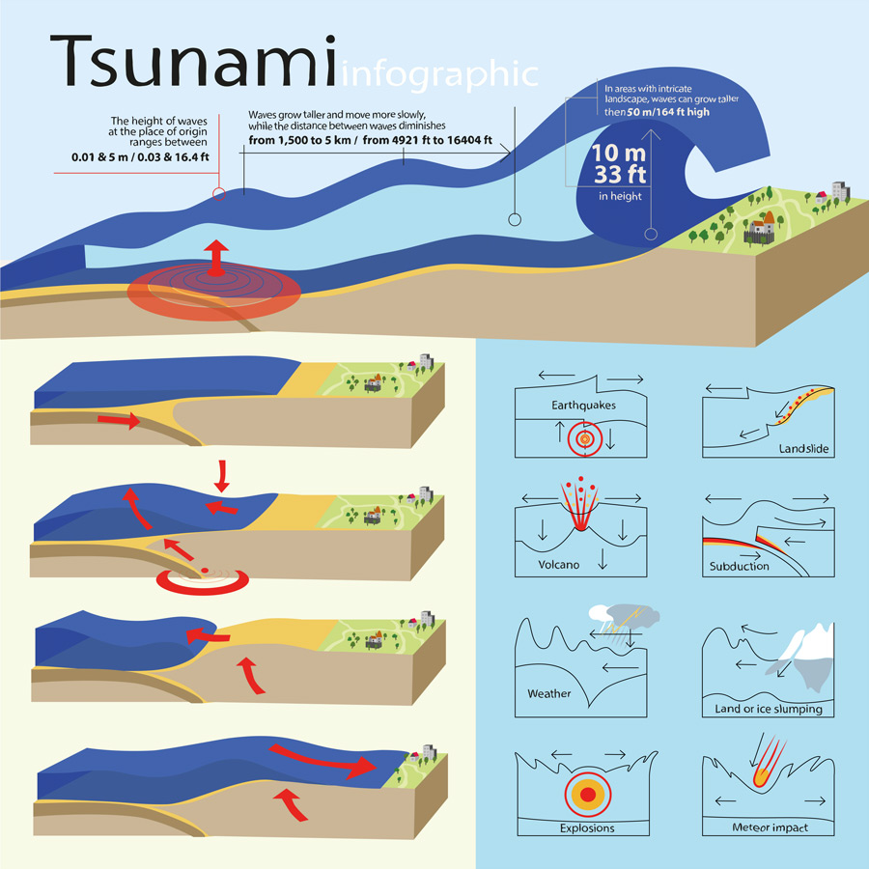
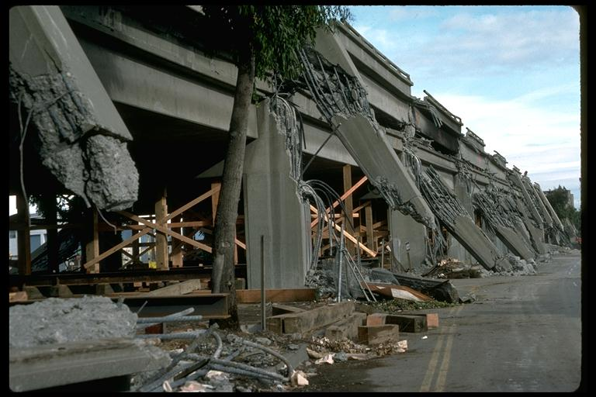
The impacts of earthquakes on the natural environment and ecosystem
Notes:
surface faulting, tsunamis, soil liquefactions, ground resonance, landslides and ground failure ground shaking, ground rupture, landslides, tsunamis, and liquefaction Primary effects: which are the surface expression of the seismogenic source (e.g., surface faulting), normally observed for crustal earthquakes above a given magnitude threshold (typically M_{w}=5.5–6.0);
Secondary effects: mostly this is the intensity of the ground shaking (e.g., landslides, liquefaction, etc.).

Slide 6
Conclusion
We have finally learnt how earthquakes get formed and the effect it has on the environment, and how we measure and predict the earthquakes appearance and magnitude of the earthquake.
Before we end this presentation we all thank you for watching this presentation.
THANK you.

Slide 7
recources
1st slide :Introduction to Earthquake – Volcano
2nd slide: Introduction to Earthquake - Volcano – DOST
3rd slide :What Affects Earthquake Shaking or Intensity? - Jumpstart Blog
4th slide: How are earthquakes detected? - British Geological Survey
5th slide: What are the Effects of Earthquakes? | U.S. Geological ...

