Slide 1
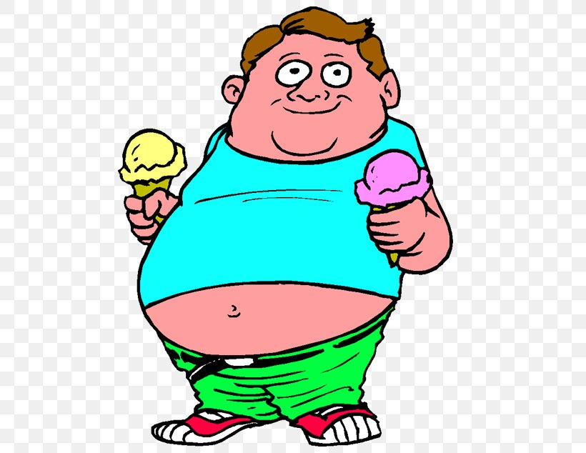
OBESITY
Done by : Marwan kakish, Amir Al-Momaiz
Angelina Sahouri, Lamar Al Azzeh

Slide 2
What is obesity?
Obesity is a complex disease involving an excessive amount of body fat. Obesity isn't just a cosmetic concern. It's a medical problem that increases the risk of other diseases and health problems, such as heart disease, diabetes, high blood pressure and certain cancers.

Slide 3
Causes of obesity
Unhealthy eating behaviours
Lack of physical activity
Not getting enough good-quality sleep
High amounts of stress
Health conditions
Genetics
Medicines
Excessive sugar intake, consumption of high calorie food and food rich in saturated fat.
Not enough exercise or low activity level.
Sleeping less than 8 hours a day will reduce the rate of metabolism.
Stress will increase the levels of cortisol in the body which reduces the metabolic rate.
Diseases such as Hypothyroidism, epilepsy, hormonal diseases and others.
Hereditary factors and the presence of obesity gene.
The use of drugs such as steroids, antidepressants, birth control pills and many others.

Slide 4
Consequences of obesity
Physical
Psychological
Social
Liver disease
Mood disorders
Low self-esteem: poor body image
Isolation
Depression
Mental health problems
Body dissatisfaction
Anxiety
Low quality of life
Discrimination in some situations for example: employment, travel, schooling, healthcare, and others.
Fewer friends
Low educational attainment
Heart disease
Lung disease
Colon disease
Arthritis
Hypertension
Stroke
Cancer
Type 2 diabetes
fertility problems

Slide 5
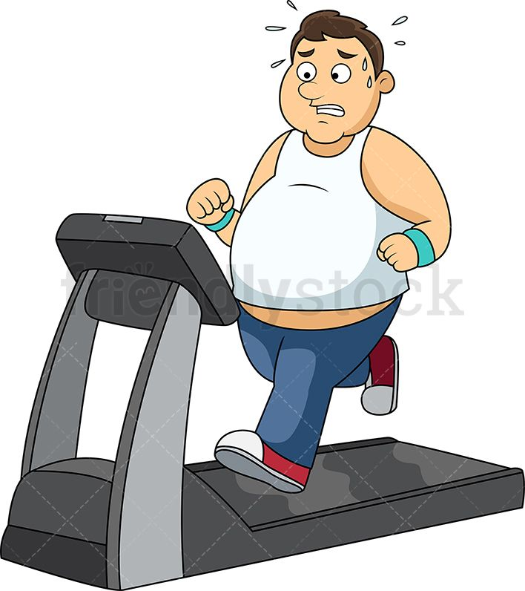
How to prevent obesity?
Try to eat a healthier diet more often
Exercise daily
Limit your screentime
Set Consistent Sleep Routines
Avoid processed foods
Reduce sugar consumption
Limit artificial sweeteners
Skip saturated fats
Sip wisely
Cook at home
Try a plant-based diet

Slide 6
Actions in helping to resolve obesity problem
Increase awareness through social media, customized special sessions and
street banners regarding this issue.
Distributing free fat burning tablets through medical sector.
Weight-loss local and global competition against a valuable award.

Slide 7
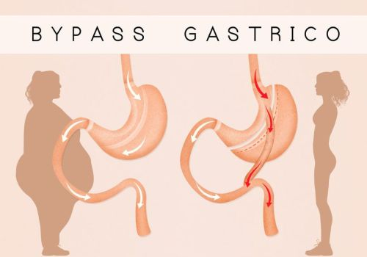
Obesity Treatment
Follow lifestyle healthy food plan.
Exercise on daily basis.
Drugs and medication.
Surgery for severe cases.

Slide 8
Resources
https://www.mayoclinic.org/diseases-conditions/obesity/symptoms-causes/syc-20375742
https://www.cdc.gov/obesity/index.html
https://www.health.harvard.edu/blog/a-new-treatment-for-obesity-202109102589
https://my.clevelandclinic.org/health/diseases/11209-weight-control-and-obesity
https://www.niddk.nih.gov/health-information/weight-management/adult-overweight-obesity/health-risks

Slide 9
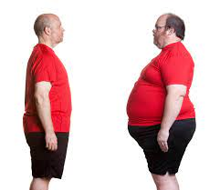
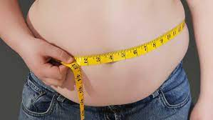
Obesity Quiz
Get started

Slide 10
What is Obesity?
a)Obese people have an unhealthy and abnormally high percentage of body fat
b) To measure obesity, researchers use a formula that is based on an individual’s weight and height, known as the body mass index (BMI = weight in kg / m2). Obesity is defined as a BMI above 30.

Slide 11
Correct
CONTINUE THE QUIZ !

Slide 12
What causes Obesity?
a) Too much food and too little exercise
b) Too much food and too much exercise
CONTINUE THE QUIZ !

Slide 13
Correct
CONTINUE THE QUIZ !

Slide 14
WRONG
TRY AGAIN !

Slide 15
Can Obesity Effect our health?
a) No Obesity is good for our health
b) Of course, obesity increases the risk of developing diabetes, high blood pressure, heart disease, vascular disease and heart attack.

Slide 16
WRONG
TRY AGAIN !

Slide 17
Correct
CONTINUE THE QUIZ !

Slide 18
Can Obesity decrease life expectancy?
a)No, it has no effect at all
b) Sure. After smoking, obesity is the number two cause of preventable premature death. It shortens life .

Slide 19
WRONG
TRY AGAIN !

Slide 20
Correct

