Slide 1
Obesity
By faris bassam

Slide 2
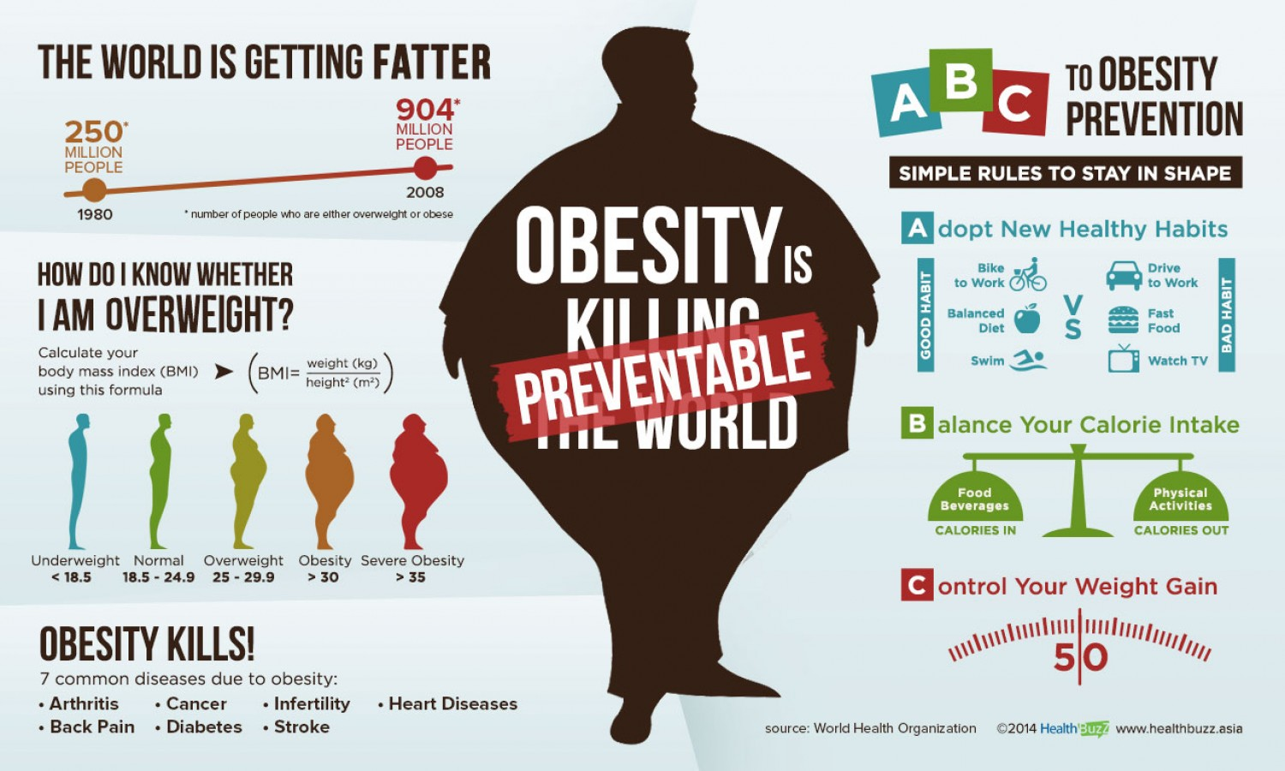
WHAT IS OBESITY?
Obesity is a common problem found among young children, it is also found in adults, Obesity basically means having an excessive amount of body fat.
This usually also causes to other medical problems
This Photo by Unknown Author is licensed under CC BY

Slide 3
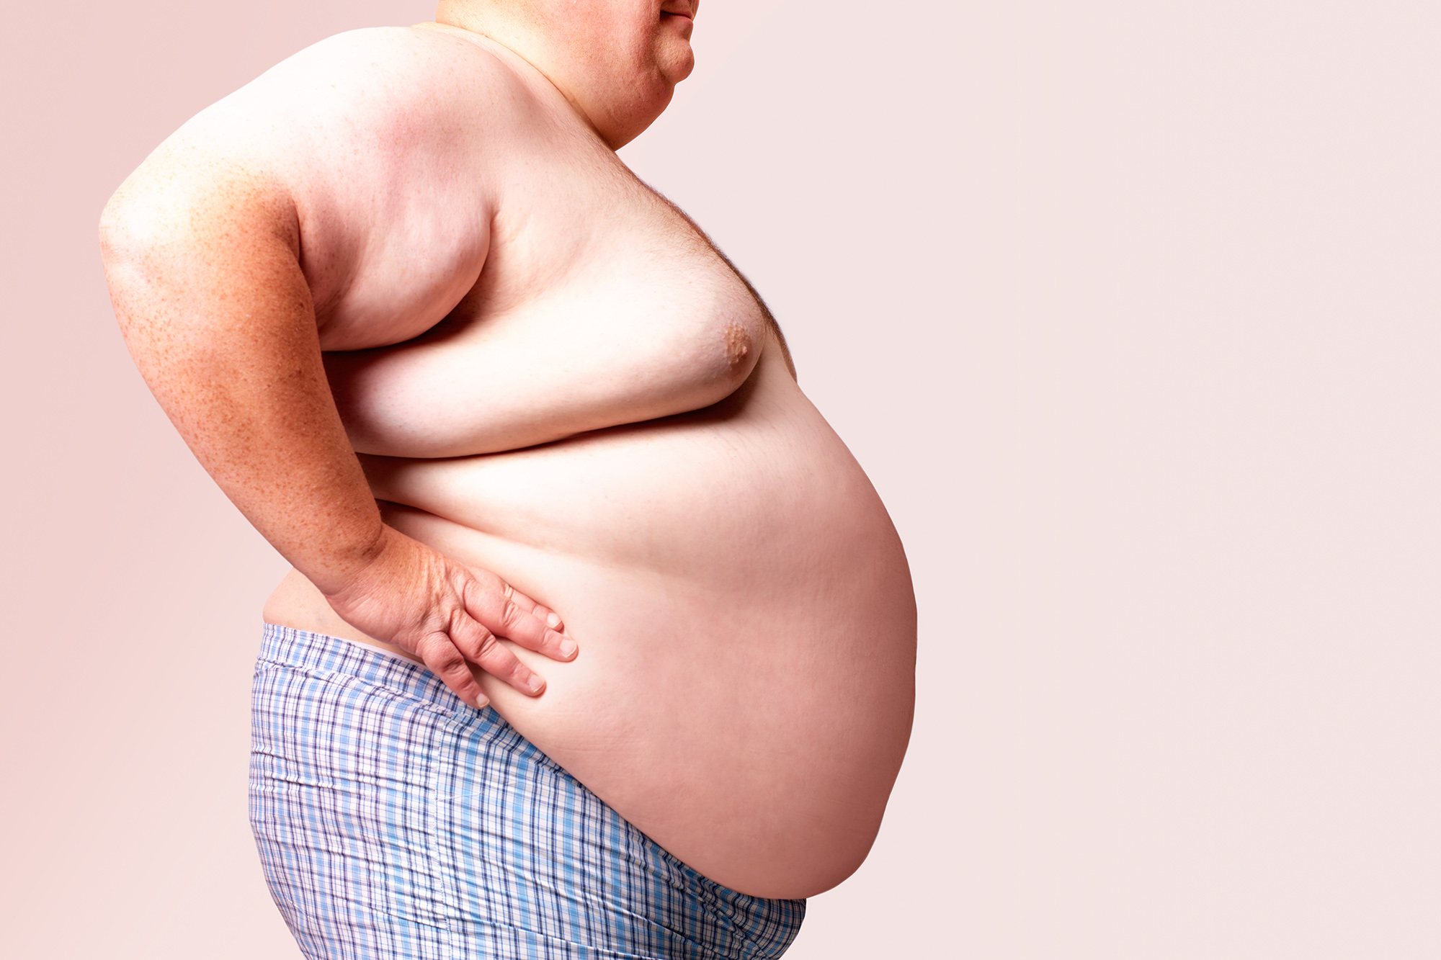
What causes obesity?
Well usually obesity is caused by eating unhealthy food, but there is a lot of ways that can cause you obesity.
1. Eating a lot of food causes extra energy to be build up as extra body fat.
2. Not moving a lot.
3.Always eating fast food.

Slide 4
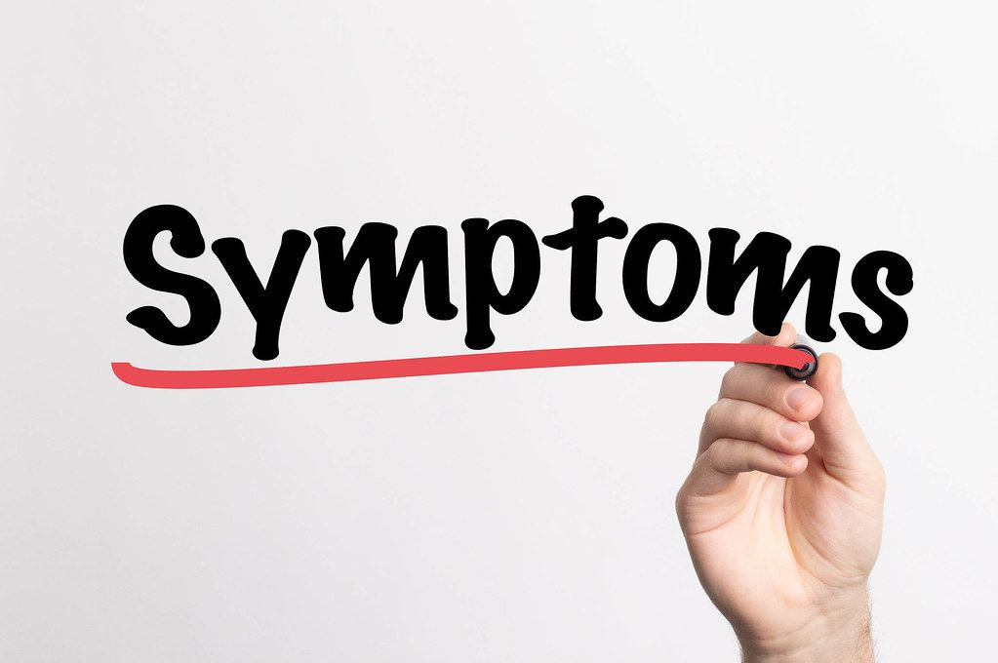
Symptoms of obesity
Sleeping problems
Back pain
Excessive sweating
Depression
Fatigue

Slide 5
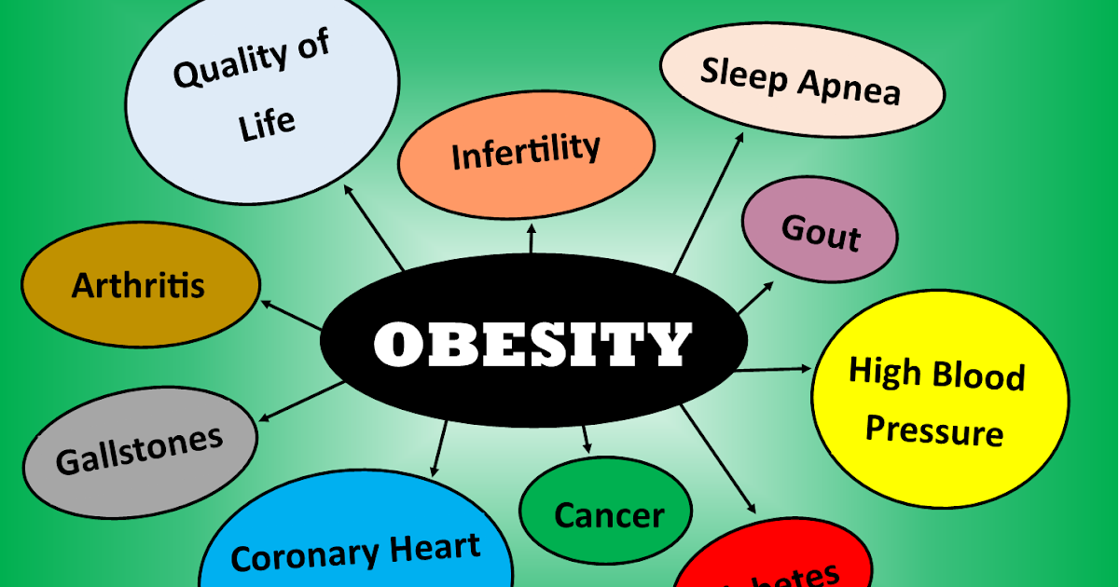
Consequences of obesity
High blood pressure and high cholesterol which are risk factors for heart disease.
Type 2 diabetes.
Breathing problems, such as asthma and sleep apnea.
Joint problems such as osteoarthritis and musculoskeletal discomfort.
Gallstones and gallbladder disease.

Slide 6
How to avoid having obesity?
Sleep more often
Less screen time
More workouts
Limit eating fats and limit eating unhealthy food, eat healthier foods like fruits and vegetables, Limit sugary drinks and limit processed food.

Slide 7
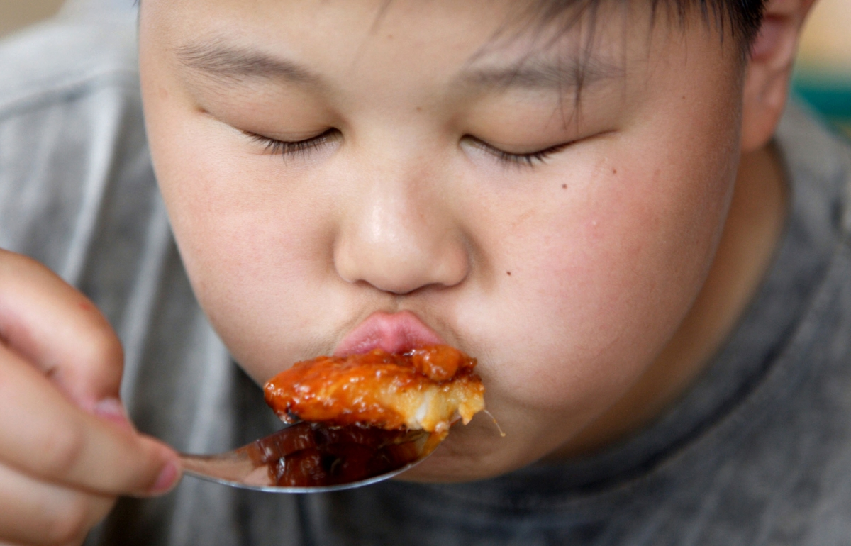
Is obesity common?
Nearly 3 in 4 adults age 20 or older in the United States have either overweight or obesity. Nearly 1 in 5 children and teens ages 2 to 19 years have obesity. Overweight and obesity can lead to serious health issues for people of all age

Slide 8
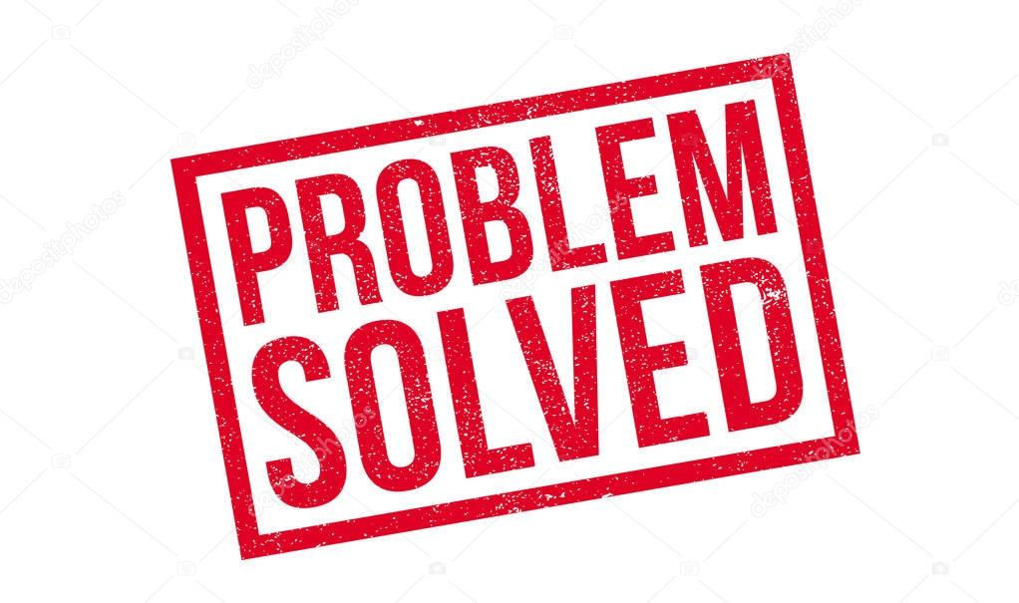
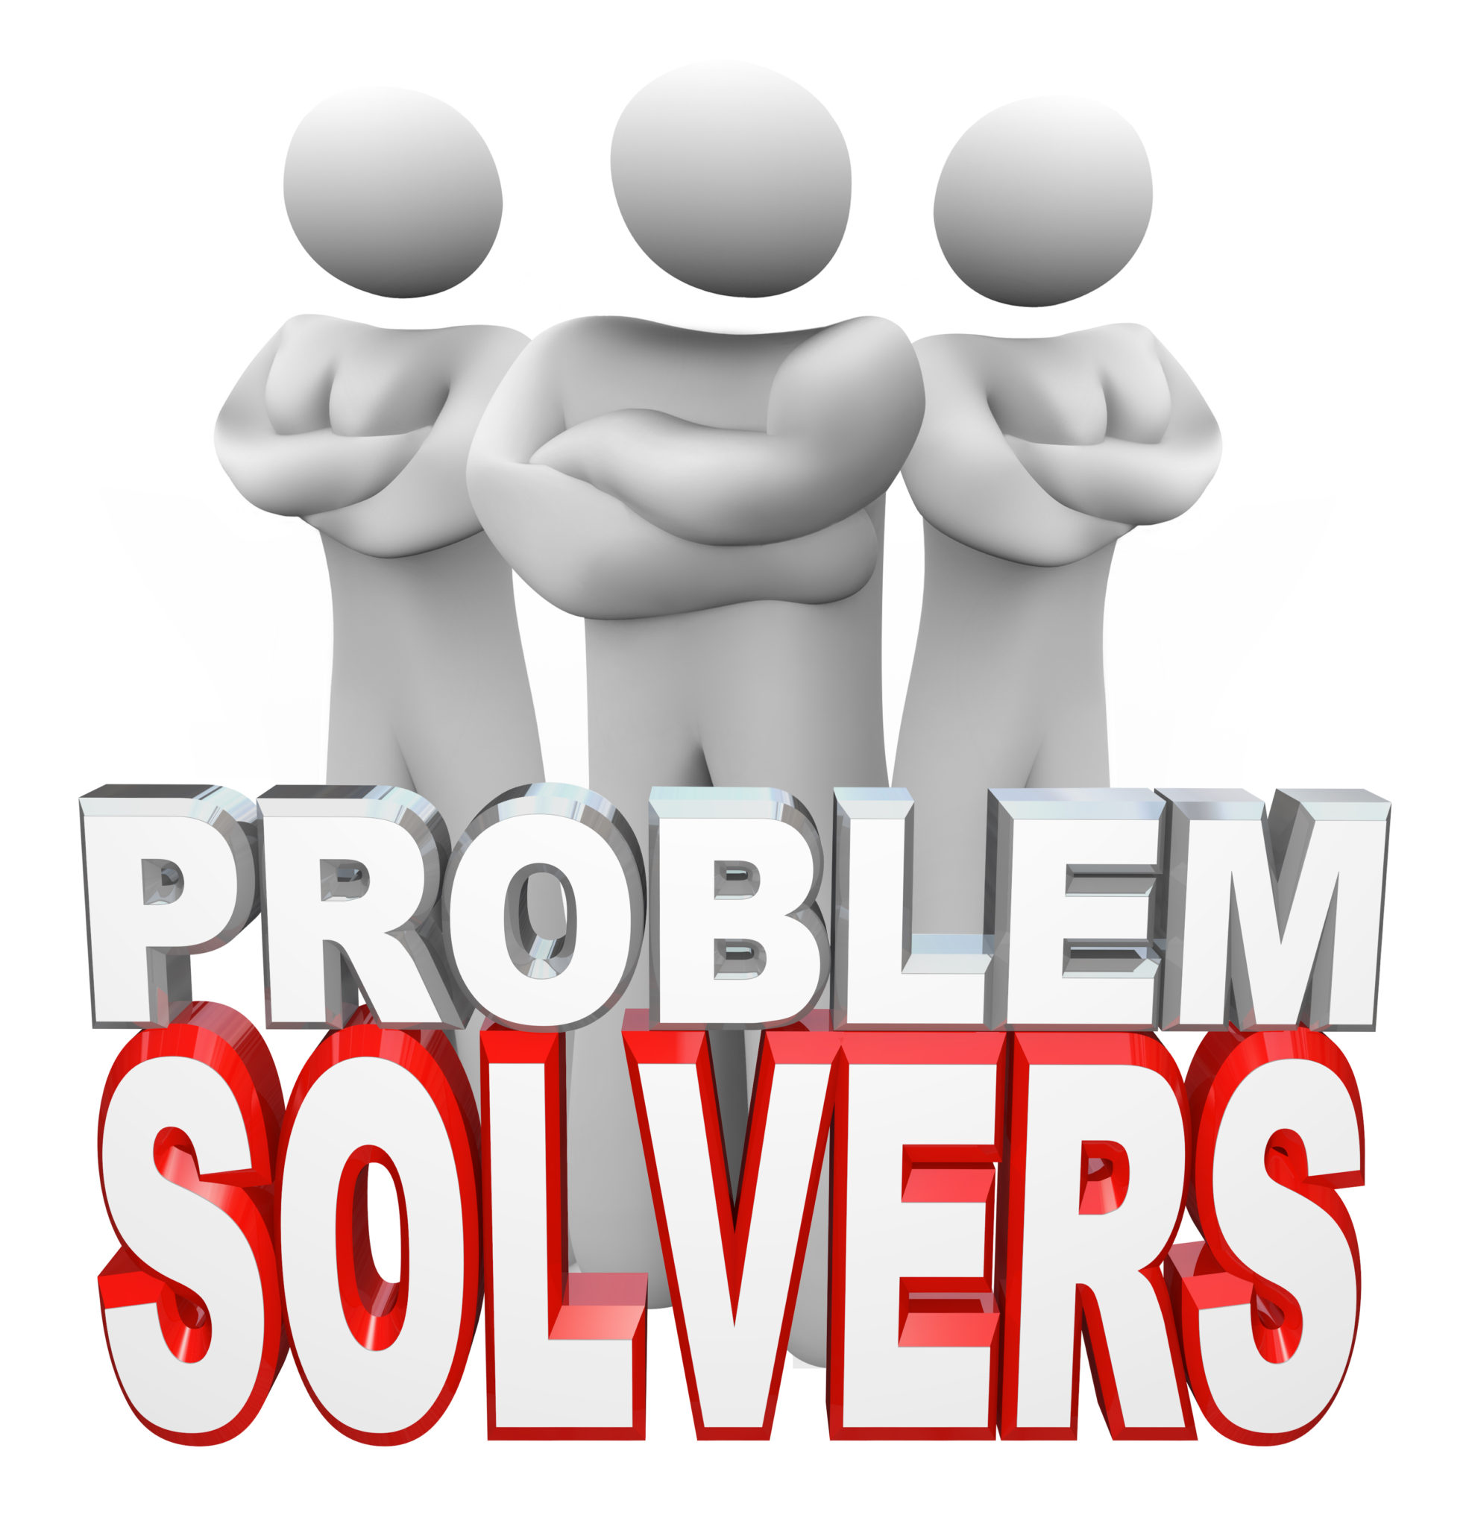
Can obesity be cured?
First of all to cure obesity you have to do a wide range of tests which include
1. BMI Test
2. A general in body test which measures your height and calculates your weight, your blood pressure and heart rate examining your organs.
3. Doctors would check for other health problems usually having obesity would cause you high blood pressure as we said before on the previous slides.

Slide 9
Can obesity shorten life expectancy?
Yes, obesity can shorten life expectancy why?
First of all because of so many medical problems obese people have a increased risk of getting hit with many medical risks

Slide 10
RECOURCES
https://www.mayoclinic.org/diseases-conditions/obesity/symptoms-causes/syc-20375742
https://www.cancerresearchuk.org/about-cancer/causes-of-cancer/obesity-weight-and-cancer/what-causes-obesity
https://www.cdc.gov/obesity/basics/consequences.html https://www.hsph.harvard.edu/obesity-prevention-source/obesity-prevention/#:~:text=Choosing%20healthier%20foods%20(whole%20grains,%2C%20and%20other%20%E2%80%9Csit%20time%E2%80%9D
https://www.clinicbarcelona.org/en/assistance/diseases/obesity/symptoms https://www.nhlbi.nih.gov/health/overweight-and-obesity#:~:text=Nearly%203%20in%204%20adults,for%20people%20of%20all%20ages
https://www.mayoclinic.org/diseases-conditions/obesity/diagnosis-treatment/drc-20375749
https://www.lifespan.org/lifespan-living/obesity-its-about-more-extra-weight#:~:text=Obesity%20is%20associated%20with%20a,abnormalities%20that%20often%20accompany%20obesity

