Slide 1
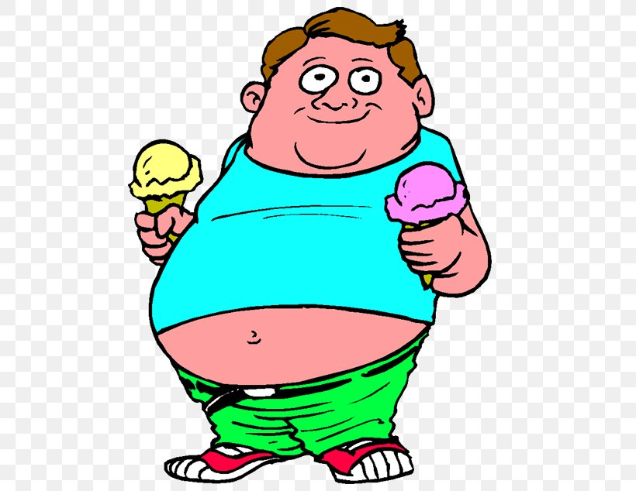
OBESITY
Amir Al-Momaiz, Marwan kakish, Angelina Sahouri, Lamar Al Azzeh

Slide 2
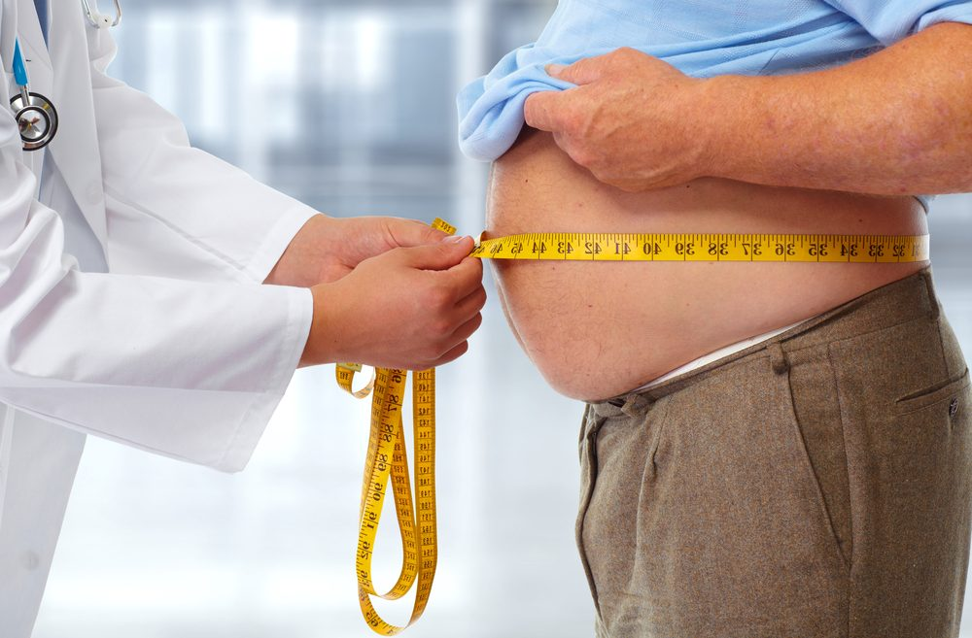
What is obesity?
Obesity is a complex disease involving an excessive amount of body fat. Body fat itself is not a disease, of course. But when your body has too much extra fat, it can change the way it functions. These changes are progressive, can worsen over time, and they can lead to adverse health effects.

Slide 3
5 causes of obesity
Genetics, there are some genes associated with obesity and overweight. In some people, genes can affect how their bodies change food into energy and store fat. Genes can also affect people's lifestyle choices.
Calories, The energy value of food is measured in units called calories. The average physically active man needs about 2,500 calories a day to maintain a healthy weight, and the average physically active woman needs about 2,000 calories a day.
Diet, diet and lifestyle factors contribute to development of obesity and overweight.
Stress, chronic stress can lead to comfort eating.
Unhealthy food, eating large amounts and processed food leads to obesity

Slide 4
Consequences of obesity
Heart disease
Stroke
Liver disease
Lung disease
Colon disease
Mood disorders

Slide 5
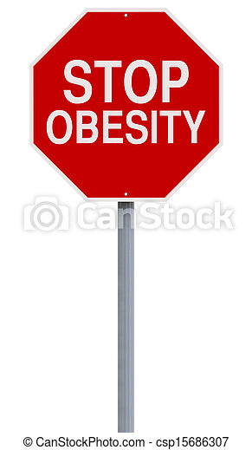
How to prevent obesity
Try to eat a healthier diet more often.
Exercise daily.
Limit your screentime.
Set Consistent Sleep Routines.
Avoid processed foods
Reduce sugar consumption
Limit artificial sweeteners
Skip saturated fats
Sip wisely
Cook at home
Try a plant-based diet

Slide 6
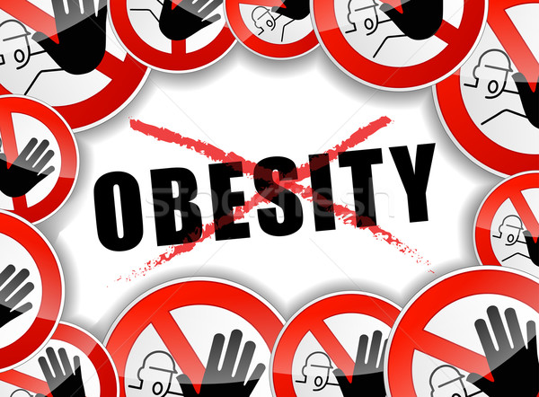
How to control obesity
Burn the calories you eat
Do your diet right
Maintain a food diary
Track your BMI
Pay attention to food labels

Slide 7
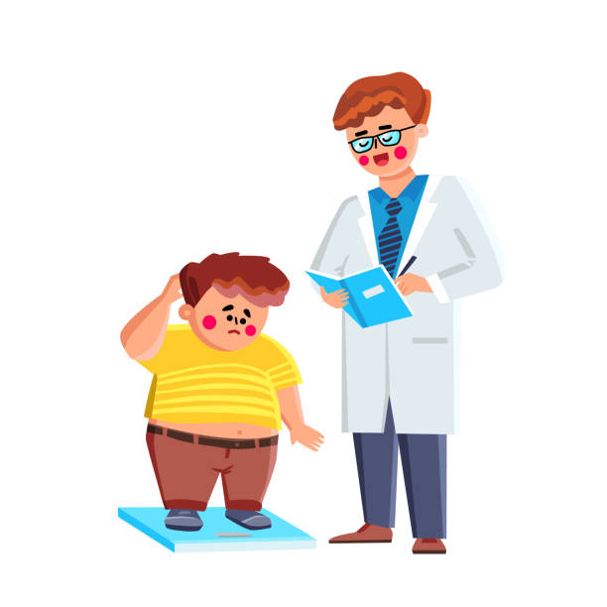
Symptoms of obesity
breathlessness.
increased sweating.
snoring.
difficulty doing physical activity.
often feeling very tired.
joint and back pain.
low confidence and self-esteem.
feeling isolated.

Slide 8
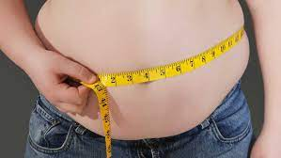
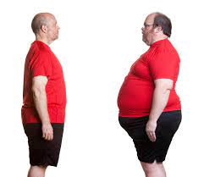
Obesity quiz
Get started

Slide 9
What is Obesity?
a) Obese people have an unhealthy and abnormally high percentage of body fat
b) To measure obesity, researchers use a formula that is based on an individual’s weight and height, known as the body mass index (BMI = weight in kg / m2). Obesity is defined as a BMI above 30.

Slide 10

Correct
CONTINUE THE QUIZ !

Slide 11
What causes Obesity?
a) Too much food and too little exercise
a) Too much food and too much exercise
CONTINUE THE QUIZ !

Slide 12
Correct
CONTINUE THE QUIZ !

Slide 13

WRONG
TRY AGAIN !

Slide 14
Can Obesity Effect our health?
a) No Obesity is good for our health
b) Of course, obesity increases the risk of developing diabetes, high blood pressure, heart disease, vascular disease and heart attack.

Slide 15
WRONG
TRY AGAIN !

Slide 16
Correct
CONTINUE THE QUIZ !

Slide 17
Can Obesity decrease life expectancy?
a) No It has no effect at all
b) Most definitely. After smoking, obesity is the number two cause of preventable premature death. It shortens life expectancy by approximately 10 years.

Slide 18
WRONG
TRY AGAIN !

Slide 19
Correct

