Slide 1
Water crises in jordan
By: leen shmaisani, MAYA SALAMEH, AND MUSTAFA ATOUM

Slide 2
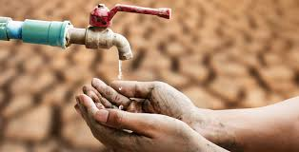
Introduction to water crises
Jordan is one of the most water-scarce countries in the world. The country’s renewable water supply currently meets around two-thirds of the population’s water demands, with groundwater being used twice as quickly as it can be replenished. Population growth puts additional strain on an already stressed water supply.

Slide 3
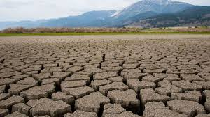
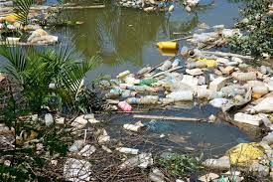
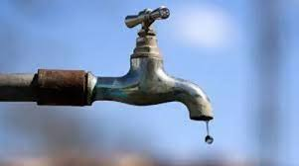
Issues of water crises in Jordan
Water shortage, drought, and water pollution are all kinds of the issues jordan has been dealing with from water crises. Pollution and drought can be created by human activity whereas water shortage is mostly caused by climate change.

Slide 4
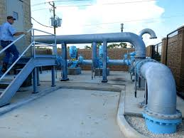
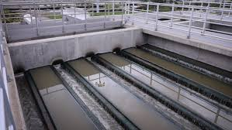
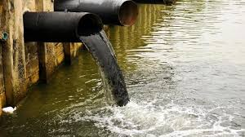
CAUSES OF WATER CRISES IN JORDAN
The overflow of wastewater pumping stations, leaks from sewage systems and exposure to industrial and commercial waste are polluting Jordan’s surface river sources. Pollution: Pollution is exacerbating water shortages. Rainfall: Jordan gets 110 mm of rainfall a year and ranked ninth in the top 10 countries with the lowest rainfall in 2017.

Slide 5
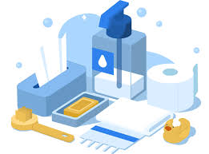
The consequences of water crises in jordan
Shortage of water in schools can undermine school attendance and performance, particularly for girls. Limited access to water results in children and young adults being unable to practice important hygiene behaviour like hand-washing and proper disposal of menstruation products.

Slide 6
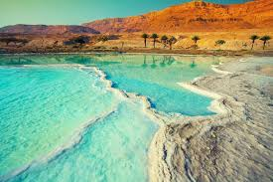
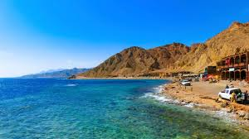
how do we Solve this problem?
The cornerstone of developing sustainable water solutions in Jordan is the Red Sea-Dead Sea Water Conveyance Project. Alongside desalination and gaining access to unusually deep aquifers, the Read-Dead project, as it is commonly known, is hailed as a “perpetual” solution to water supply in Jordan.

Slide 7
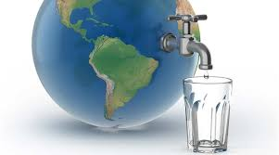
Conclusion
To wrap everything up, Water shortage has significantly increased stress on water resources in Jordan. Aquifers have reached historically low levels, water demand is rising exponentially, water pollution is rising and mismanagement of water resources continues unabated. Water scarcity is a big threat to Jordan’s industrial development, economic growth, food production and overall well-being of its population.

Slide 8
Citations
| A. D. (2022a, May 28). Water scarcity in Jordan: An overview. EcoMENA. https://www.ecomena.org/water-jordan/
Saiesha. (2022, April 14). 7 facts about water scarcity in Jordan. The Borgen Project. https://borgenproject.org/water-scarcity-in-jordan/#:~:text=The%20overflow%20of%20wastewater%20pumping,phosphorus%20contamination%20of%20water%20supplies.
Water Resources &amp; Environment: Basic page: Jordan. U.S. Agency for International Development. (2022, August 16). https://www.usaid.gov/jordan/water-resources-environment#:~:text=Jordan%20is%20one%20of%20the,as%20it%20can%20be%20replenished.
| A. D. (2022a, May 28). Water scarcity in Jordan: An overview. EcoMENA. https://www.ecomena.org/water-jordan/#:~:text=Groundwater%20resources%20account%20for%2054,of%20Jordan’s%20total%20water%20consumption.

Slide 9
Thank you for listening!

