Slide 1
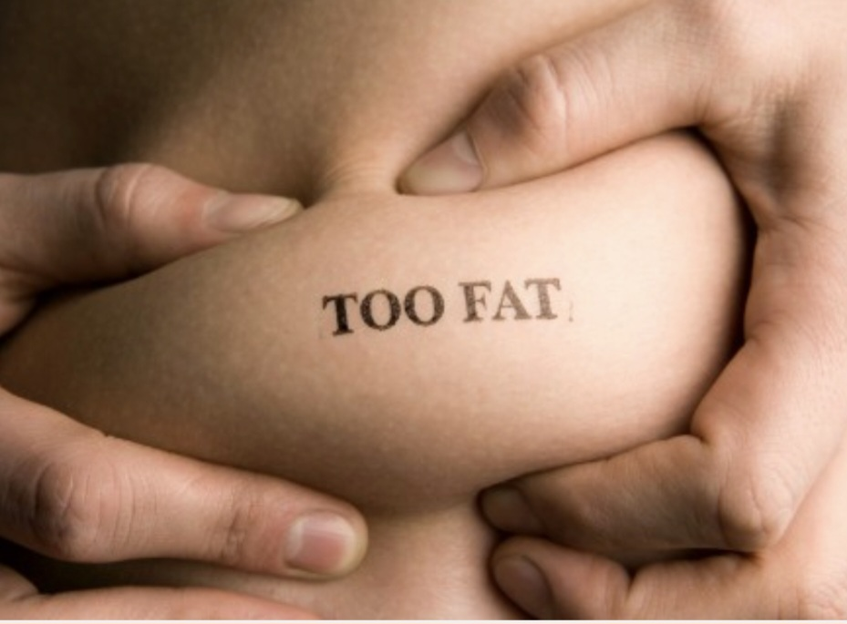
Obesity
By bassam sweis , faris madanat , aoun hammad , jad kurdi

Slide 2
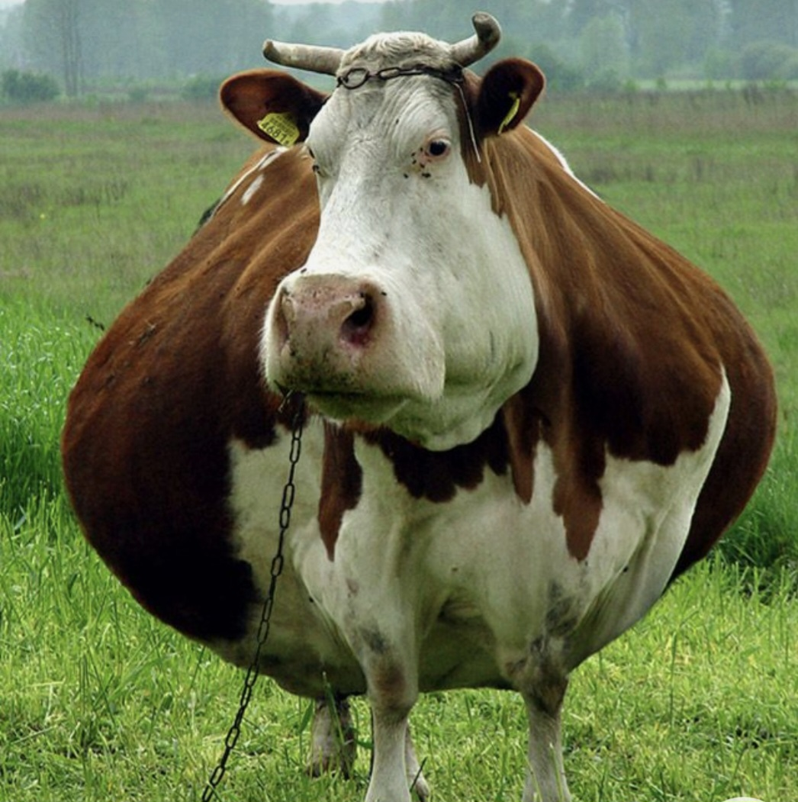
What is the obesty?!
Obesity means having too much body fat. it is different from being overweight, which means weighing too much. the weight may come from muscle, bone, fat, and/or body water. both terms mean that a person's weight is greater than what's considered healthy for his or her height. obesity happens over time when you eat more calories than you use. obesity is a complex disease involving an excessive amount of body fat. obesity isn't just a cosmetic concern. it's a medical problem that increases the risk of other diseases and health problems.

Slide 3
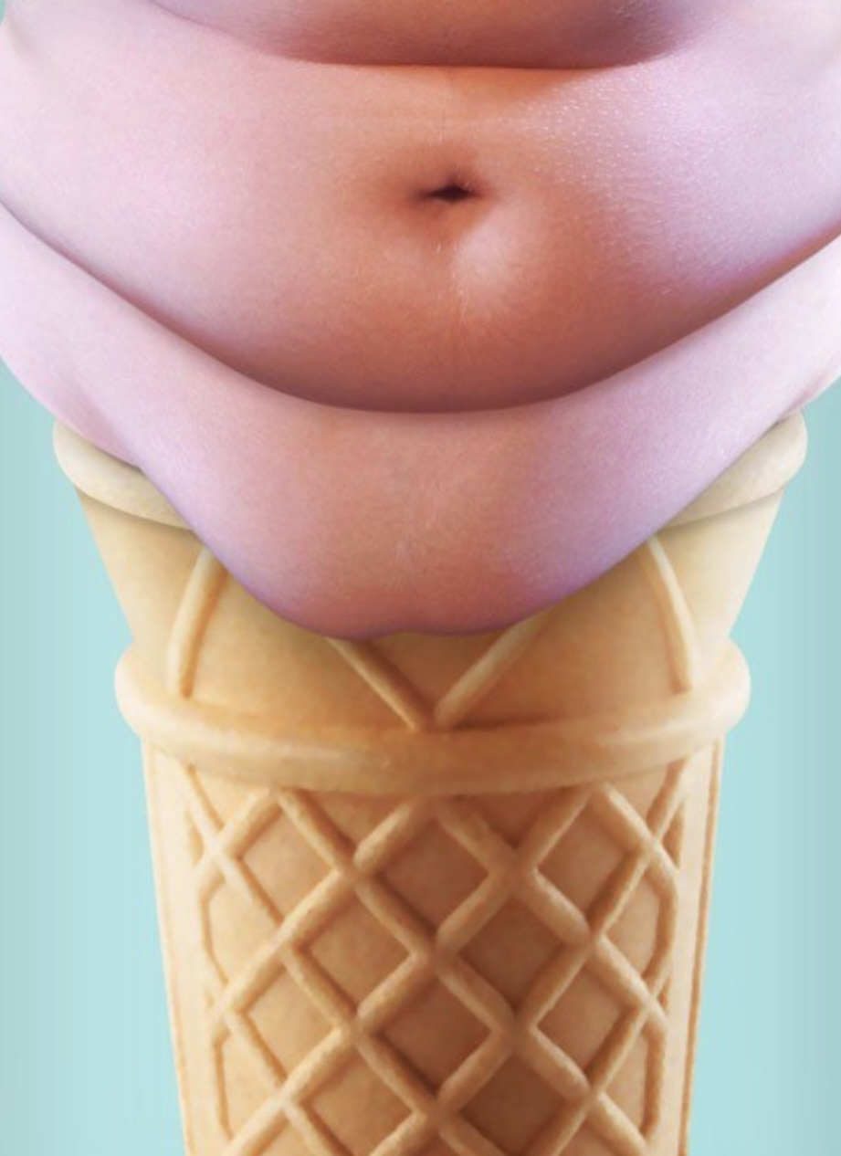
How do you categorize obesity?
There are many the ways to determine whether a body is fat or fit?
Body fat can be measured in several ways, with each body fat assessment method having pros and cons.
Here is a brief overview of some of the most popular methods for measuring body fat.

Slide 4
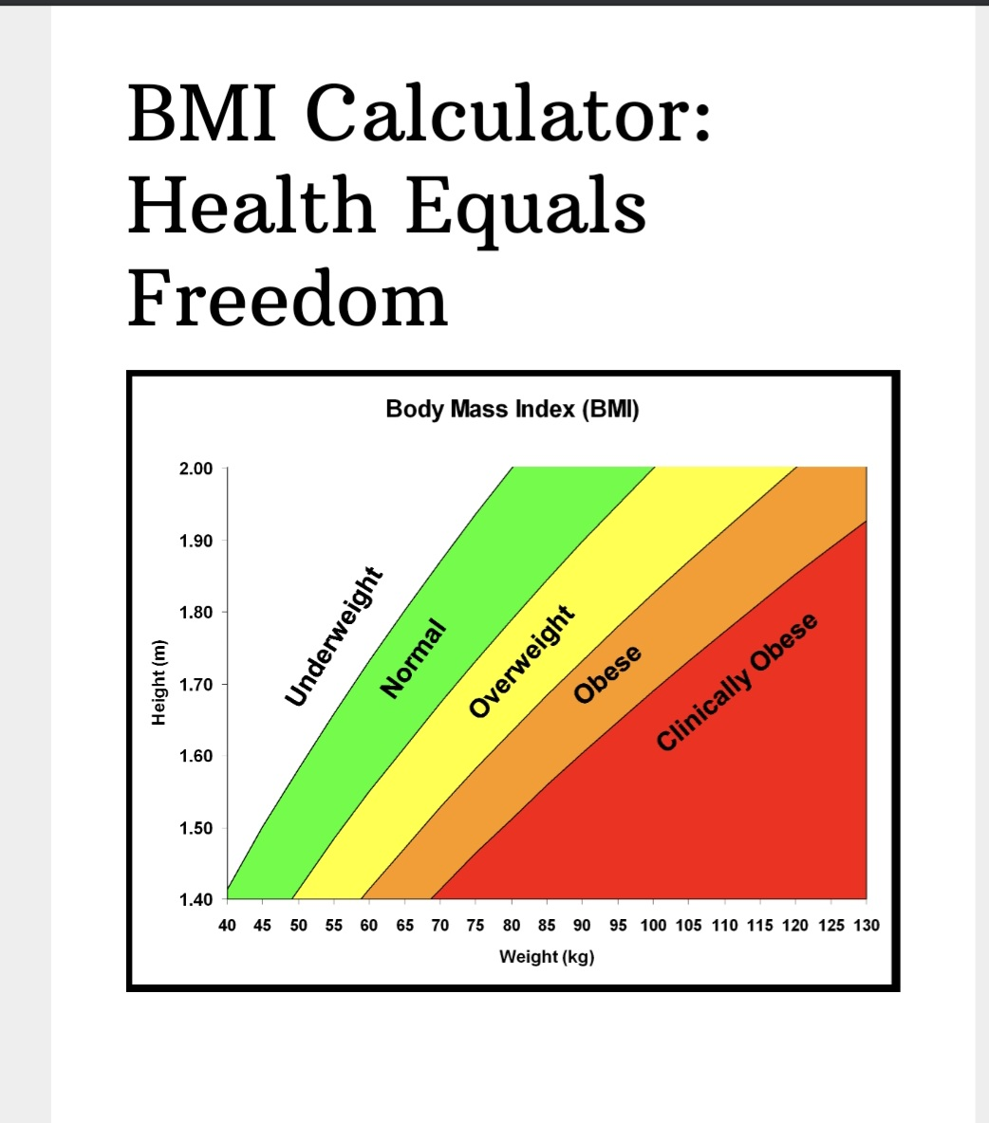
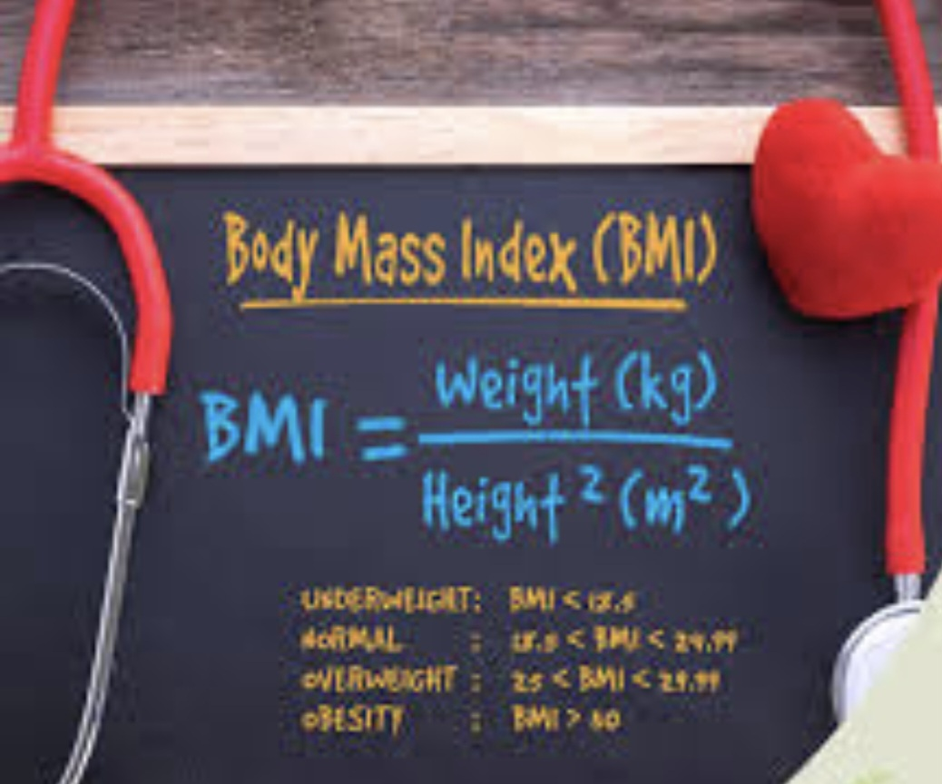
Body Mass Index (BMI)
Body mass index (bmi) is the ratio of weight to height, calculated as weight (kg)/height (m²), or weight (lb)/height (in²) multiplied by 703.

Slide 5
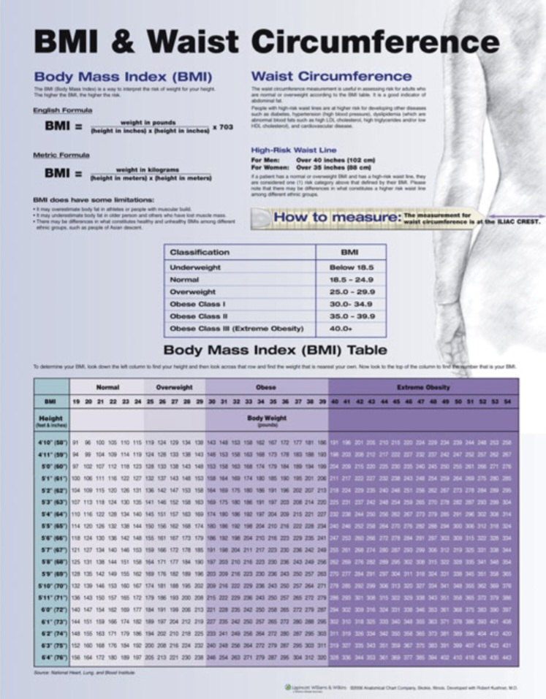
Waist Circumference
Waist circumference is the simplest and most common way to measure “abdominal obesity”, the extra fat found around the middle that is an important factor in health, even independent of BMI.
It’s the circumference of the abdomen, measured at the natural waist (in between the lowest rib and the top of the hip bone), the umbilicus (belly button), or at the narrowest point of the midsection.

Slide 6
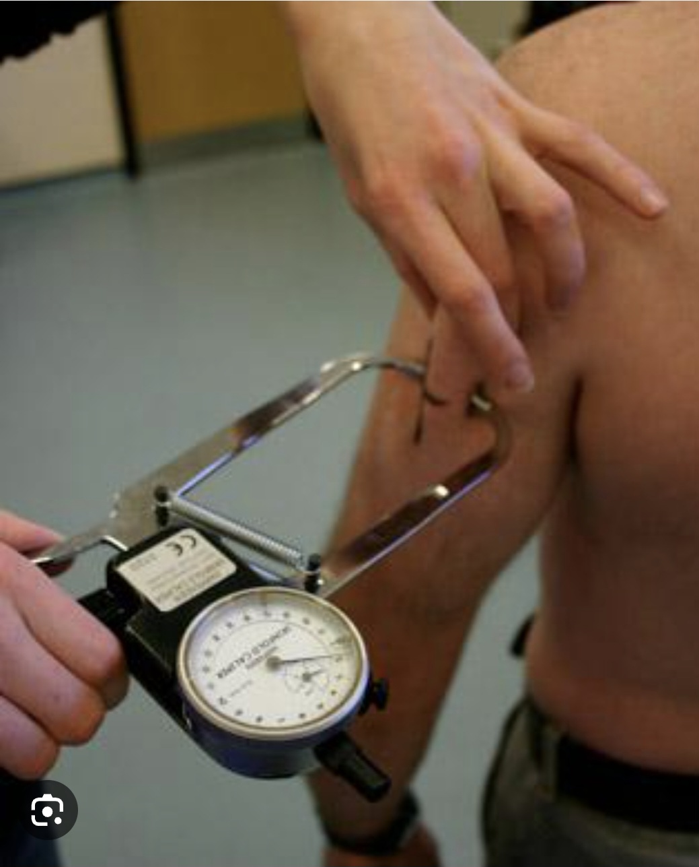
Skinfold Thickness
In this method, researchers use a special caliper to measure the thickness of a “pinch” of skin and the fat beneath it in specific areas of the body (the trunk, the thighs, front and back of the upper arm, and under the shoulder blade).
Equations are used to predict body fat percentage based on these measurements.

Slide 7
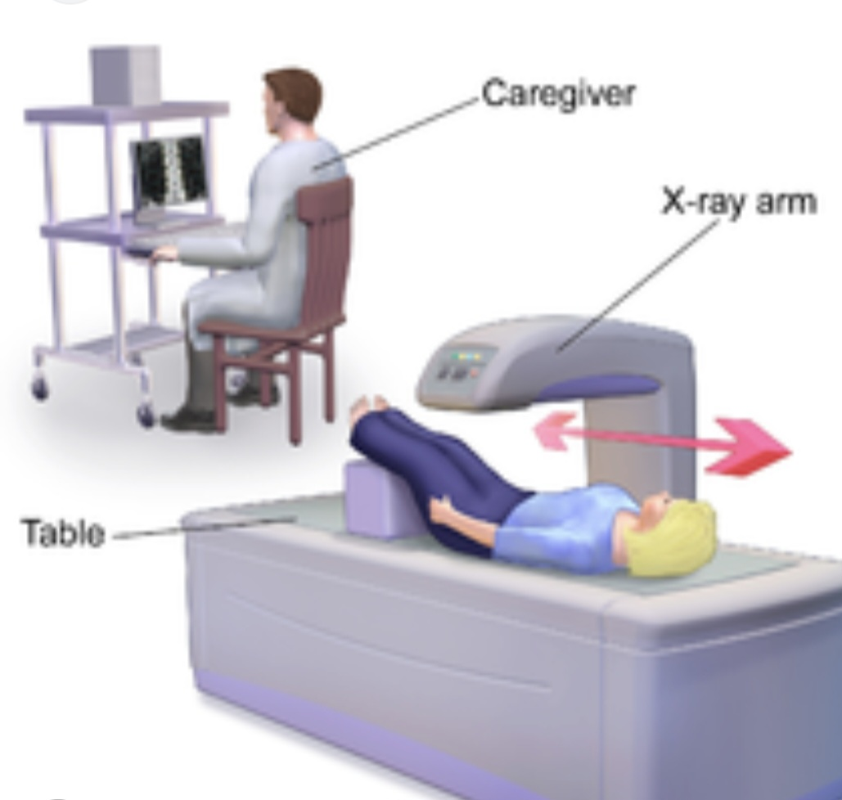
Dual Energy X-ray Absorptiometry (DEXA)
X-ray beams pass through different body tissues at different rates. so DEXA uses two low-level x-ray beams to develop estimates of fat-free mass, fat mass, and bone mineral density. DEXA is typically only used for this purpose in research settings.

Slide 8
Obesity Causes
Genes, genes seem to increase the risk of weight gain and interact with other risk factors in the environment, such as unhealthy diets and inactive lifestyles. and healthy lifestyles can counteract these genetic effects.
Prenatal and postnatal influences, early life is important, too. pregnant mothers who smoke or who are overweight may have children who are more likely to grow up to be obese adults. excessive weight gain during infancy also raises the risk of adult obesity, while being breastfed may lower the risk.
Unhealthy diets, foods that are lacking in the western diet-whole grains, vegetables, fruits, and nuts-seem to help with weight control, and also help prevent chronic disease.
Too much screen time, too little activity, and too little sleep, screen watching is a strong obesity risk factor, in part because exposure to food and beverage advertising can influence what people eat. physical activity can protect against weight gain, but globally, people just aren’t doing enough of it. lack of sleep-another hallmark of the western lifestyle-is also emerging as a risk factor for obesity.

Slide 9
5. Toxic Environment-Food and Physical Activity,
The physical and social environment in which people live plays a huge role in the food and activity choices they make, the incessant and unavoidable marketing of unhealthy foods and sugary drinks. the lack of safe areas for exercising. the junk food sold at school, at work, and at the corner store. add it up, and it’s tough for individuals to make the healthy choices that are so important to a good quality of life and a healthy weigh.

Slide 10
Health Effects of Overweight and Obesity
People who have overweight or obesity, compared to those with healthy weight, are at increased risk for many serious diseases and health conditions. these include:
High blood pressure (hypertension).
High IDL cholesterol, low HDL cholesterol, or high levels of triglycerides (dyslipidemia).
Type 2 diabetes.
Coronary heart disease.
Stroke.
Gallbladder disease.
Osteoarthritis (a breakdown of cartilage and bone within a joint).
Sleep apnea and breathing problems.
low quality of life.
Mental illness such as clinical depression, anxiety, and other mental disorders.

Slide 11

How to end this nightmare?!!!!

Slide 12
GETTING STARTED
check out our step-by-step guide to help you get on the road to weight loss and better health.
Improving Your Eating Habits
your eating habits, not just what you eat, may be leading to weight gain—for example, eating too fast, always clearing your plate, eating when you’re not hungry, or skipping meals.
Keeping the Weight Off
losing weight is the first step. once you’ve lost weight, you’ll want to learn how to keep it off.
Body Image
creating a positive body image through healthy eating habits.
Strategies for Success
find resources to help you lose or gain weight safely and effectively.
Weight Management for Youth
address weight issues in children and teens with healthy guidelines, links to interactive and skill-building tools, and more.
What you should know about popular diets
learn how to evaluate claims made by weight loss products and diets. find information to choose weight loss strategies that are healthy, effective and safe for you.

Slide 13

What can I do to help prevent obesity in a teen?
young people often become overweight or obese because they have poor eating habits and aren’t active enough. genes also play a role.
Here are some tips to help your teen stay at a healthy weight:

Slide 14
Focus on the whole family. Slowly work to change your family’s eating habits and activity levels. Don’t focus on a child’s weight.
Be a role model. Parents who eat healthy foods and are physically active set an example. Their child is more likely to do the same.
Encourage physical activity. Children should get at least 60 minutes of physical activity each day.
Limit screen time. Cut your teen’s screen time to less than 2 hours a day in front of the TV and computer.
Have healthy snacks on hand. Keep the refrigerator stocked with fat-free or low-fat milk instead of soft drinks. Offer fresh fruit and vegetables instead of snacks high in sugar and fat.
Aim for 5 or more. Serve at least 5 servings of fruits and vegetables each day.
Drink more water. Encourage teens to have water instead of drinks with added sugar. Limit your child’s intake of soft drinks, sports drinks, and fruit juice drinks.
Get enough sleep. Encourage teens to get more sleep every night. Earlier bedtimes have been found to decrease rates of obesity.

Slide 15
Obesity: MedlinePlus
Obesity - Symptoms and causes - Mayo Clinic
Measuring Obesity | Obesity Prevention Source | Harvard T.H. Chan School of Public Health
Health Effects of Overweight and Obesity | Healthy Weight, Nutrition, and Physical Activity | CDC
Obesity in Teens (stanfordchildrens.org)

