Slide 1
Obesity
Rakan,Zaid,Alex

Slide 2
What we will talk about:
1) what is obesity
2) what are its consequences
3) Our solution

Slide 3
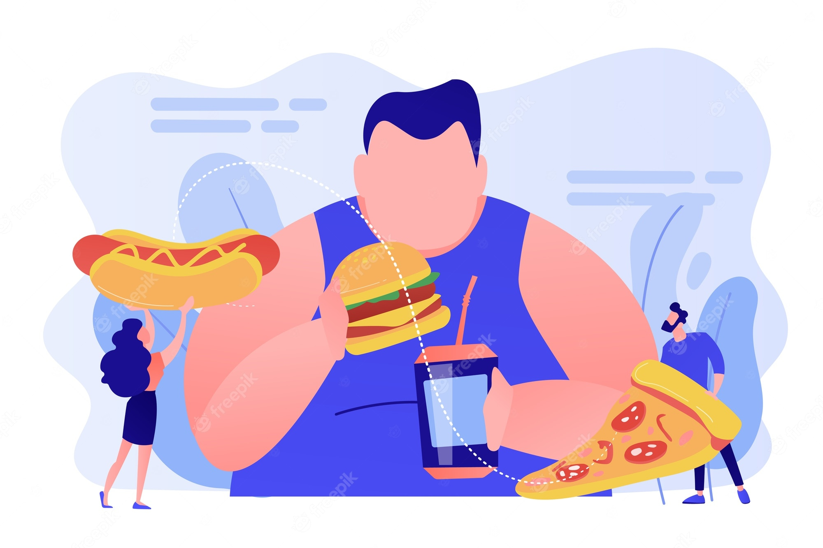
What is obesity?
Overweight and obesity are defined as abnormal or excessive fat accumulation that presents a risk to health.
The issue has grown to epidemic proportions, with over 4 million people dying each year as a result of being overweight or obese in 2017 according to the global burden of disease.

Slide 4
Causes of obesity
Food and Activity. People gain weight when they eat more calories than they burn
Environment. The world around us influences our ability to maintain a healthy weight.
Genetics
Health Conditions and Medications
Stress, Emotional Factors, and Poor Sleep

Slide 5
Consequences
All-causes of death.
High blood pressure.
High LDL cholesterol.
Type 2 diabetes.
Coronary heart disease.
Stroke.
Gallbladder disease.
Sleep apnea and breathing problems.

Slide 6
Solution
Obesity is a major public health concern that can lead to serious health problems such as heart disease, diabetes, and cancer. To prevent obesity, it is essential to adopt a healthy lifestyle, which includes a balanced diet and regular physical activity. Reducing the intake of high calorie foods and sugary drinks and increasing the consumption of fruits, vegetables, whole grains, and lean proteins can help maintain a healthy weight. Regular physical activity, such as walking, cycling, or swimming, can also help prevent obesity. Additionally, getting enough sleep, managing stress levels, and avoiding smoking and excessive alcohol consumption can contribute to a healthy lifestyle and prevent obesity. We will encourage people to do physical activities by constantly doing physical events that involve sports that can help reduce obesity, and any money made will be donated to charity’s.

Slide 7
Our Goal:
Our goal is to lower the rates of obesity and allow people to have a healthier life style. We will do this by constantly making physical activities and events.

Slide 8
Our website:
https://sites.google.com/view/lean-life23/home

Slide 9
Resources
https://www.who.int/health-topics/obesity#:~:text=Overweight%20and%20obesity%20are%20defined,and%20over%2030%20is%20obese.
https://www.nichd.nih.gov/health/topics/obesity/conditioninfo/cause
https://www.cdc.gov/healthyweight/effects/index.html

