Slide 1
circuits
Angela Naber (8F)

Slide 2
Kitchen

Slide 3
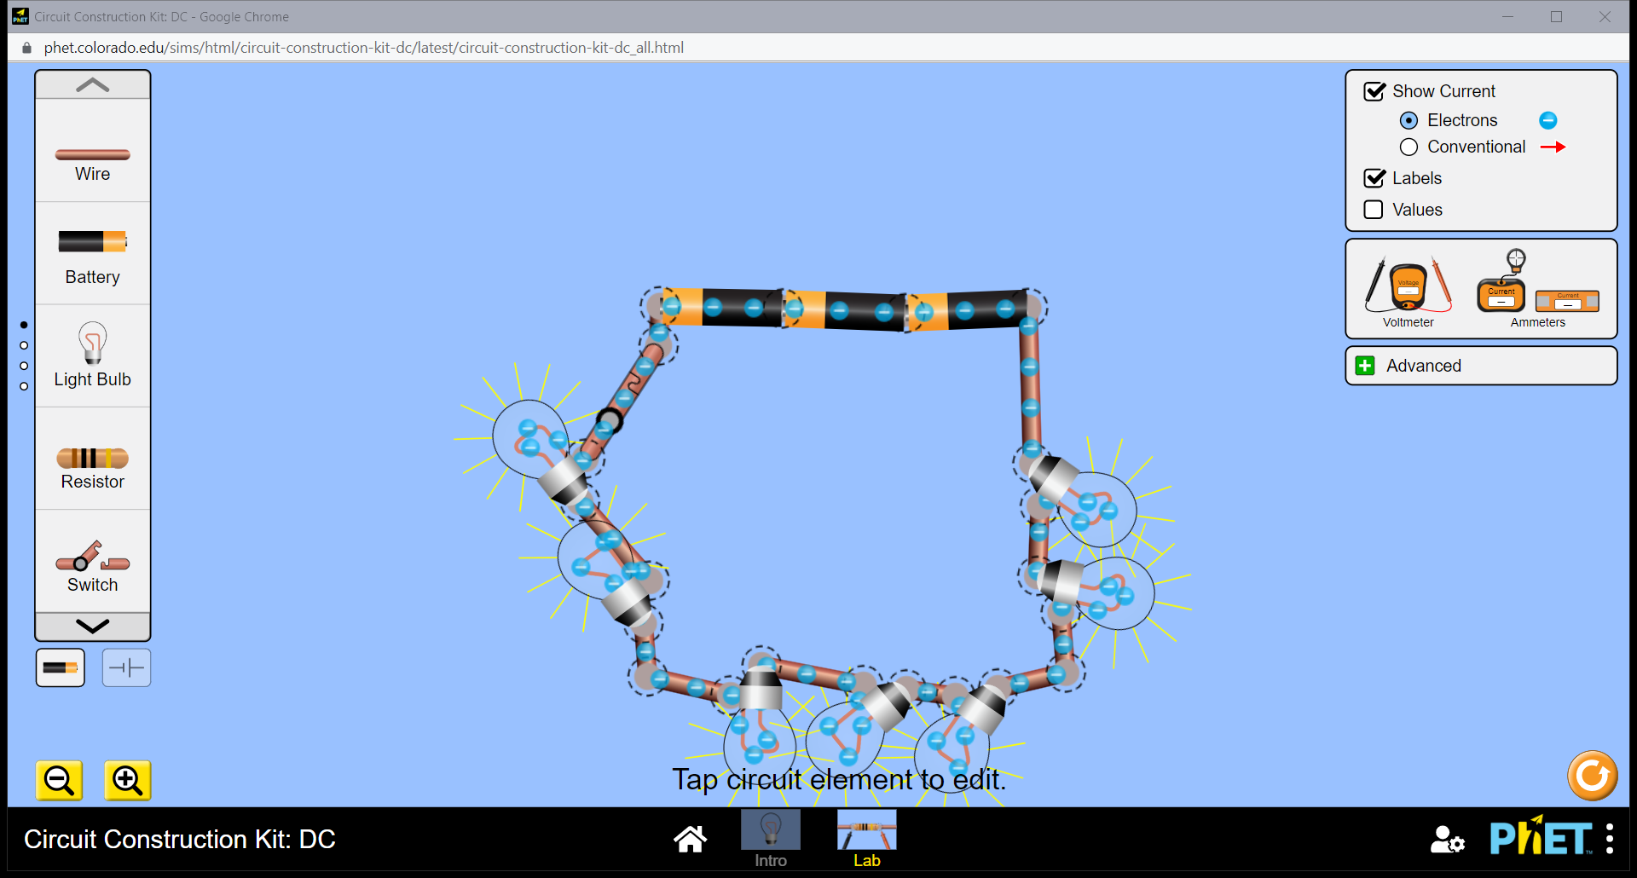

Slide 4
Living Room

Slide 5
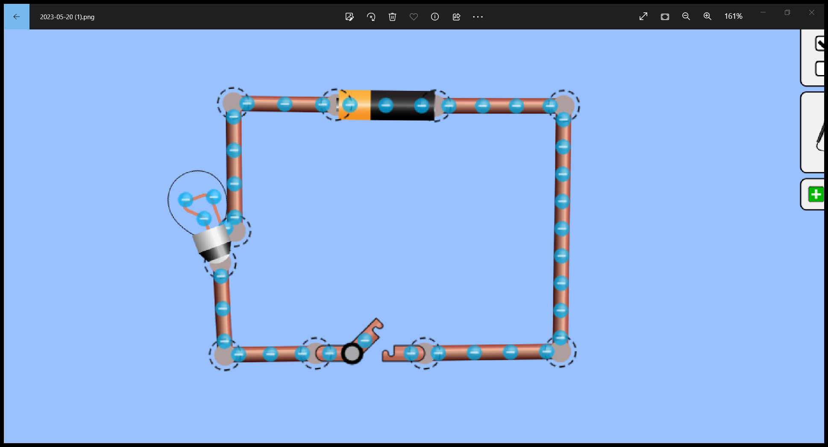

Slide 6
Bed Room

Slide 7
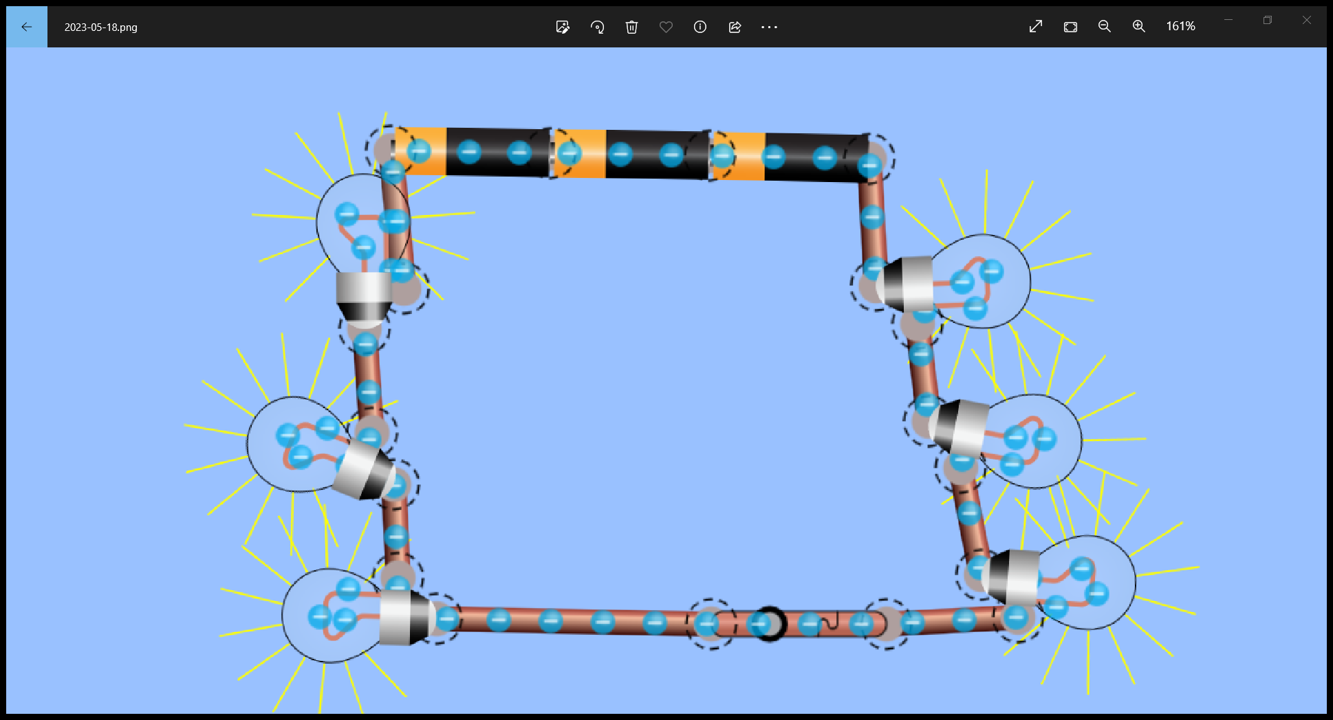

Slide 8
Bath Room

Slide 9
