Slide 1
Testing Chemical Substances (Dissolved In Water)
By: Tia Karadsheh, Katia Ebaid And Tala Alwazani

Slide 2
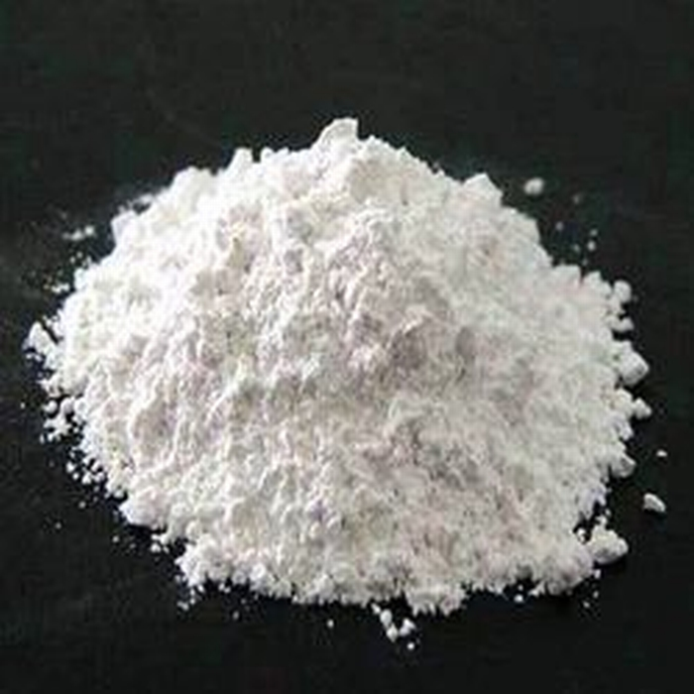
Calcium Carbonate (CaCO3)
Calcium Carbonate is included in milk and other sources of dairy products such as cheese and yogurt.
Dissolving calcium carbonate in water is exothermic, this is because less energy is required to break the bonds in the NaHCO3 and CaCl2 molecules than is released when the CaCO3, NaCl, CO2 and H2O molecules form.
Chemical property:
calcium carbonate is an odorless white powder formed by two main elements: carbon and oxygen.

Slide 3
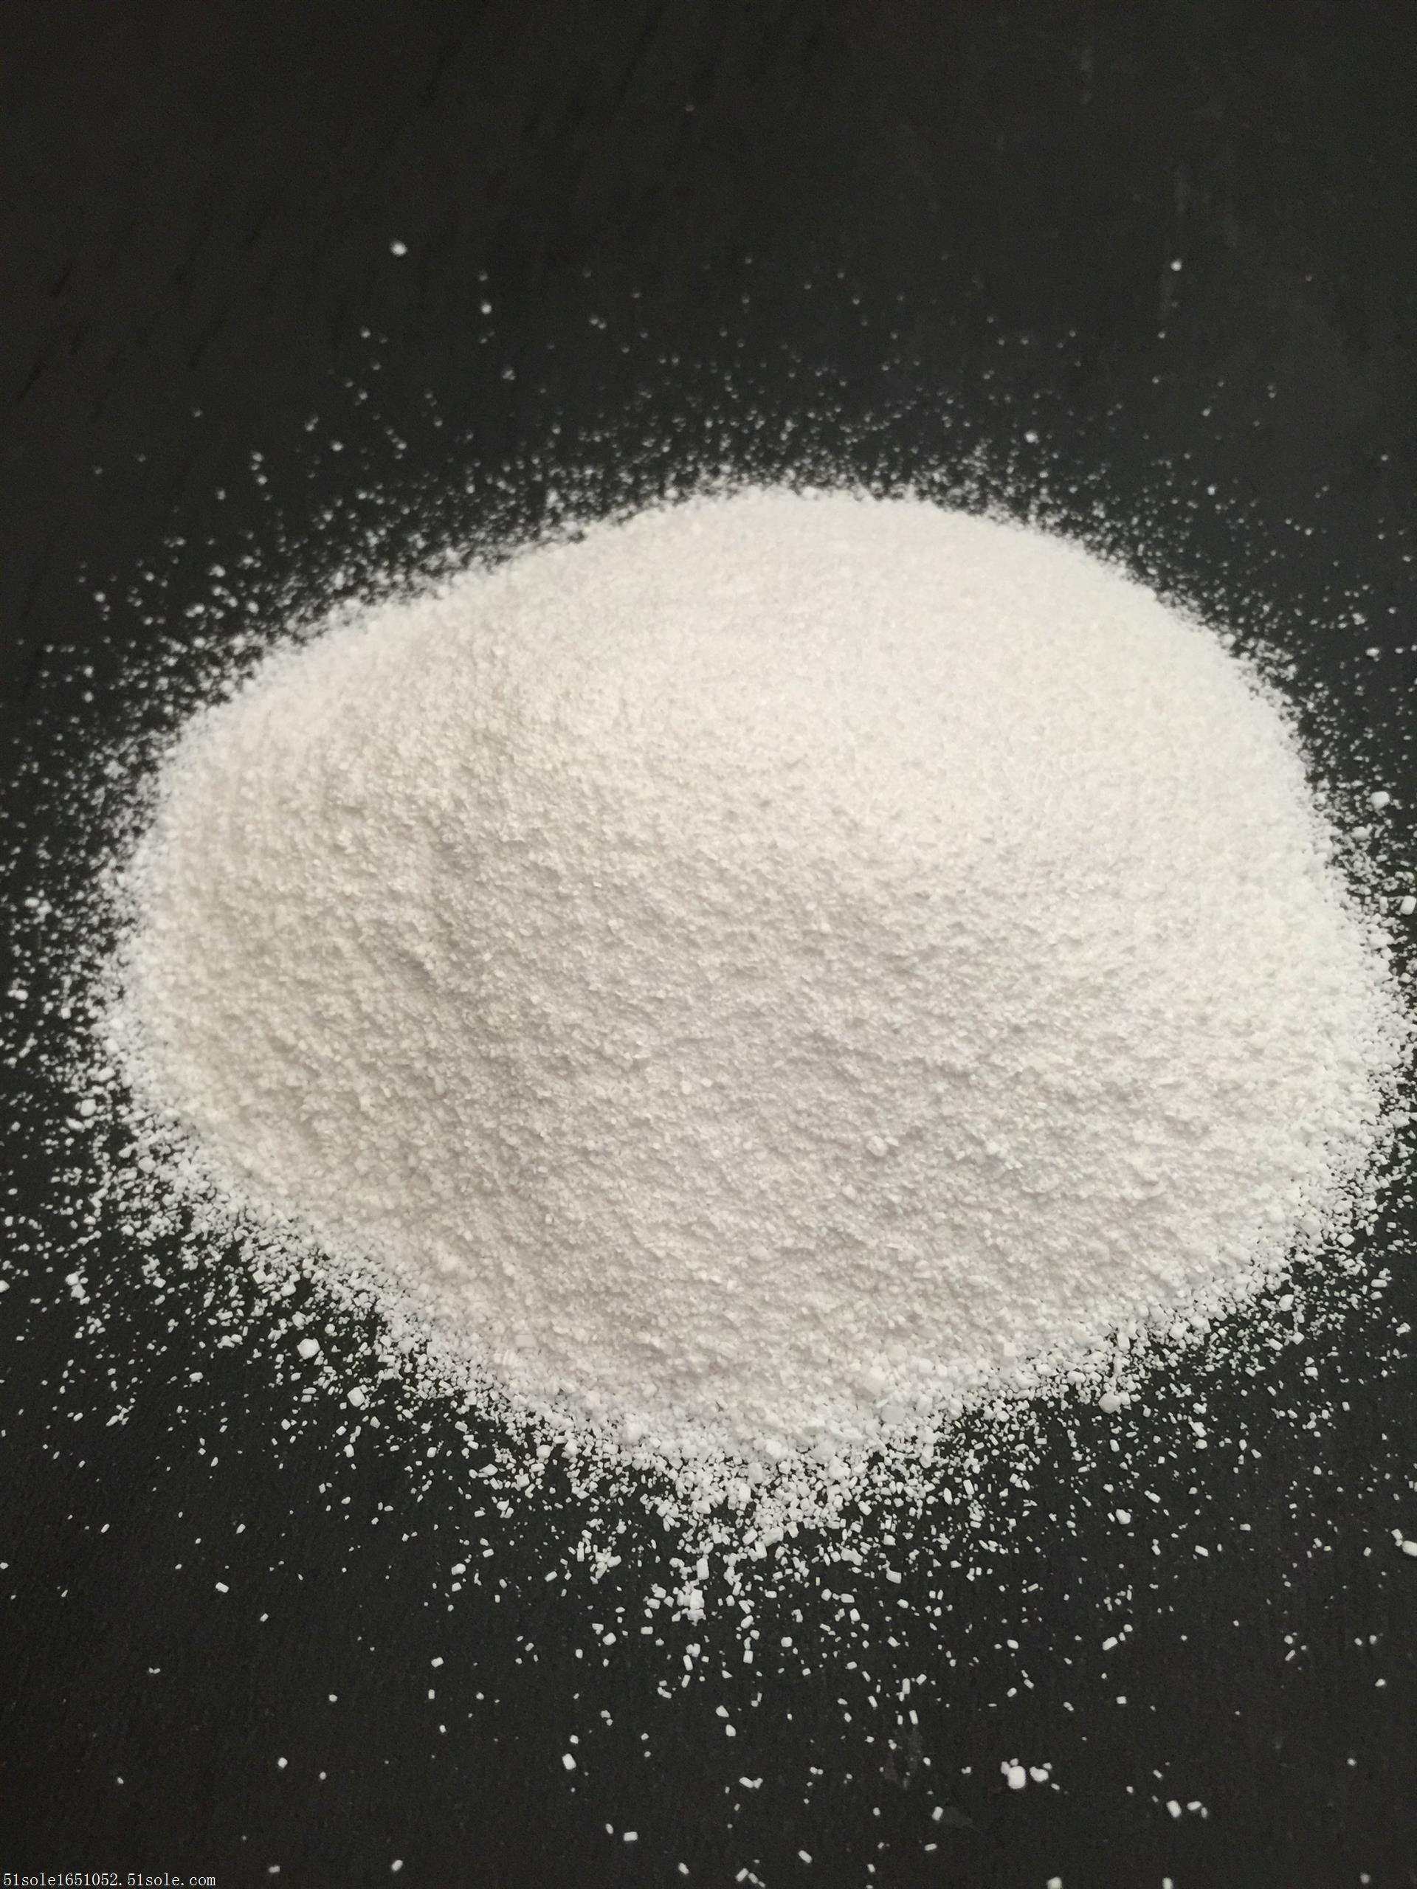
Sodium Carbonate (Na2CO3)
We can find sodium carbonate in some types of mineral waters. In addition, large quantities of this salt are used in forming glass.
When we dissolve sodium carbonate an exothermic rection occurs, because the energy required to separate the particles of sodium carbonate is less than the energy released by bonding of water molecules to the particles of sodium carbonate.
Chemical property:
Sodium carbonate forms carbonic acid and sodium hydroxide.

Slide 4
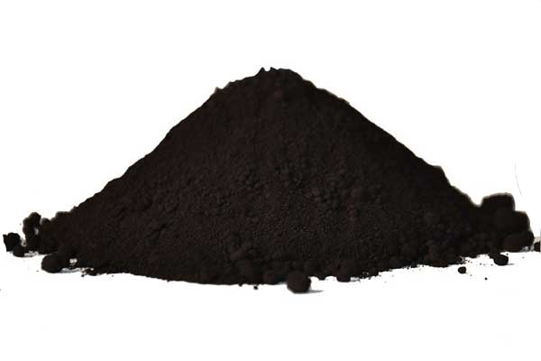
Iron Oxide (Fe2O)
they are used in pigments found in paints, coatings and colored concrete.
Iron oxide takes in and absorbs heat/energy from its surroundings, which makes it an endothermic reaction when dissolved in water.
Chemical property:
Iron oxide is a chemical complex which occurs naturally comprising iron and oxygen.

Slide 5
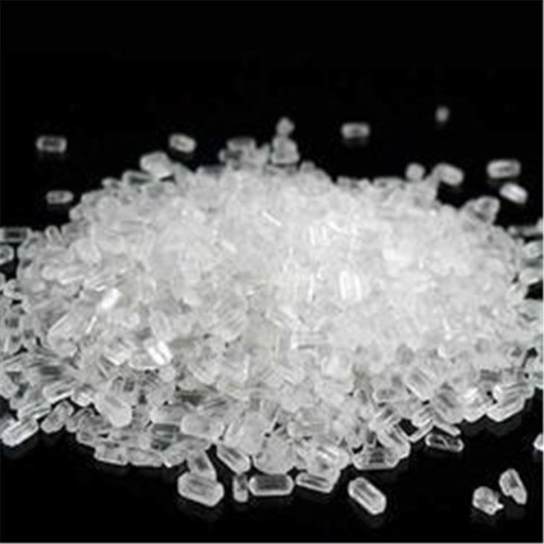
Magnesium sulfate (MgSO4)
Magnesium sulfate is mainly found in soils, seawater and mineral springs.
When magnesium sulfate is dissolved in water, energy or heat is released and given out, which makes this reaction an exothermic reaction.
Chemical property:
Magnesium sulfate is made up with sulfuric acid and sodium hydroxide for ph. adjustment.

Slide 6
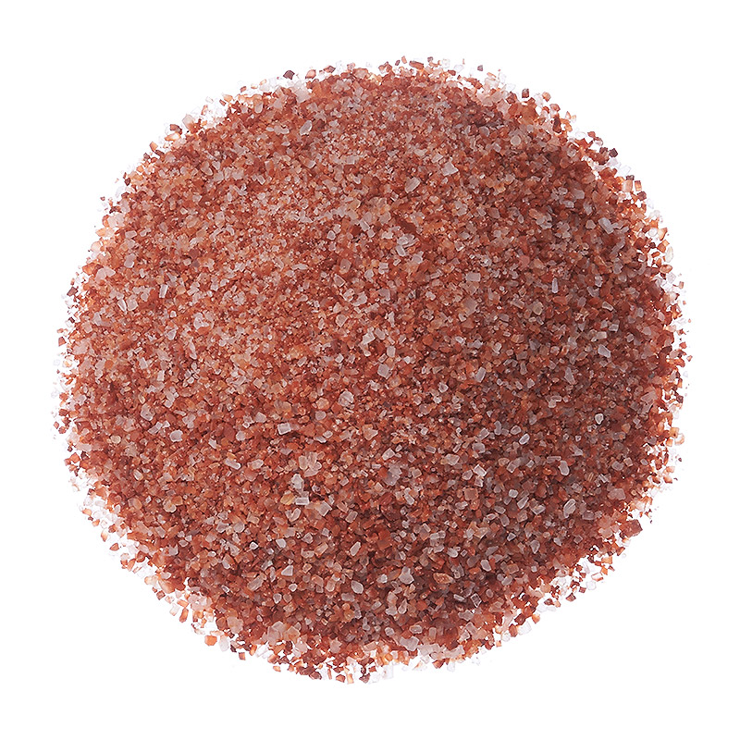
Potassium chloride (KCl)
It can be used as a salt replacer, and it can be found In many other foods including cereals and frozen entrees.
Potassium chloride is endothermic when it's dissolved in water, that’s because it absorbs heat from its surroundings which makes it an endothermic reaction.
Chemical property:
Potassium chloride is a colorless, crystalline appearance which is unscented.

