Slide 1
Obesity
By nassif, Thomas laith h and omar f

Slide 2
What is obesity?
Overweight and obesity are defined as abnormal or excessive fat accumulation that presents a risk to health. A body mass index (BMI) over 25 is considered overweight, and over 30 is obese .In this PowerPoint, Obesity is the main topic, you will learn about the causes consequences and disadvantages of obesity.

Slide 3
How obesity happens?
People gain weight when they eat more calories than they burn through activity. This imbalance is the greatest contributor to weight gain.

Slide 4
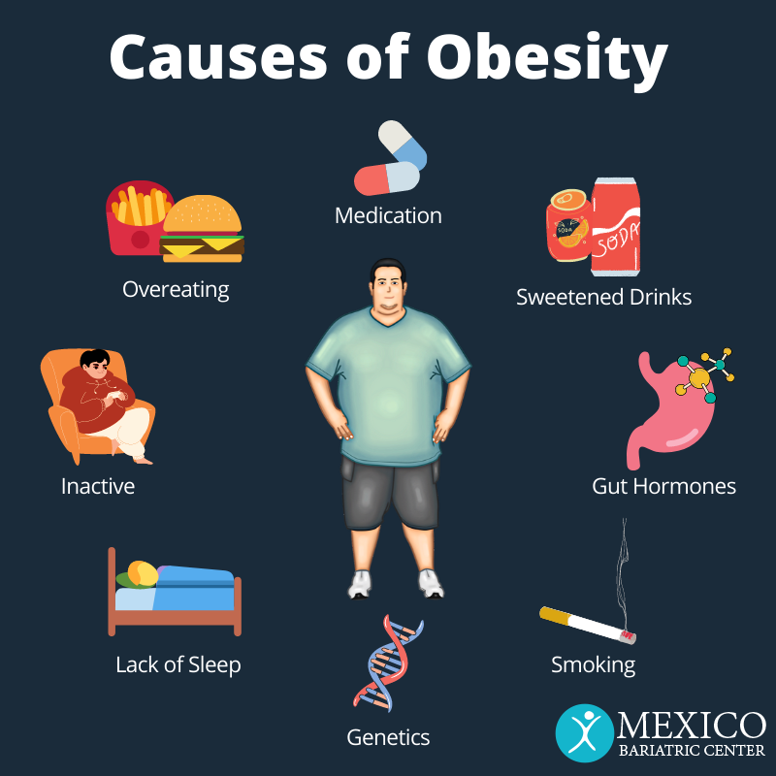
Causes to Obesity
Obesity is a complex disease that occurs when an individual’s weight is higher than what is considered healthy for his or her height. Obesity affects children as well as adults.
Sometimes, obesity occurs when people consume more than their body needs, or when people eat too much unhealthy food that have no nutrients.

Slide 5
Consequences to Obesity
Carrying extra fat leads to serious health consequences such as cardiovascular disease, which is a heart disease musculoskeletal disorders, and some cancers .These conditions cause premature death and substantial disability.

Slide 6
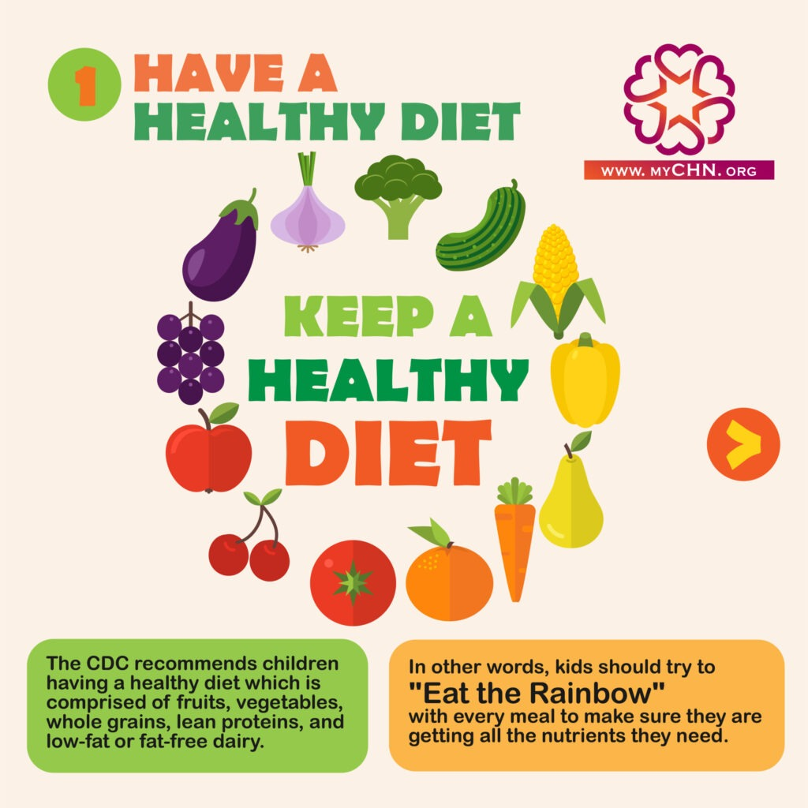
How to prevent Obesity
Choosing healthier foods (whole grains, fruits and vegetables)
Limiting unhealthy foods
Increasing physical activity
Improving sleep

Slide 7
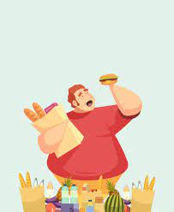
Disadvantages of Obesity
Some disadvantages of obesity are:
Heart disease and stroke
High blood pressure
Diabetes
Some cancers
Osteoarthritis
Depression
Obstructive sleep apnea

Slide 8
Resources.
https://www.cdc.gov/obesity/basics/causes.html
https://www.who.int/news-room/questions-and-answers/item/obesity-health-consequences-of-being-overweight#:~:text=Carrying%20extra%20fat%20leads%20to,premature%20death%20and%20substantial%20disability
https://www.nhlbi.nih.gov/health/overweight-and-obesity/causes

