Slide 1
WATER CRISES
IN JORDAN
Done by: Natalie Nino, qais musharbash, bandar omari

Slide 2
CONTENTS
01
Introduction
02
Main Issues
03
Water Pollution and Water Drought
04
EFFECTS OF WATER
POLLUTION
05
Proposed Solutions
06
Citation

Slide 3
Introduction
Water is an odorless, tasteless liquid compound of hydrogen and oxygen that makes up rain, oceans, lakes, and rivers. These bodies of water cover 71% of earth’s surface and fill 60% to 80% of human and animal bodies and up to 95% of plants, which makes it along with Air the most important compounds for life on planet Earth .With fewer than 100 m3 of annual renewable water per person, Jordan is the second-most water-scarce country in the world. Water shortages brought on by population growth, economic expansion, and agricultural capacity have made this problem worse. Water scarcity is a result of long-term groundwater monitoring, high amounts of non-revenue water, and the misconception that water is a scarce resource. Jordan is predicted to experience substantial effects from climate change, including rising temperatures, altered precipitation patterns, extreme weather events, and flash flooding.
Back to Contents page

Slide 4
Water pollution
Water pollution: When pollutants are released into subterranean groundwater or into bodies of water including lakes, streams, rivers and oceans, it is referred to as "water pollution." These compounds interfere with the water's ability to be used for good or with ecosystems' ability to operate naturally. Water pollution can also involve the discharge of energy, such as radiation or heat, into bodies of water, in addition to the release of things such as chemicals, debris, or germs.
Water constraints are getting worse due to pollution. Jordan's surface river sources are being contaminated by the overflow of wastewater pumping stations, leakage from sewage systems, and exposure to industrial and commercial garbage. Jordan’s major water resources are the Jordan River and the Yarmouk River which are shared with Israel(Palestine) and Syria, that leaves only a small amount for the use of Jordan, in addition to the polluted Zarqa River water which goes to the Ghore Eastern canal (King Abdullah Canal) for irrigation through King Talal DAM. The country’s renewable water supply currently only meets about half of the population’s water demand, with ground water being used twice as quickly as it can be recharged, a high rate of population growth and influx of refugees from regional conflicts put additional strain on already stressed water supply, while changing rain patterns threatens to worsen the problem.
Back to Contents page

Slide 5
Water scarcity
Water scarcity : Water scarcity can occur for a variety of causes, including inadequate infrastructure, high demand, and institutional failure to balance requirements. The idea of water shortage is relative. Water availability fluctuates according to supply and demand, which changes throughout time. As demand rises and the amount of the water supply declines, there is an increase in water scarcity.
Water supply in Jordan is characterized by severe water scarcity, which has been hammered by several forced immigration as a result of the 1948 and 1967 wars with Israel, the 1990 Gulf war, the 2003 Iraq war and the ongoing Syrian civil war since 2011.
Furthermore, rising temperatures, less rainfall, and limited crop yields are to blame for the scarcity.
Back to Contents page

Slide 6
Effects Of Water Pollution and Water Scarcity
Human contact with polluted water through drinking, skin contact or even consumption of food that is grown or prepared using polluted water poses a significant danger to health. Pollutants in water may directly cause disease or act as poisons. Consuming polluted water might result in major health issues since it causes infections. from cholera, hepatitis, typhoid, and diarrhea to death. An estimated 5 million people each year pass away from drinking this water, according to estimates.
When water runs out, people cannot drink, wash, or feed crops, and the economy may suffer. Poor sanitation, which affects 2.4 billion people, can also lead to the same severe diseases as mentioned above.
Back to Contents page

Slide 7
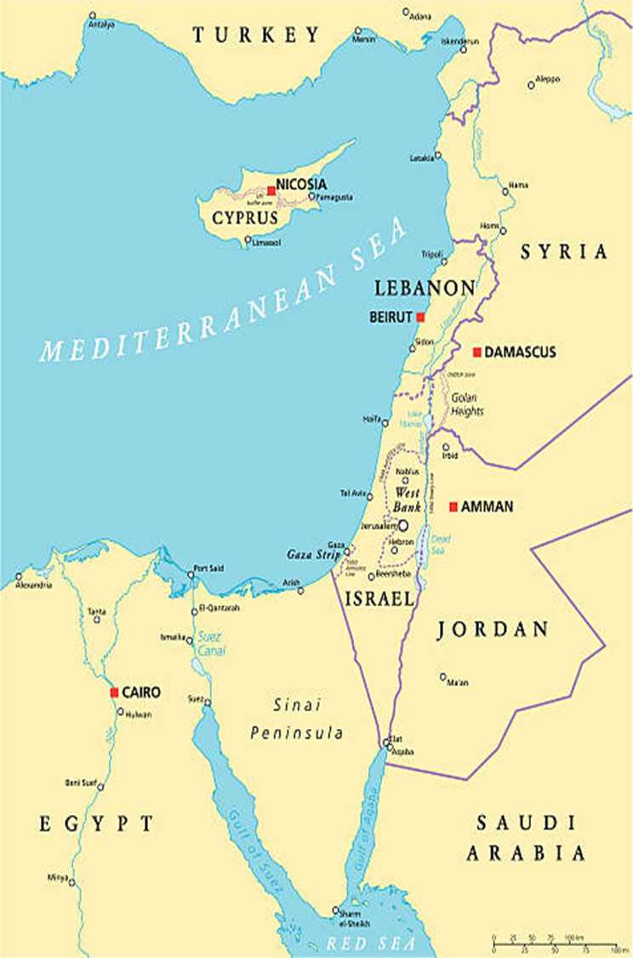
There are numerous imaginative and practical solutions to this terrible problem, and here are some of the greatest of them.
Solution 1
Solution 2
Solution 3
Back to Contents page

Slide 8
Improve irrigation and agricultural practices
More than 50 percent of the Jordan’s freshwater is used for agriculture. Improving irrigation can help close supply and demand gaps; Adopting new technology has become a necessity to reduce water wastage, such drip irrigation and hydroponics
Back to Contents page

Slide 9
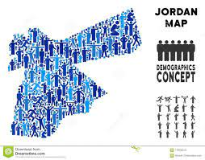

2.Population growth control
Education and awareness of Jordan’s limited water resources might decrease the accelerating growth in the country population, while maintain peace in the region shall stop the waves of refugee’s influx to the country. Educate to change consumption and lifestyles changing the face of this crisis involves education to motivate new behaviors. Coping with the coming era of
water scarcity will require major alterations for all forms of consumption in a way to optimize usage of the most precious liquid, the most critical task is making sure the problem is much better understood Jordan wide
Back to Contents page

Slide 10

3.Appropriately price water
According to experts from the Organization for Economic Co-operation and Development (OECD), raising prices will help lower waste and pollution, Jordan up to date subsidizes water tariff for domestic use which leads to over consumption
Back to Contents page

Slide 11
Water Resources & Environment: Basic page: Jordan. U.S. Agency for International Development. (2022, August 16). https://www.usaid.gov/jordan/water-resources-environment
Citation
Water, sanitation and hygiene. UNICEF Jordan. (2020, November 4). https://www.unicef.org/jordan/water-sanitation-and-hygiene
Saiesha. (2022, April 14). 7 facts about water scarcity in Jordan. The Borgen Project. https://borgenproject.org/water-scarcity-in-jordan/#:~:text=Pollution%3A%20Pollution%20is%20exacerbating%20water,phosphorus%20contamination%20of%20water%20supplies.
Horton, B. A. (2022, May 4). Can planting trees prevent desertification in Jordan?. euronews. https://www.euronews.com/green/2022/05/04/jordan-s-water-shortages-are-life-threatening-is-tree-planting-the-answer
1. (n.d.). Jordan - Environment and Water Sector. International Trade Administration | Trade.gov. https://www.trade.gov/country-commercial-guides/jordan-environment-and-water-sector
THANKS !

