Slide 1
Light Up your House!
Done by:hind habash and yasmine abuaitah

Slide 2
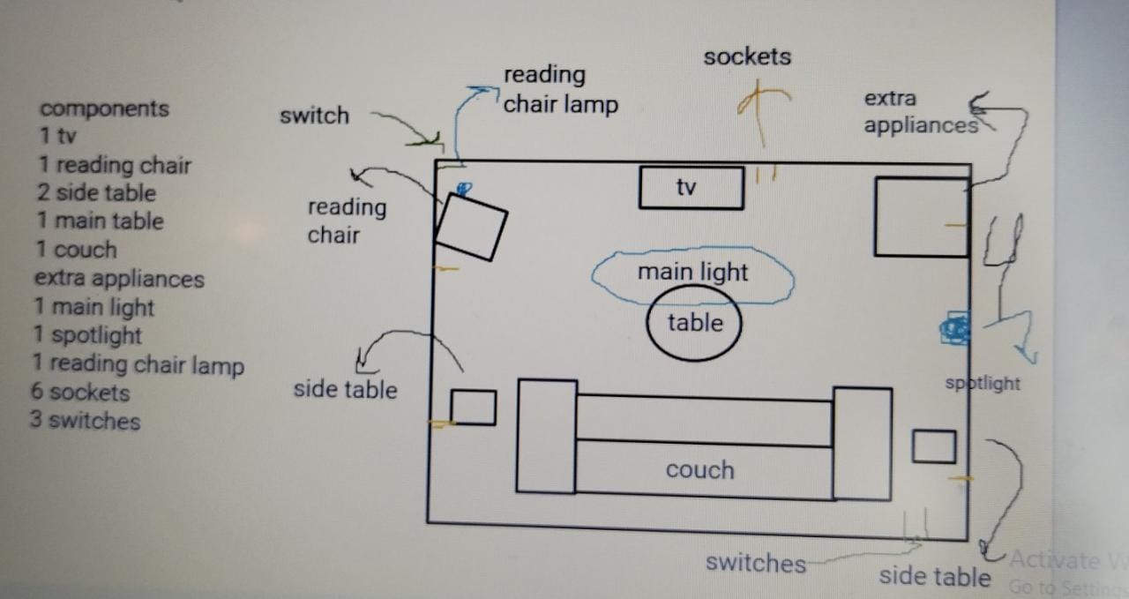
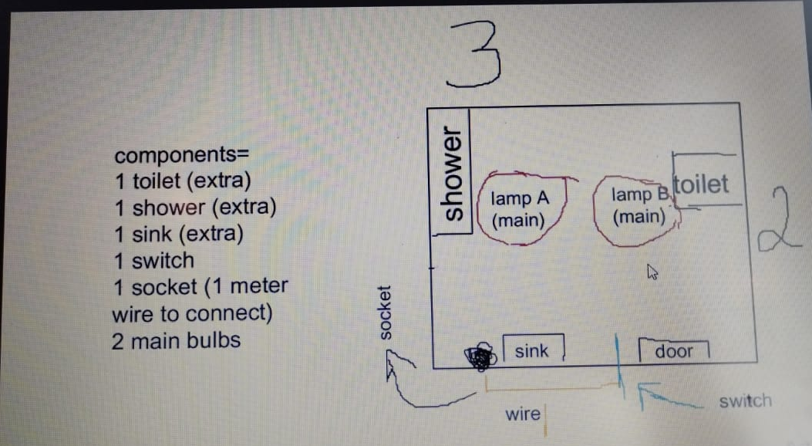
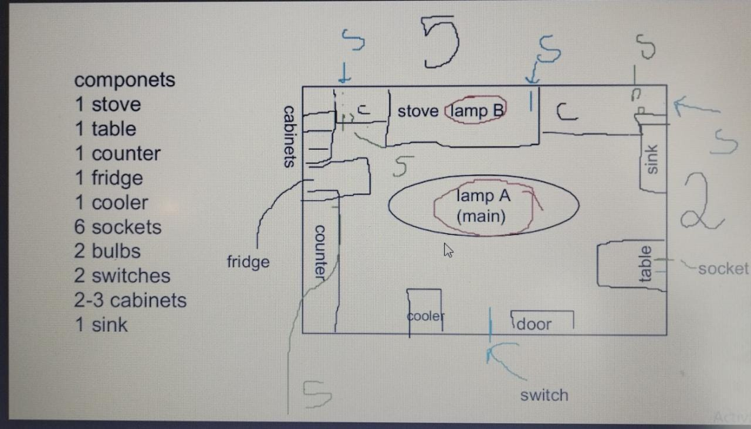
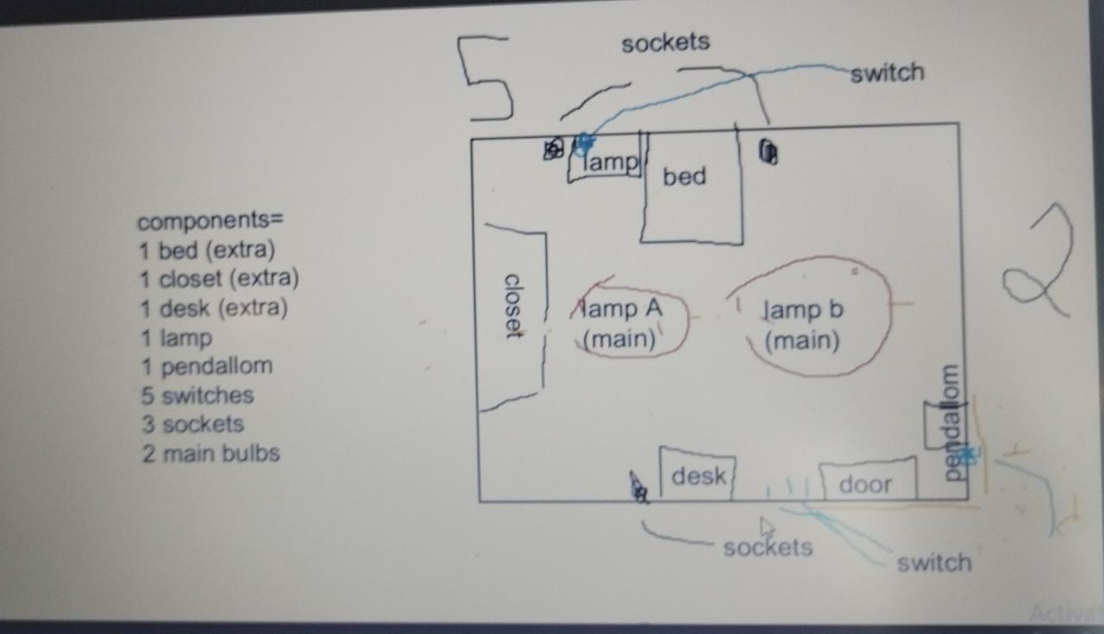
Introduction
For a home with a kitchen, a bedroom, a living room, and a bathroom, we created a lighting system. This power point will demonstrate the circuits we built along with a description on how we got the house to light up.
living room
bathroom
kitchen
bedroom

Slide 3
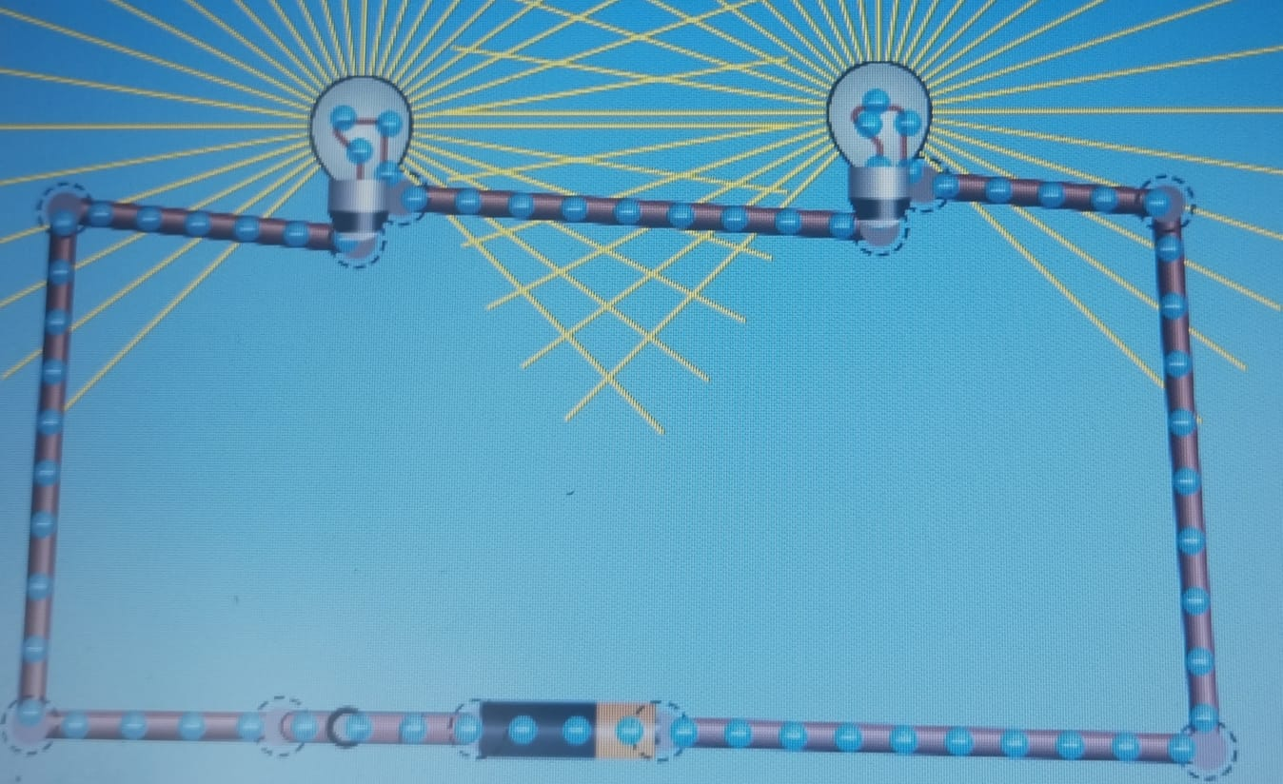
bathroom
The bathroom had an area of 6cm squared and needed 1500 lumens. We made the decision to add 2 ordinary light bulbs, each priced at 0.5 jds. We created two of these, each of which produced an additional 100 lumens over an ordinary lightbulb's 800 lumens. The total cost of the bulbs was 1 jd. Then, we added 1 socket next to the sink for 0.5jd to power a hairdryer or similar device. We also chose to include a fancy switch that would turn on both lights together for 0.75jd. We utilized 8 meters of wire, which cost 8jds.The overall cost of the bathroom, including the extra cost of the energy, was 10.35jds.

Slide 4
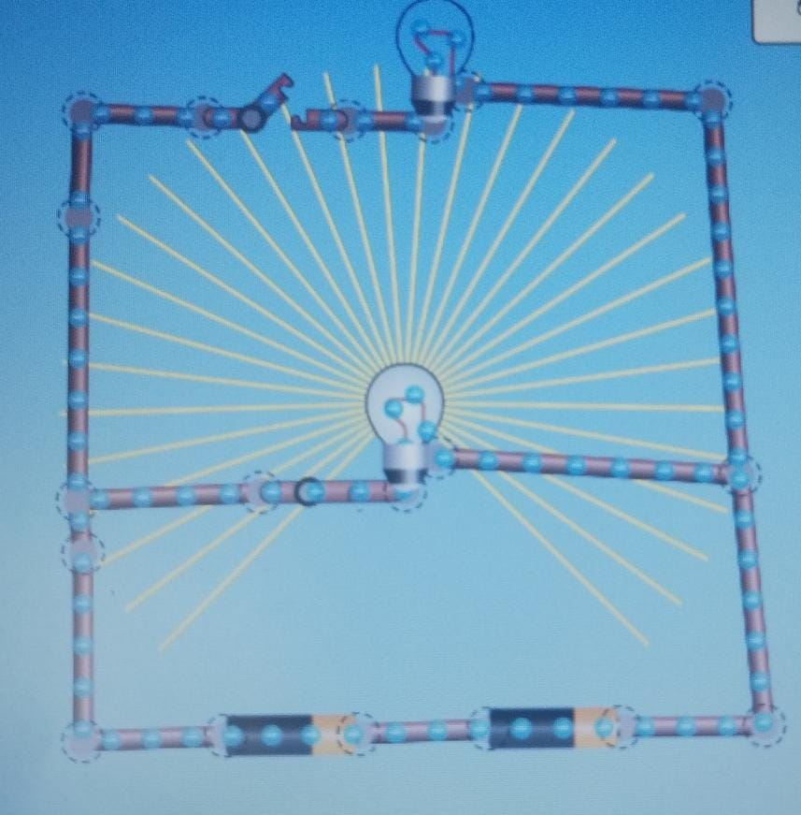
Kitchen
The kitchen had a 10 cm squared area and required 2500 lumens, so we chose to add two lightbulbs to the kitchen one normal bulb for the main lightbulb that costs 0.5 jds, and one CFL lightbulb above the stove which costs 1 jd. Bulb costs therefore came to 1.5jds in total. After that, we added six sockets: one each for the microwave, cooler, fridge, kettle, additional appliances, and chargers. Since each socket costs 0.50jds, that makes 6 sockets for 3jds. Then we added 2 switches, one for the main light and the other for the light above the stove. After we used 79m of wire for 79 jds, the total cost for the kitchen was 84.85 jds with the energy used.

Slide 5
Bedroom
The bedroom requires 2500 lumens for a 10cm square area, so we started by adding 4 bulbs: 2 CFL lightbulbs for a lamp and a pendulum, which costs 2 jds, and 2 normal lightbulbs for the main lights, which costs 1 jds. This brings the total cost of the bulbs to 3 jds. The cost of the sockets is 1.5jds because we decided to install 3 of them—one for the lamp, one for the desk, and one near the bed. Afterwards, we made the decision to add 5 switches: 1 ordinary switch for the pendulum, 1 ordinary switch for the lamp, 2 fancy switches for each main light, and 1 more fancy switch to open them both together. After we added 10m of wire for 10jds, the price for the bedroom ended up being 31.75 with the energy used.

Slide 6
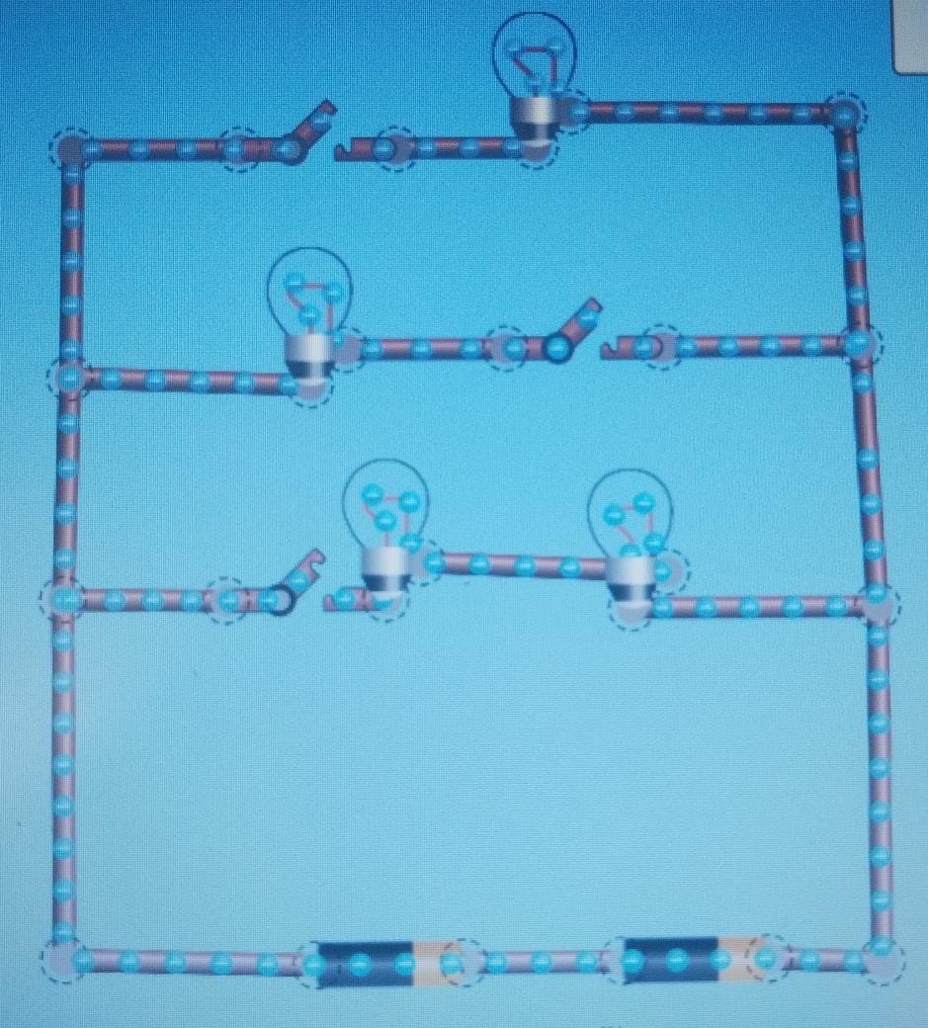
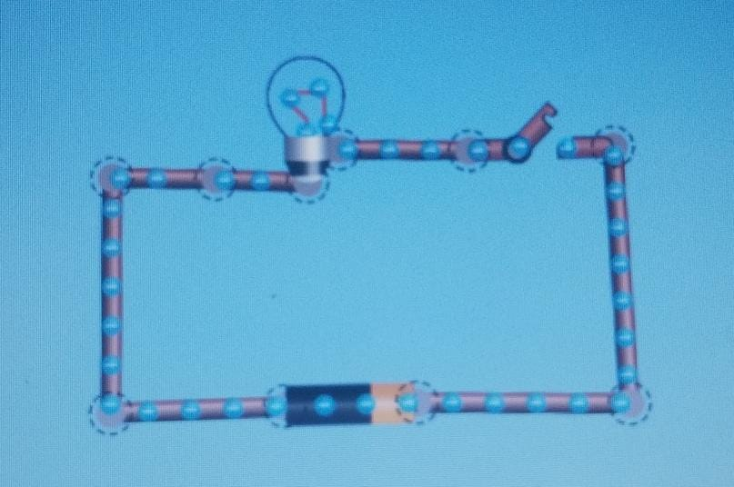
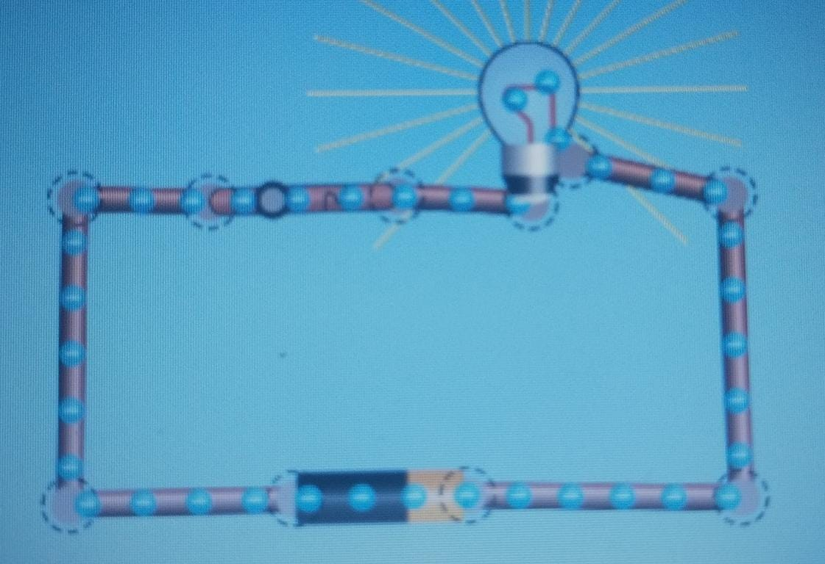
Bedroom circuts:
Main lights:
Lamp:
Pendulum:

Slide 7
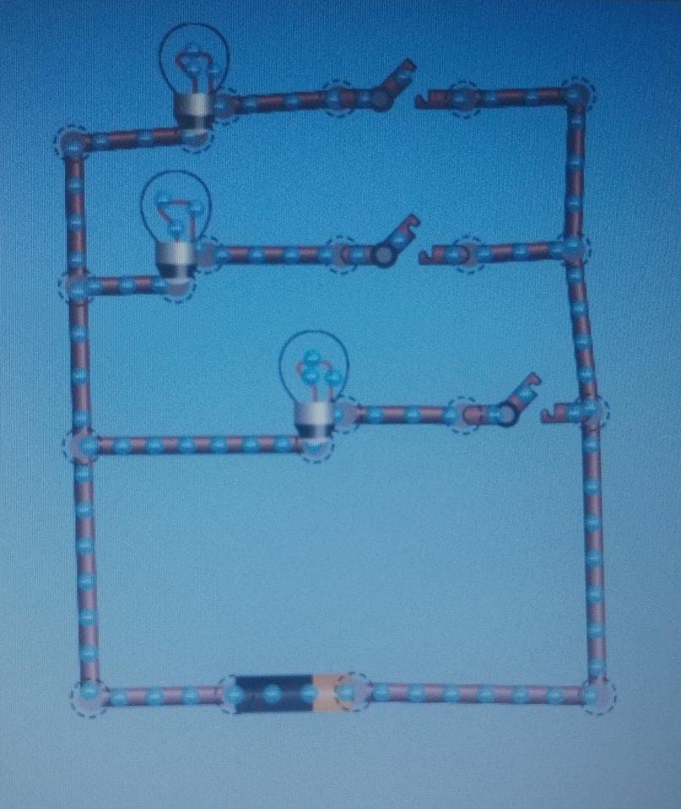
Living room
1st branch is the main light
2nd branch is the spotlight
3rd branch is the reading lamp
The living room required 3000 lumens and had a 12 cm square size. We selected three bulbs, and they added an additional 50 lumens. One normal lightbulb and two LED bulbs were chosen. The bulbs were 3.5 jds in price. Then we put three switches: an automatic switch for a lamp, two fancy switches for the main lights and spotlights. 2.50 jds was the cost of the switches. Then, we placed six sockets: one for the television, two for charging stations, one for a lamp, one for additional electronics like a Playstation, and one for extra gadgets like a fan or heater. The sockets were 3jds. Then we added 69.5m of wire for 69.5 jds. The total cost for the living room was 78.65jds with the energy used (0.15jds).

