Slide 1
-Earthquakes-
By: Celina , Raya , Dina , Kinda

Slide 2
2.
3.
4.
5.
1.
What is an earthquake?
What are the effects and causes of earthquakes?
What are the factors that affect the intensity of an earthquake?
What are the methods to detect and measure earthquakes?
6.
how can you survive an earthquake?
What are the impacts of earthquakes on the natural environment?

Slide 3
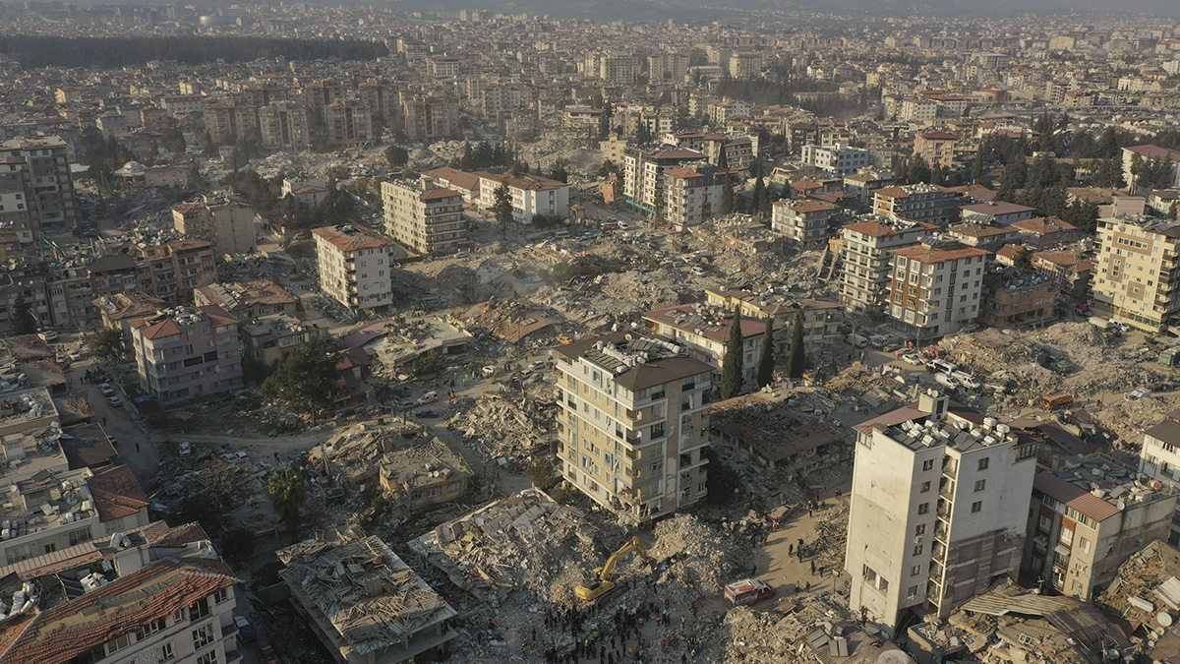
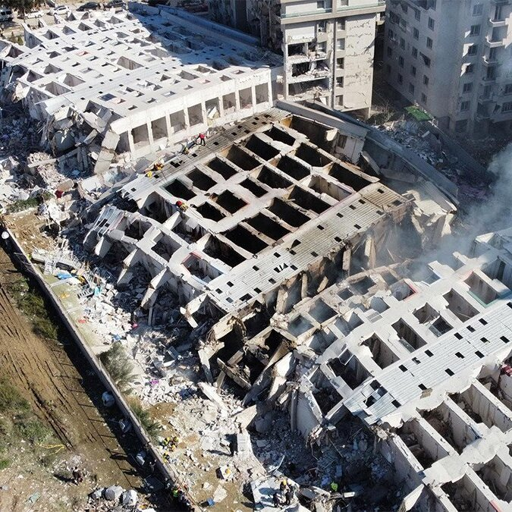
1.
What is an earthquake?
Notes:
An earthquake is an intense shaking of the Earth’s crust.
The shaking is caused by movements in Earth’s outermost layer.

Slide 4
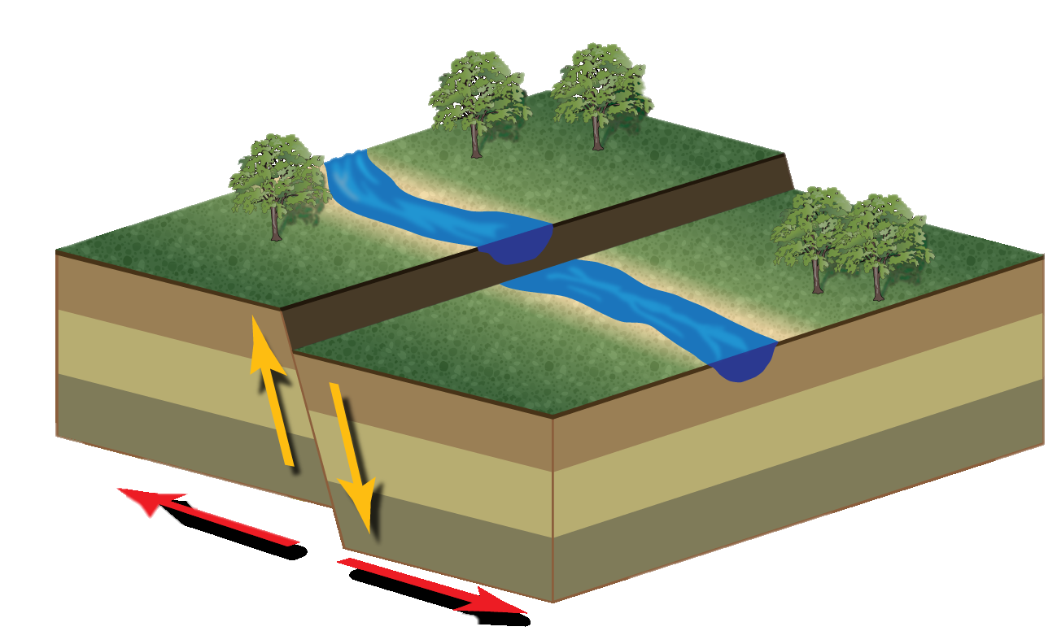
What are the effects and causes of earthquakes?
2.
Notes:
-the causes of earthquakes-
An earthquake is caused by -:
a sudden slip on a fault
When the rock on either side of a fault slowly deforms over time due to tectonic forces.
-The effects of earthquakes-
-The effects of earthquakes include-:
ground shaking
surface faulting
ground failure
and less commonly, tsunamis.

Slide 5
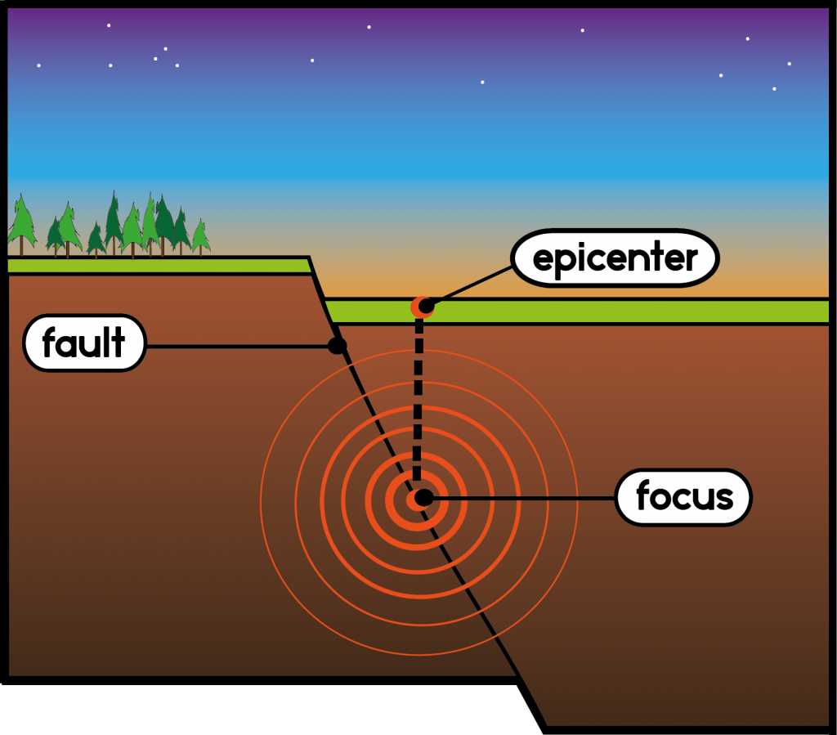
What are the factors that affect the intensity of an earthquake?
3.
Notes:
Magnitude
Distance from the epicenter(the part of the earth's surface directly above the starting point of an earthquake)
Depth to the hypocenter(is the position where the strain energy stored in the rock is first released, marking the point where the fault begins to rupture)
Local rock and soil conditions

Slide 6
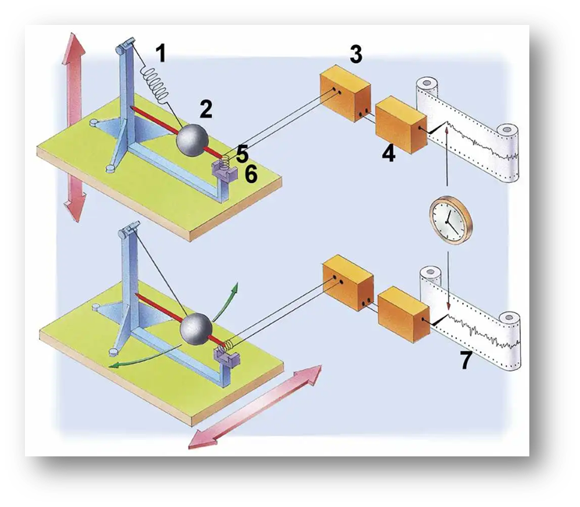
4.
What are the methods to detect and measure earthquakes?
Notes:
-To detect and measure earthquakes we use Seismometers-:
Seismology is the study of earthquakes and seismic waves that move through and around the Earth.
A seismologist is a scientist who studies earthquakes and seismic waves.

Slide 7
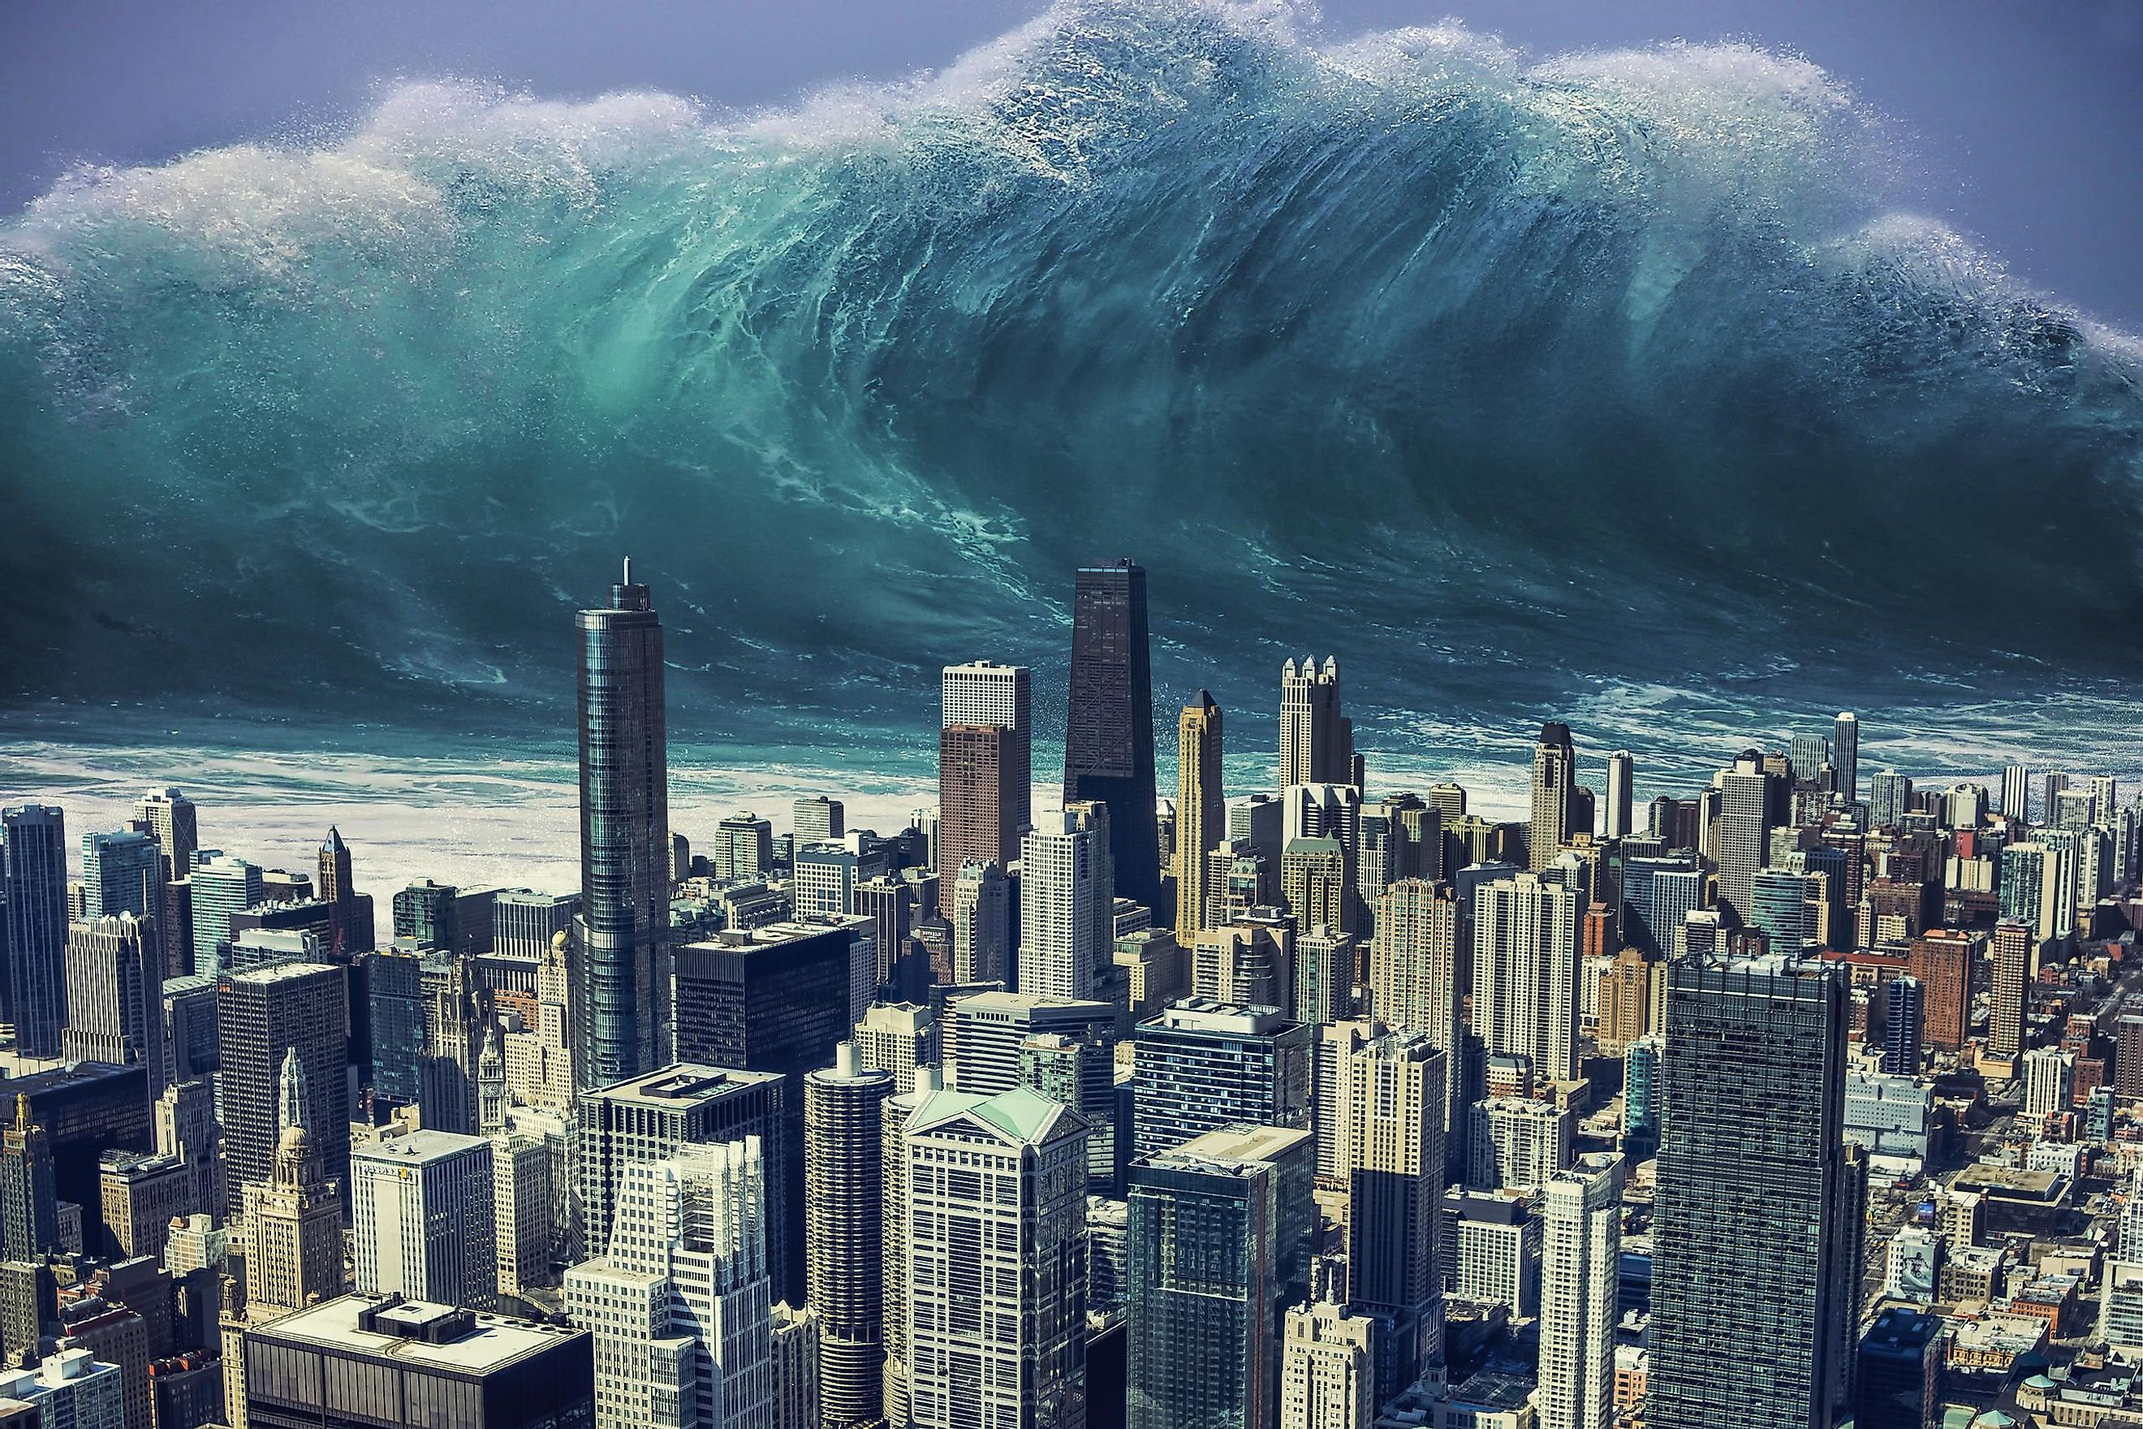
What are the impacts of earthquakes on the natural environment?
5.
Notes:
ground cracks
slope movements
dust clouds
liquefactions
Tsunamis
trees shaking
jumping stones.

Slide 8
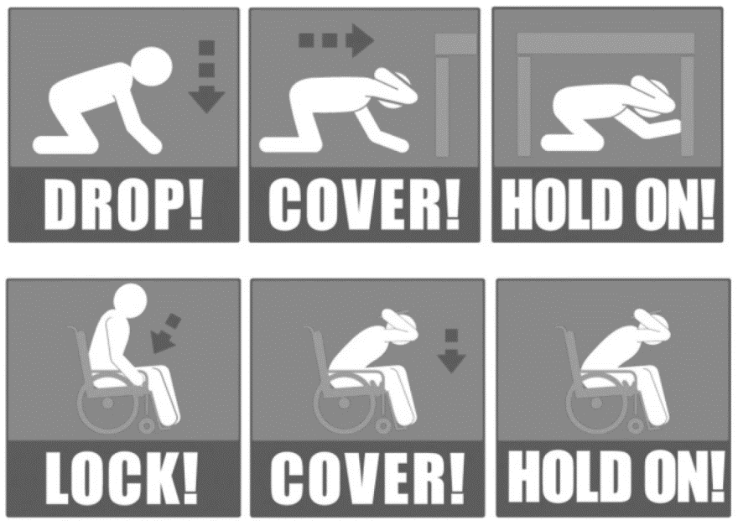
how can you survive an earthquake?
6.
Notes:
To survive an earthquake you need to cover your head and neck with your arms. If a sturdy table or desk is nearby, crawl underneath it for shelter. If no shelter is nearby, crawl next to an interior wall (away from windows).

Slide 9
1-https://www.usgs.gov/programs/earthquake-hazards/what-are-effects-earthquakes 2-https://www.mtu.edu/geo/community/seismology/learn/earthquake-cause/ 3-https://www.iris.edu/hq/inclass/animation/intensityintroduction_to_4_modules 4-https://ui.adsabs.harvard.edu/abs/2017EGUGA..19.3884M/abstract 5-https://spaceplace.nasa.gov/earthquakes/en/
Resources:

Slide 10
Thank you =)

