Slide 1
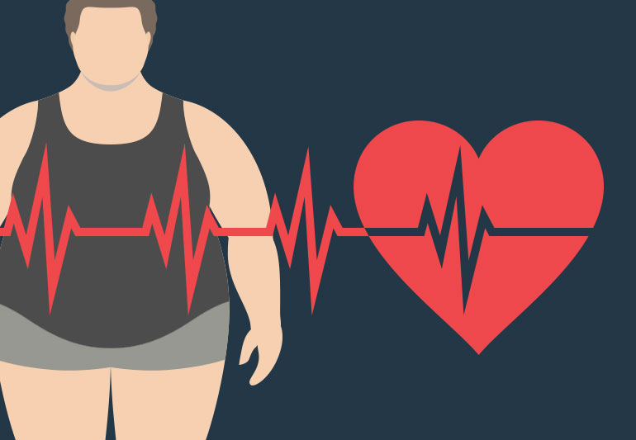
Obesity
By omar, rawad, michael

Slide 2
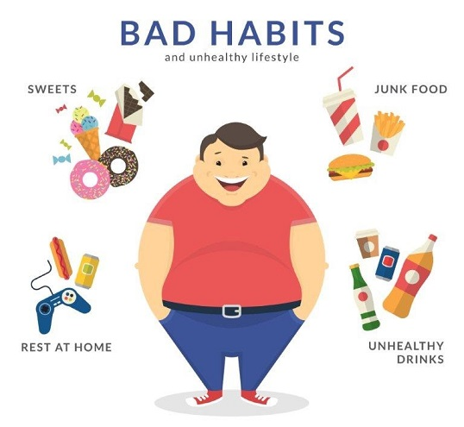
What is obesity?
To start off, we need to understand what obesity is, it is the abnormal or excessive fat accumulations that pose a health concern.
Social determinants of health are the circumstances in which we live, learn, work, and play. If these factors do not promote health, it may be challenging to choose nutritious foods and obtain adequate exercise.
13% of adults in the world are obese. 39% of adults in the world are overweight. One-in-five children and adolescents, globally, are overweight
It is also known as BMI (Adult Body Mass Index) and if your BMI is above 30,

Slide 3
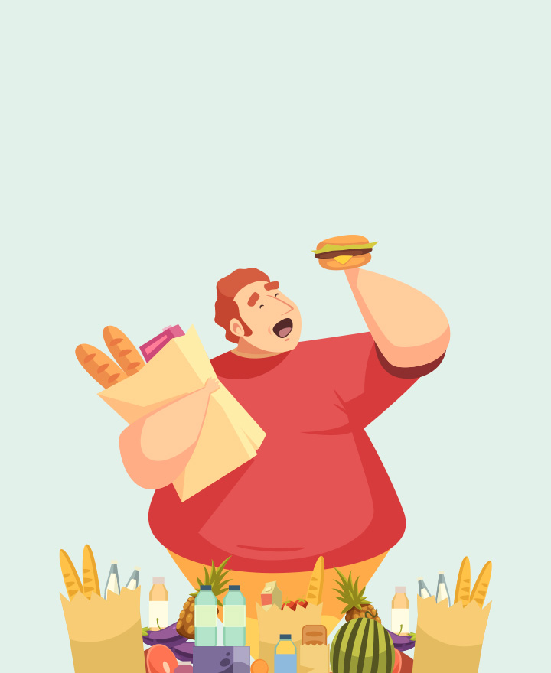
How is it caused?
Obesity or weight increase can result from some disorders, like Cushing's disease. The use of medications like steroids and some antidepressants might result in weight gain. The impact of additional elements, such as chemical exposures and the microbiota, is still being studied.
Genetics:
Genetic changes in human populations occur too slowly to be responsible for the obesity epidemic.
Bad eating habits:
It places a focus on a range of fruits and vegetables, whole grains, a selection of lean protein rich foods, and dairy products that are low in fat and fat-free. Additionally, it restricts items that include sodium, solid fats, or added sugars.

Slide 4
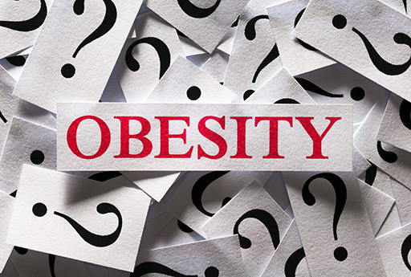
Consequences of obesity
In 2019, it was anticipated that the annual cost of medical care associated to obesity in the United States will be close to $173 billion.9 The annual productivity costs of obesity-related absenteeism in the United States range from $3.38 billion ($79 per obese person) to $6.38 billion ($132 per obese person).10
Those who are obese are more likely to develop a wide range of significant illnesses and medical issues than those who are a healthy weight. Additionally, obesity and the health issues it causes have a large financial impact on the US healthcare system. Also impacted by obesity is military readiness.

Slide 5
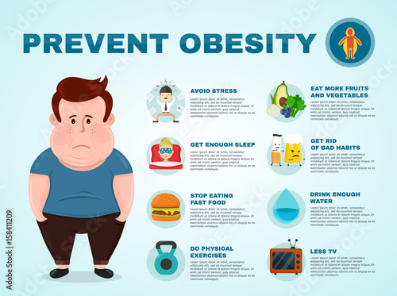
How can it be prevented?
Evidence suggests that policies and environmental changes aimed at preventing obesity should emphasize on a few important behaviors:
1 Restricting unhealthy foods (red meat, potatoes, processed grains and sweets, etc.);
2 stepping up physical activity.
Sleep:
Newborns need 14 to 17 hours of sleep per day. That amount decreases with age; teenagers need 8 to 10 hours of sleep per day, and adults need 7 or more hours of sleep per day.
Physical activities:
kids between the ages of 3 and 5 should be active throughout the day. Children between the ages of 6 and 17 must engage in 60 minutes or more of moderate to intense physical activity each day.

Slide 6
sources
https://www.cdc.gov/obesity/basics/consequences.html
https://www.cdc.gov/
https://www.medicalnewstoday.com/articles/323691
https://www.mayoclinic.org/diseases-conditions/obesity/symptoms-causes/syc-20375742

Slide 7
Thank you for listening!

