Slide 1
Earthquakes
By: Taimour, Rayan, Adam

Slide 2
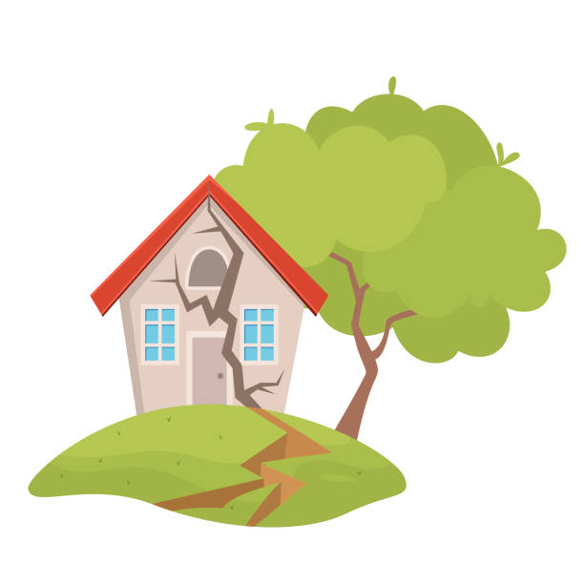
What Causes Earthquakes?
Notes:
An earthquake is caused by a sudden slip on a fault. The tectonic plates are always slowly moving, but they get stuck at their edges due to friction. When the stress on the edge overcomes the friction, there is an earthquake that releases energy in waves that travel through the earth’s crust and cause the shaking that we feel.

Slide 3
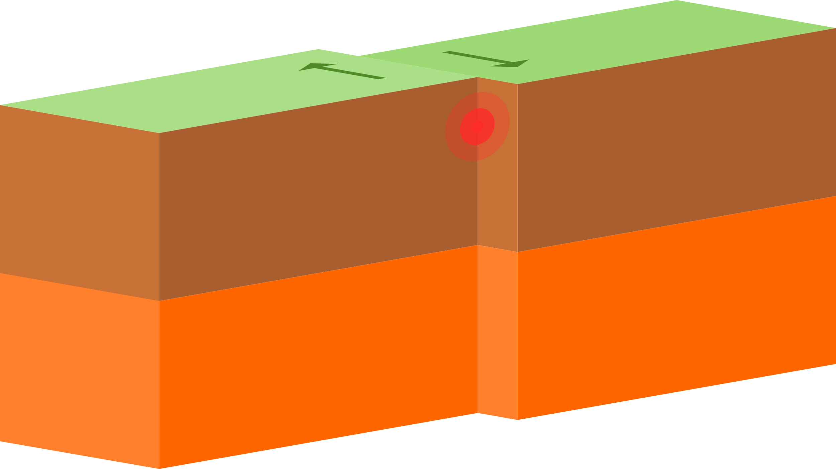
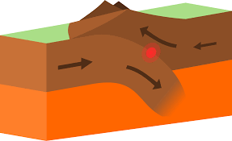
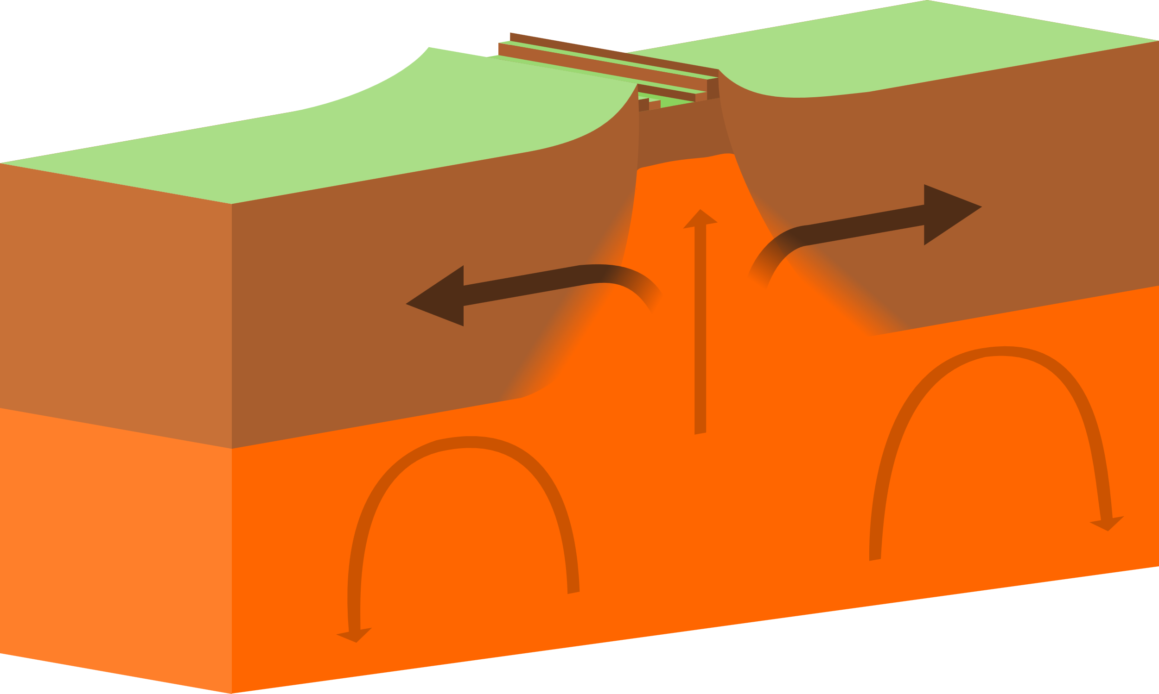
Different Types of Tectonic Plates
Notes:
There are three kinds of plate tectonic boundaries: divergent, convergent, and transform plate boundaries.

Slide 4
The effects of Earthquakes on the Environment
Notes:
The effects from earthquakes include ground shaking, surface faulting, ground failure, and less commonly, tsunamis.

Slide 5
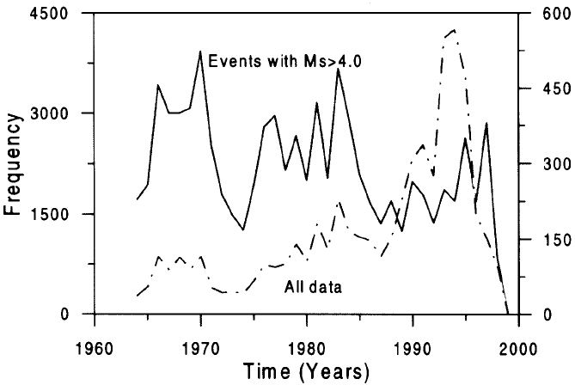
The factors that affect the intensity and frequency of earthquakes.
Notes:
When an earthquake strikes, the intensity of earthquake shaking determines the severity of damage. In turn, the main factors affecting earthquake shaking intensity are earthquake depth, proximity to the fault, the underlying soil, and building characteristics—particularly height.

Slide 6
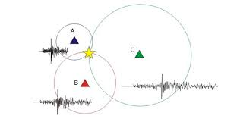
Methods used to detect, measure and predict earthquakes.
Earthquake casualties
Notes:
Seismometers allow us to detect and measure earthquakes by converting vibrations due to seismic waves into electrical signals, which we can then display as seismograms on a computer screen. Seismologists study earthquakes and can use this data to determine where and how big a particular earthquake is. earthquake.

Slide 7
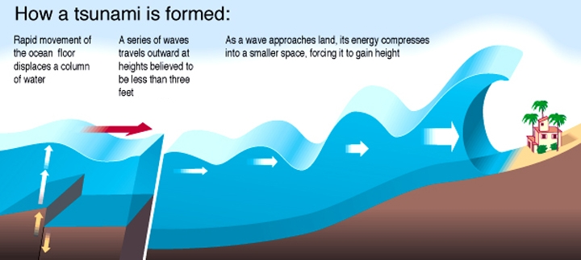
How is a Tsunami Formed?
Notes:
A tsunami is a series of extremely long waves caused by a large and sudden displacement of the ocean, usually the result of an earthquake below or near the ocean floor. This force creates waves that radiate outward in all directions away from their source, sometimes crossing entire ocean basins.

Slide 8
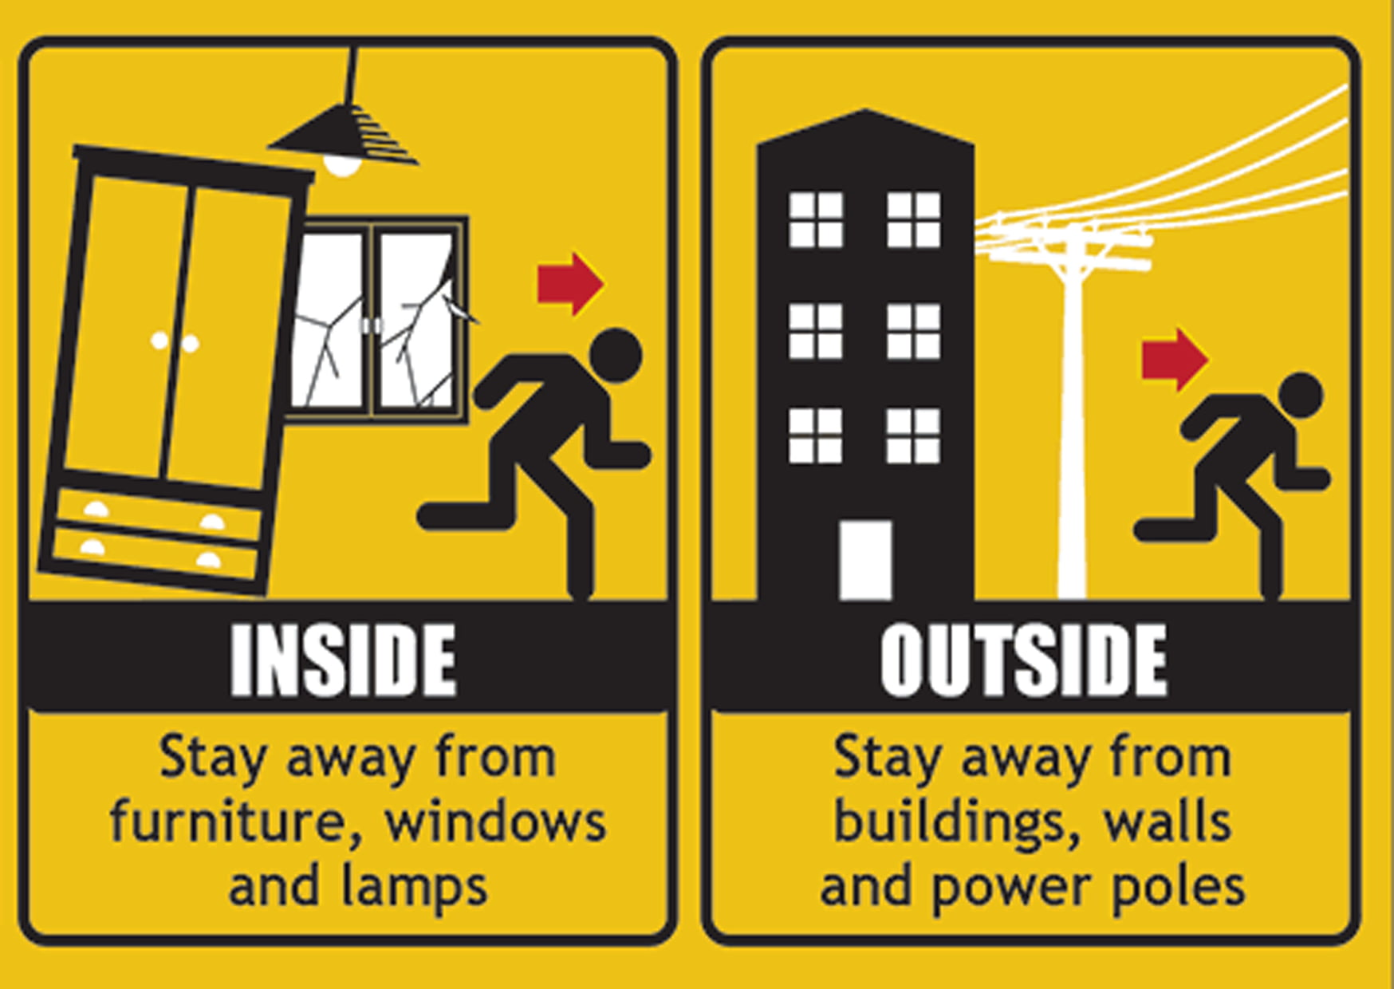
What are the actions to take during an Earthquake?

Slide 9
Sources (1/2)
https://www.usgs.gov/faqs/what-earthquake-and-what-causes-them-happen#:~:text=The%20tectonic%20plates%20are%20always,the%20shaking%20that%20we%20feel.
https://oceanexplorer.noaa.gov/facts/plate-boundaries.html#:~:text=There%20are%20three%20kinds%20of,convergent%2C%20and%20transform%20plate%20boundaries.
https://www.usgs.gov/programs/earthquake-hazards/what-are-effects-earthquakes
https://www.usgs.gov/faqs/how-do-earthquakes-affect-buildings#:~:text=Many%20factors%20influence%20the%20strength,geology%2C%20and%20the%20soil%20type.
https://www.bgs.ac.uk/discovering-geology/earth-hazards/earthquakes/how-are-earthquakes-detected/#:~:text=Seismometers%20allow%20us%20to%20detect,big%20a%20particular%20earthquake%20is.
https://www.noaa.gov/education/resource-collections/ocean-coasts/tsunamis#:~:text=A%20tsunami%20is%20a%20series,sometimes%20crossing%20entire%20ocean%20basins.

Slide 10
Sources (2/2)
https://www.cdc.gov/disasters/earthquakes/during.html#:~:text=Move%20away%20from%20buildings%2C%20utility,there%20until%20the%20shaking%20stops.

Slide 11
Thank You

