Slide 1
Bullying
By: Natalie Mansour, Haya baqleh, reena abuzalaf 6a
resources
https://www.twinkl.co.uk/teaching-wiki/bullying
https://www.bullyzero.org.au/statistics-and-figures
https://newsroom.unsw.edu.au/news/health/kids-autism-spectrum-experience-more-bullying
https://www.stopbullying.gov/cyberbullying/what-is-it
https://www.positiveaction.net/blog/social-bullying
https://www.yourlifeyourvoice.org/Pages/Social-Bullying.aspx

Slide 2
https://www.youtube.com/watch?v=iFlrCuSyhvU
Physical bullying — using violence to cause physical harm
Verbal bullying — using words to cause emotional harm
Social bullying — using various means to damage the victim’s social reputation or relationships
Cyberbullying — using digital means to bully
The consequences: Physical harm, emotional harm, damaging the victim’s social reputation or relationships, digital means to hurt the victim.
The issue; bullying might cause harm to the person who is being bullied, and he/she might want to revenge on the bully that has to deal with another physical harm

Slide 3
The issue : this person is getting harmed, if he fell hard it may cause injuries that might hurt him, and cause serval problems .
The term ‘bullying’ is often used to describe lots of different kinds of aggressive or rude behavior. Bullying is intentionally harmful behavior that is often repeated over time.
Soultion:to stop bullying tell your parents or teacher or tell him or her to stop

Slide 4
Solution: tell an adult or tell the teacher.
The consequences: it can ruin the person who is being bullied his/her reputations and relationships.
The issue: this person I being bullied my two white kids they are bullying him because he is black, and he might start to blame his self why is he black even though its not his problem

Slide 5
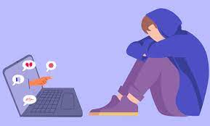
The consequences: it can cause distress, and makes the person suffer from depression, while bullying in him/her through out the social media.
The issue: this boy is being bullied on social media and that causes depression and anxiety
Cyberbullying is bullying that takes place over digital devices like cell phones, computers, and tablets. Cyberbullying can occur through SMS, Text, and apps, or online in social media, forums, or gaming where people can view, participate in, or share content.

Slide 6
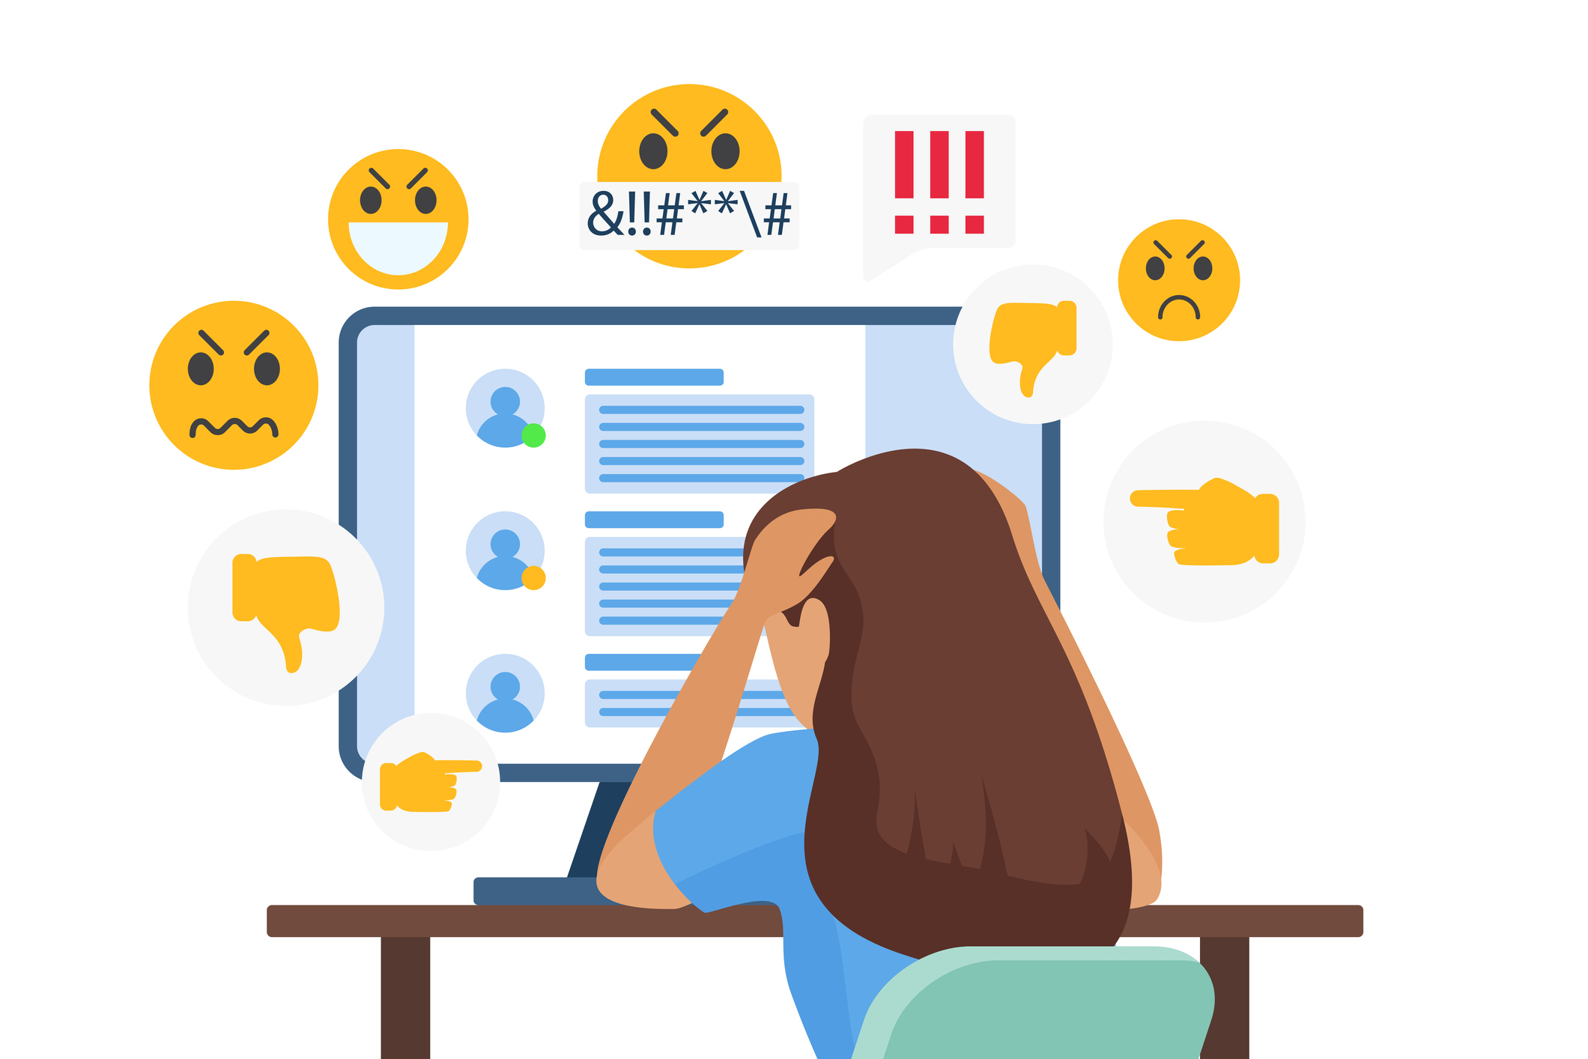
The issue; this is also an example for cyberbullying, and this girl might have stress from all of it, its not nice to bully someone like this , its not even nice to bully.
Solution: report these people to the web or to the internet.
If anything, new technology is making it tougher to avoid bullying. With smartphones, tablets and laptops, kids can encounter cyberbullying, even when they aren’t at school.

Slide 7
The issue: this person is being bullied just because he is different, more like the “odd one out” he feels left out and annoyed because he is being bullied by different people
Social bullying is done with the intent to hurt somebody's reputation, relationships, or social standing. It could include spreading a story to damage someone's reputation, or having others ignore or threaten a friend.

Slide 8
التنمر حول العالم
كسر عشري | كسر عادي | النسبة المئوية | البلد | السنة
0.24 | 24 100 | 24% | الاردن | 2023
0.29 | 29 100 | 29% | مصر | 2023
0.061 | 6.1x10............ 100x10.............. | 6.1% | العراق | 2023
0.37 | 37 100 | 37% | كوريا الجنوبية | 2023
0.04 | 4 100 | 4% | هولندا | 2023

