Slide 1
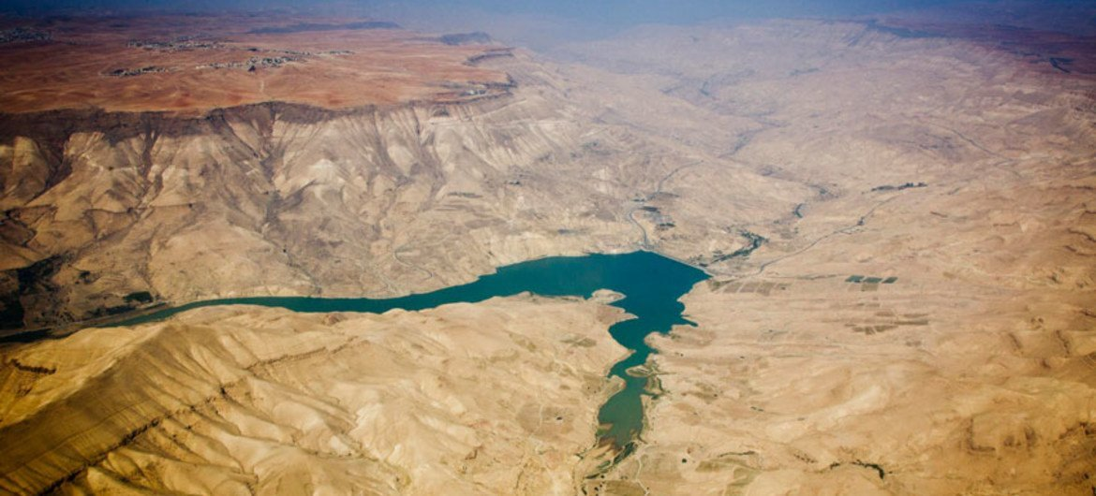
Water Crisis In Jordan
Done By: Majed Abu Barham, Michael Elwerr , Rami Sunna

Slide 2
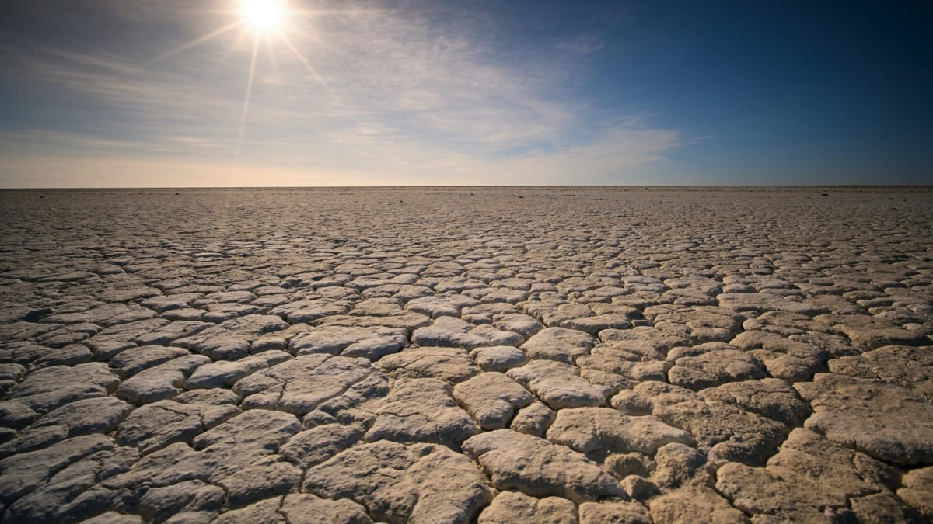
Water Crisis
Water crisis is a lack of managing water so badly that billions of people and the environment suffer badly. There are different types of water crisis which are water pollution, Physical water scarcity and Economic water scarcity.

Slide 3
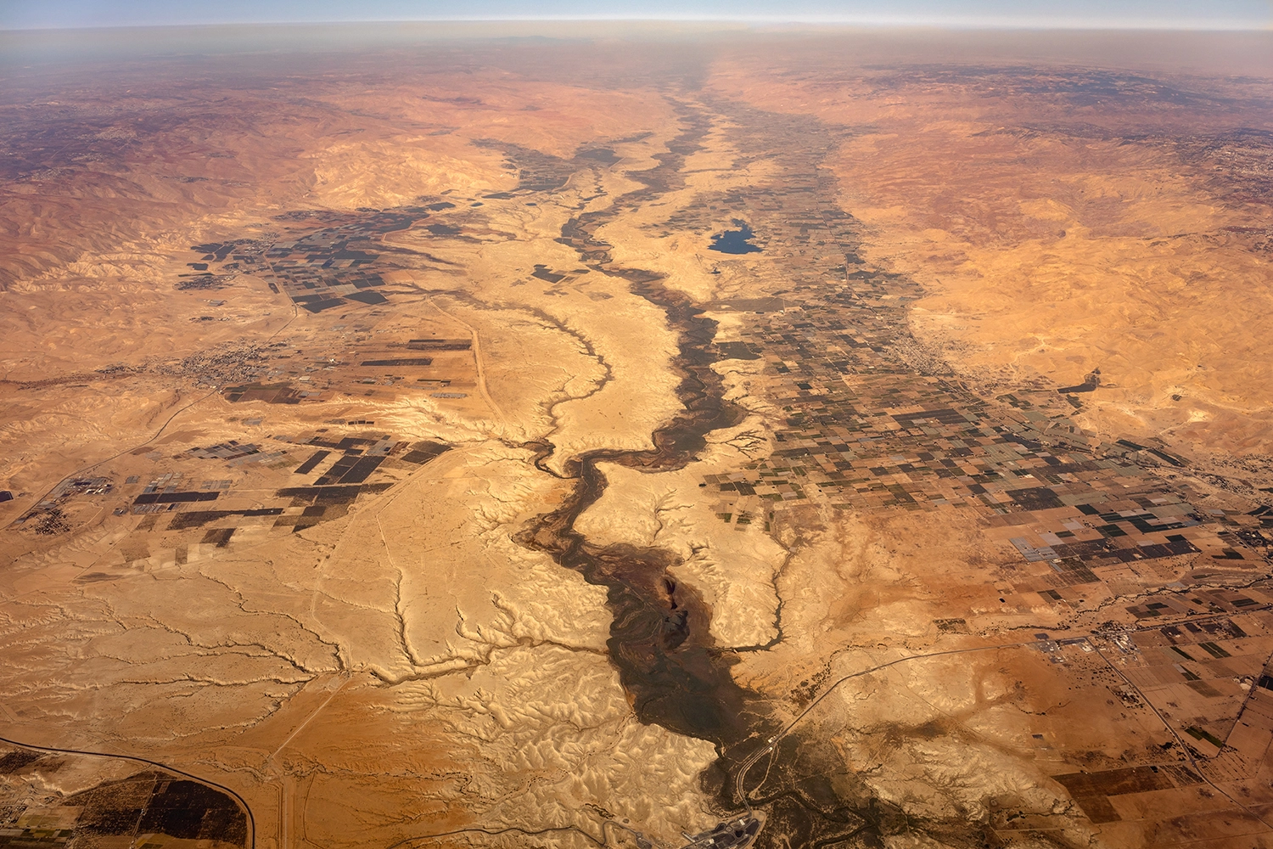
Water crisis in Jordan
Jordan is the second most water scarce country in the world. Jordan’s annual renewable water resources are less than 100 m³ per person, significantly below the threshold of 500 m³ per person which defines severe water scarcity.

Slide 4
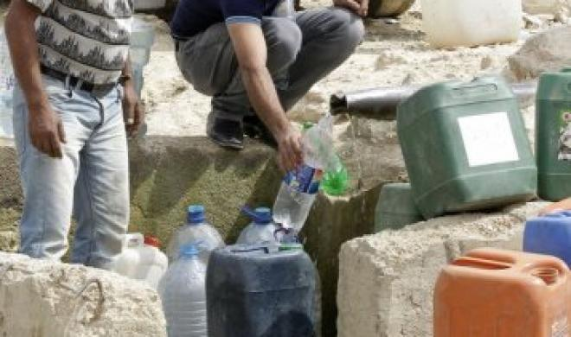
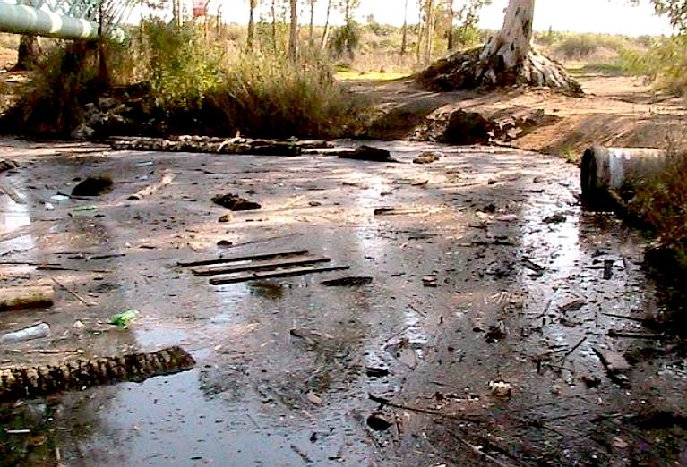
Issues of water Crisis In Jordan
Water pollution
The overflow of wastewater pumping stations, leaks from sewage systems and exposure to industrial and commercial waste.
Water shortage
Jordan is one of the most water-scarce countries in the world. The country's renewable water supply currently meets around two-thirds of the population's water demands, with groundwater being used twice as quickly as it can be replenished.

Slide 5
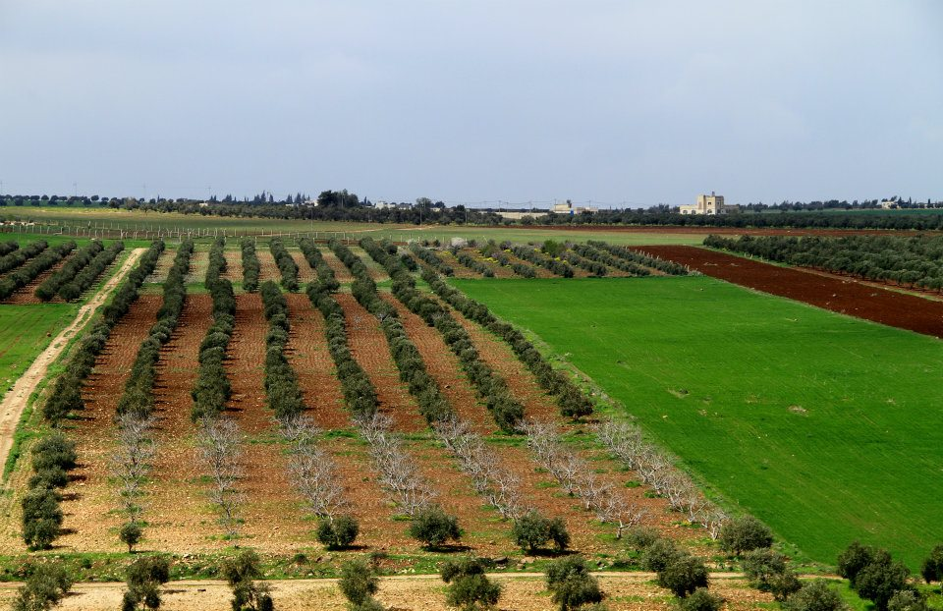
Consequences of water crisis In Jordan
water shortage
Water stress and shortages can lead to worsened educational outcomes. Increased water stress can also lead to crop failure, import dependency, and increased costs for consumers and businesses
water pollution
Water pollution has resulted in nitrate and phosphorus contamination of water supplies . lack of access to safe water causes around 1.6m deaths every year.

Slide 6
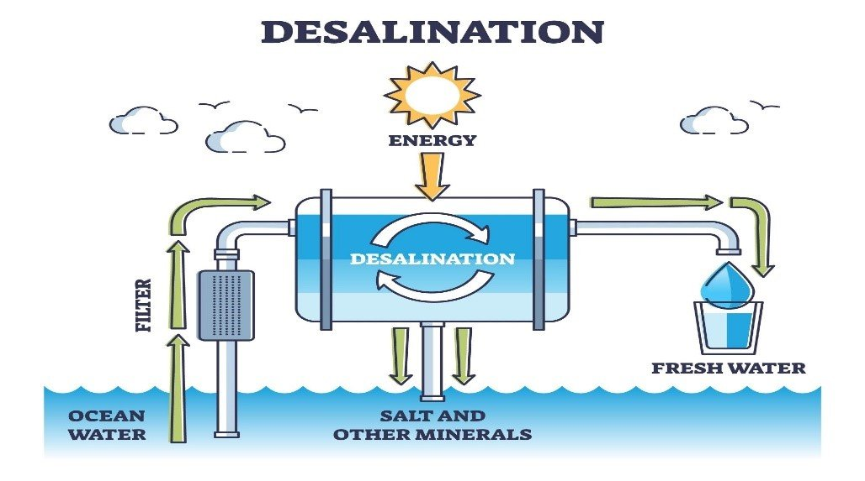
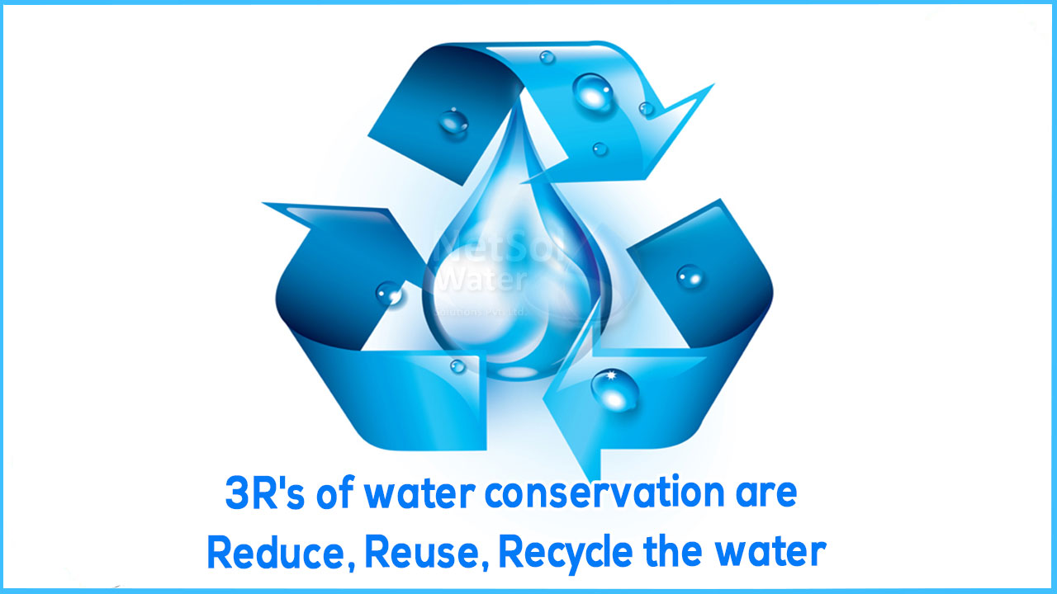
Solutions for water shortage and water pollution in Jordan
Solutions for water shortage
desalination of seawater and recycling of wastewater. Desalination can provide a safe drinking water to areas facing severe water scarcity.
The other way to counter water scarcity in Jordan is by recycling and reuse of municipal waste water which is an attractive method in terms of water savings.
Solutions for water pollution
Scaling up alternative water technologies, including water saving and reuse, and engaging children as agents of change on water conservation, in communities and through school Environment Clubs.

Slide 7
Water crisis. Water Crisis | World Water Council. (n.d.). https://www.worldwatercouncil.org/en/water-crisis#:~:text=It%20is%20a%20crisis%20of,the%20crisis%20to%20be%20worsening.
Water, sanitation and hygiene. UNICEF Jordan. (2020b, November 4). https://www.unicef.org/jordan/water-sanitation-and-hygiene#:~:text=Challenges,which%20defines%20severe%20water%20scarcity.
Saiesha. (2022, April 14). 7 facts about water scarcity in Jordan. The Borgen Project. https://borgenproject.org/water-scarcity-in-jordan/#:~:text=The%20overflow%20of%20wastewater%20pumping,phosphorus%20contamination%20of%20water%20supplies.
Water Resources & Environment: Basic page: Jordan. U.S. Agency for International Development. (2022, August 16) https://www.usaid.gov/jordan/water-resourcesenvironment#:~:text=Jordan%20is%20one%20of%20the,as%20it%20can%20be%20replenished.
| N. A. A. (2023, February 6). Ways to counter water scarcity in Jordan. EcoMENA. https://www.ecomena.org/water-scarcity-jordan/#:~:text=The%20other%20way%20to%20counter,highest%20levels%20in%20the%20world.

Slide 8
Water stress in Jordan - Executive Summary. UNICEF Jordan. (n.d.). https://www.unicef.org/jordan/water-stress-jordan-executive-summary#:~:text=Water%20shortages%20could%20have%20a,GDP%20and%2070%25%20of%20employment.
Saiesha. (2022, April 14). 7 facts about water scarcity in Jordan. The Borgen Project. https://borgenproject.org/water-scarcity-in-jordan/#:~:text=Pollution%3A%20Pollution%20is%20exacerbating%20water,phosphorus%20contamination%20of%20water%20supplies.
The costs of the water crisis in Jordan. UNICEF Jordan. (n.d.). https://www.unicef.org/jordan/costs-water-crisis-jordan#:~:text=Production-,Agriculture,costs%20for%20consumers%20and%20businesses.

