Slide 1
fortnite
What I have

Slide 2
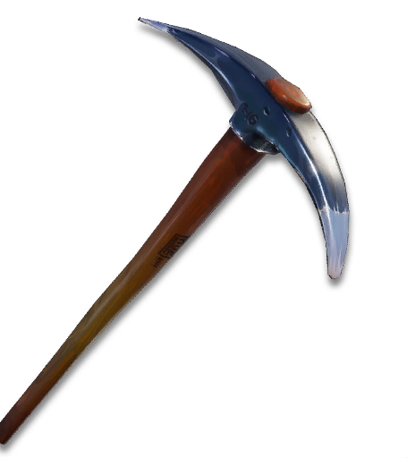
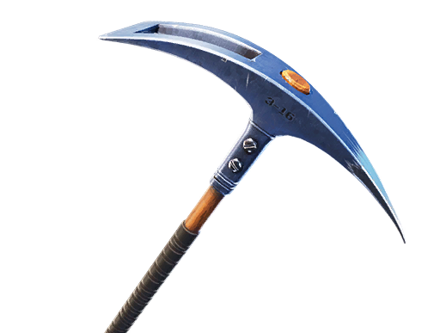
pickaxes
Throwback pickaxe was free
This Photo by Unknown Author is licensed under CC BY-SA-NC
This Photo by Unknown Author is licensed under CC BY-SA-NC

Slide 3
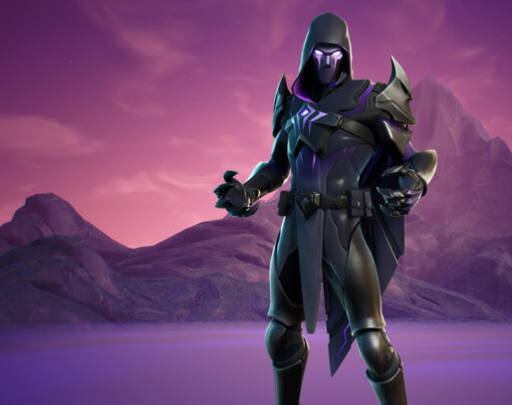
skins
My favorite skin is dread omen that’s why I told nizar to gift it to me because I killed him with pickaxe.

Slide 4
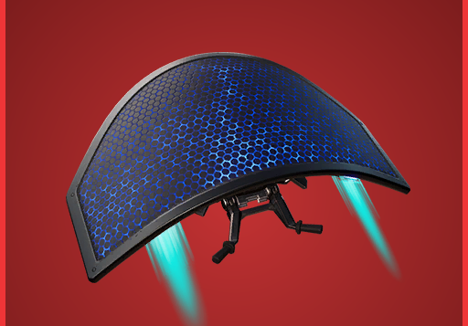
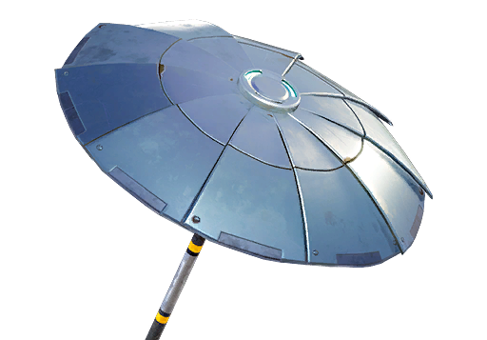
gliders
This Photo by Unknown Author is licensed under CC BY-SA-NC
I have 3 gliders I also have mighty marvel umbrella but I couldn’t find picture.☺

Slide 5
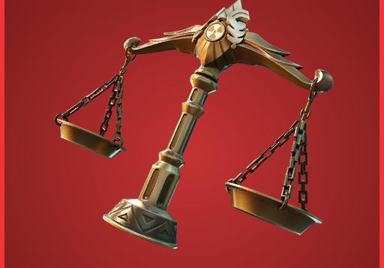
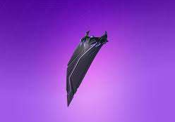
I have 2 backblings

Slide 6
I have no wrapping☹

Slide 7
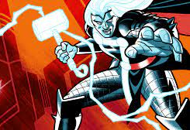
customizations
I have thor and iron man loading screen and one music.

Slide 8
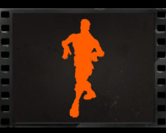
I have two emotes and two dances I also have thor and hulk and boogie down
This Photo by Unknown Author is licensed under CC BY-NC-ND

