Slide 1
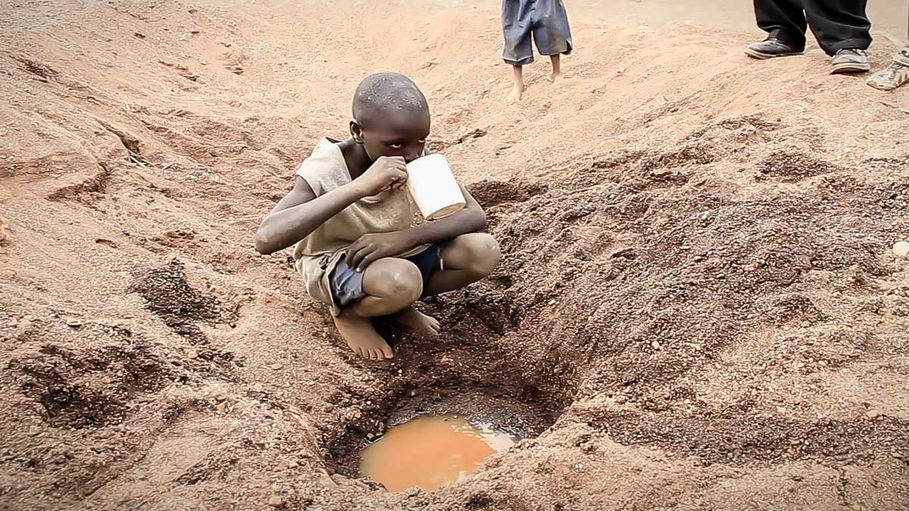
Water crisis

Slide 2
What is Water Crisis in Jordan?
Being one of the most arid countries in the middle east, Jordan is facing severe water shortages. The current per capita water supply in the country is 200 cubic meters per year which is almost one-third of the global average. To make matters worse, it is projected that Jordan's population is currently at 10 million, causing a drastic decline in per capita water availability to measly 91 cubic meters. Read on to know more about water scarcity in Jordan.

Slide 3
Population Growth(cause).
Population growth doesn’t just mean more water breakdown, but also more water needed for food production. In order to meet the food population difficulties from population growth, we will need to pump groundwater faster than it can be reloaded.

Slide 4
Demand(cause).
Demand is the Issue, Not Supply: About 93% of Jordanians have access to a safely-managed water source, according to internet reflecting enough infrastructure. However, in 2017, Jordan’s yearly water supply suitable to “less than 100m 3 per person, significantly below the United Nations’ threshold of 500m3 per person, which defines severe water scarcity,” reflecting the helplessness to meet population demand. This issue has worsened in recent years with the large influx of Syrian refugees.

Slide 5
Consequences
Reduction in water supply, reduced crop yields, and potential crop failures can significantly undermine Jordan’s agricultural production. Agriculture contributes roughly 5% to Jordan’s GDP, but it is responsible for more than 50% of the country's freshwater consumption.

Slide 6
consequences
children and young adults and babies being unable to practice significant and important hygiene behavior like hand-washing and proper disposal of menstruation products and personal hygiene and more. According to estimates, only around a third of schools in Jordan have adequate WASH facilities.

Slide 7
First Solution
The other way to counter water scarcity in Jordan is by recycling and reuse of municipal wastewater which is an attractive method in terms of water savings . In fact the reuse of the treated waste water in Jordan has reached one of the highest levels in the world.

Slide 8
Second solution
Achieving and maintaining WASH services in health care facilities is critical for universal quality health coverage, infection prevention and control (IPC), patient safety, and child and maternal health, in particular the time around child delivery.

Slide 9
CITATIONS
1.Water stress in Jordan - Executive Summary. UNICEF Jordan. (n.d.). https://www.unicef.org/jordan/water-stress-jordan-executive-summary#:~:text=Limited%20access%20to%20water%20results,Jordan%20have%20adequate%20WASH%20facilities
Water stress in Jordan - Executive Summary. UNICEF Jordan. (n.d.-a). https://www.unicef.org/jordan/water-stress-jordan-executive-summary#:~:text=Water%20shortages%20could%20have%20a,GDP%20and%2070%25%20of%20employment

Slide 10
citation
Deborah.bensen. (2023, April 20). How does population growth affect water scarcity? . Healing Waters. https://healingwaters.org/how-does-population-growth-affect-water-scarcity/#:~:text=Population%20growth%20doesn’t%20just,than%20it%20can%20be%20replenished
Saiesha. (2022, April 14). 7 facts about water scarcity in Jordan. The Borgen Project. https://borgenproject.org/water-scarcity-in-jordan/

Slide 11
citation
Water Resources & Environment: Basic page: Jordan. U.S. Agency for International Development. (2022, August 16). https://www.usaid.gov/jordan/water-resources-environment

Slide 12
By :Naser Sunna Nicola Shnoodi Nadeem Wakileh

