Slide 1
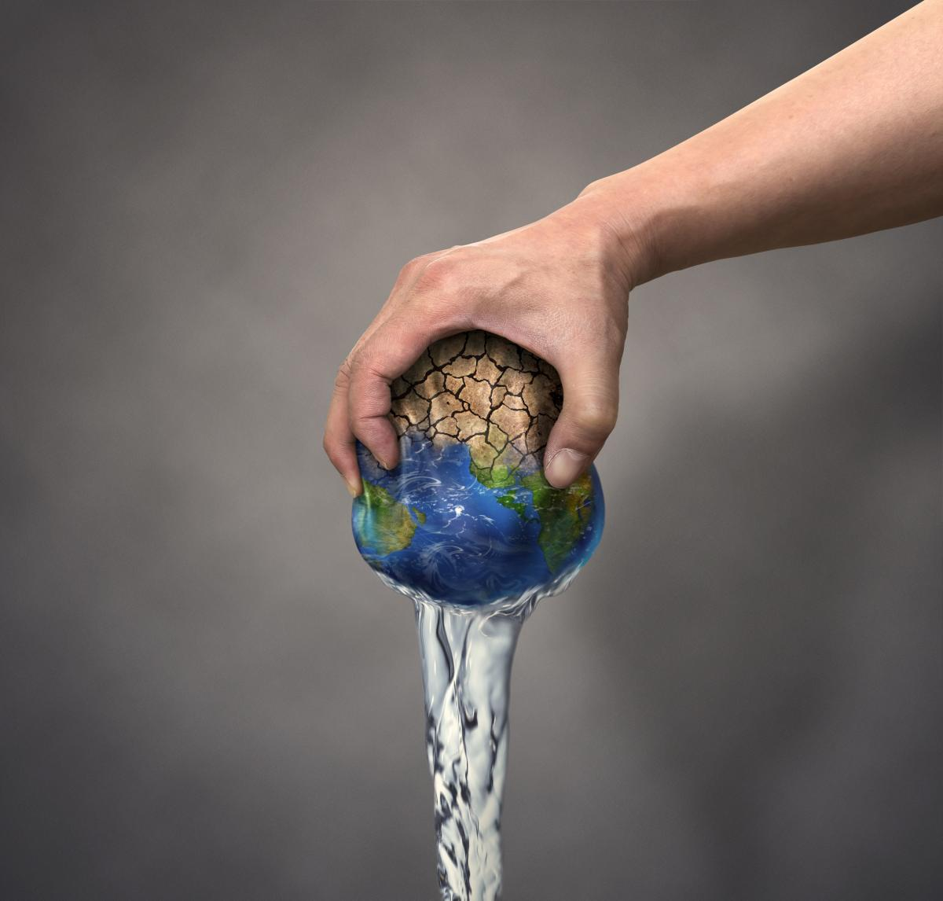
Improving your community - Water Crisis
Created by: Rita Halteh
Faris Ghawi & Rami Abu Eita
Created by: Rita Halteh

Slide 2
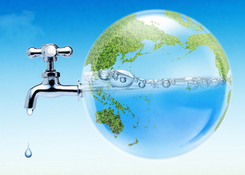
INTRODUCTION
The water crisis is a major global issue that affects many countries, including Jordan.
At the national level, the water crisis in Jordan is characterized by a lack of water resources and poor water management practices.
At the local level, Jordanian communities face a range of challenges related to the water crisis.

Slide 3
Causes of the water crisis
One of the main causes of the water crisis in Jordan is limited water resources. The country is located in an arid region, and its water supply is primarily dependent on rainfall and groundwater.
Another contributing factor is population growth. Jordan's population has grown rapidly over the past few decades, and this has put pressure on the country's limited water supply.

Slide 4
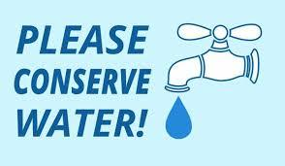
Action to improve the availability and quality of water resources
Promote water conservation: Encouraging households and businesses to reduce water use through conservation measures, such as installing low-flow fixtures and repairing leaks, can help reduce demand for water and ease pressure on limited water resources.

Slide 5
CONCLUSION
In conclusion, the water crisis is a serious issue that affects many communities in Jordan. There are several course of actions that can be taken to address this issue, such as promoting water conservation.

Slide 6
References
"Jordan Water Crisis: Causes, Effects and Solutions" by EcoMENA (https://www.ecomena.org/jordan-water-crisis/): This article provides a comprehensive overview of the water crisis in Jordan, including its causes, effects, and possible solutions.
"Water Crisis in Jordan" by World Bank (https://www.worldbank.org/en/news/feature/2017/07/12/water-crisis-in-jordan): This article discusses the impact of the water crisis on Jordan's economy, environment, and society, and suggests strategies for addressing the issue.
"Water Scarcity in Jordan: Causes, Impacts and Solutions" by EJARNAL (https://www.ejarnal.org/article/water-scarcity-in-jordan-causes-impacts-and-solutions): This article discusses the social, economic, and environmental impacts of the water crisis in Jordan, and proposes solutions for addressing the issue.
"Water Crisis in Jordan: Challenges and Solutions" by Water Journalists Africa (https://waterjournalistsafrica.org/2017/06/water-crisis-in-jordan-challenges-and-solutions/): This article provides an in-depth analysis of the water crisis in Jordan, including its political, economic, and environmental dimensions, and suggests ways to address the issue.

