Slide 1
Interdisciplinary Project
By: Samir, Rashed, Mohammed, Hashem

Slide 2
Table of Content
Table of Content
Topic | Slide Number
Introduction | 3,4
The causes and consequences leading to water scarcity in Jordan | 5,6
Water pollution in Jordan | 7
Water shortage in Jordan | 8
Proposals and Solutions | 9,10,11
Conclusion | 12
Citation and Resources | 13,14

Slide 3
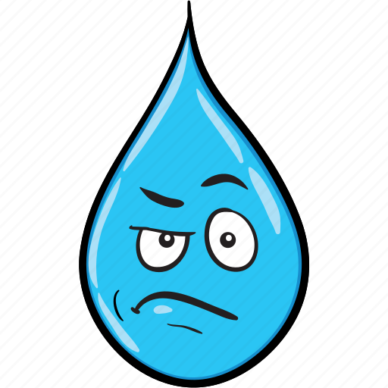
Water Crisis (Globally)
Water crisis is defined as having a serious lack of safe and clean water. Water connects every aspect of life. Access to safe water and sanitation can quickly turn problems into potential – empowering people with time for school and work, and contributing to improved health for women, children, and families around the world. Today, 771 million people – 1 in 10 – lack access to safe water.

Slide 4
Water Crisis (in Jordan)
Jordan is the second most water scarce country in the world.
Jordan’s annual renewable water resources are less than 100 m³ per person, significantly below the threshold of 500 m³ per person which defines severe water scarcity.
Another compounding factor is the high levels of non-revenue water (water leakage, illegal connections, meter losses), estimated at 52%, as well as the perception that water is not a scare resource & the high levels of subsidies.
The situation in informal settlements is of particular concern due to high rates of open defecation and the limited access to safe water.
Vulnerable households are forced to spend a large portion of their limited incomes on limited and poor-quality services.
This will compromise the resilience of water and sanitation services making it more complex the achievement towards Sustainable Development Goal 6.
Climate change is expected to have a significant impact on Jordan, most likely leading to increased temperatures, variation in precipitation patterns, extreme weather events, and flash flooding.
Key hygiene norms, including handwashing, are well-practiced in Jordan, but gaps remain in access to basic hygiene items for vulnerable households.

Slide 5
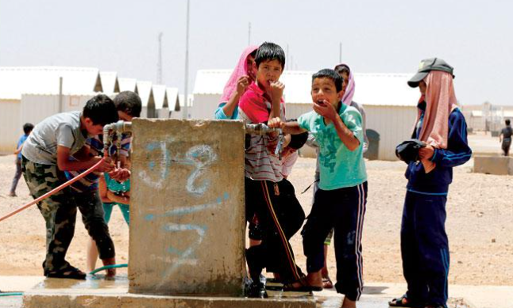
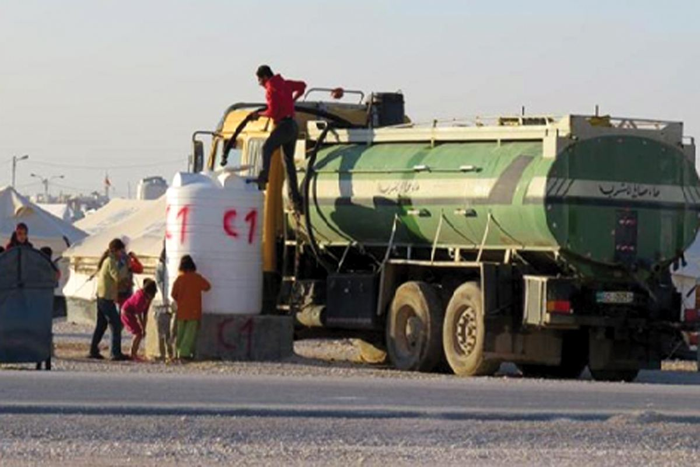
Causes of Water Crisis In Jordan
The demand exceeds the supply of water , and the gap between supply and demand is expected to widen.
The cost of using new sources such as water desalination is high.
Poor use of water where about 40-50% of it is lost.
Dilapidated water networks that are spread all over the country.
Sometimes illegal usage and theft.
Climate change, rapid population growth, increasing industrial development, these all are causes of water crisis in Jordan.

Slide 6
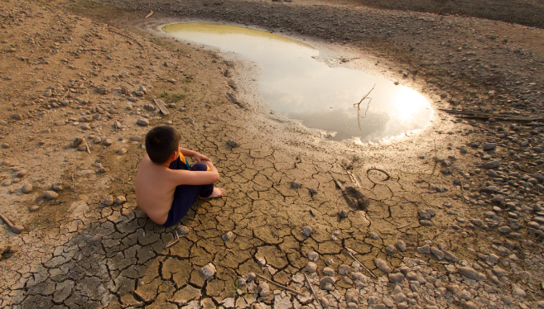
Consequences of Water Crisis In Jordan
Economic decline may occur.
When water runs dry, people can’t get enough to drink, wash, or feed crops.
Water dryness can lead do deadly diseases, including cholera and typhoid fever.
When water becomes scarce, natural landscapes often lose out.

Slide 7
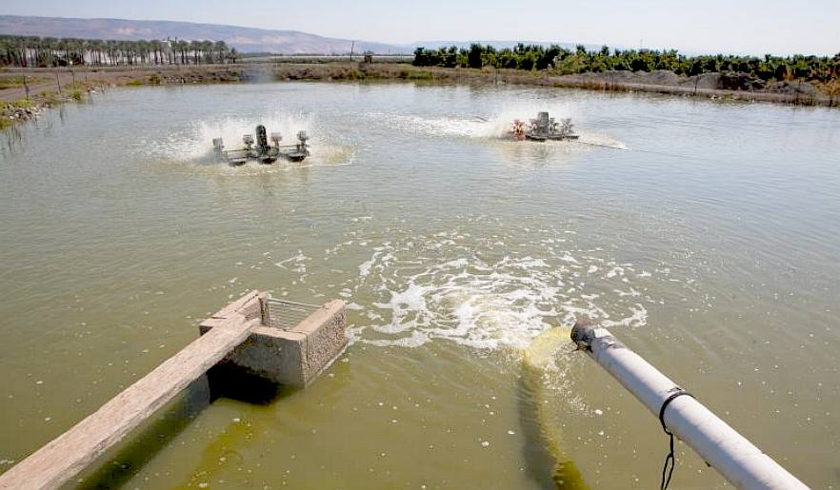
Water Pollution in Jordan
Due to water pollution, contaminated and unsafe water is another contributing factor of water crisis.
Water pollution can come from a number of sources, including sewage and wastewater.
Consequently, precious water resources get contaminated resulting in less fresh water and drinking water available.
Pollution is due to over-pumping of aquifers, seepage from landfill sites, and improper disposal of dangerous chemicals.

Slide 8
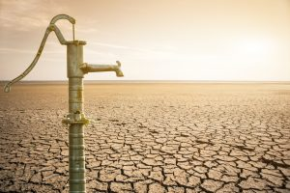
Water Shortage in Jordan
The current per capita water supply in the country is 200 cubic meters per year which is almost one-third of the global average.
Water shortage in Jordan is caused by unsustainable groundwater extraction.
Drought causes water shortage in Jordan since it can refuse access to clean water in Jordan.
Water shortage increases stress on water resources that are significant to Jordanian’s lives.

Slide 9
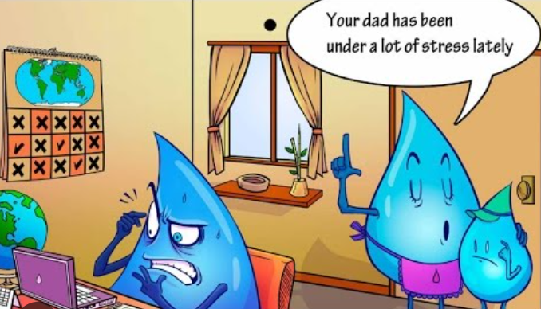
Proposals and Solutions
Reform the water sector by managing
and using water resources carefully.
Work on the implementation of the Bahrain conveyor project and develop the Disi Basin.
Groundwater replenishment.
Using new technological methods for water treatment, such as sea desalination.
Water safety and public health.
To install new water networks all around Jordan.
To maximize the water theft punishments by developing the legislations.

Slide 10
Our Achievement (Solution) Two of our colleagues in the group developed a smart mobile application as a part of a research of Fouad Farraj Award as a contribution that will mitigate the water crises and be part of the crises solution in Jordan.
We figured out that we need to use the technology revolution and the ease of use of smartphones to find the right solution to the problem of water losses.
The wireless sensors will be measuring the intake water pumped and the loss water after a programmed closure from the relevant authorities.
If there is no significant water loss, the application will show specific information for the knowledge of the user. But if there is a water loss the user and the relevant authorities will be notified for urgent actions.
The idea is to cooperate with the relevant authorities to implement wireless sensors in the small reservoirs in the houses to measure the water levels.
The Mobile application will be the link between the sensor and the user to inform him/her that a significant water loss is been attributed to their water level and this need to be modified.

Slide 11
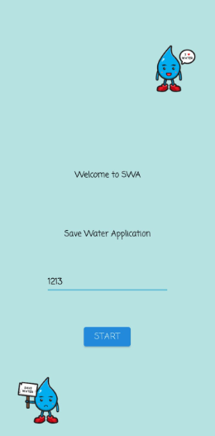
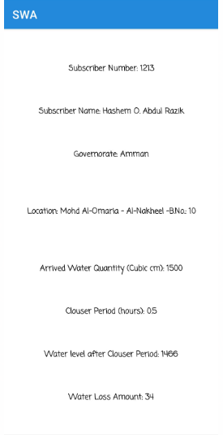
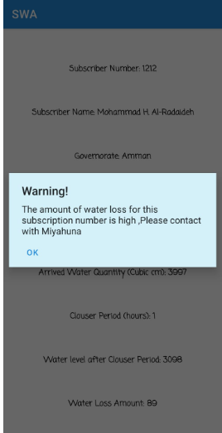
Save Water Application Solution (SWA)

Slide 12
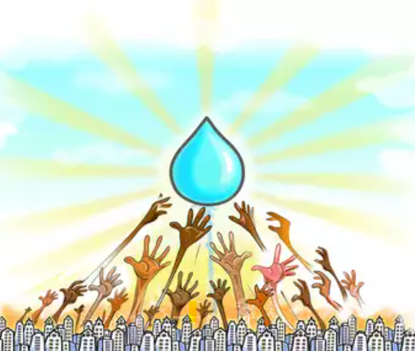
Conclusion
Jordan is a country that lacks access to clean water due to water pollution and water shortage.
Water in Jordan gets less in many such as illegal usage and theft, also sometimes other global problems can affect it like climate change rapid population and intensive farming.
When water crisis is occurring in a certain place sometimes there can be like economic decline in addition, when water runs dry people can’t drink, wash neither feed crops.
Due to water pollution that has lacked access to clean and fresh water that is unsafe to drink. Water pollution comes from the sewage and wastewater.
Jordanians can solve this dilemma by building new water networks instead of the ones that have been damaged and broken. Moreover, Jordan can maximize the water theft punishments by developing the legislations.

Slide 13
Resources (Citated)
Water crisis - learn about the global water crisis. Water.org. (n.d.). https://water.org/our-impact/water-crisis
Water, sanitation and hygiene. UNICEF Jordan. (2020a, November 4). https://www.unicef.org/jordan/water-sanitation-and-hygiene
World Wildlife Fund. (n.d.). Water scarcity. WWF. https://www.worldwildlife.org/threats/water-scarcity
Mulhern, O. (2021, January 5). Jordan - ranked 30th in the global sustainability index. Earth.Org. https://earth.org/global_sustain/jordan-ranked-30th-in-the-global-sustainability-index
A. D. (2022, May 28). Water scarcity in Jordan: An overview. EcoMENA. https://www.ecomena.org/water-jordan/.

Slide 14
Thank you for listening!

