Slide 1
Earthquakes
By Karam Gammoh and Sanad MASANNAT 6E

Slide 2
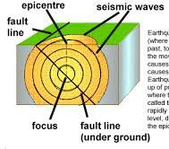
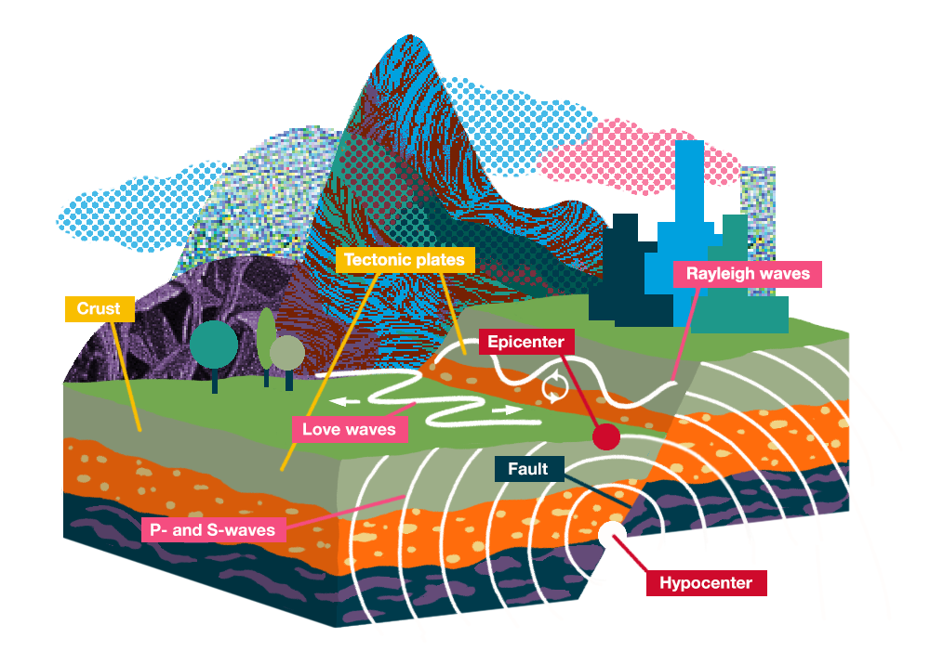
What are Earthquakes?
Notes:
An earthquake is the ground shaking caused by a sudden slip on a fault. Stresses in the earth's outer layer push the sides of the fault together. The point where the earthquake starts is called the focus. The point at ground level directly above the focus is called the epicenter. The force of the earthquake (and destruction) is most severe at the epicenter and lessens gradually away from the center.
Earthquakes happen in waves and are called seismic waves. The waves travel in circles away from the epicenter and can travel thousands of kilometers. Smaller earthquakes usually happen after the main one and are called after-shocks.

Slide 3
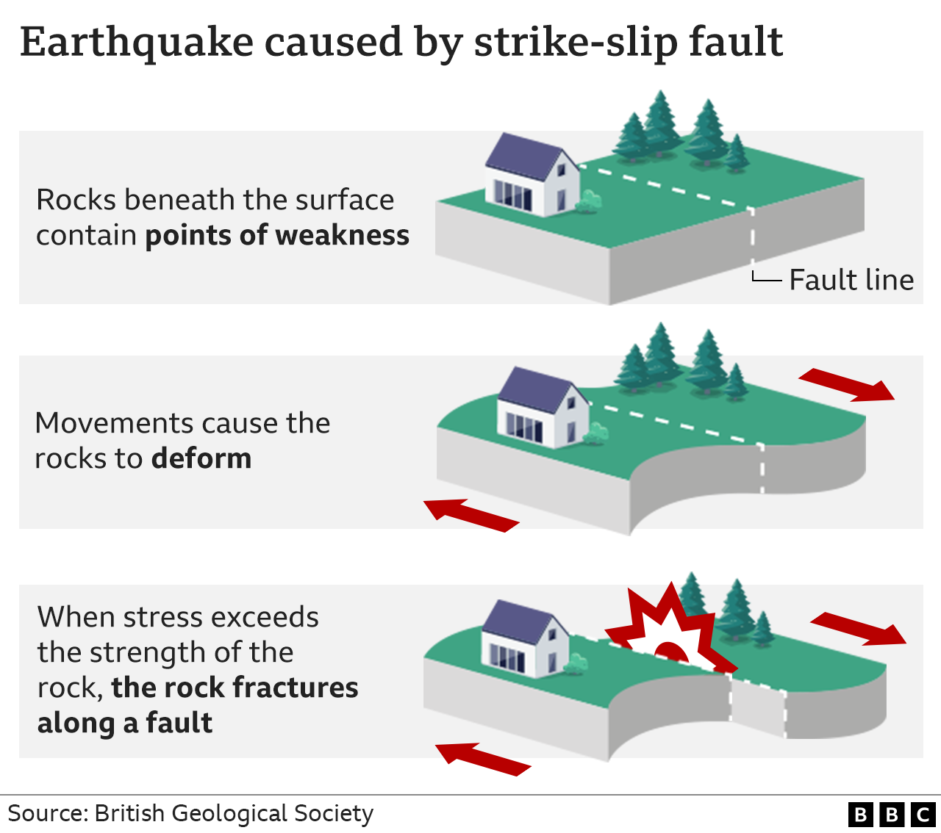
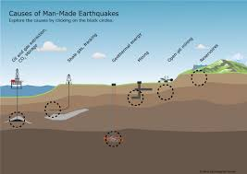
What are the causes of Earthquakes?
Notes:
The tectonic plates are always slowly moving, but they get stuck at their edges due to friction. When the stress on the edge overcomes the friction, there is an earthquake that releases energy in waves that travel through the earth's crust and cause the shaking that we feel.
Earthquakes happen because of the constant movement in tectonic plates of the earth’s crust.

Slide 4
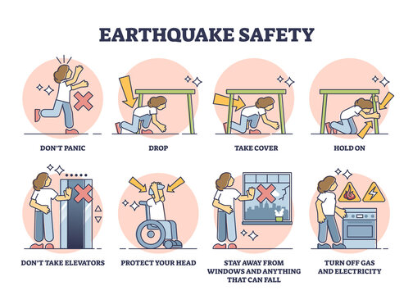
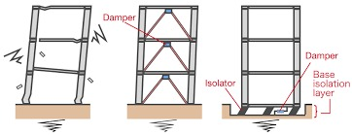
What protection measures can we take against earthquakes?
Notes:
We cannot prevent natural earthquakes from occurring but we can significantly mitigate their effects by identifying hazards, building safer structures, and providing education on earthquake safety.
Some countries where they have a lot of earthquakes, like Japan, design and build their buildings on special foundations that have giant spring pads that allow the building to move with the earthquake to avoid its collapse.

Slide 5
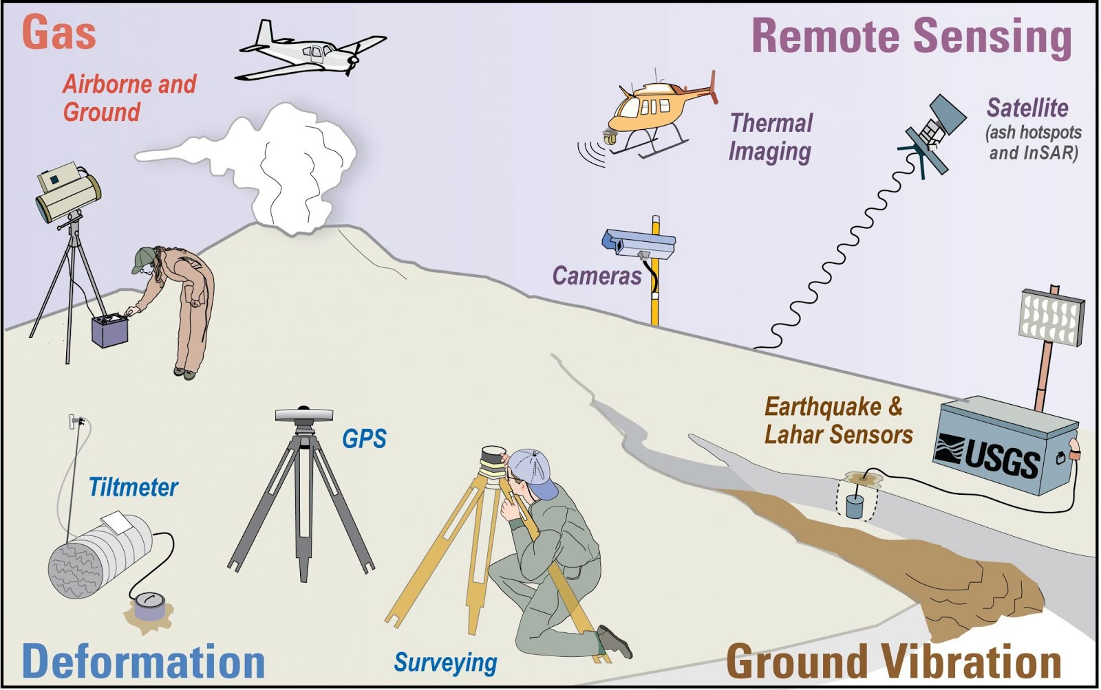
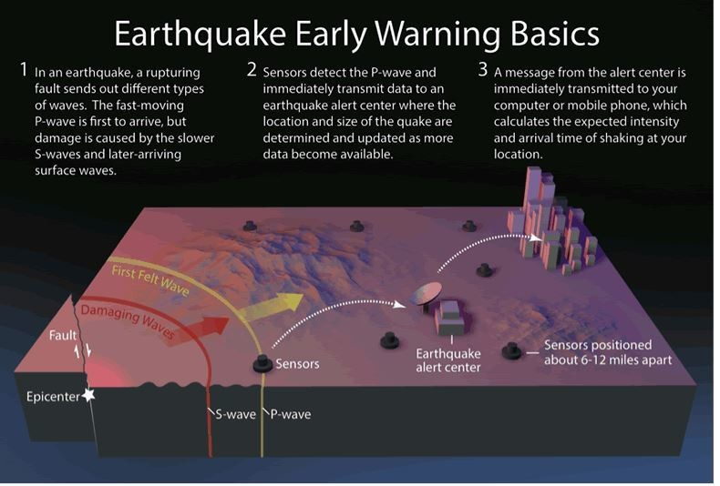
What are some methods to predict and detect earthquakes?
Notes:
Seismometers allow us to detect and measure earthquakes by converting vibrations due to seismic waves into electrical signals, which we can then display as seismograms on a computer screen.

Slide 6
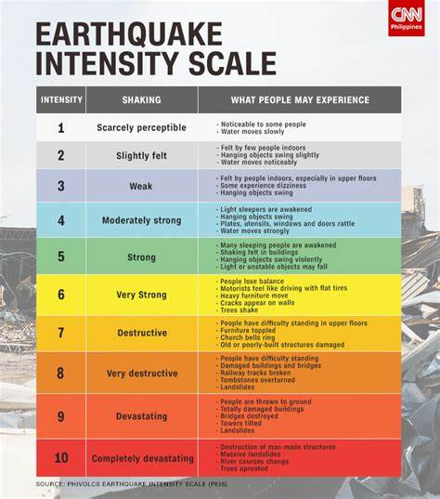
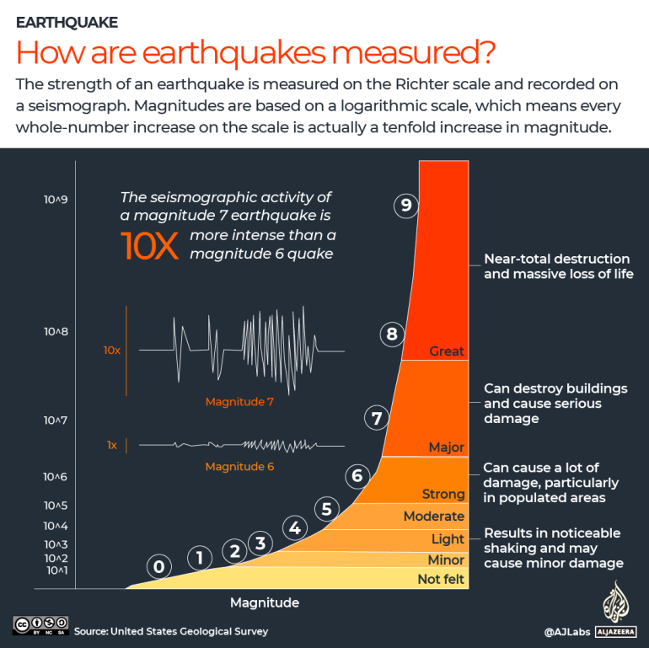
How are earthquakes measured?
Notes:
Some factors that affect intensity are the distance away from the epicenter, the depth of the earthquake, the population density of the area affected by the earthquake, the local geology of the are, the type of building construction in the area, and the duration of the shaking.
Earthquakes vary greatly in intensity. Some are very mild, and we do not even feel them, while others are extremely destructive.
Scientists developed a scale for measuring earthquake intensity called the Richter Scale from 1 to 10.
The Richter Scale is logarithmic, meaning that each number is 10x stronger than the number before.
So, an earthquake of magnitude 7 is 10 times stronger than 6. And a quake of magnitude 8 is 10 times stronger than 7.

Slide 7
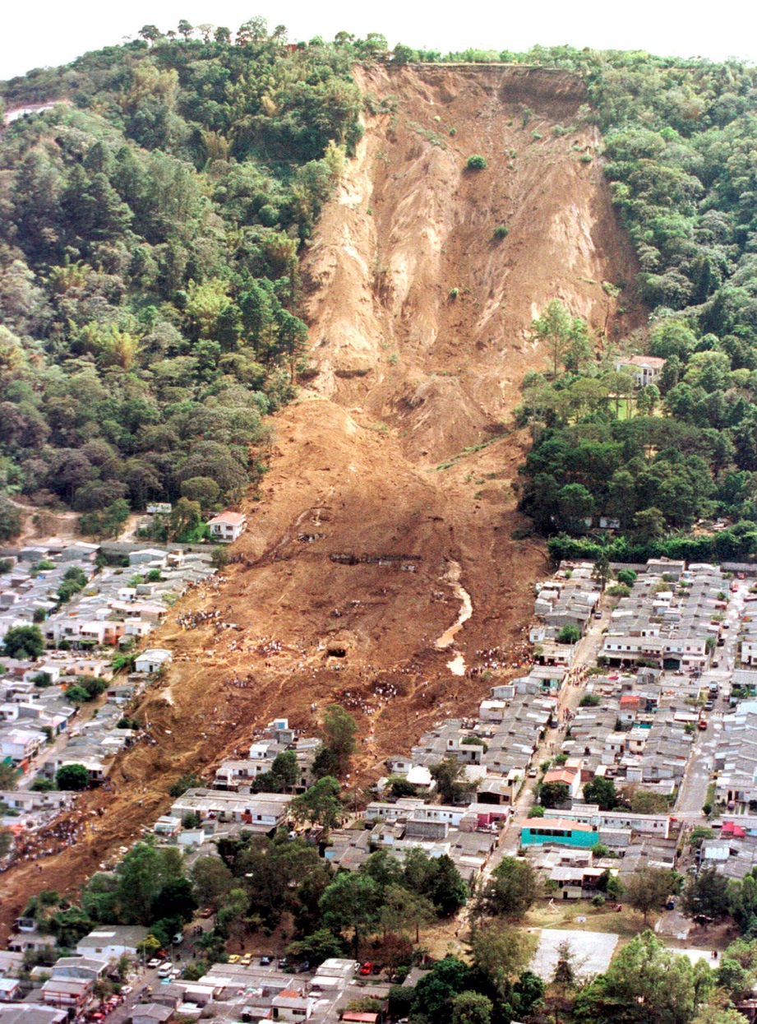
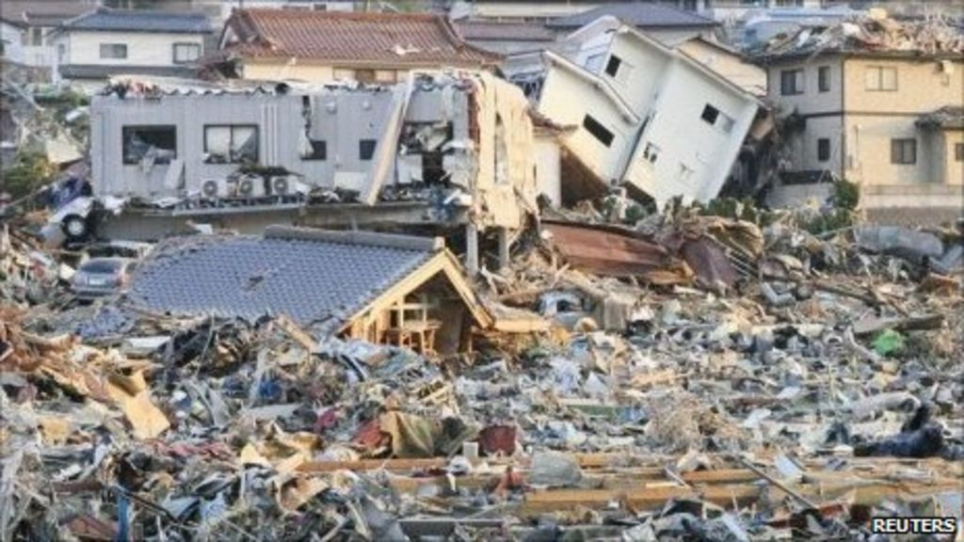
The impact earthquakes have on the environment
Notes:
Some environmental effects of earthquakes include: surface faulting, tsunamis, soil liquefactions, ground resonance, landslides and ground failure.

Slide 8
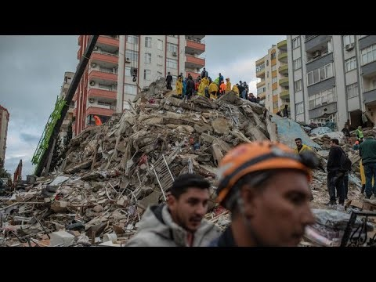
Video of a large earthquake in Turkey.
Notes:
Feb 10, 2023

Slide 9
Thank you!
Official Resources:
https://www.usgs.gov/programs/earthquake-hazards/earthquake-magnitude-energy-release-and-shaking-intensity
https://spaceplace.nasa.gov/earthquakes/en/
https://seismo.berkeley.edu/seismo.real.time.map.html
https://scedc.caltech.edu/recent/Quakes/quakes0.html
https://www.emsc-csem.org/Earthquake/world/

