Slide 1
Obesity
By Reine and Jenna

Slide 2
—Jim Rohn
“Take care of your body. It’s the only place you have to live.”

Slide 3
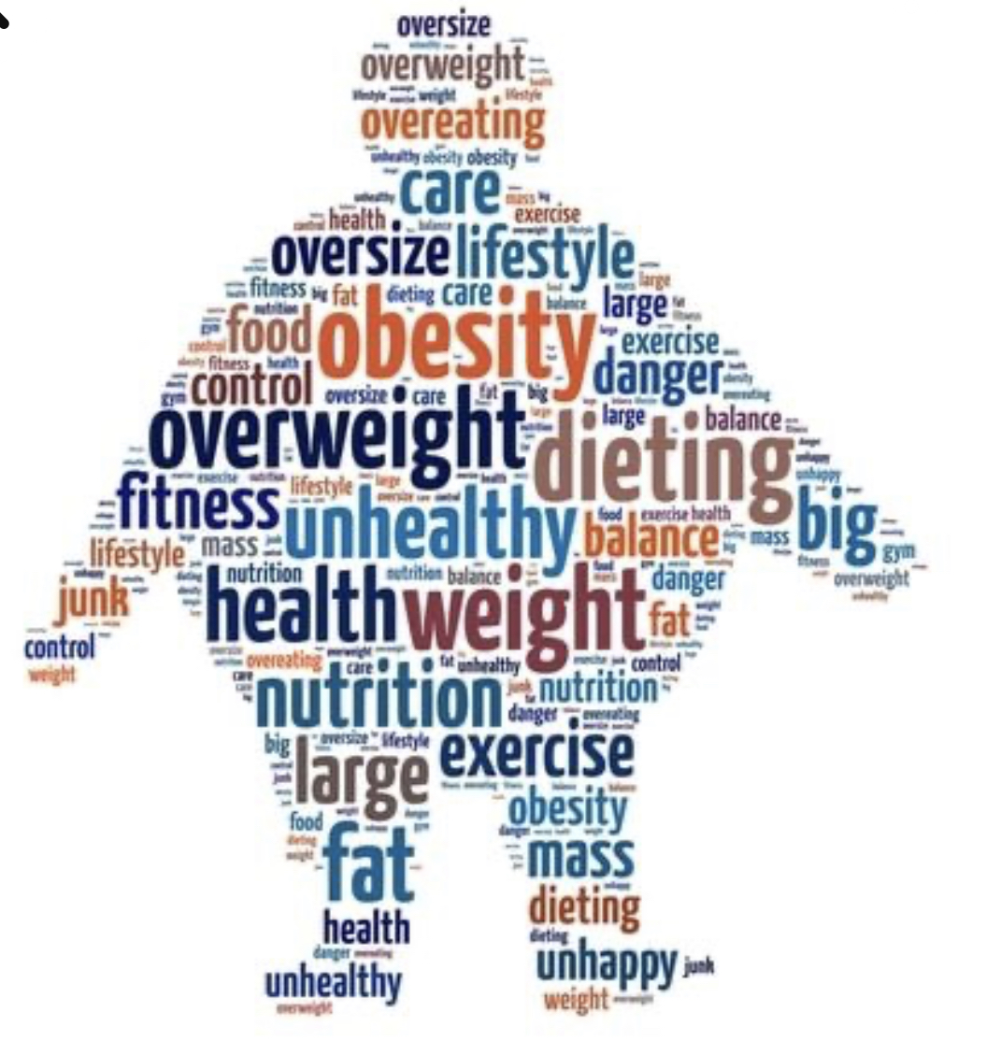
What is obesity
Obesity is an intricate disease which has an enormous amount of body fat.
It doesn’t only concern appearances, it also increases the risk of other medical problems. It can cause heart attacks ,diabetes , high blood pressure , and diseases in other body organs.

Slide 4
What causes obesity?
Obesity is caused by a a various amount of factors such as genetics, unhealthy food diet, as well as a persons environment. More potential causes of obesity contains hormonal imbalances , stress and lack of sleep.

Slide 5
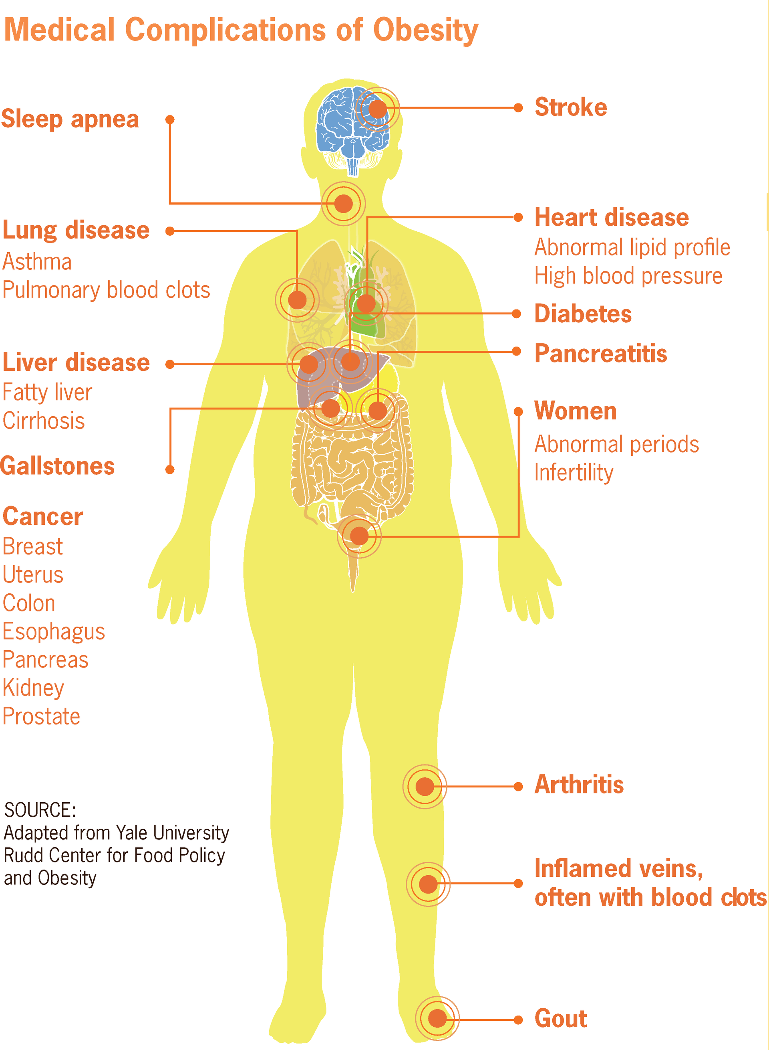

Consequences
of Obesity
Obesity can lead to death in ways. It has the potential to cause cancer, heart strokes and heart disease. furthermore, it can cause mental health issues such as difficulty with mobility as self esteem. If a person has difficulty with mobility they may , end up using a wheelchair.

Slide 6
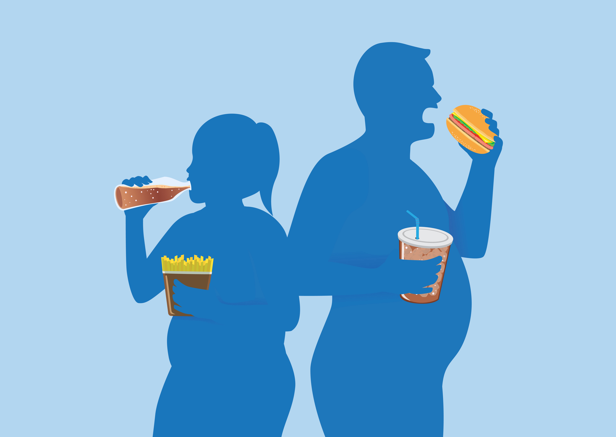

Can obesity be cured?
No it cannot be cured, since obesity is a chronic disease. However it can be managed, with proper medical care such as diet changes and regular exercise.

Slide 7
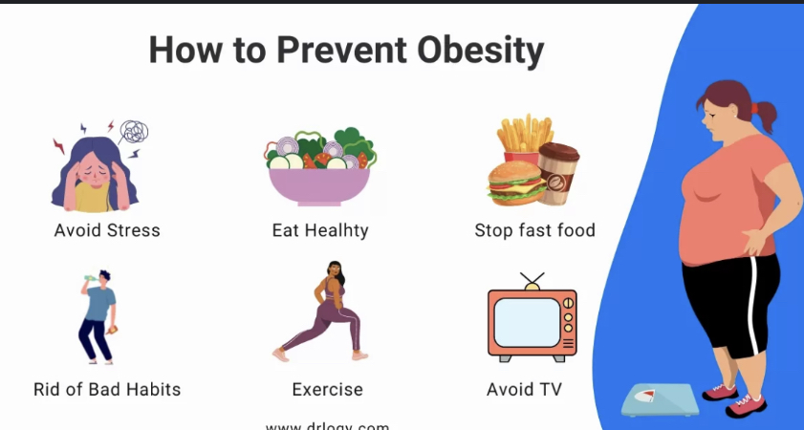
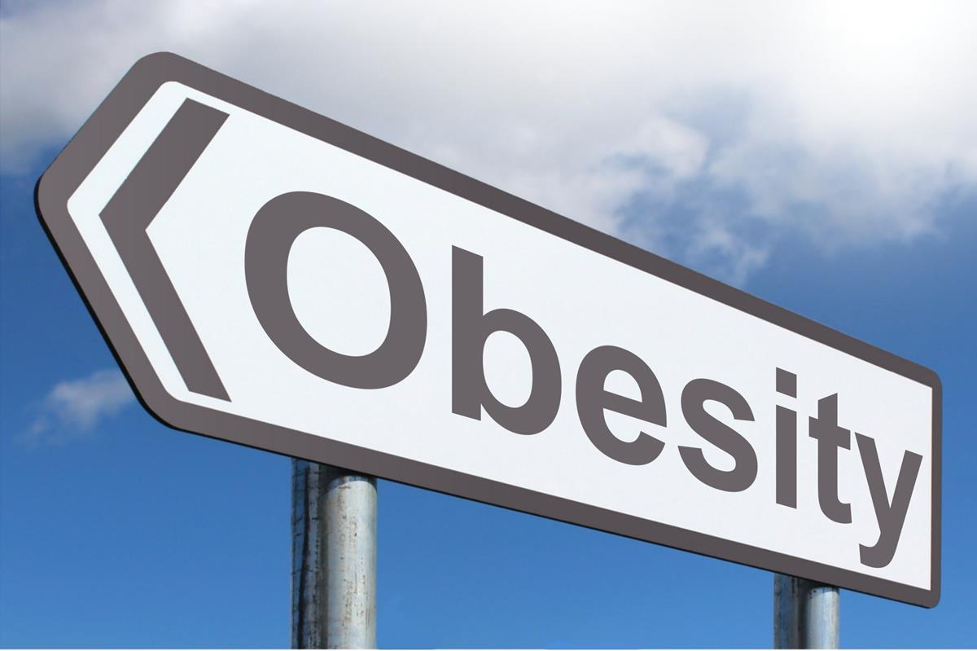
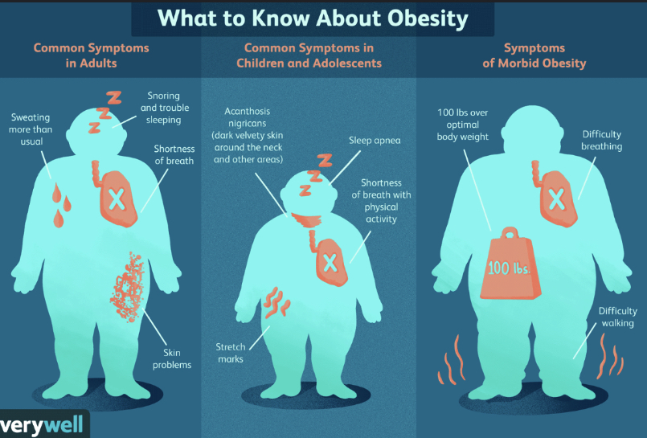
How to prevent obesity
There are various ways to prevent obesity which includes a healthy diet , lifestyle , staying hydrated , getting enough sleep ,exercise , avoiding surgery drinks, and reducing stress. Lastly, it’s important to be careful of portion sizes and limit intake of processed foods.
This Photo by Unknown Author is licensed under CC BY-SA

Slide 8
Resources
mayoclinic.org
https://www.mayoclinic.org/diseases-conditions/obesity/symptoms-causes/syc-20375742
cdc.gov
https://www.cdc.gov/healthyweight/effects/index.html
universityhealth.org
https://www.universityhealth.org/wellness-tips-information/everyday-health/obesity-weight-management

