Slide 1
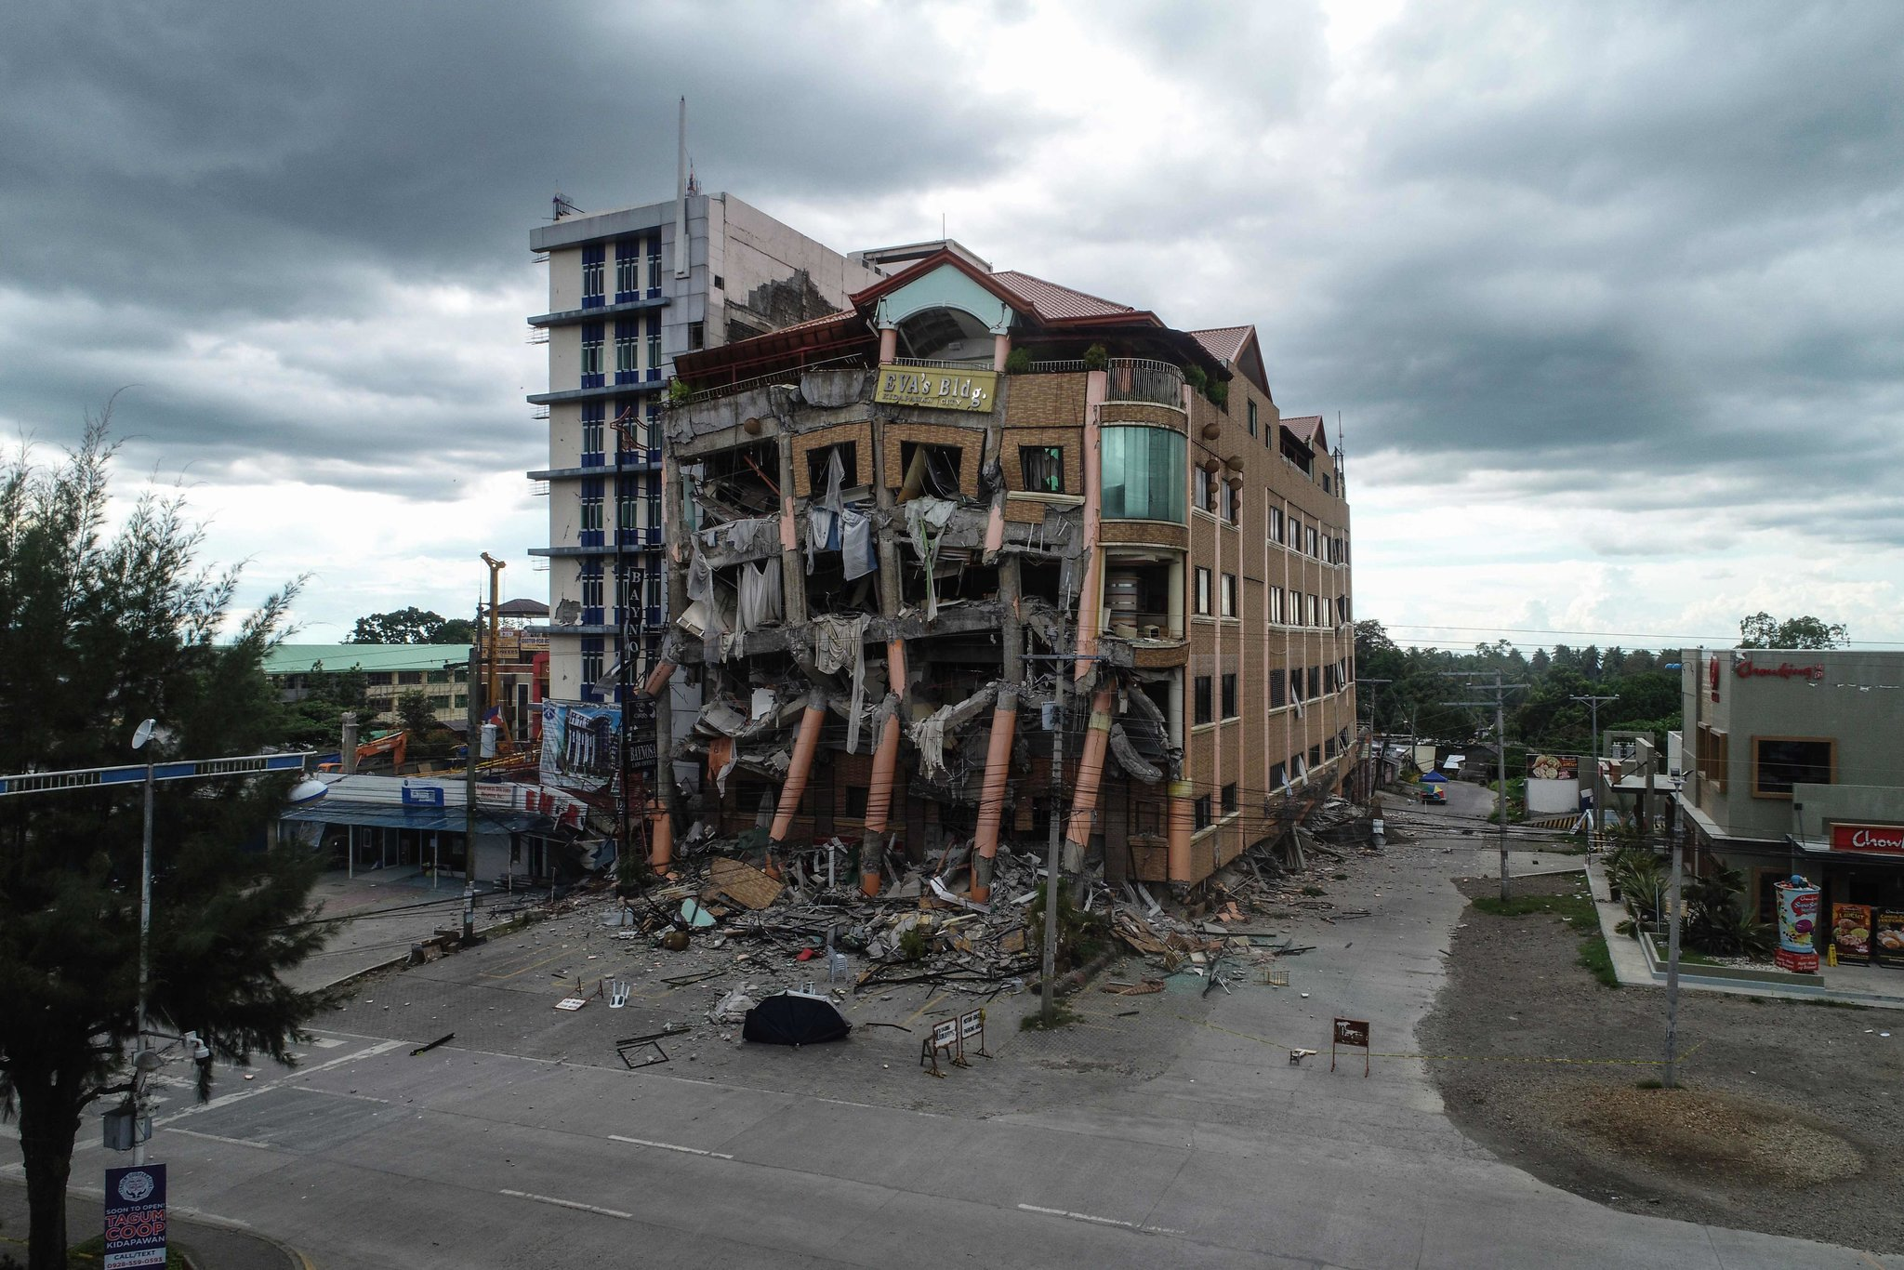
Earth quakes
Nabeel joseph Faisal Ramzi

Slide 2
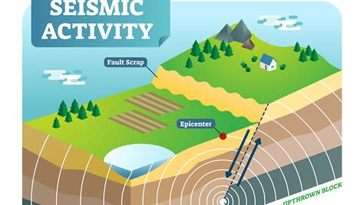
CAUSES OF EARTHQUAKES
Notes:
First Cause: Movement of tectonic plates 🍽
Second Cause: Underground explosions💥

Slide 3
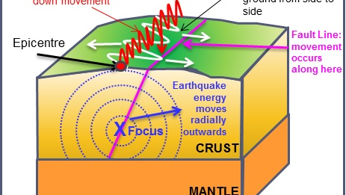
EFFECTS OF EARTHQUAKES
Notes:
First Effect: Ground shaking leading to structures breaking apart
Second Effect: Fires🔥
Third Effect: Tsunamis 🌊💦

Slide 4
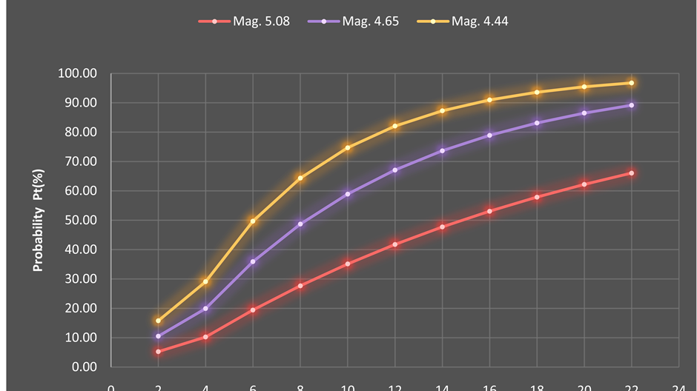
Factors that effects the intensity OF EARTHQUAKES
Notes:
1)The softness of the surface rocks
2)The thickness of surface sediments

Slide 5
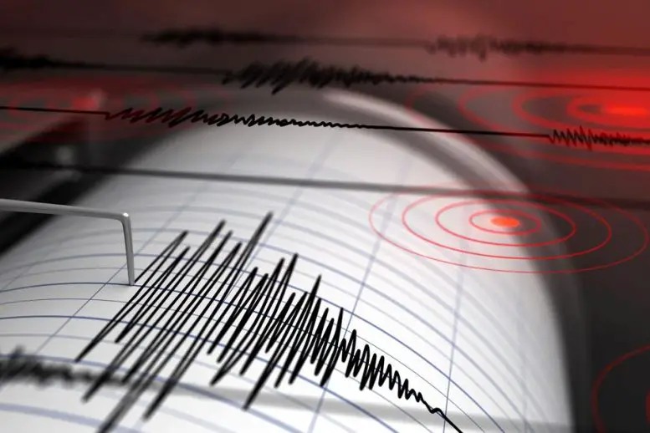
Methods used to detect ,measure and predict earthquakes
Notes:
Seismometers allows us to detect and measure earthquakes

Slide 6
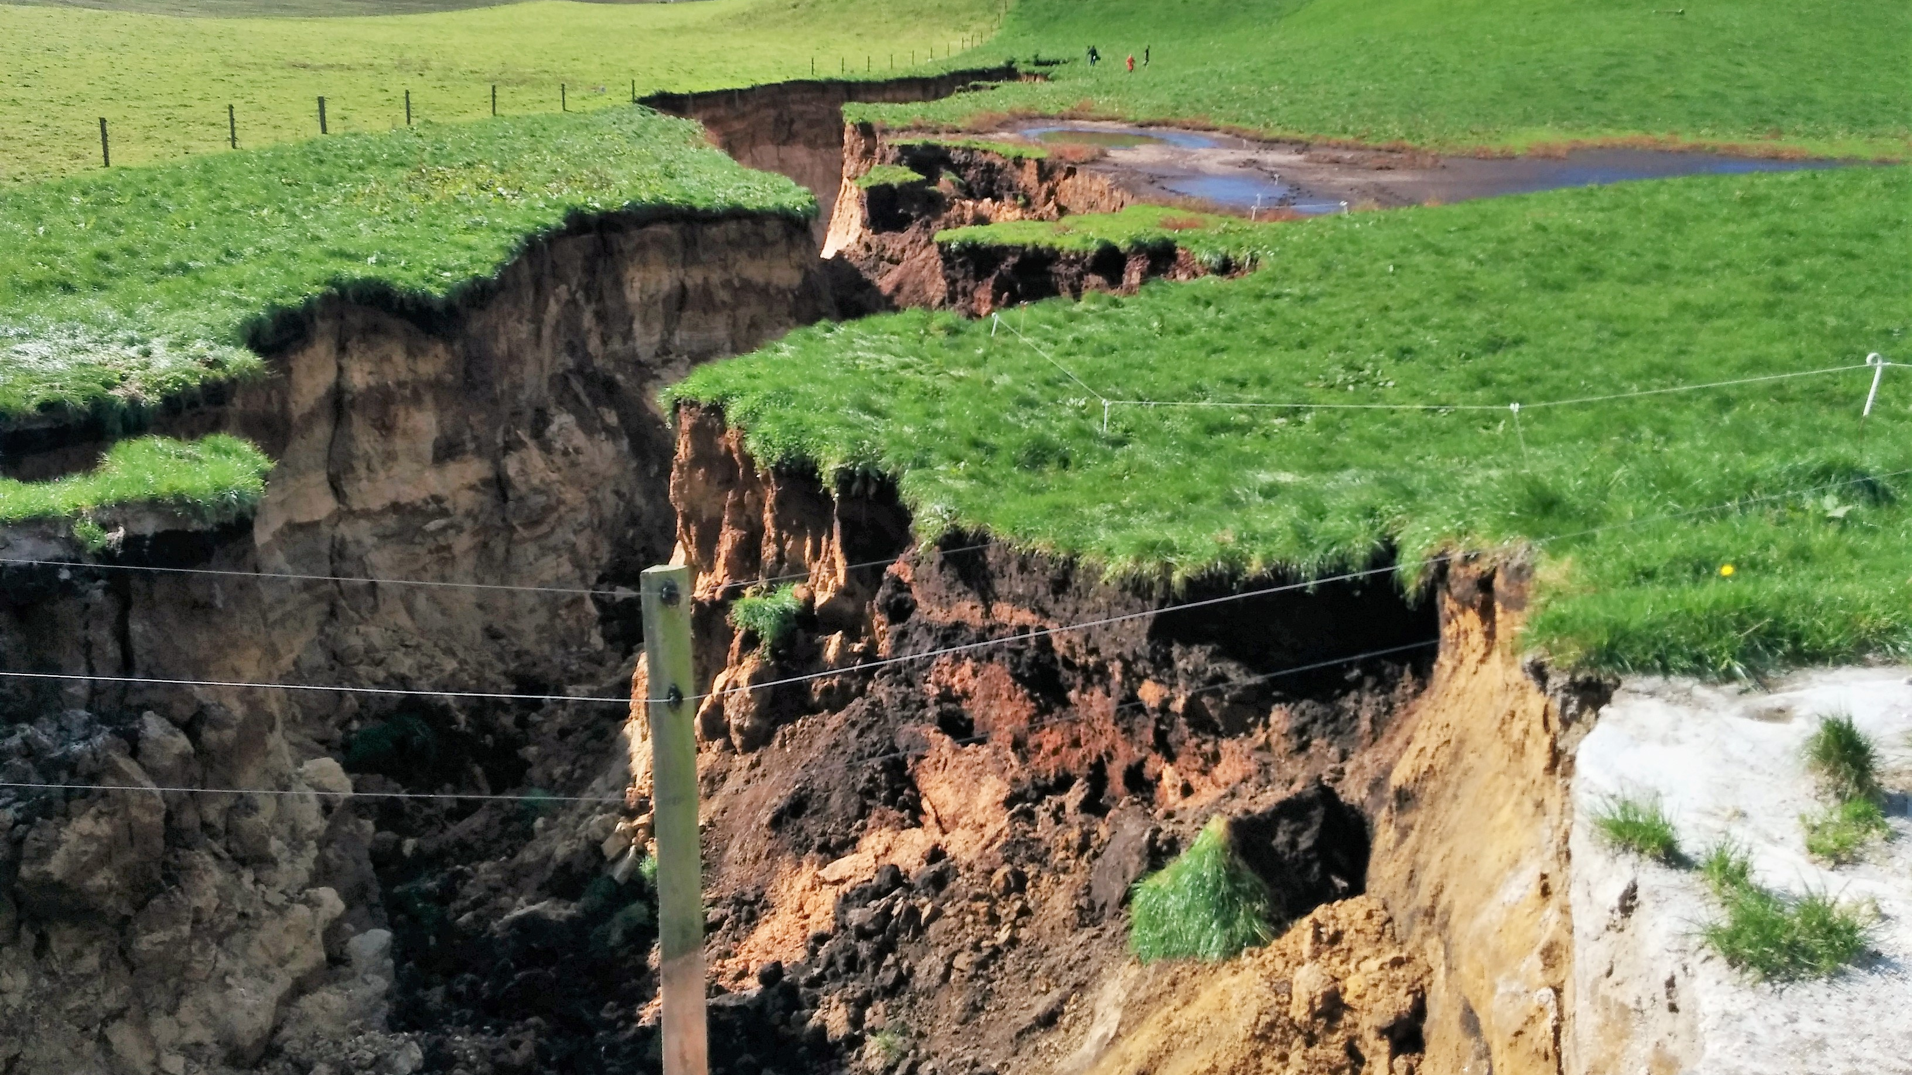
The impacts of earthquakes on our natural environment and ecosystem
This Photo by Unknown Author is licensed under CC BY
Notes:
1: tsunamis
2: ground failure
3: land slides

Slide 7
Solutions to prevent earthquakes

