Slide 1
Water Crisis
By Marah Badran and Talia Alnazer

Slide 2
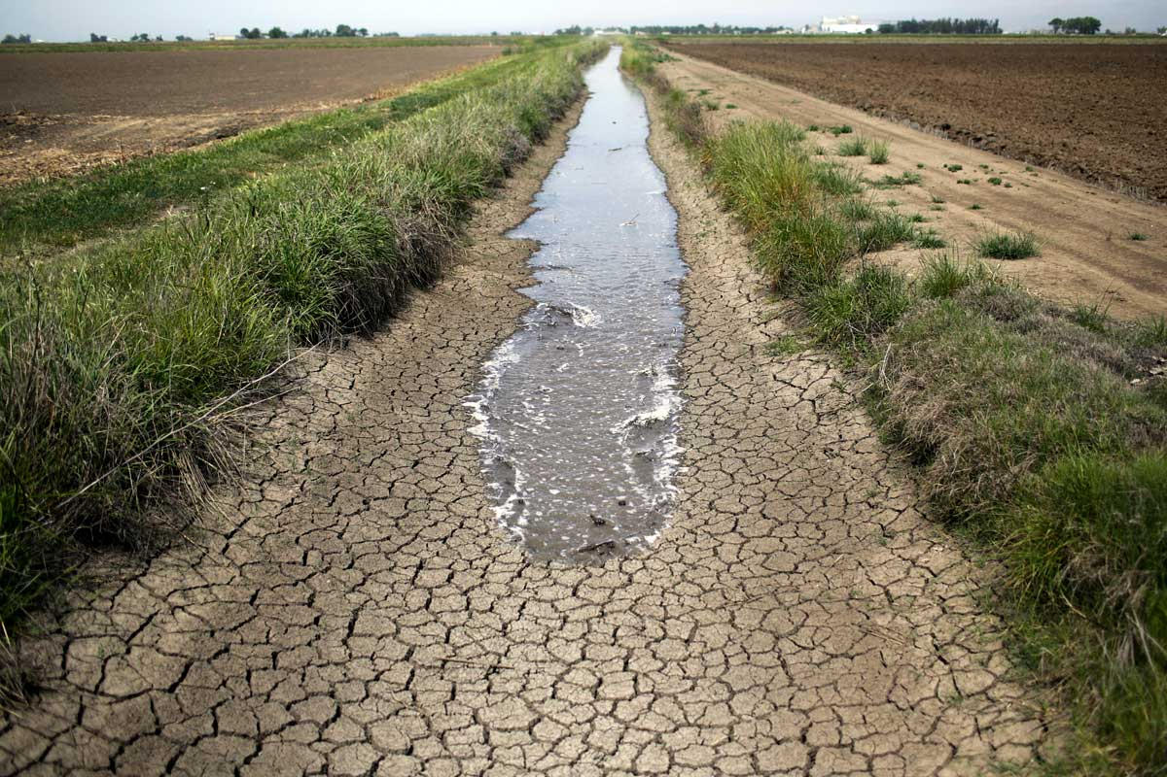
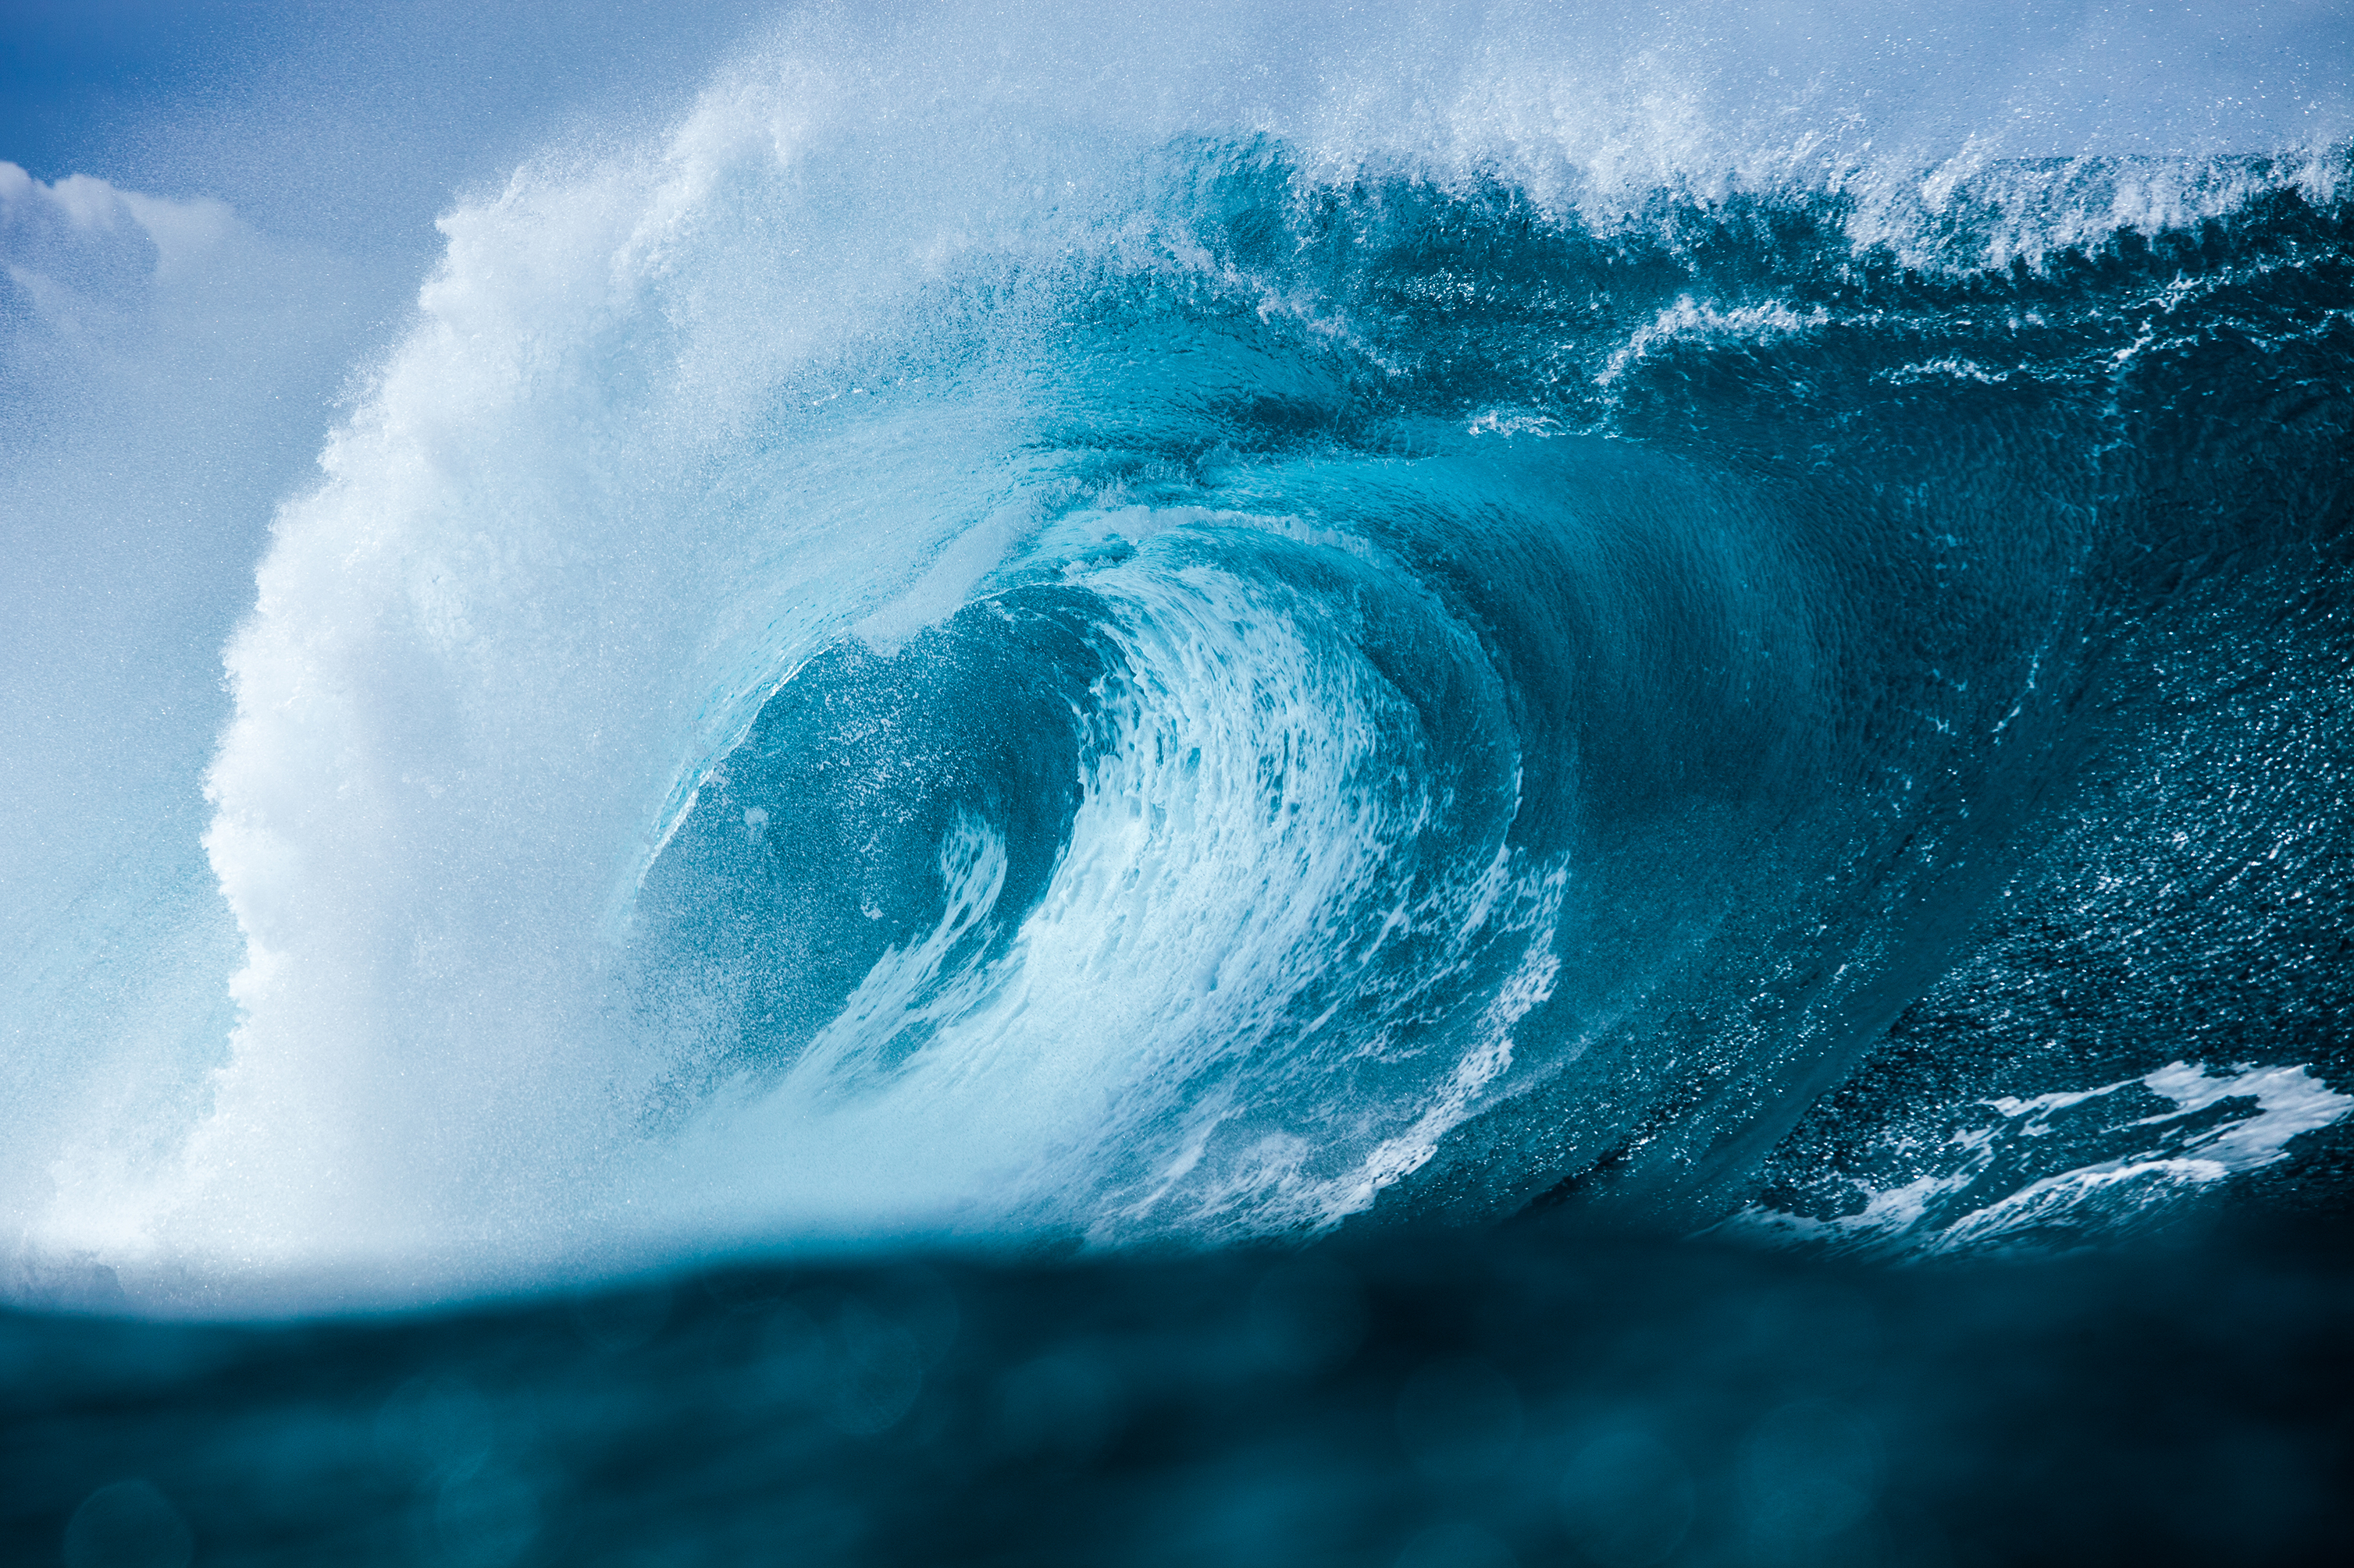
What is water crisis?
Water scarcity is an increasing problem on every continent, with poorer communities most badly affected. To build resilience against climate change and to serve a growing population, an integrated and inclusive approach must be taken to managing this finite resource.

Slide 3
What are the causes of water crisis in Jordan?
Pollution: The overflow of wastewater pumping stations, leaks from sewage systems and exposure to industrial and commercial waste are polluting Jordan’s surface river sources.
Mismanagement of Surface Water Resources: There are three major surface water sources in Jordan — the Jordan, Zarqa and Yarmouk rivers. Israel and Syria’s “upstream diversion and over-pumping” of the Jordan and Yarmouk rivers are drying up Jordan’s access to their stream due to the lack of regional environmental cooperation. Meanwhile, the Zarqa River is severely contaminated due to overflow from wastewater treatment plants and sewage leaks.

Slide 4
Issues of water crisis in Jordan:
Jordan is one of the most water-scarce countries in the world. The country’s renewable water supply currently meets around two-thirds of the population’s water demands, with groundwater being used twice as quickly as it can be replenished.
Population growth and the influx of refugees from regional conflicts put additional strain on an already stressed water supply. Climate change will exacerbate the problem. Jordan’s water security is critical to the country’s long-term political and economic stability.
These are great issues we must deal with.
.

Slide 5
What are the consequences of water crisis in Jordan?
people can't get enough to drink, wash, or feed crops, and economic decline may occur.

Slide 6
Solutions to water crisis in Jordan:
The other way to counter water scarcity in Jordan is by recycling and reuse of municipal wastewater which is an attractive method in terms of water savings. Infact, the reuse of the treated wastewater in Jordan has reached one of the highest levels in the world

Slide 7
Citation
Water scarcity: UN-water. UN. (n.d.-a). https://www.unwater.org/water-facts/water-scarcity
Saiesha. (2022b, April 14). 7 facts about water scarcity in Jordan. The Borgen Project. https://borgenproject.org/water-scarcity-in-jordan
Water Resources & Environment: Basic page: Jordan. U.S. Agency for International Development. (2022b, August 16). https://www.usaid.gov/jordan/water-resources-environment#:~:text=Jordan%20is%20one%20of%20the,as%20it%20can%20be%20replenished.
World Wildlife Fund. (n.d.). Water scarcity. WWF. https://www.worldwildlife.org/threats/water-scarcity
| A. D. (2022, May 28). Water scarcity in Jordan: An overview. EcoMENA. https://www.ecomena.org/water-jordan/

Slide 8
Math part
نسبة الامطار المتساقطة خلال السناوات
العام | 2010 | 2011 | 2013 | 2014
نسبة مئوية | 62% | 89.00% | 23% | 55%
كسر | 62/100 | 89/100 | 23/100 | 55/100
عدد عشري | 6.2 | 8.9 | 2.3 | 5.5
عدد مئوي | 0.62 | 0.89 | 0.23 | 0.55

