Slide 1
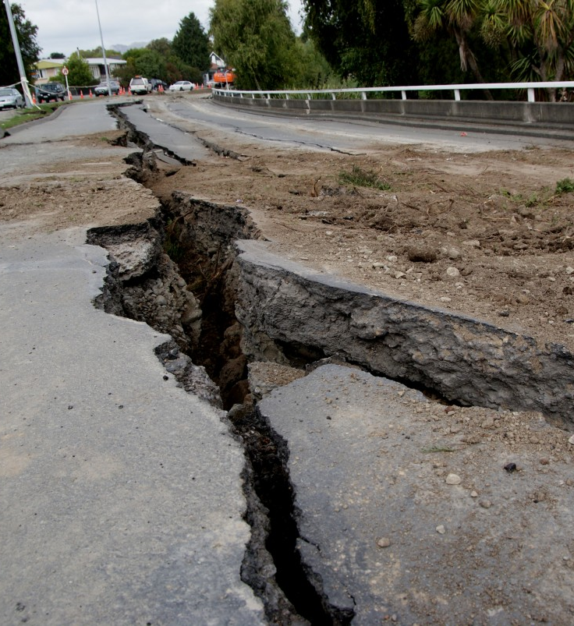
Earthquakes
INTRODUCTION TO EARTHQUAKES
CAUSES AND CONSEQUENCES
COURSE OF ACTIONS
CONCLUSION
Made by: Tala Mouasher,
Tia AlAyoub,
Taleen Ammari,
Alba Lara
Saama Dababneh

Slide 2
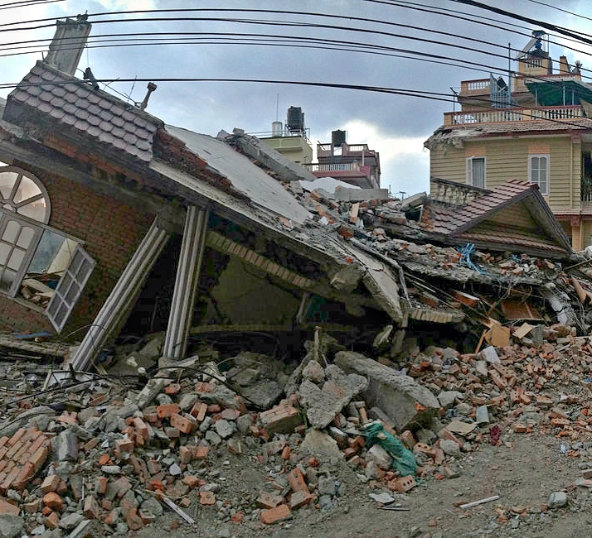
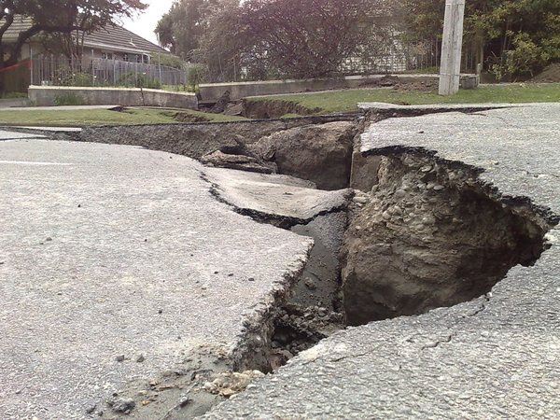
This Photo by Unknown Author is licensed under CC BY-SA-NC
This Photo by Unknown Author is licensed under CC BY-SA
This Photo by Unknown Author is licensed under CC BY-SA-NC
Notes:
WHAT ARE EARTHQUAKES?
AN EARTHQUAKE IS A SUDDEN MOVEMENT FROM THE GROUND THAT RELEASES ELASTIC ENERGY STORED IN ROCKS.

Slide 3
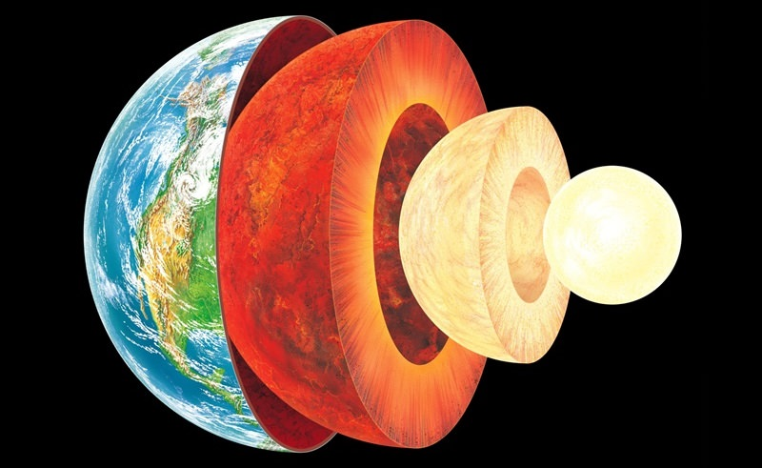
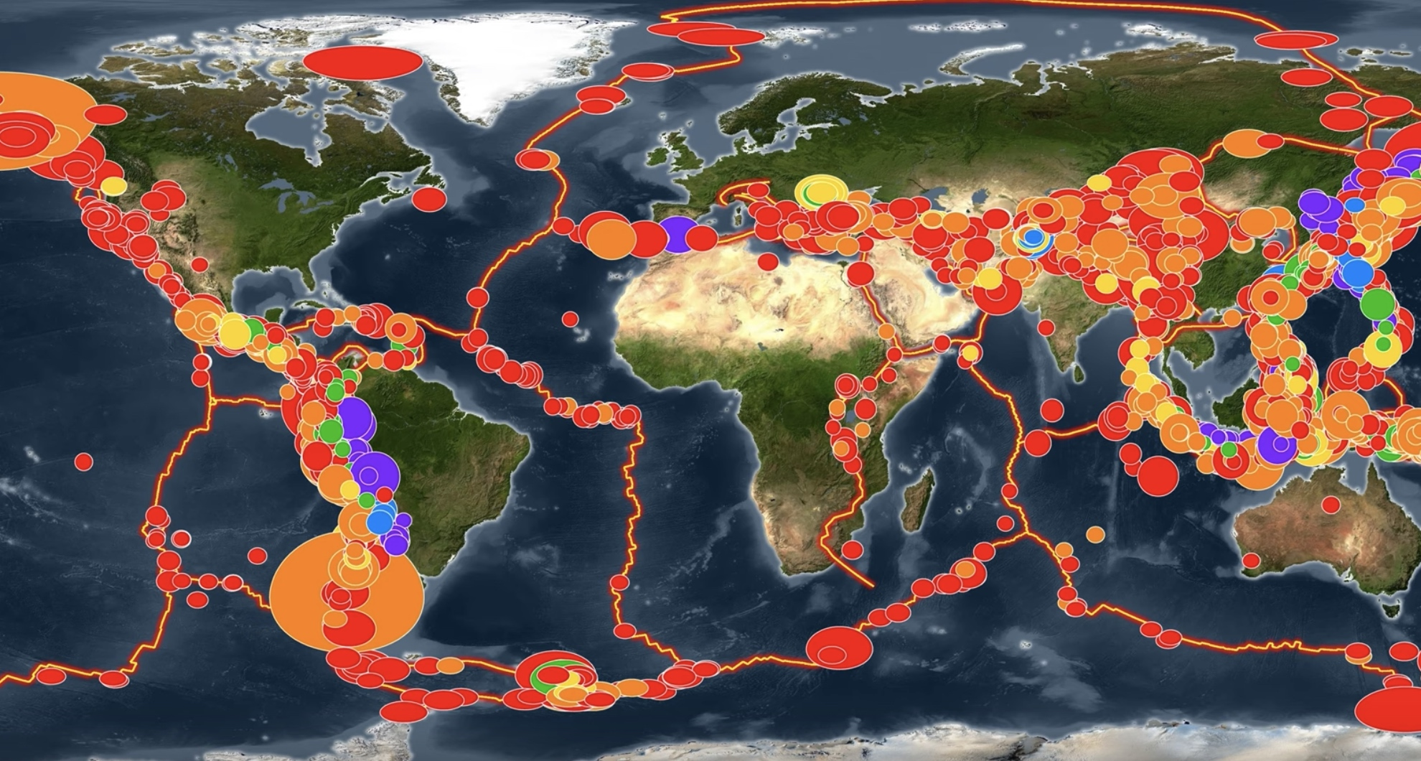
Notes:
Causes and consequences
The tectonic plates are slowly moving, but they get stuck at their edges due to friction. When the stress on the edge overcomes the friction . There is an earthquake that releases energy in waves that travel through the earths crust and causes the shaking.

Slide 4
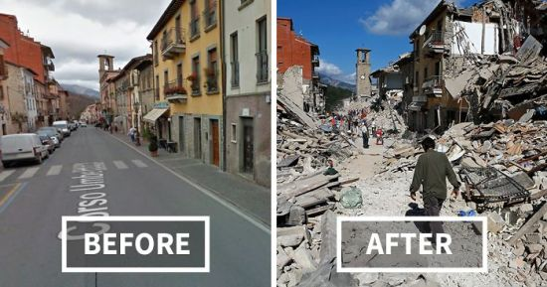
Notes:
SOLUTIONS
WE CANNOT PREVENT EARTHQUAKES BUT WE CAN LESSEN THE EFFECTS OF THEM BY IDENTIFYING HAZARDS, BUILDING SAFER STRUCTURES, AND PROVIDING EDUCATION.
WE CANNOT PREVENT EARTHQUAKES BUT WE CAN LESSEN THE EFFECTS OF THEM BY IDENTIFYING HAZARDS, BUILDING SAFER STRUCTURES, AND PROVIDING EDUCATION

Slide 5
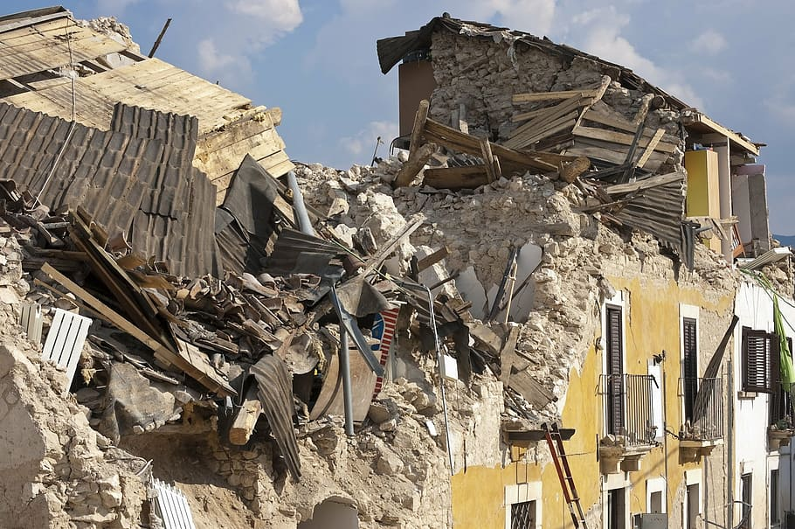
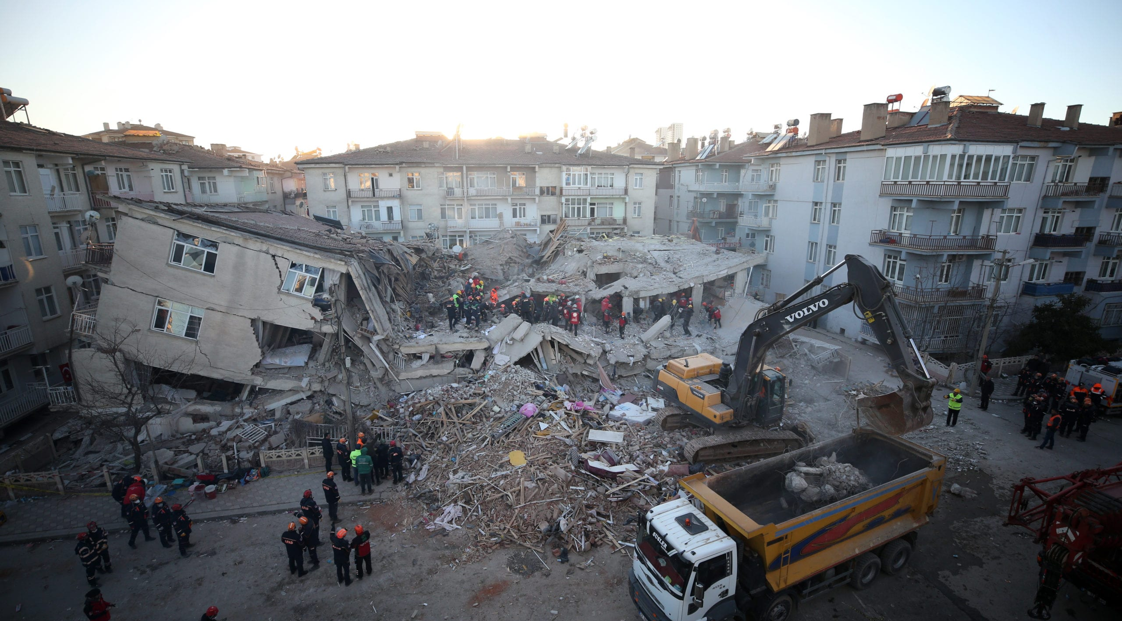
Notes:
Conclusion
An earthquake is a dangerous natural disaster thet causes extensive damage in various parts of the world.

Slide 6
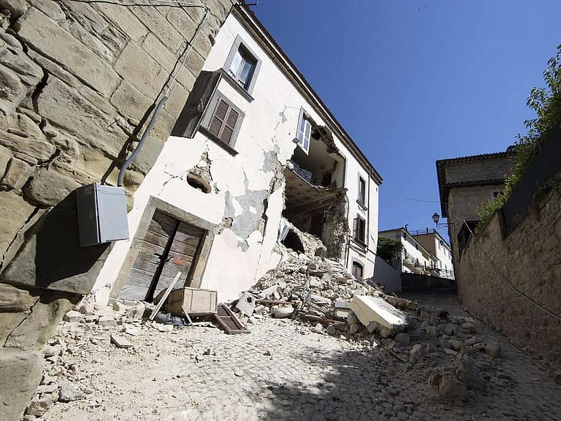
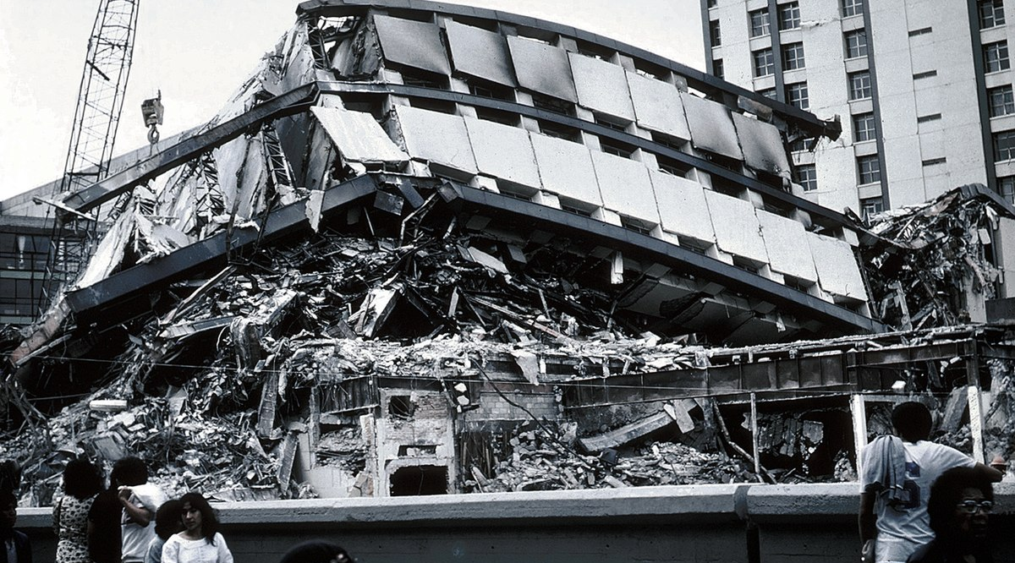
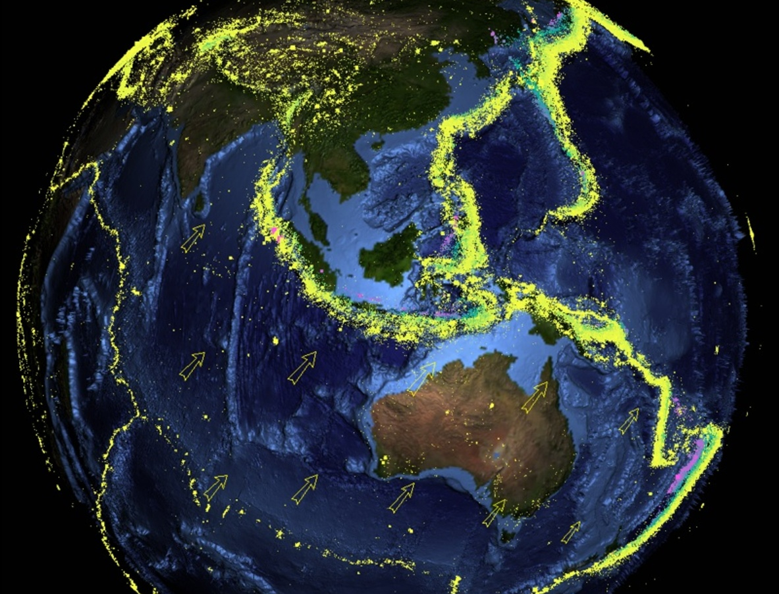

Slide 7
Resources
Gupshups.Org
usgs.org
usgs.gov
Who.int
spaceplace.nasa.gov

