Slide 1
WATER CRISIS
Done By:
SALEEM WAHHAB
EMIL HADDAD
MERAL SAHLIEH

Slide 2
WHAT IS WATER CRISIS?
WATER CRISIS IS THE LACK OF WATER FOR CERTAIN PEOPLE, WATER CRISIS IS #5 ON THE LIST OF GLOBAL ISSUES IN TERMS OF IMPACT TO SOCIETY.
JORDAN IS THE SECOND MOST COUNTRY HAVING WATER SHORTAGE, MORE THAN 98% OF THE POPULATION HAS ACCESS TO AN IMPROVED WATER SOURCE, ONLY 93% ACCESS A SAFELY-MANAGED SOURCE AND 86% TO A PIPED NETWORK.

Slide 3
Consequences And Causes
Drought:Climate change and rising global temperatures are also affecting the quality and spatial distribution of water resources but droughts is the main point.
Pollution:water contamination occurs when pollutants such as:chemicals,garbage , bacteria, and parasites. Contaminate water sources and ruin it. Preventing it from being used for various purposes.

Slide 4
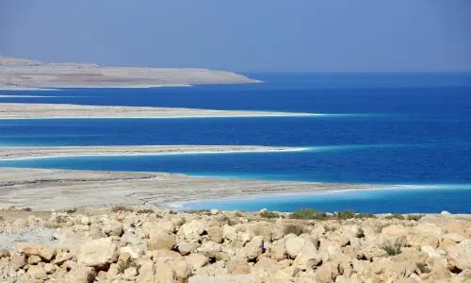
Solutions for water shortage locally
There are many solutions to help stop water shortage:
Locally
To build a channel of water so the water can go from the red sea to the dead sea to prevent the loss of our dead sea.
to increase signs in bathrooms to reduce the use of water.

Slide 5
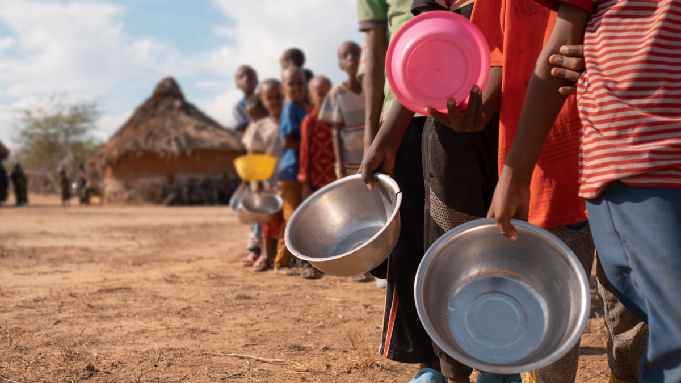
Solutions for water shortage global
There are many solutions to help stop water shortage:
Globally
Reduce pollution: pollution is a big part of causing global warming and global warming is very bad for the environment
To encourage a larger number of people to donate to charities to deliver water to a larger number of countries.(could be locally and globally)
.

Slide 6
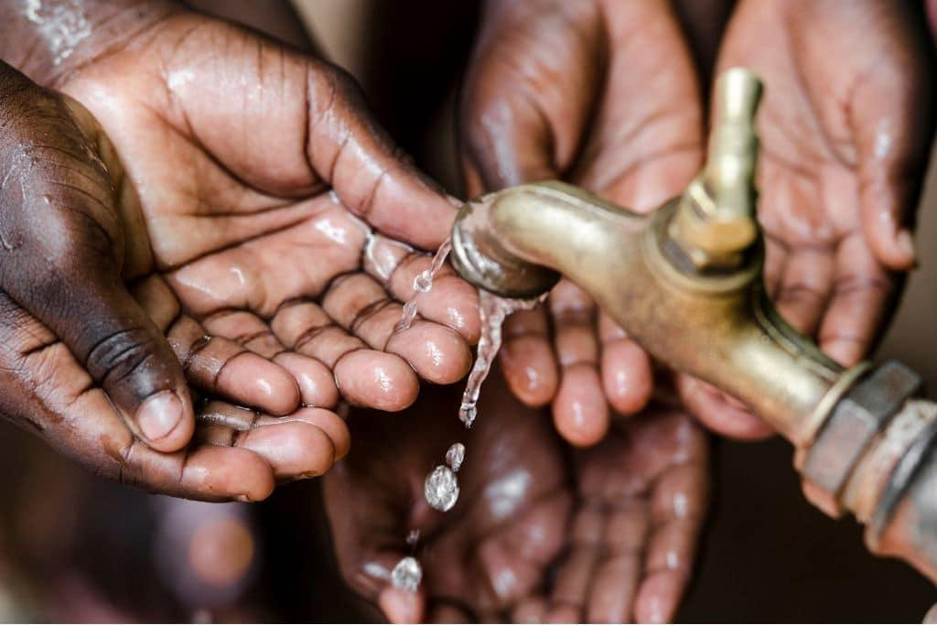
In conclusion everybody should help the planet and put our hands together to maintain earth’s cleanliness. So we suggest that we grow more organization that support water crisis and not only a certain place but WORLDWIDE.

Slide 7
References
Water, sanitation and hygiene. UNICEF Jordan. (2020, November 4). Retrieved May 6, 2023, from https://www.unicef.org/jordan/water-sanitation-and-hygiene
1…..The global water crisis. Water.org. (n.d.). https://water.org/our-impact/water-crisis/global-water-crisis/
Lai, O. (2022, October 19). Water shortage: Causes and effects. Earth.Org. Retrieved May 6, 2023, from https://earth.org/causes-and-effects-of-water-shortage/
Project, B. (2019, December 18). Sustainable water solutions in Jordan also fuel diplomatic progress. The Borgen Project. Retrieved May 7, 2023, from https://borgenproject.org/sustainable-water-solutions-in-jordan/
Water Resources & Environment: Basic page: Jordan. U.S. Agency for International Development. (2022a, August 16). https://www.usaid.gov/jordan/water-resources-environment#:~:text=Jordan%20is%20one%20of%20the,as%20it%20can%20be%20replenished.

