Slide 1
The dangers of Earthquakes
By Alazar, Saif.y, Raad, Muhannad, Mohammad

Slide 2
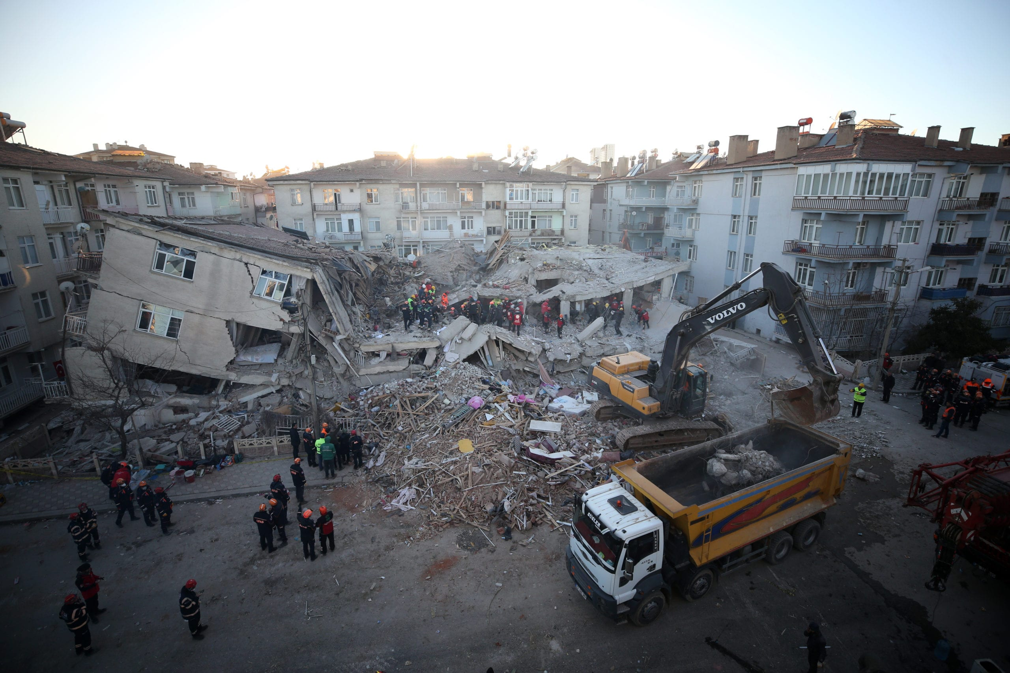
What are earthquakes
Notes:
An earthquake is a violent and abrupt shaking of the ground, caused by movement between tectonic plates along a fault line in the earth's crust.

Slide 3
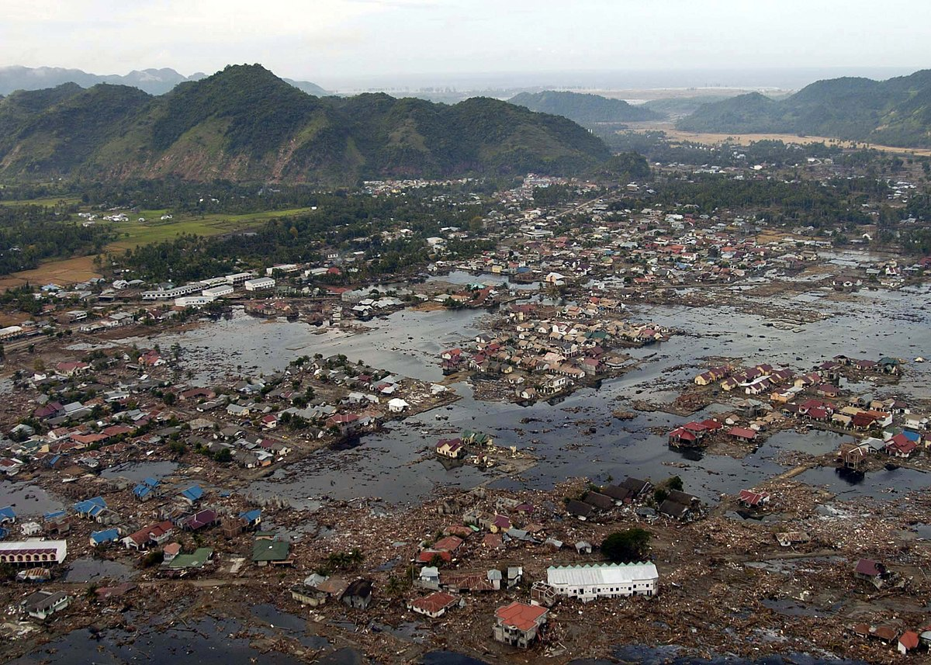
What are the effects of earthquakes
Notes:
Earthquakes can cause a tsunami if near a ocean, they can also cause: volcano eruptions landslides and sinkholes

Slide 4
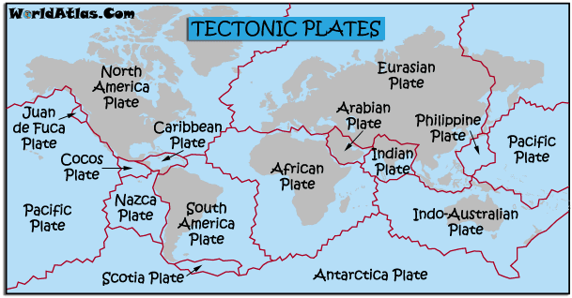
What are the factors of earthquakes
Notes:
The factors that affect the intensity of an earthquake are the depth, the geologic location and the magnitude of the earthquake

Slide 5
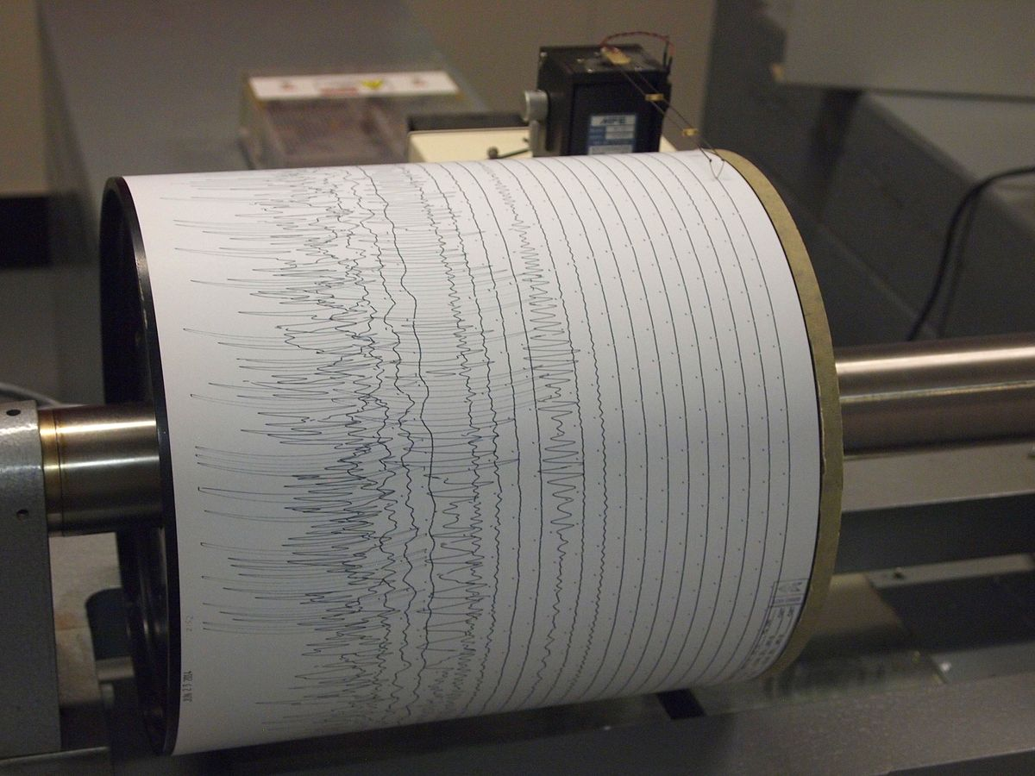
How to detect and measure earthquakes
Notes:
Seismometers allow us to detect and measure earthquakes by converting vibration due to seismic waves into electrical signals which we can then display as seismograms on a computer screen

Slide 6
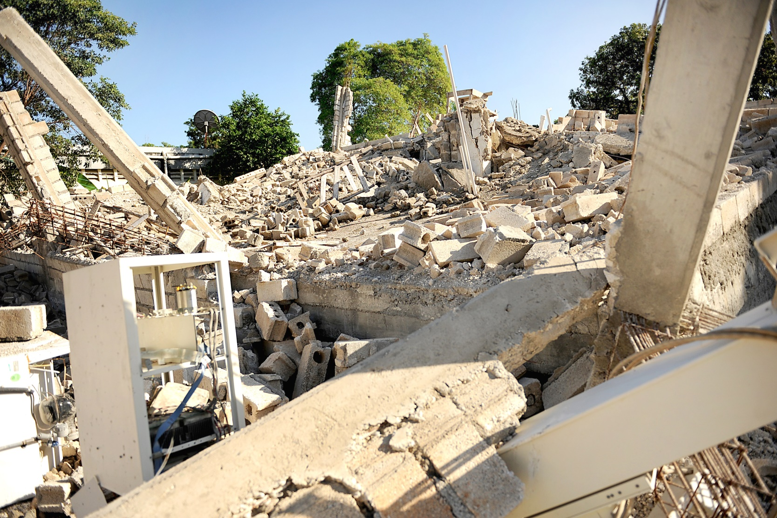
The impacts of earthquakes on the environment
Notes:
Earthquakes can destroy the homes of both animals and people alike as well as destroying wildlife and cutting of important resources to people in the area

Slide 7
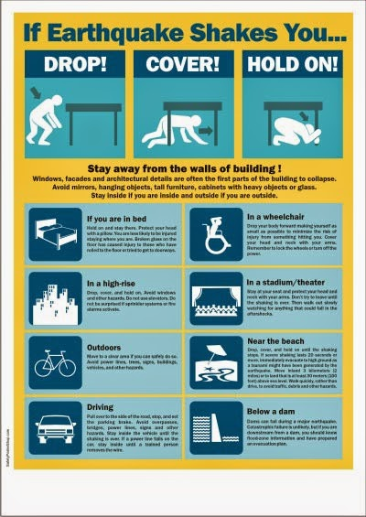
How to survive earthquakes
Notes:
If possible run to a open area where there are no objects that can fall on you if you are in a building find a sturdy desk or another sturdy object that can cover your body

Slide 8
Credits
Credits to:
Ready.gov
Usgs. Gov
World health Organization. Int
The university of California. Edu
American museum of natural History. Org

