Slide 1
Earthquakes
By Rakan, Jad, and Iskander

Slide 2
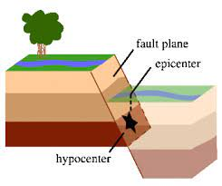
What is an Earthquake
Notes:
An earthquake is what happens when two blocks of the earth suddenly slip past one another. (When the Earth shakes)

Slide 3
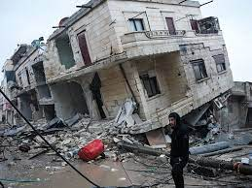
What causes an Earthquake
:
Notes:
The tectonic plates are always slowly moving, but they get stuck at their edges due to friction. When the stress on the edge overcomes the friction, there is an earthquake that releases energy in waves that travel through the earth's crust and cause the shaking that we feel.

Slide 4
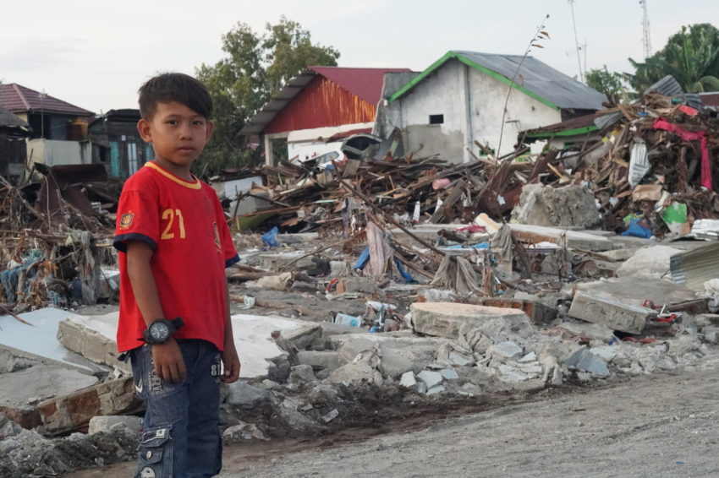
How Does Earthquakes Effect Humans
Notes:
Ground shaking from earthquakes can cause buildings and bridges to collapse; disrupt gas, electricity, and telephone services; and sometimes trigger landslides, avalanches, flash floods, fires, and tsunami.

Slide 5

How To Survive An Earthquake
Notes:
Cover your head and neck with your arms. If a sturdy table or desk is nearby, crawl underneath it for shelter. If no shelter is nearby, crawl next to an interior wall (away from windows). Crawl only if you can reach better cover without going through an area with more debris.

Slide 6
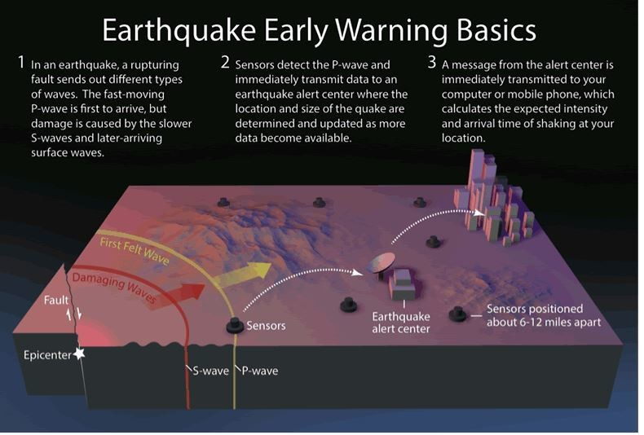
Can Earthquakes Be Predicted
Notes:
No. Neither the USGS nor any other scientists have ever predicted a major earthquake. We do not know how, and we do not expect to know how any time in the foreseeable future.

Slide 7
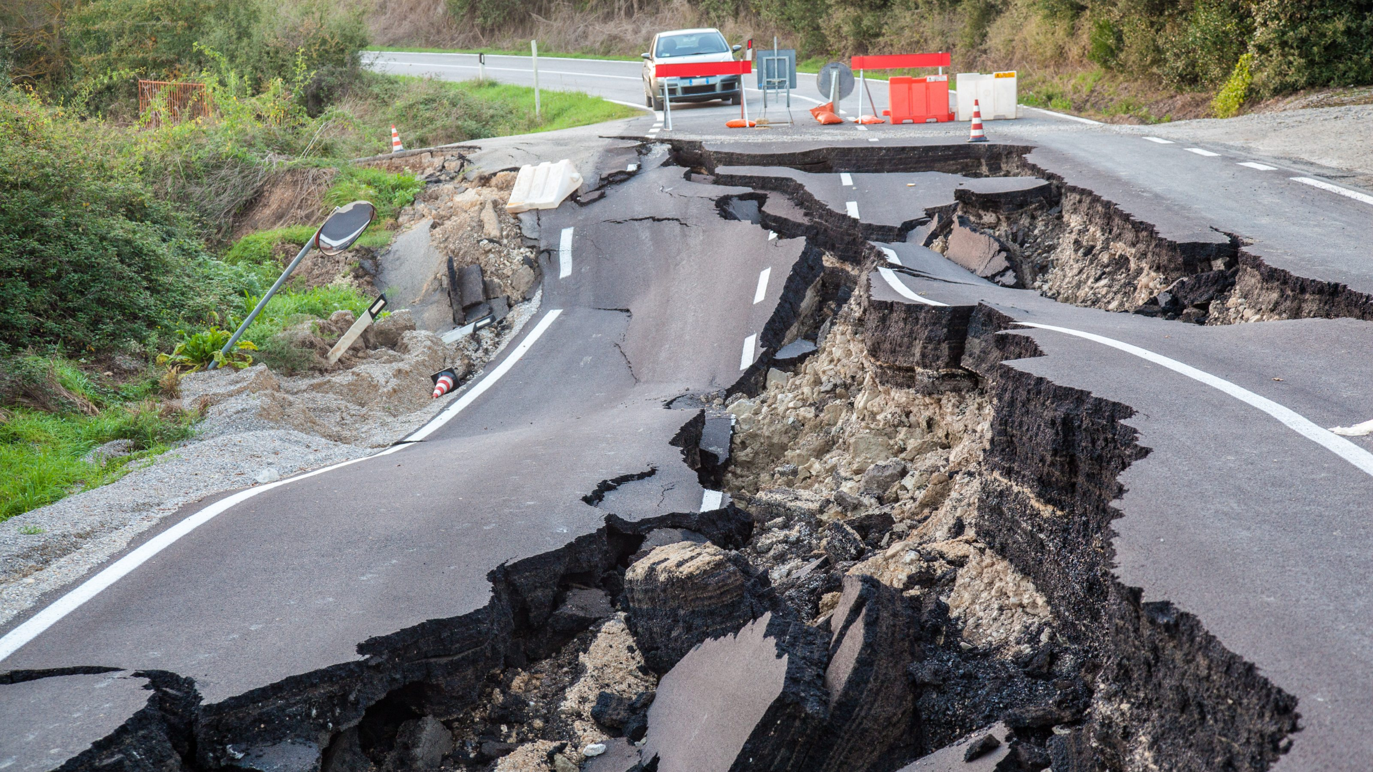
How Long Do Earthquakes Last
Notes:
Earthquakes may last seconds to minutes. While the shaking of small earthquakes typically lasts only a few seconds, strong shaking during moderate to large earthquakes

Slide 8
Sources
What is an Earthquake : https://www.usgs.gov/
What causes an Earthquake : https://www.usgs.gov/
How Does Earthquakes Effect Humans : https://www.waikatoregioncdemg.govt.nz/
How To Survive An Earthquake : https://www.ready.gov/
Can Earthquakes Be Predicted : https://www.usgs.gov/
How Long Do Earthquakes Last : pnsn.org

