Slide 1
OBESITY
BY :NABEEL, KARAM, MUNA, MARTINA

Slide 2
—Elbert Hubbard
“
“A LITTLE MORE PERSISTENCE, A LITTLE MORE EFFORT, AND WHAT SEEMED HOPELESS FAILURE MAY TURN TO GLORIOUS SUCCESS.”

Slide 3
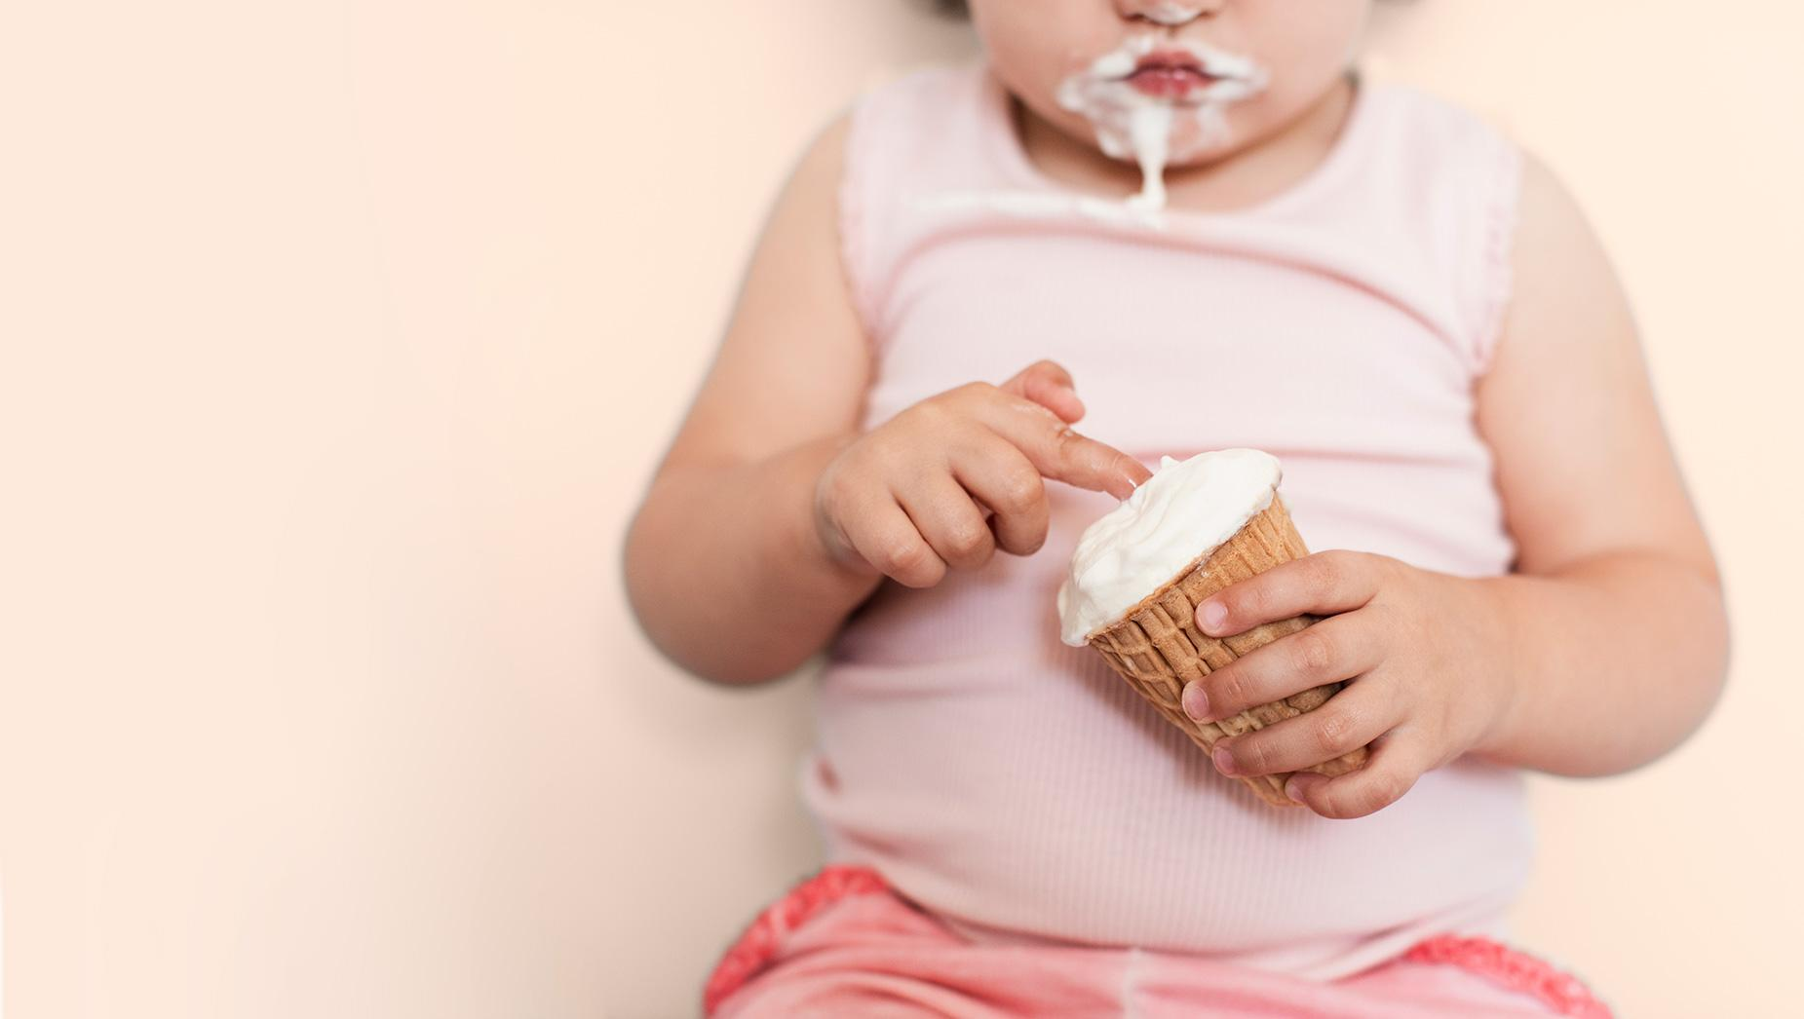

Slide 4
01
What is Obesity?

Slide 5
Obesity is a complex disease that occurs when an individual’s weight is higher than what is considered healthy for his or her height.

Slide 6
02
What Causes Obesity?

Slide 7
Excessive weight gain which could result from: not enough sleep, over/under eating and/or low physical activity
In some rare cases, it could be genetic from a single gene called “monogenic obesity” which shows an inherited obesity within a family
It could also be the result of some illnesses, such as drugs, and/or antidepressants

Slide 8
03
What are the Effects of Obesity?

Slide 9
Impact of obesity
High blood pressure
Breathing problems
Snoring
Type 2 diabetes
Increased sweating
Joint and back pain

Slide 10
Body mass index (BMI) is often used to diagnose obesity. To calculate BMI, divide weight in kilograms by height in meters squared.
BMI | Weight Status
Below 18.5 | Underweight
18.5-24.9 | Normal
25.0-29.9 | Overweight
30.0 and higher | Obesity

Slide 11
05
How to Prevent Obesity?

Slide 12
Ways to avoid it
Increasing physical activity
Choosing healthier foods and beverages
Reducing stress
Limiting television time, screen time, and other
Improving sleep

Slide 13
05
How to Recover from Obesity?

Slide 14
Sleep better
Physical Activity
Newborns: 14-17 hours
Teenagers: 8-10 hours
Adults: 7 hours or more
Age 3-5: through out the day
Age 6-17: 60 minutes every day
Adults: 150 minutes in a week
Join a local weight loss group
calorie-controlled diet
Recommended by your GP weight loss management health professional

Slide 15
Resources
1-https://www.cdc.gov/obesity/basics/causes.html
2-https://www.mayoclinic.org/diseases-conditions/obesity/symptoms-causes/syc-20375742
3-https://health.gov/our-work/nutrition-physical-activity/physical-activity-guidelines/current-guidelines
4-https://www.hsph.harvard.edu/obesity-prevention-source/obesity-prevention/

Slide 16
Thanks!
Do you have any questions?
Please keep this slide for attribution

